Slide 1
Microblogs Data Management and Analysis
Amr Magdy Mohamed F. Mokbel
Department of Computer Science and Engineering
University of Minnesota – Twin Cities

Slide 2






Microblogs
Microblogs are short user-generated messages on Web
  e.g., reviews (Yelp, Amazon), tweets,
  comments (news, social media), check in’s…etc
Microblogs are very popular
  Twitter: 300+M active users, 500+M tweets/day ^{[1]}
  Facebook: 1.3B users, 3.2+B likes and comments/day ^{[2]}
Are Microblogs Useful:
  Real-time news
  Understanding people interests
  Market study
  Event detection
  Getting first hand reviews from other users (hotels, movies, items)
[1] expandedramblings.com/index.php/march-2013-by-the-numbers-a-few-amazing-twitter-stats/ [2] newsroom.fb.com/Key-Facts
Notes:
Remove animation
[3] http://techcrunch.com/2012/12/18/god-bless-us-every-one/

Slide 3
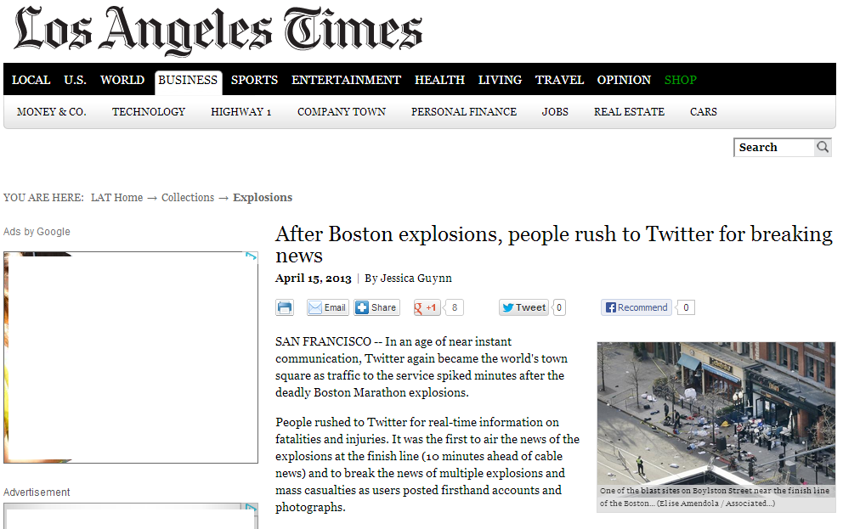

Slide 4
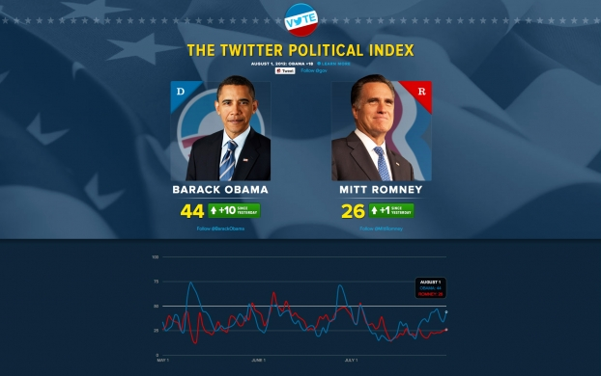

Slide 5
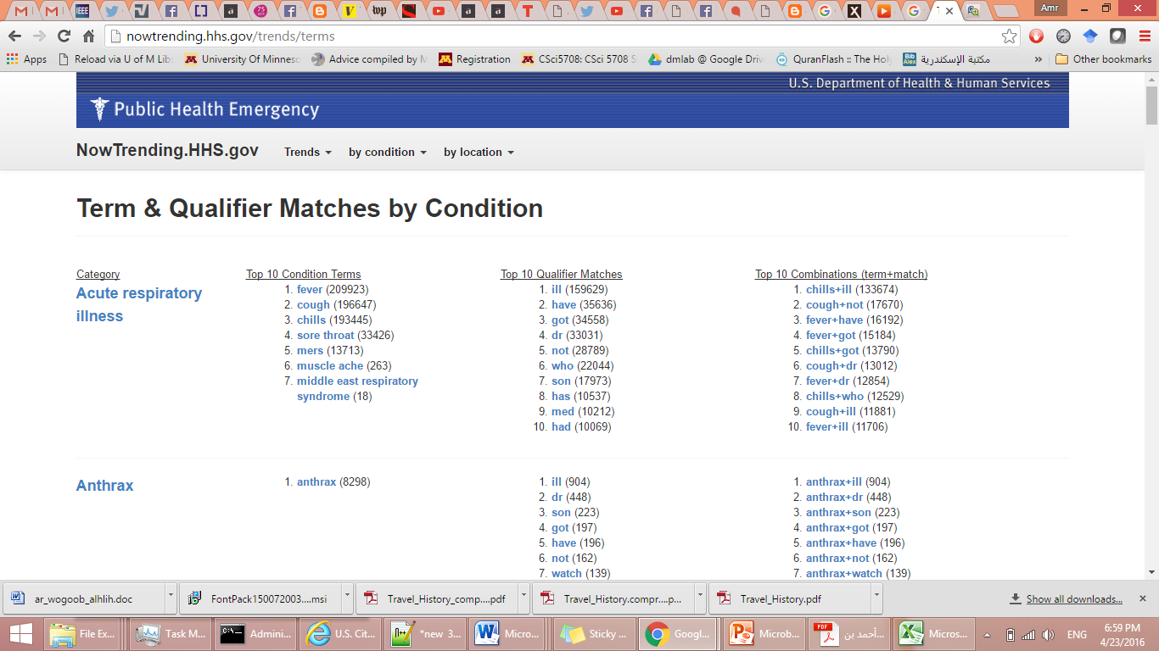

Slide 6
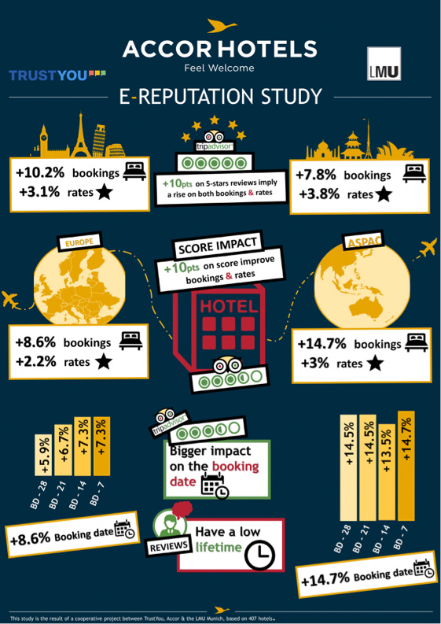
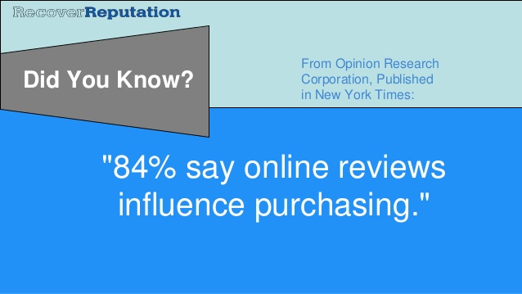
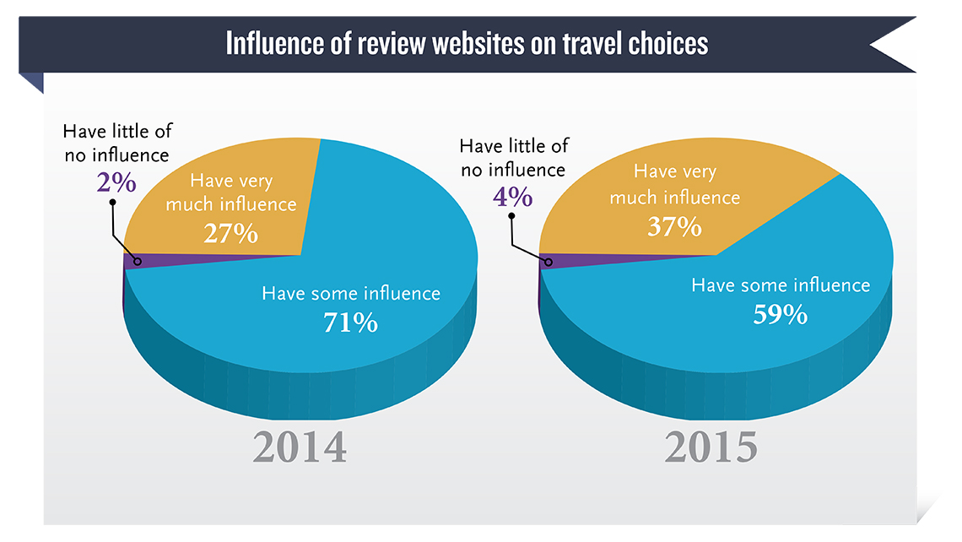

Slide 7
Microblogs Research Outline
Query Languages
TweeQL [51]
MDMS [52]
Microblogs
Data
Management
GeoScope [57]
Taghreed [33]
Mercury [58]
AFIA [59]
Indexing and
Query Processing
TI [53]
Earlybird [54]
Provenance [55]
LSII [56]
SocialSearch [60]
MDMS [52]
Main-memory
Management
Mercury [58]
AFIA [59]
Venus [61]
Event Detection
and Analysis
Shaker [1]
Situation [2]
ControversialEvent
[3]
TwitInfo [4]
TweetTracker [5]
Political Index [6]
Jasmine [7]
TEDAS [8]
OpenEve [9]
ET-LDA [10]
BEven [11]
EvenTweet [12]
STED [13]
EventCo [14]
SEvent [15]
TrafficEvetns [16]
VEvent [17]
StreamCube [18]
UnEvent [19]
Sentiment and
Semantic Analysis
SentClass [20]
SemanticKnow [21]
Seman [22]
Twanchor [23]
PlaceSemantic [24]
HashSemantic [25]
Microblogs
Data
Analysis
TopUsers [35]
IdUsers [36]
MUsers [37]
PUsers [38]
User
Analysis
UserRec [31]
CUser [32]
Taghreed [33]
FUsers [34]
Automatic
Geotagging
LocInfer [39]
Tloc [40]
DisasterLoc [41]
LocIden [42]
KeyLoc [43]
10kmLoc [44]
Recommendation
NewsRec [45]
UserRec [31]
Jury [46]
FocalU [47]
MicRec [48]
ProductRec [49]
EventRec [50]
Aggregation
MVis [27]
TwitterViz [69]
CityViz [70]
TileViz [71]
VisCAT [29]
TwitterViz [73]
Microblogs
Data
Visualization
Sampling
TwitterStand [26]
Taghreed [30]
Hybrid
TwitInfo [4]
TweetTracker [5]
mapD [28]
UserViz [68]
VEvent [17]
EmotionWatch [72]
Microblogs
Systems
Academia
H-Store [62]
AsterixDB [63]
Taghreed [33]
MDMS [52]
Industry
Twitter Birth
Topsy [64]
Cassandra (FB)
VoltDB [65]
Hive (FB)
Earlybird [54]
Topsy Political
Index [6]
Topsy Oscars
Index [66]
Scuba (FB)
Presto (FB)
Tweet Complete
Index [67]
2006–2008 2009 2010 2011 2012 2013 2014 2015

Slide 8
Microblogs Research Outline
Query Languages
TweeQL [51]
MDMS [52]
Microblogs
Data
Management
GeoScope [57]
Taghreed [33]
Mercury [58]
AFIA [59]
Indexing and
Query Processing
TI [53]
Earlybird [54]
Provenance [55]
LSII [56]
SocialSearch [60]
MDMS [52]
Main-memory
Management
Mercury [58]
AFIA [59]
Venus [61]
Event Detection
and Analysis
Shaker [1]
Situation [2]
ControversialEvent
[3]
TwitInfo [4]
TweetTracker [5]
Political Index [6]
Jasmine [7]
TEDAS [8]
OpenEve [9]
ET-LDA [10]
BEven [11]
EvenTweet [12]
STED [13]
EventCo [14]
SEvent [15]
TrafficEvetns [16]
VEvent [17]
StreamCube [18]
UnEvent [19]
Sentiment and
Semantic Analysis
SentClass [20]
SemanticKnow [21]
Seman [22]
Twanchor [23]
PlaceSemantic [24]
HashSemantic [25]
Microblogs
Data
Analysis
TopUsers [35]
IdUsers [36]
MUsers [37]
PUsers [38]
User
Analysis
UserRec [31]
CUser [32]
Taghreed [33]
FUsers [34]
Automatic
Geotagging
LocInfer [39]
Tloc [40]
DisasterLoc [41]
LocIden [42]
KeyLoc [43]
10kmLoc [44]
Recommendation
NewsRec [45]
UserRec [31]
Jury [46]
FocalU [47]
MicRec [48]
ProductRec [49]
EventRec [50]
Aggregation
MVis [27]
TwitterViz [69]
CityViz [70]
TileViz [71]
VisCAT [29]
TwitterViz [73]
Microblogs
Data
Visualization
Sampling
TwitterStand [26]
Taghreed [30]
Hybrid
TwitInfo [4]
TweetTracker [5]
mapD [28]
UserViz [68]
VEvent [17]
EmotionWatch [72]
Microblogs
Systems
Academia
H-Store [62]
AsterixDB [63]
Taghreed [33]
MDMS [52]
Industry
Twitter Birth
Topsy [64]
Cassandra (FB)
VoltDB [65]
Hive (FB)
Earlybird [54]
Topsy Political
Index [6]
Topsy Oscars
Index [66]
Scuba (FB)
Presto (FB)
Tweet Complete
Index [67]
2006–2008 2009 2010 2011 2012 2013 2014 2015

Slide 9
Microblogs Research Outline
Query Languages
TweeQL [51]
MDMS [52]
Microblogs
Data
Management
GeoScope [57]
Taghreed [33]
Mercury [58]
AFIA [59]
Indexing and
Query Processing
TI [53]
Earlybird [54]
Provenance [55]
LSII [56]
SocialSearch [60]
MDMS [52]
Main-memory
Management
Mercury [58]
AFIA [59]
Venus [61]
Event Detection
and Analysis
Shaker [1]
Situation [2]
ControversialEvent
[3]
TwitInfo [4]
TweetTracker [5]
Political Index [6]
Jasmine [7]
TEDAS [8]
OpenEve [9]
ET-LDA [10]
BEven [11]
EvenTweet [12]
STED [13]
EventCo [14]
SEvent [15]
TrafficEvetns [16]
VEvent [17]
StreamCube [18]
UnEvent [19]
Sentiment and
Semantic Analysis
SentClass [20]
SemanticKnow [21]
Seman [22]
Twanchor [23]
PlaceSemantic [24]
HashSemantic [25]
Microblogs
Data
Analysis
TopUsers [35]
IdUsers [36]
MUsers [37]
PUsers [38]
User
Analysis
UserRec [31]
CUser [32]
Taghreed [33]
FUsers [34]
Automatic
Geotagging
LocInfer [39]
Tloc [40]
DisasterLoc [41]
LocIden [42]
KeyLoc [43]
10kmLoc [44]
Recommendation
NewsRec [45]
UserRec [31]
Jury [46]
FocalU [47]
MicRec [48]
ProductRec [49]
EventRec [50]
Aggregation
MVis [27]
TwitterViz [69]
CityViz [70]
TileViz [71]
VisCAT [29]
TwitterViz [73]
Microblogs
Data
Visualization
Sampling
TwitterStand [26]
Taghreed [30]
Hybrid
TwitInfo [4]
TweetTracker [5]
mapD [28]
UserViz [68]
VEvent [17]
EmotionWatch [72]
Microblogs
Systems
Academia
H-Store [62]
AsterixDB [63]
Taghreed [33]
MDMS [52]
Industry
Twitter Birth
Topsy [64]
Cassandra (FB)
VoltDB [65]
Hive (FB)
Earlybird [54]
Topsy Political
Index [6]
Topsy Oscars
Index [66]
Scuba (FB)
Presto (FB)
Tweet Complete
Index [67]
2006–2008 2009 2010 2011 2012 2013 2014 2015

Slide 10

Query Languages: TweeQL
SQL-like languages, tailored for microblogs specs
TweeQL: Select-Project-Join-Aggregate queries
  SELECT sentiment (text), latitude (loc), longitude (loc)
  FROM twitter
  WHERE text contains ‘obama’
  WINDOW 3 hours
User
Query
Answer
SQL-like
Queries
Functions
Sentiment, Geotagging
Filters
Keyword, Spatial, Temporal Window
TweeQL
Twitter APIs
[51] A. Marcus et al. "Tweets as Data: Demonstration of TweeQL and TwitInfo" In SIGMOD’11

Slide 11
Query Languages: MQL
MQL: Select-Project-Join-Count queries
  SELECT * FROM twitter
  WHERE text contains ‘obama’
  ORDER BY Max(timestamp)
  LIMT 20 ON LAST 30 DAYS
User
Query
Answer
SQL-like
Queries
Ranking
Top-k, arbitrary functions
Filters
Temporal, Keyword, Spatial
Other
Continuous, COUNT aggr
MQL
Microblogs Data
Management Systems
[52] A. Magdy and M. Mokbel “Towards a Microblogs Data Management System" In MDM’15

Slide 12
Microblogs Research Outline
Query Languages
TweeQL [51]
MDMS [52]
Microblogs
Data
Management
GeoScope [57]
Taghreed [33]
Mercury [58]
AFIA [59]
Indexing and
Query Processing
TI [53]
Earlybird [54]
Provenance [55]
LSII [56]
SocialSearch [60]
MDMS [52]
Main-memory
Management
Mercury [58]
AFIA [59]
Venus [61]
Event Detection
and Analysis
Shaker [1]
Situation [2]
ControversialEvent
[3]
TwitInfo [4]
TweetTracker [5]
Political Index [6]
Jasmine [7]
TEDAS [8]
OpenEve [9]
ET-LDA [10]
BEven [11]
EvenTweet [12]
STED [13]
EventCo [14]
SEvent [15]
TrafficEvetns [16]
VEvent [17]
StreamCube [18]
UnEvent [19]
Sentiment and
Semantic Analysis
SentClass [20]
SemanticKnow [21]
Seman [22]
Twanchor [23]
PlaceSemantic [24]
HashSemantic [25]
Microblogs
Data
Analysis
TopUsers [35]
IdUsers [36]
MUsers [37]
PUsers [38]
User
Analysis
UserRec [31]
CUser [32]
Taghreed [33]
FUsers [34]
Automatic
Geotagging
LocInfer [39]
Tloc [40]
DisasterLoc [41]
LocIden [42]
KeyLoc [43]
10kmLoc [44]
Recommendation
NewsRec [45]
UserRec [31]
Jury [46]
FocalU [47]
MicRec [48]
ProductRec [49]
EventRec [50]
Aggregation
MVis [27]
TwitterViz [69]
CityViz [70]
TileViz [71]
VisCAT [29]
TwitterViz [73]
Microblogs
Data
Visualization
Sampling
TwitterStand [26]
Taghreed [30]
Hybrid
TwitInfo [4]
TweetTracker [5]
mapD [28]
UserViz [68]
VEvent [17]
EmotionWatch [72]
Microblogs
Systems
Academia
H-Store [62]
AsterixDB [63]
Taghreed [33]
MDMS [52]
Industry
Twitter Birth
Topsy [64]
Cassandra (FB)
VoltDB [65]
Hive (FB)
Earlybird [54]
Topsy Political
Index [6]
Topsy Oscars
Index [66]
Scuba (FB)
Presto (FB)
Tweet Complete
Index [67]
2006–2008 2009 2010 2011 2012 2013 2014 2015

Slide 13
Searching Real-time Microblogs
Query Signature:
  Find top-k microblogs ranked based on F
Ranking Functions:
  Temporal
  Spatio-temporal
  Significance-temporal
  Socio-temporal
Indexing design goals
  In-memory indexing optimized for high digestion rate
  Secondary storage indexing for fast retrieval of historical data
  Indexes should be optimized for top-k queries with temporally-aware ranking function

Slide 14

Temporal Ranking: Earlybird
$$F\left(M, Q\right)=fresh\left(M.time, Q.time\right), M contains Q.keywords$$
Tweets
Read-only
Write-friendly
Twitter
Partitioner
…
Partitioning
Blender
Query
Earlybird
Server
(In-memory)
Query
Answer
One writable segment
(append-only writes)
Others are read-only segments
Single-writer, multi-readers
Earlybird Servers
[54] M. Busch et al. “Real-time Search at Twitter" In ICDE’12

Slide 15
Spatio-temporal Ranking: Mercury
$$F\left(L, M\right)= α \frac{Distance(L,M.loc) }{\operatorname{MaxRadius}{ R}}+\left(1−α\right)\frac{NOW − M.time }{MaxTime T}$$
Main-memory space-
partitioning index
  Incomplete pyramid index
Efficient update and
structuring:
  Bulk insertion and lazy deletion
  Speculative cell split and lazy
  merging
[58] A. Magdy et al.“Mercury: Memory-Constrained Spatio-temporal Real-time Search on Microblogs" In ICDE’14

Slide 16
Significance-temporal Ranking: Log Structured Inverted Index
$$F\left(M, Q\right)=w_{1}sig\left(M\right)+w_{2}sim\left(M,Q\right)+w_{3}fresh(M.time, Q.time)$$
I₀: Single Keyword List Index
I₁ - I_{m} : Triple List Indexes
freshness
Stream
significance
freshness
term weight
.
.
.
.
.
.
I₀
.
.
.
…..
Temporal Lists
merge
I₁
merge
I₂
Size of I_{i+1}
= 2*Size of I_{i}
I_{m}
[56] L. Wu et al.“LSII: Indexing Structure for Exact Real-time Search on Microblogs" In ICDE’13

Slide 17
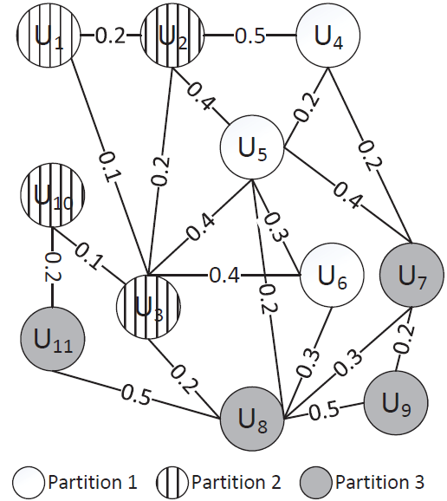
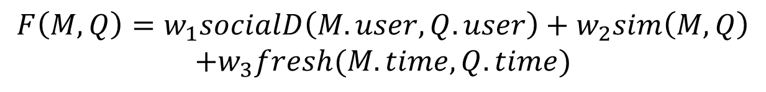
Social-temporal Ranking: 3D Index
$$F\left(M, Q\right)=w_{1}socialD\left(M.user,Q.user\right)+w_{2}sim\left(M,Q\right)$$
$$+w_{3}fresh(M.time, Q.time)$$
Keyword Index
Time Slice i, i=0,1,2,..
Textual Relevance
0-0.4 0.4-0.7 0.7-1.0
P1
P2
P3
r1
r4,r6,r8
Social Relevance
r4
[60] Y. Li et al.“Real Time Personalized Search on Social Networks" In ICDE’15
Notes:
Total 1 day of data, if two time slices, each spans 12 hours

Slide 18
Microblogs Research Outline
Query Languages
TweeQL [51]
MDMS [52]
Microblogs
Data
Management
GeoScope [57]
Taghreed [33]
Mercury [58]
AFIA [59]
Indexing and
Query Processing
TI [53]
Earlybird [54]
Provenance [55]
LSII [56]
SocialSearch [60]
MDMS [52]
Main-memory
Management
Mercury [58]
AFIA [59]
Venus [61]
Event Detection
and Analysis
Shaker [1]
Situation [2]
ControversialEvent
[3]
TwitInfo [4]
TweetTracker [5]
Political Index [6]
Jasmine [7]
TEDAS [8]
OpenEve [9]
ET-LDA [10]
BEven [11]
EvenTweet [12]
STED [13]
EventCo [14]
SEvent [15]
TrafficEvetns [16]
VEvent [17]
StreamCube [18]
UnEvent [19]
Sentiment and
Semantic Analysis
SentClass [20]
SemanticKnow [21]
Seman [22]
Twanchor [23]
PlaceSemantic [24]
HashSemantic [25]
Microblogs
Data
Analysis
TopUsers [35]
IdUsers [36]
MUsers [37]
PUsers [38]
User
Analysis
UserRec [31]
CUser [32]
Taghreed [33]
FUsers [34]
Automatic
Geotagging
LocInfer [39]
Tloc [40]
DisasterLoc [41]
LocIden [42]
KeyLoc [43]
10kmLoc [44]
Recommendation
NewsRec [45]
UserRec [31]
Jury [46]
FocalU [47]
MicRec [48]
ProductRec [49]
EventRec [50]
Aggregation
MVis [27]
TwitterViz [69]
CityViz [70]
TileViz [71]
VisCAT [29]
TwitterViz [73]
Microblogs
Data
Visualization
Sampling
TwitterStand [26]
Taghreed [30]
Hybrid
TwitInfo [4]
TweetTracker [5]
mapD [28]
UserViz [68]
VEvent [17]
EmotionWatch [72]
Microblogs
Systems
Academia
H-Store [62]
AsterixDB [63]
Taghreed [33]
MDMS [52]
Industry
Twitter Birth
Topsy [64]
Cassandra (FB)
VoltDB [65]
Hive (FB)
Earlybird [54]
Topsy Political
Index [6]
Topsy Oscars
Index [66]
Scuba (FB)
Presto (FB)
Tweet Complete
Index [67]
2006–2008 2009 2010 2011 2012 2013 2014 2015

Slide 19
Main-Memory Management
Goal: Answer most queries from in-memory contents
Problem: Main memory is limited
Solution: Once memory is full, flush some in-memory contents to secondary storage
How to select the in-memory contents to be flushed:
  Classical DBMS buffering problem..?? Not really…!!
  Load shedding in data streams..?? Not really …!!
  Simple solution: Flush temporal
  Smarter solutions:
    Consider the fact that all queries are top-K ones
    Tie the flushing policy with the ranking functions

Slide 20
Memory Flushing for Top-K Queries
Typical Skewed Keyword Frequency
  Searching for Kw4 to Kw9 result in a miss
  Searching for Kw1 to Kw 3 is a hit.
    Yet, there are too many entries that will not make it into top-k queries
Optimal In-memory distribution
  Searching for Kw1 to Kw9 is a hit
  Every in-memory keyword is fully utilized. No useless entries

Slide 21
kFlushing Policy
kFlushing policy: increases memory hit ratio for top-k queries
Three phases to flush X% of the memory:
  Phase 1: remove microblogs beyond k
  Phase 2: remove low-frequent keywords
  Phase 3: remove least queried keywords
k
Arrival | Query | Keyword
10:28 AM | 11:01 AM | Obama
11:03 AM | 10:58 AM | NBA
9:12 AM | 8:01 AM | Chicago
7:31 AM | 8:13 AM | smile
8:52 AM | 5:34 AM | picture
A. Magdy et al.“On Main-memory Flushing in Microblogs Data Management Systems" In ICDE’16

Slide 22
Memory Flushing for Spatio-temporal Ranking
Observation:
  Top-K queries in Chicago area may happen in the last hour
  Top-K queries in Northfield, MN may happen over the last day
Idea: Temporal Flushing should be done per cell
Question: what time range should each cell cover?
  By default, last T time units
A. Magdy et. al. Venus: Scalable Real-time Spatial Queries on Microblogs with Adaptive Load Shedding. In TKDE, 2015.

Slide 23
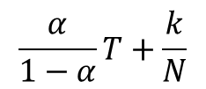

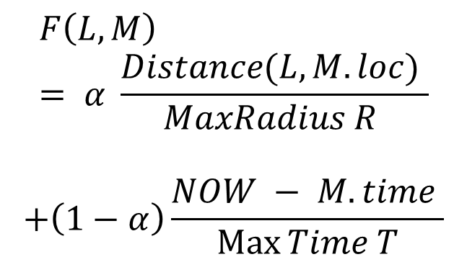
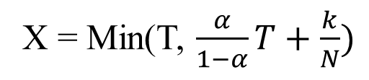

Memory Flushing for Spatio-temporal Ranking
Space
Query space and time boundaries
$$F\left(L, M\right)= α \frac{Distance(L,M.loc) }{MaxRadius R }$$
$$+\left(1−α\right)\frac{NOW − M.time }{\operatorname{Max}{Time T}}$$
R
α $≥$ 0.5
α = 0
For a given query parameters, each cell need to store only microblogs of last X time units where
X = Min(T, $\frac{α}{1−α}T+\frac{k}{N})$
$$\frac{k}{N}$$
$$\frac{α}{1−α}T+\frac{k}{N}$$
T
Time
tweet rate per R

Slide 24
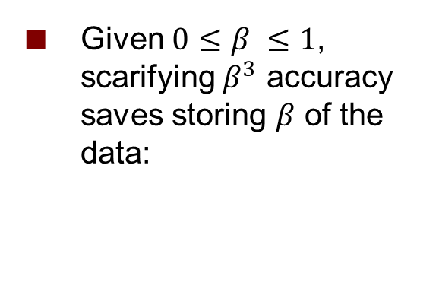
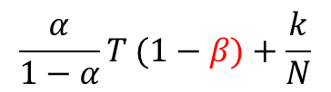
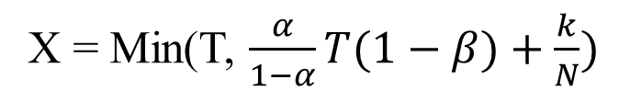
Memory Flushing for Spatio-temporal Ranking
Space
Query space and time boundaries
$$F\left(L, M\right)= α \frac{Distance(L,M.loc) }{MaxRadius R }$$
$$+\left(1−α\right)\frac{NOW − M.time }{\operatorname{Max}{Time T}}$$
R
α $≥$ 0.5
α = 0
Given $0≤β ≤1$, scarifying $β^{3}$ accuracy saves storing $β$ of the data:
β R
X = Min(T, $\frac{α}{1−α}T(1−β)+\frac{k}{N})$
$$\frac{α}{1−α}T (1−β)+\frac{k}{N}$$
$$\frac{k}{N}$$
$$\frac{α}{1−α}T+\frac{k}{N}$$
T
Time
tweet rate per R

Slide 25

Memory Flushing for Spatio-temporal Ranking
Space
Query space and time boundaries
$$F\left(L, M\right)= α \frac{Distance(L,M.loc) }{MaxRadius R }$$
$$+\left(1−α\right)\frac{NOW − M.time }{\operatorname{Max}{Time T}}$$
R
α $≥$ 0.5
α = 0
Memory Savings: 75%
Query Accuracy: 95-99%
Given $0≤β ≤1$, scarifying $β^{3}$ accuracy saves storing $β$ of the data:
β R
X = Min(T, $\frac{α}{1−α}T(1−β)+\frac{k}{N})$
$$\frac{k}{N}$$
$$\frac{α}{1−α}T (1−β)+\frac{k}{N}$$
T
Time
tweet rate per R

Slide 26
Microblogs Research Outline
Query Languages
TweeQL [51]
MDMS [52]
Microblogs
Data
Management
GeoScope [57]
Taghreed [33]
Mercury [58]
AFIA [59]
Indexing and
Query Processing
TI [53]
Earlybird [54]
Provenance [55]
LSII [56]
SocialSearch [60]
MDMS [52]
Main-memory
Management
Mercury [58]
AFIA [59]
Venus [61]
Event Detection
and Analysis
Shaker [1]
Situation [2]
ControversialEvent
[3]
TwitInfo [4]
TweetTracker [5]
Political Index [6]
Jasmine [7]
TEDAS [8]
OpenEve [9]
ET-LDA [10]
BEven [11]
EvenTweet [12]
STED [13]
EventCo [14]
SEvent [15]
TrafficEvetns [16]
VEvent [17]
StreamCube [18]
UnEvent [19]
Sentiment and
Semantic Analysis
SentClass [20]
SemanticKnow [21]
Seman [22]
Twanchor [23]
PlaceSemantic [24]
HashSemantic [25]
Microblogs
Data
Analysis
TopUsers [35]
IdUsers [36]
MUsers [37]
PUsers [38]
User
Analysis
UserRec [31]
CUser [32]
Taghreed [33]
FUsers [34]
Automatic
Geotagging
LocInfer [39]
Tloc [40]
DisasterLoc [41]
LocIden [42]
KeyLoc [43]
10kmLoc [44]
Recommendation
NewsRec [45]
UserRec [31]
Jury [46]
FocalU [47]
MicRec [48]
ProductRec [49]
EventRec [50]
Aggregation
MVis [27]
TwitterViz [69]
CityViz [70]
TileViz [71]
VisCAT [29]
TwitterViz [73]
Microblogs
Data
Visualization
Sampling
TwitterStand [26]
Taghreed [30]
Hybrid
TwitInfo [4]
TweetTracker [5]
mapD [28]
UserViz [68]
VEvent [17]
EmotionWatch [72]
Microblogs
Systems
Academia
H-Store [62]
AsterixDB [63]
Taghreed [33]
MDMS [52]
Industry
Twitter Birth
Topsy [64]
Cassandra (FB)
VoltDB [65]
Hive (FB)
Earlybird [54]
Topsy Political
Index [6]
Topsy Oscars
Index [66]
Scuba (FB)
Presto (FB)
Tweet Complete
Index [67]
2006–2008 2009 2010 2011 2012 2013 2014 2015

Slide 27
Microblogs Research Outline
Query Languages
TweeQL [51]
MDMS [52]
Microblogs
Data
Management
GeoScope [57]
Taghreed [33]
Mercury [58]
AFIA [59]
Indexing and
Query Processing
TI [53]
Earlybird [54]
Provenance [55]
LSII [56]
SocialSearch [60]
MDMS [52]
Main-memory
Management
Mercury [58]
AFIA [59]
Venus [61]
Event Detection
and Analysis
Shaker [1]
Situation [2]
ControversialEvent
[3]
TwitInfo [4]
TweetTracker [5]
Political Index [6]
Jasmine [7]
TEDAS [8]
OpenEve [9]
ET-LDA [10]
BEven [11]
EvenTweet [12]
STED [13]
EventCo [14]
SEvent [15]
TrafficEvetns [16]
VEvent [17]
StreamCube [18]
UnEvent [19]
Sentiment and
Semantic Analysis
SentClass [20]
SemanticKnow [21]
Seman [22]
Twanchor [23]
PlaceSemantic [24]
HashSemantic [25]
Microblogs
Data
Analysis
TopUsers [35]
IdUsers [36]
MUsers [37]
PUsers [38]
User
Analysis
UserRec [31]
CUser [32]
Taghreed [33]
FUsers [34]
Automatic
Geotagging
LocInfer [39]
Tloc [40]
DisasterLoc [41]
LocIden [42]
KeyLoc [43]
10kmLoc [44]
Recommendation
NewsRec [45]
UserRec [31]
Jury [46]
FocalU [47]
MicRec [48]
ProductRec [49]
EventRec [50]
Aggregation
MVis [27]
TwitterViz [69]
CityViz [70]
TileViz [71]
VisCAT [29]
TwitterViz [73]
Microblogs
Data
Visualization
Sampling
TwitterStand [26]
Taghreed [30]
Hybrid
TwitInfo [4]
TweetTracker [5]
mapD [28]
UserViz [68]
VEvent [17]
EmotionWatch [72]
Microblogs
Systems
Academia
H-Store [62]
AsterixDB [63]
Taghreed [33]
MDMS [52]
Industry
Twitter Birth
Topsy [64]
Cassandra (FB)
VoltDB [65]
Hive (FB)
Earlybird [54]
Topsy Political
Index [6]
Topsy Oscars
Index [66]
Scuba (FB)
Presto (FB)
Tweet Complete
Index [67]
2006–2008 2009 2010 2011 2012 2013 2014 2015

Slide 28
Event Detection and Analysis
Detection
Identifying events that are not
known beforehand
Analysis
Analyzing events that are already
known and identified
TwitInfo [4]
TweetTracker [5]
SEvent [15]
Political Index [6]
EventCo [14]
VEvent [17]
Detecting arbitrary
events
Detecting specific
types of events
Situation [2]
STED [13]
BEven [11]
OpenEve [9]
TEDAS [8]
Shaker [1]
ControversialEvent [3]
UnEvent [19]
StreamCube [18]
EvenTweet [12]
TrafficEvetns [16]
ET-LDA [10]
Jasmine [7]

Slide 29
Detecting Arbitrary Events
Examples:
  Find coherent discussions on Twitter [11, 13]
  Find public events in local cities [12, 18],
  e.g., Seattle festival, state fairs
Hierarchal clustering [12]
Lexical Matching [7]
Latent variable model [9]
Graph partitioning [13]
Bayesian [19]
Twitter
Stream
Feature
Extraction
Temporal, Keyword,
Spatial Features
Grouping
Potential Events
Ranking based on temporal diffusion [9]
Ranking based on temporal-keyword
diffusion [11,12]
Scoring
Labeling based on
keyword correlation [13]
Labeling binary based on
spatial-keyword pairs [7]
Selected Events
Visualizer

Slide 30
Detecting Specific Types of Events
Information of events types are input to match with Twitter stream
Examples:
  Earthquakes [1]
  Crimes [8]
  Traffic [16]
Support Vector Machines [1]
Regression [3]
Lexical Matching [8]
Wavlet analysis + MMR [16]
Twitter
Stream
Feature
Extraction
Temporal, Keyword,
Spatial Features
Classification
Events
Tweets
Visualizer
Genres Info
Event-related
Info
Keywords [8,16]
Training Labeled Data [1,3]

Slide 31
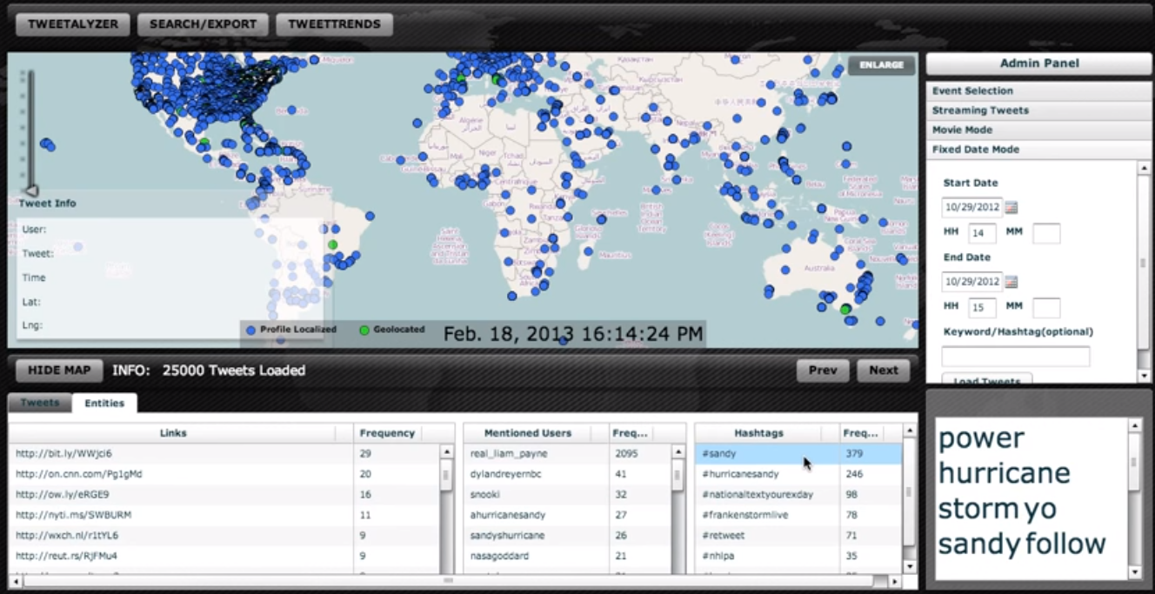
Event Analysis
Track and analyze event that are known beforehand
Examples:
  Elections (USA) [6]
  Uprisings (Arab Spring) [5]
  Conflicts (Ukraine), …etc
Twitter
Stream
Filtering
Event Tweets
Visualization
& Analysis
Event Features

Slide 32
Microblogs Research Outline
Query Languages
TweeQL [51]
MDMS [52]
Microblogs
Data
Management
GeoScope [57]
Taghreed [33]
Mercury [58]
AFIA [59]
Indexing and
Query Processing
TI [53]
Earlybird [54]
Provenance [55]
LSII [56]
SocialSearch [60]
MDMS [52]
Main-memory
Management
Mercury [58]
AFIA [59]
Venus [61]
Event Detection
and Analysis
Shaker [1]
Situation [2]
ControversialEvent
[3]
TwitInfo [4]
TweetTracker [5]
Political Index [6]
Jasmine [7]
TEDAS [8]
OpenEve [9]
ET-LDA [10]
BEven [11]
EvenTweet [12]
STED [13]
EventCo [14]
SEvent [15]
TrafficEvetns [16]
VEvent [17]
StreamCube [18]
UnEvent [19]
Sentiment and
Semantic Analysis
SentClass [20]
SemanticKnow [21]
Seman [22]
Twanchor [23]
PlaceSemantic [24]
HashSemantic [25]
Microblogs
Data
Analysis
TopUsers [35]
IdUsers [36]
MUsers [37]
PUsers [38]
User
Analysis
UserRec [31]
CUser [32]
Taghreed [33]
FUsers [34]
Automatic
Geotagging
LocInfer [39]
Tloc [40]
DisasterLoc [41]
LocIden [42]
KeyLoc [43]
10kmLoc [44]
Recommendation
NewsRec [45]
UserRec [31]
Jury [46]
FocalU [47]
MicRec [48]
ProductRec [49]
EventRec [50]
Aggregation
MVis [27]
TwitterViz [69]
CityViz [70]
TileViz [71]
VisCAT [29]
TwitterViz [73]
Microblogs
Data
Visualization
Sampling
TwitterStand [26]
Taghreed [30]
Hybrid
TwitInfo [4]
TweetTracker [5]
mapD [28]
UserViz [68]
VEvent [17]
EmotionWatch [72]
Microblogs
Systems
Academia
H-Store [62]
AsterixDB [63]
Taghreed [33]
MDMS [52]
Industry
Twitter Birth
Topsy [64]
Cassandra (FB)
VoltDB [65]
Hive (FB)
Earlybird [54]
Topsy Political
Index [6]
Topsy Oscars
Index [66]
Scuba (FB)
Presto (FB)
Tweet Complete
Index [67]
2006–2008 2009 2010 2011 2012 2013 2014 2015

Slide 33
Sentiment Analysis
Existing techniques work for microblogs, yet, brevity improves their performance
Results: 75% accuracy for binary sentiment (+/-)
Better than long text (blog and news)
  Long text hide sentiment, called topic drift (65%)
  Brevity of tweets improves sentiment catching
Support Vector Machines
Multinomial Naïve Bayes
Twitter
Stream
Keyword
Extraction
Keywords
Classification
Sentiment
Manual Annotations
[20] A. Bermingham and A. Smeaton “Classifying Sentiment in Microblogs: Is Brevity an Advantage?" In CIKM’10

Slide 34




Semantics Analysis
Given text, find concepts (i.e., entities, persons, locations,…etc) that shape the text contents
Traditional techniques: Lexical matching, Search-based
Microblogs Challenges:
  Short text with noise (e.g., abbreviations)
Machine Learning (Classification and clustering)
Link
Semantically
Precision: 57% (vs 42%)
Recall: 84% (vs 66%)
Twitter
Stream
Feature
Extraction
Articles
NLP Features
N-grams [21,22]
Synthetic fragments[21]
Occurrences/
Co-occurrences [22]
ML Module
Tweet Feature
Article Features
Co-features
Classification
(SVM, NB, DT) [22]
Clustering + Labeling [21]
Notes:
Wikipedia articles are concepts
Get n-grams from tweets
Link n-gram to concepts (use machine learn instead lexical matching or search-based approaches)
Extract features (n-gram) (this is challenging due to nature of tweet, short, noisy, abbr,…etc)
and EF(concept) and EF(pair of n-gram and concept)
And EF(whole tweet)
Use different machine learning methods and compare them
Performance: recall 84 vs 66, precision 57 vs 42 %

Slide 35
Microblogs Research Outline
Query Languages
TweeQL [51]
MDMS [52]
Microblogs
Data
Management
GeoScope [57]
Taghreed [33]
Mercury [58]
AFIA [59]
Indexing and
Query Processing
TI [53]
Earlybird [54]
Provenance [55]
LSII [56]
SocialSearch [60]
MDMS [52]
Main-memory
Management
Mercury [58]
AFIA [59]
Venus [61]
Event Detection
and Analysis
Shaker [1]
Situation [2]
ControversialEvent
[3]
TwitInfo [4]
TweetTracker [5]
Political Index [6]
Jasmine [7]
TEDAS [8]
OpenEve [9]
ET-LDA [10]
BEven [11]
EvenTweet [12]
STED [13]
EventCo [14]
SEvent [15]
TrafficEvetns [16]
VEvent [17]
StreamCube [18]
UnEvent [19]
Sentiment and
Semantic Analysis
SentClass [20]
SemanticKnow [21]
Seman [22]
Twanchor [23]
PlaceSemantic [24]
HashSemantic [25]
Microblogs
Data
Analysis
TopUsers [35]
IdUsers [36]
MUsers [37]
PUsers [38]
User
Analysis
UserRec [31]
CUser [32]
Taghreed [33]
FUsers [34]
Automatic
Geotagging
LocInfer [39]
Tloc [40]
DisasterLoc [41]
LocIden [42]
KeyLoc [43]
10kmLoc [44]
Recommendation
NewsRec [45]
UserRec [31]
Jury [46]
FocalU [47]
MicRec [48]
ProductRec [49]
EventRec [50]
Aggregation
MVis [27]
TwitterViz [69]
CityViz [70]
TileViz [71]
VisCAT [29]
TwitterViz [73]
Microblogs
Data
Visualization
Sampling
TwitterStand [26]
Taghreed [30]
Hybrid
TwitInfo [4]
TweetTracker [5]
mapD [28]
UserViz [68]
VEvent [17]
EmotionWatch [72]
Microblogs
Systems
Academia
H-Store [62]
AsterixDB [63]
Taghreed [33]
MDMS [52]
Industry
Twitter Birth
Topsy [64]
Cassandra (FB)
VoltDB [65]
Hive (FB)
Earlybird [54]
Topsy Political
Index [6]
Topsy Oscars
Index [66]
Scuba (FB)
Presto (FB)
Tweet Complete
Index [67]
2006–2008 2009 2010 2011 2012 2013 2014 2015

Slide 36
User Analysis
Mostly, find top-k users with certain characteristics
Examples:
  Find top-k (influential, active,..etc) users related to topic X
  Find top-k users related to X in location L
Other examples: link user entities on two social media [36], recommend users to follow [31], discover a user community[32]
Temporal modeling [38]
Topic-based modeling [34]
Spatial indexing [35]
User
Tweets
Feature
Extraction
Keywords, Followers,
Timestamps,…etc
Modeling/
Indexing
User
Query
Processor

Slide 37
Microblogs Research Outline
Query Languages
TweeQL [51]
MDMS [52]
Microblogs
Data
Management
GeoScope [57]
Taghreed [33]
Mercury [58]
AFIA [59]
Indexing and
Query Processing
TI [53]
Earlybird [54]
Provenance [55]
LSII [56]
SocialSearch [60]
MDMS [52]
Main-memory
Management
Mercury [58]
AFIA [59]
Venus [61]
Event Detection
and Analysis
Shaker [1]
Situation [2]
ControversialEvent
[3]
TwitInfo [4]
TweetTracker [5]
Political Index [6]
Jasmine [7]
TEDAS [8]
OpenEve [9]
ET-LDA [10]
BEven [11]
EvenTweet [12]
STED [13]
EventCo [14]
SEvent [15]
TrafficEvetns [16]
VEvent [17]
StreamCube [18]
UnEvent [19]
Sentiment and
Semantic Analysis
SentClass [20]
SemanticKnow [21]
Seman [22]
Twanchor [23]
PlaceSemantic [24]
HashSemantic [25]
Microblogs
Data
Analysis
TopUsers [35]
IdUsers [36]
MUsers [37]
PUsers [38]
User
Analysis
UserRec [31]
CUser [32]
Taghreed [33]
FUsers [34]
Automatic
Geotagging
LocInfer [39]
Tloc [40]
DisasterLoc [41]
LocIden [42]
KeyLoc [43]
10kmLoc [44]
Recommendation
NewsRec [45]
UserRec [31]
Jury [46]
FocalU [47]
MicRec [48]
ProductRec [49]
EventRec [50]
Aggregation
MVis [27]
TwitterViz [69]
CityViz [70]
TileViz [71]
VisCAT [29]
TwitterViz [73]
Microblogs
Data
Visualization
Sampling
TwitterStand [26]
Taghreed [30]
Hybrid
TwitInfo [4]
TweetTracker [5]
mapD [28]
UserViz [68]
VEvent [17]
EmotionWatch [72]
Microblogs
Systems
Academia
H-Store [62]
AsterixDB [63]
Taghreed [33]
MDMS [52]
Industry
Twitter Birth
Topsy [64]
Cassandra (FB)
VoltDB [65]
Hive (FB)
Earlybird [54]
Topsy Political
Index [6]
Topsy Oscars
Index [66]
Scuba (FB)
Presto (FB)
Tweet Complete
Index [67]
2006–2008 2009 2010 2011 2012 2013 2014 2015

Slide 38
Automatic Geotagging: Single Microblog
Mostly, geotagging one microblog at a time [39][41][43][44]
Depend on entity recognition using classification
  To overcome abbreviations noise
Low precision for exact matching (within 100 meters), high precision for approximate matching (within 30+KM)
Entity Recog.
+ Keyword
Extraction
Classification
Tweet Location
Training
Tweets
Training Features (Places and Keywords)
Single Tweet
Cosine Similarity [38]
Support Vector Machines [39]
(Multinomial) Naïve Bayes [41]
Probabilistic Models [42]
Error Dist | Precision
100M | 10%^{[38]}, 20%^{[41,42]}
30KM | 60%^{[39]}, 80%^{[41]}
100+KM | 80%^{[40]}, 90%^{[39]}
Notes:
Evaluation based on distance from exact lat/lng
ICDE14
For each u’s microblogs
Get exact locations (using sub-strings and hierarchical POI tree)
Get fuzzy locations (edit distance)
Aggregate locations of all u’s microblogs
Get top-k locations for u’s
For each location L, get L coverage
For each microblog, refine top-k locations
To assign microblog-specific k locations
Perform comparison (based on LCAncestors) between m-locations and u-locations
Performance: 12K/sec to 7K/sec based on matching type with high precision, recall, and F-measure (90+%) with very low threshold (100 meters)
WWW12:
Classification based location assignment
Through associations between location and relevant keywords
Similarity measure is cosine similarity
Precision: 30-60% (30km threshold)
With 100 meters threshold, precision 10-20%
ICWSM12:
Classification using SVM, NB, MNB
Features: words, hashtages, places (NER)
Classifier ensemble based on timezone and loc classifications
(threshold,Accuracy): (20%,100m) (80%,800mile)
W3C13:
NER using existing tools as is (evaluate different packages)
W3C14:
label tweet words with locations
classify based on prob models
(threshold,Accuracy): (<10%,100m) (80%,30km) (90+%,100km)
KyeLoc:
Not related
given tweets and locations, identifies which is home and which is work

Slide 39
Automatic Geotagging: Collections of Microblogs
State of the art: use collections of tweets [42]
Estimate user top-k locations, use them to refine tweet’s location
95+% precision within 100 meters threshold
User Tweets
Exact + Fuzzy
Location
Extraction
Top-k
Location
Extraction
Tweet
Location
Refinement
User
Locations
Top-k User
Locations
Top-k Tweet
Locations
Tweet Locations
Top-k
Location
Extraction
Single Tweet
[42] G. Li et al. “Effective Location Identification from Microblogs" In ICDE’14
Notes:
Evaluation based on distance from exact lat/lng
Performance: 95+% precision with 100M threshold, cope up with 7-12K/sec
ICDE14
For each u’s microblogs
Get exact locations (using sub-strings and hierarchical POI tree)
Get fuzzy locations (edit distance)
Aggregate locations of all u’s microblogs
Get top-k locations for u’s
For each location L, get L coverage
For each microblog, refine top-k locations
To assign microblog-specific k locations
Perform comparison (based on LCAncestors) between m-locations and u-locations
Performance: 12K/sec to 7K/sec based on matching type with high precision, recall, and F-measure (90+%) with very low threshold (100 meters)
WWW12:
Classification based location assignment
Through associations between location and relevant keywords
Similarity measure is cosine similarity
Precision: 30-60% (30km threshold)
With 100 meters threshold, precision 10-20%
ICWSM12:
Classification using SVM, NB, MNB
Features: words, hashtages, places (NER)
Classifier ensemble based on timezone and loc classifications
(threshold,Accuracy): (20%,100m) (80%,800mile)
W3C13:
NER using existing tools as is (evaluate different packages)
W3C14:
label tweet words with locations
classify based on prob models
(threshold,Accuracy): (<10%,100m) (80%,30km) (90+%,100km)
KyeLoc:
Not related
given tweets and locations, identifies which is home and which is work

Slide 40
Microblogs Research Outline
Query Languages
TweeQL [51]
MDMS [52]
Microblogs
Data
Management
GeoScope [57]
Taghreed [33]
Mercury [58]
AFIA [59]
Indexing and
Query Processing
TI [53]
Earlybird [54]
Provenance [55]
LSII [56]
SocialSearch [60]
MDMS [52]
Main-memory
Management
Mercury [58]
AFIA [59]
Venus [61]
Event Detection
and Analysis
Shaker [1]
Situation [2]
ControversialEvent
[3]
TwitInfo [4]
TweetTracker [5]
Political Index [6]
Jasmine [7]
TEDAS [8]
OpenEve [9]
ET-LDA [10]
BEven [11]
EvenTweet [12]
STED [13]
EventCo [14]
SEvent [15]
TrafficEvetns [16]
VEvent [17]
StreamCube [18]
UnEvent [19]
Sentiment and
Semantic Analysis
SentClass [20]
SemanticKnow [21]
Seman [22]
Twanchor [23]
PlaceSemantic [24]
HashSemantic [25]
Microblogs
Data
Analysis
TopUsers [35]
IdUsers [36]
MUsers [37]
PUsers [38]
User
Analysis
UserRec [31]
CUser [32]
Taghreed [33]
FUsers [34]
Automatic
Geotagging
LocInfer [39]
Tloc [40]
DisasterLoc [41]
LocIden [42]
KeyLoc [43]
10kmLoc [44]
Recommendation
NewsRec [45]
UserRec [31]
Jury [46]
FocalU [47]
MicRec [48]
ProductRec [49]
EventRec [50]
Aggregation
MVis [27]
TwitterViz [69]
CityViz [70]
TileViz [71]
VisCAT [29]
TwitterViz [73]
Microblogs
Data
Visualization
Sampling
TwitterStand [26]
Taghreed [30]
Hybrid
TwitInfo [4]
TweetTracker [5]
mapD [28]
UserViz [68]
VEvent [17]
EmotionWatch [72]
Microblogs
Systems
Academia
H-Store [62]
AsterixDB [63]
Taghreed [33]
MDMS [52]
Industry
Twitter Birth
Topsy [64]
Cassandra (FB)
VoltDB [65]
Hive (FB)
Earlybird [54]
Topsy Political
Index [6]
Topsy Oscars
Index [66]
Scuba (FB)
Presto (FB)
Tweet Complete
Index [67]
2006–2008 2009 2010 2011 2012 2013 2014 2015

Slide 41

Recommendation
Microblogs used as sources of user preferences
Recommend users to follow (enhance social graph) [31]
Recommend news [43]
Other examples: Jury selection [46], product recommendation [49], event recommendation [50], recommend tweets [48]
Profiling
Profiles
Collaborative
Filtering
User
Tweets Social Graph Friends’ Tweets
User Tweets
Preference
Extractor
Common Keywords
Search-based
Re-rank
RSS Feeds

Slide 42
Microblogs Research Outline
Query Languages
TweeQL [51]
MDMS [52]
Microblogs
Data
Management
GeoScope [57]
Taghreed [33]
Mercury [58]
AFIA [59]
Indexing and
Query Processing
TI [53]
Earlybird [54]
Provenance [55]
LSII [56]
SocialSearch [60]
MDMS [52]
Main-memory
Management
Mercury [58]
AFIA [59]
Venus [61]
Event Detection
and Analysis
Shaker [1]
Situation [2]
ControversialEvent
[3]
TwitInfo [4]
TweetTracker [5]
Political Index [6]
Jasmine [7]
TEDAS [8]
OpenEve [9]
ET-LDA [10]
BEven [11]
EvenTweet [12]
STED [13]
EventCo [14]
SEvent [15]
TrafficEvetns [16]
VEvent [17]
StreamCube [18]
UnEvent [19]
Sentiment and
Semantic Analysis
SentClass [20]
SemanticKnow [21]
Seman [22]
Twanchor [23]
PlaceSemantic [24]
HashSemantic [25]
Microblogs
Data
Analysis
TopUsers [35]
IdUsers [36]
MUsers [37]
PUsers [38]
User
Analysis
UserRec [31]
CUser [32]
Taghreed [33]
FUsers [34]
Automatic
Geotagging
LocInfer [39]
Tloc [40]
DisasterLoc [41]
LocIden [42]
KeyLoc [43]
10kmLoc [44]
Recommendation
NewsRec [45]
UserRec [31]
Jury [46]
FocalU [47]
MicRec [48]
ProductRec [49]
EventRec [50]
Aggregation
MVis [27]
TwitterViz [69]
CityViz [70]
TileViz [71]
VisCAT [29]
TwitterViz [73]
Microblogs
Data
Visualization
Sampling
TwitterStand [26]
Taghreed [30]
Hybrid
TwitInfo [4]
TweetTracker [5]
mapD [28]
UserViz [68]
VEvent [17]
EmotionWatch [72]
Microblogs
Systems
Academia
H-Store [62]
AsterixDB [63]
Taghreed [33]
MDMS [52]
Industry
Twitter Birth
Topsy [64]
Cassandra (FB)
VoltDB [65]
Hive (FB)
Earlybird [54]
Topsy Political
Index [6]
Topsy Oscars
Index [66]
Scuba (FB)
Presto (FB)
Tweet Complete
Index [67]
2006–2008 2009 2010 2011 2012 2013 2014 2015

Slide 43
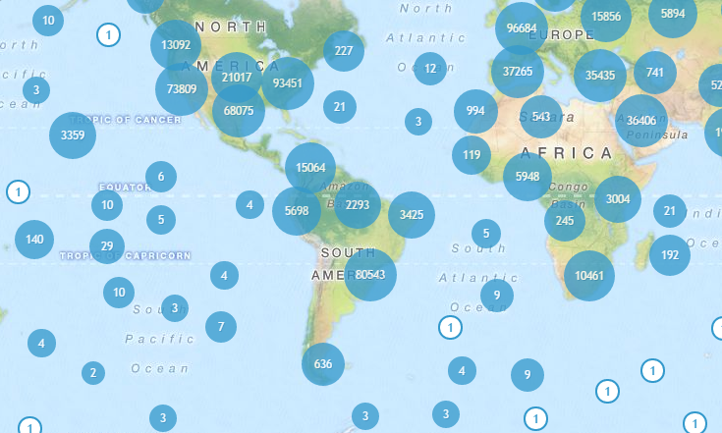
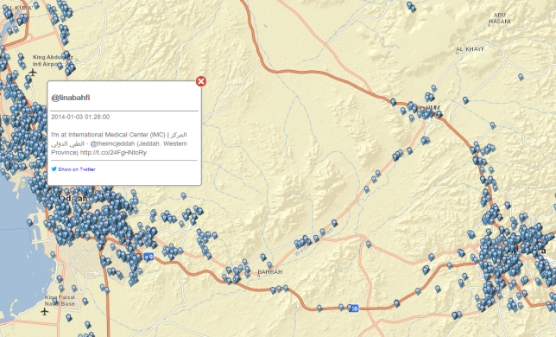
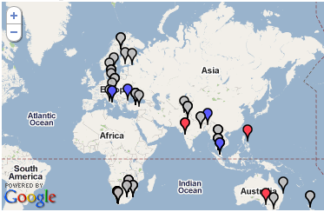
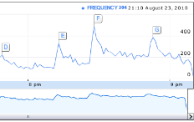
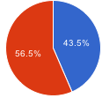
Microblogs Visualization
Aligns with generic big data visualization efforts
Challenge: Visualize large number of microblogs
Solutions
Aggregation-based
Visualization
Sampling-based
Visualization
Hybrid
Visualization

Slide 44
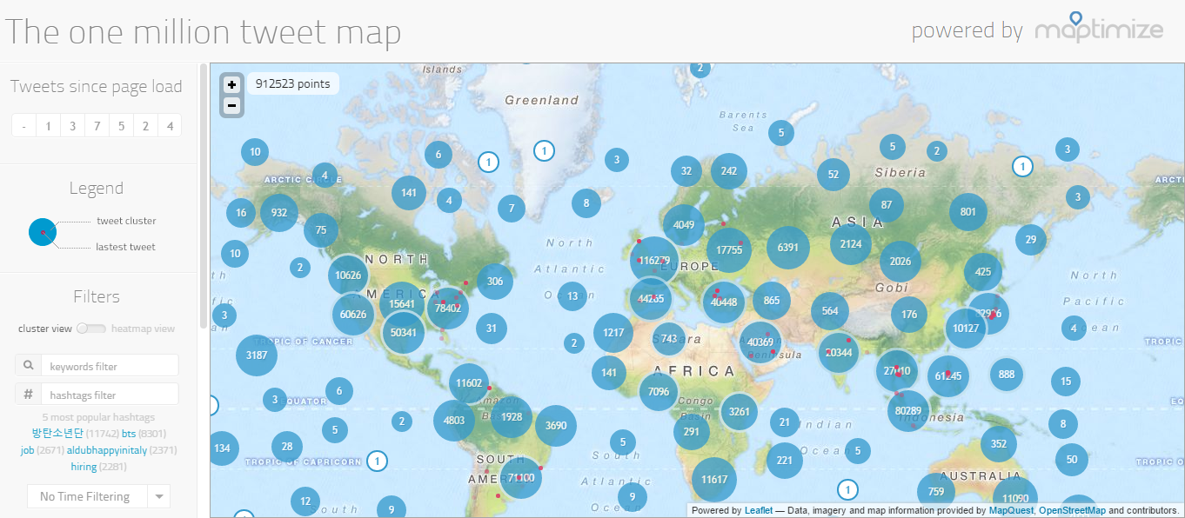
Aggregation-based Visualization
Aggregating individual microblogs

Slide 45
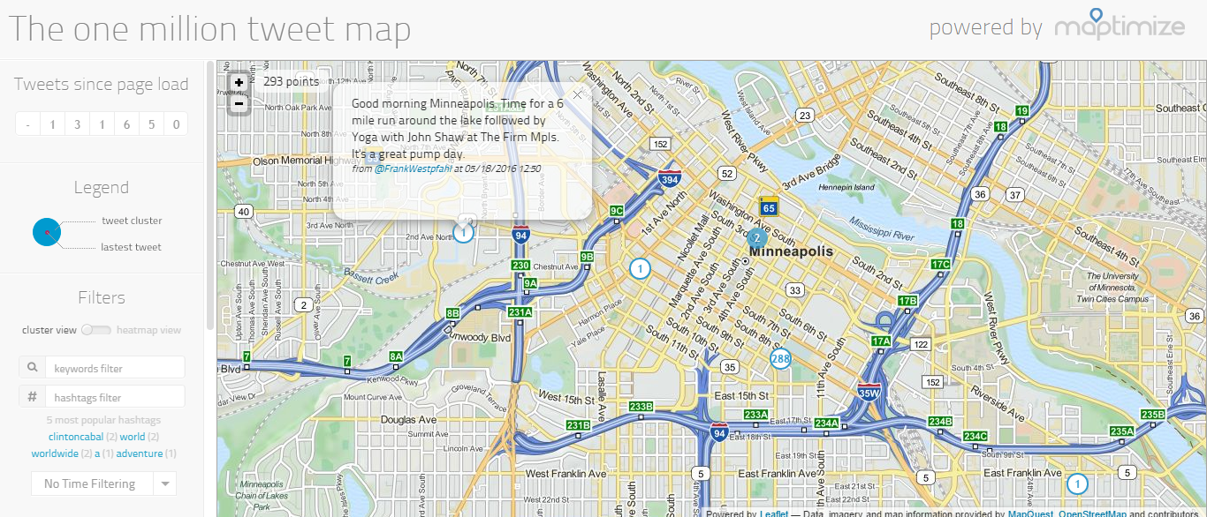
Aggregation-based Visualization
Aggregating individual microblogs

Slide 46
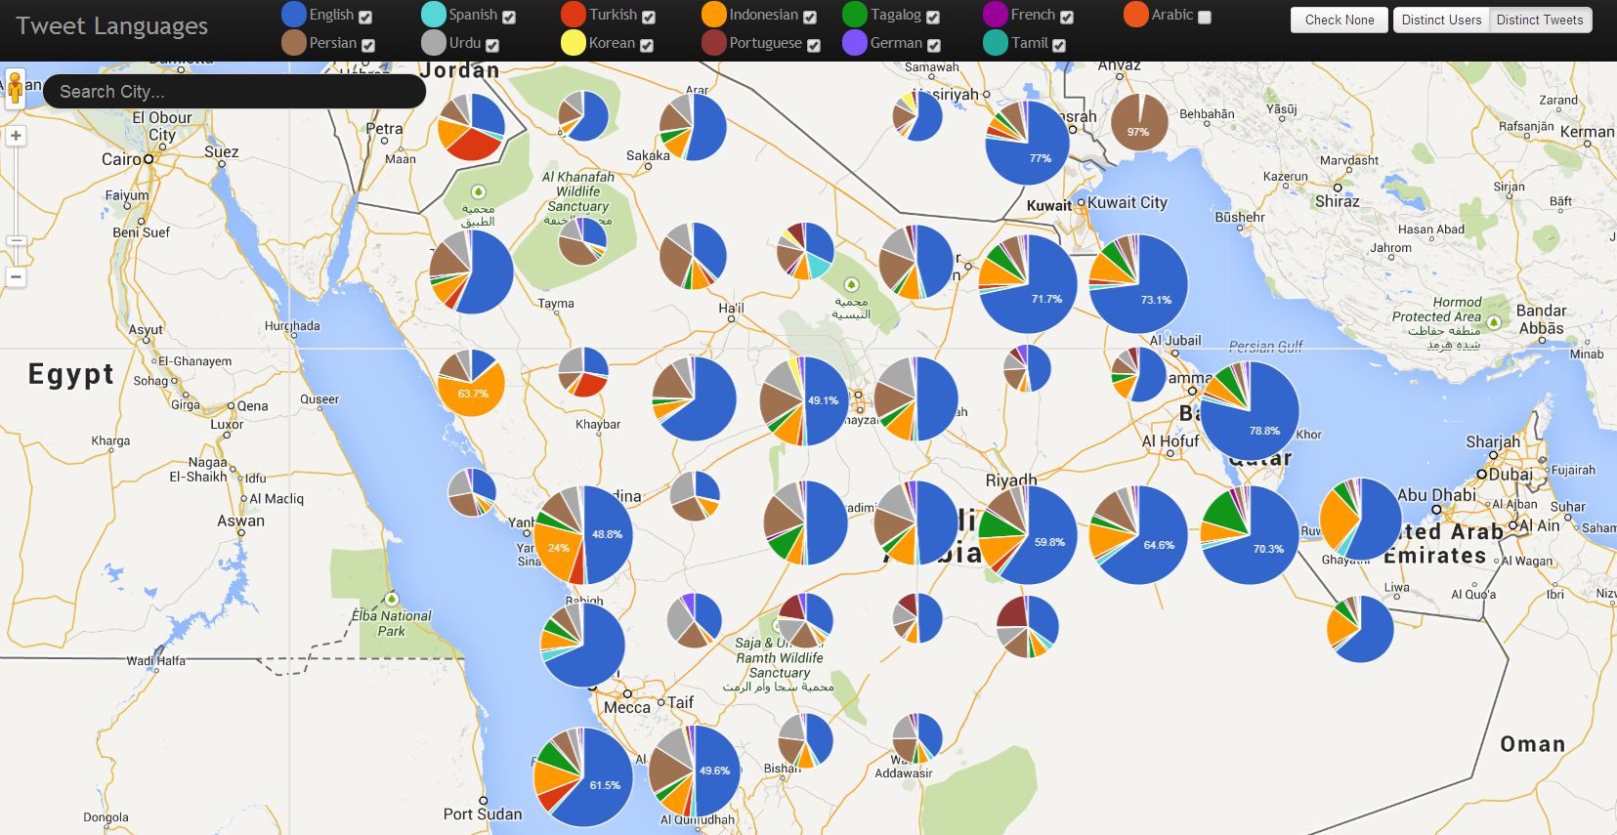
Aggregation-based Visualization
Aggregating certain attributes/information of microblogs
(application-guided aggregation)
T. Ghanem et. al. “VisCAT: Spatio-Temporal Visualization and Aggregation of Categorical Attributes in Twitter Data" In SIGSPATIAL’14

Slide 47
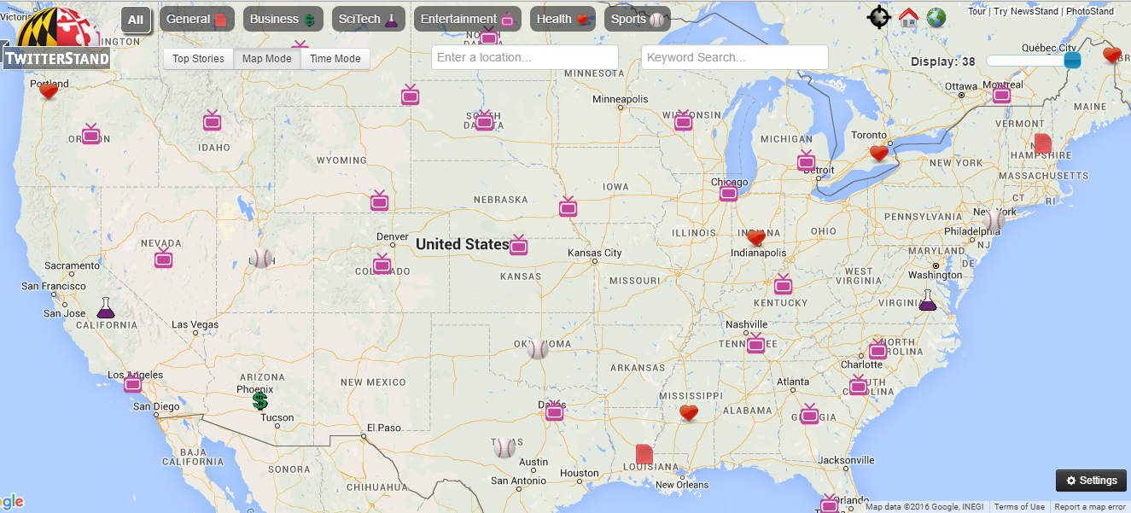
Sampling-based Visualization
Query-guided Sampling
[26] J. Sankaranarayanan et. al. “TwitterStand: News in Tweets" In SIGSPATIAL’09

Slide 48
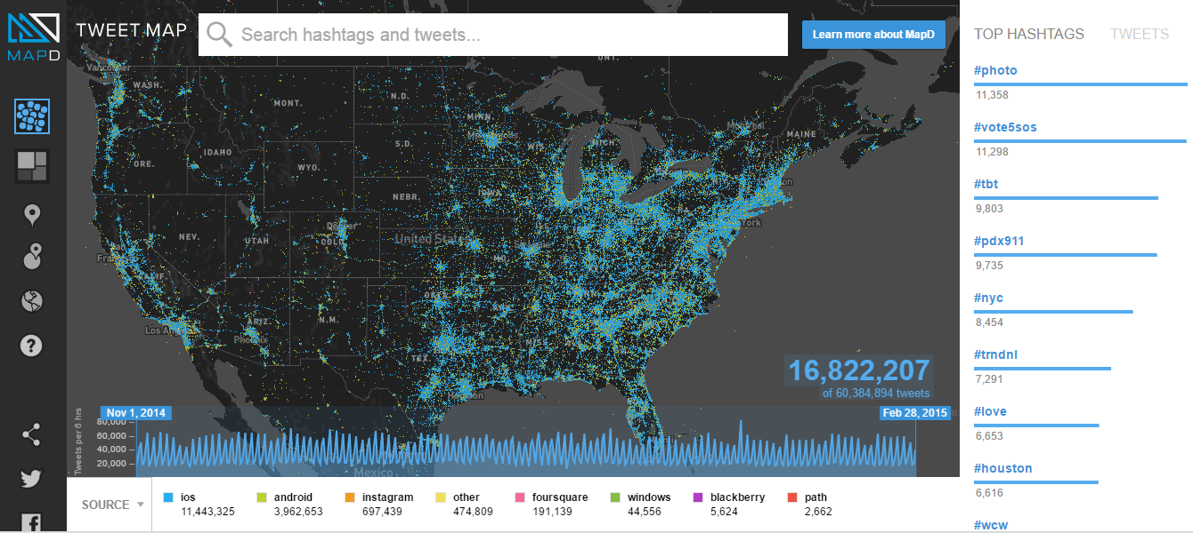
Sampling-based Visualization
Query-guided Sampling
http://www.mapd.com/demos/tweetmap/, 2016

Slide 49

Sampling-based Visualization
Arbitrary Sampling
  When query still generates a lot of data points
  Zooming in/out changes the sample
[33] A. Magdy et al. “Taghreed: A System for Querying, Analyzing, and Visualizing Geotagged Microblogs" In ACM SIGSPATIAL’14

Slide 50
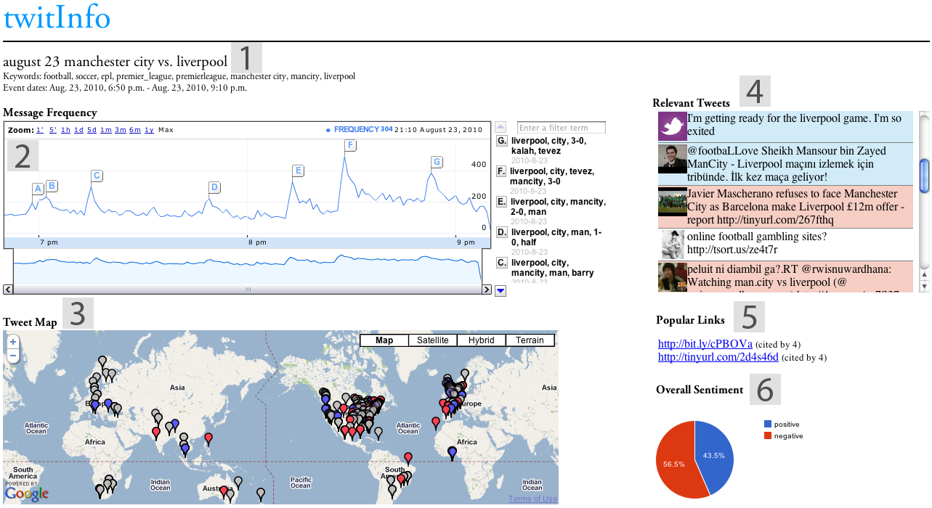
Hybrid Visualization
Sampling + Aggregation (Event Analysis)

Slide 51
Hybrid Visualization
Sampling + Aggregation (Event Analysis)

Slide 52
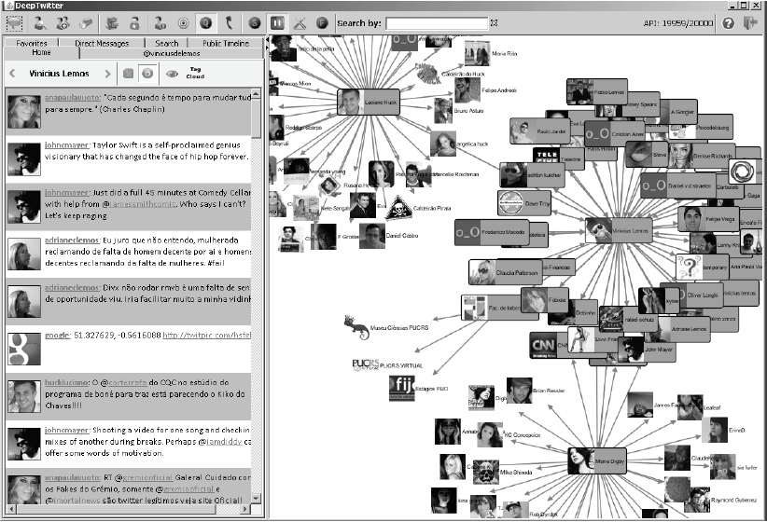
Hybrid Visualization
Sampling + Aggregation (User Network Graph)

Slide 53
Microblogs Research Outline
Query Languages
TweeQL [51]
MDMS [52]
Microblogs
Data
Management
GeoScope [57]
Taghreed [33]
Mercury [58]
AFIA [59]
Indexing and
Query Processing
TI [53]
Earlybird [54]
Provenance [55]
LSII [56]
SocialSearch [60]
MDMS [52]
Main-memory
Management
Mercury [58]
AFIA [59]
Venus [61]
Event Detection
and Analysis
Shaker [1]
Situation [2]
ControversialEvent
[3]
TwitInfo [4]
TweetTracker [5]
Political Index [6]
Jasmine [7]
TEDAS [8]
OpenEve [9]
ET-LDA [10]
BEven [11]
EvenTweet [12]
STED [13]
EventCo [14]
SEvent [15]
TrafficEvetns [16]
VEvent [17]
StreamCube [18]
UnEvent [19]
Sentiment and
Semantic Analysis
SentClass [20]
SemanticKnow [21]
Seman [22]
Twanchor [23]
PlaceSemantic [24]
HashSemantic [25]
Microblogs
Data
Analysis
TopUsers [35]
IdUsers [36]
MUsers [37]
PUsers [38]
User
Analysis
UserRec [31]
CUser [32]
Taghreed [33]
FUsers [34]
Automatic
Geotagging
LocInfer [39]
Tloc [40]
DisasterLoc [41]
LocIden [42]
KeyLoc [43]
10kmLoc [44]
Recommendation
NewsRec [45]
UserRec [31]
Jury [46]
FocalU [47]
MicRec [48]
ProductRec [49]
EventRec [50]
Aggregation
MVis [27]
TwitterViz [69]
CityViz [70]
TileViz [71]
VisCAT [29]
TwitterViz [73]
Microblogs
Data
Visualization
Sampling
TwitterStand [26]
Taghreed [30]
Hybrid
TwitInfo [4]
TweetTracker [5]
mapD [28]
UserViz [68]
VEvent [17]
EmotionWatch [72]
Microblogs
Systems
Academia
H-Store [62]
AsterixDB [63]
Taghreed [33]
MDMS [52]
Industry
Twitter Birth
Topsy [64]
Cassandra (FB)
VoltDB [65]
Hive (FB)
Earlybird [54]
Topsy Political
Index [6]
Topsy Oscars
Index [66]
Scuba (FB)
Presto (FB)
Tweet Complete
Index [67]
2006–2008 2009 2010 2011 2012 2013 2014 2015

Slide 54
Twitter Usecase: Fast Data in the Era of Big Data
Usecase: query suggestions
Twitter Solution :
  (1) Hadoop-based
This caused significant
overhead
  15 mins per hourly data
Twitter queries
distribution changes
every few minutes
Bottlenecks:
  System architecture and
  components are not
  latency sensitive
Keyword
Queries
Earlybird
System
Logging
Query
Analyzer
Access Logs
Query Suggestions
Hadoop Cluster
G. Mishne et al.“Fast Data in the Era of Big Data: Twitter’s Real-Time Related Query Suggestion Architecture" In SIGMOD’13

Slide 55
Twitter Usecase: Fast Data in the Era of Big Data
Usecase: query suggestions
Twitter Solution :
  (2) Memory-based
Keyword
Queries
Earlybird System
(In-memory)
Earlybird
Servers
Backend Engine
Existing systems need to
radically consider fast data
In-memory
Stores
Stats
Collector
Query
Analyzers
Request
Frontend
Cache
Ranking
Response
Blenders
Load
Persist every 5 mins
HDFS
G. Mishne et al.“Fast Data in the Era of Big Data: Twitter’s Real-Time Related Query Suggestion Architecture" In SIGMOD’13

Slide 56
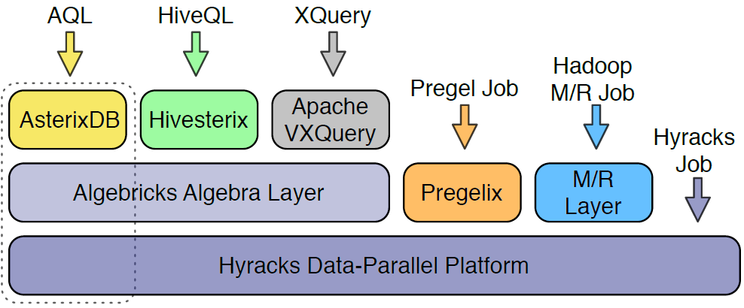
AsterixDB Usecase: Supporting Big Velocity in Big Volume Systems
Indexes with
Try to ingest higher update rates
Data Feeds components
Replacement for Hadoop Runtime
[63] S. Alsubaiee et. al.”AsterixDB: A Scalable, Open Source BDMS”. In VLDB, 2014.

Slide 57
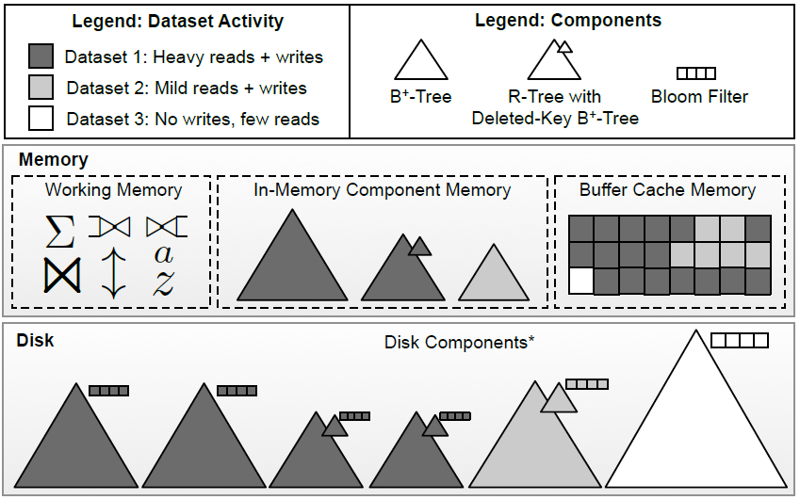
AsterixDB Usecase: Supporting Big Velocity in Big Volume Systems
In-memory components batch updates
Data queried when it is persisted in disk
AsterixDB (Indexes with feeds)

Slide 58
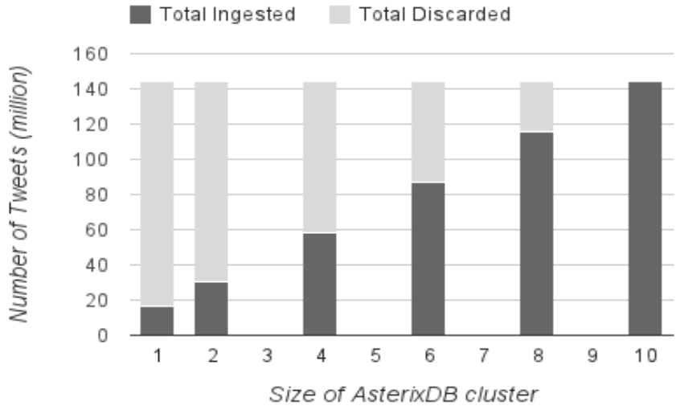
AsterixDB Usecase: Supporting Big Velocity in Big Volume Systems
Rate: 20K tweet/sec
High velocity needs to be inherently considered in system design

Slide 59

VoltDB Usecase: Transactions on Fast Data
Four sources of overhead in transactions:
  Multi-threading
  Buffer management
  Locking (concurrency control)
  Logging
Memory
Memory
Memory
Memory
CPU
CPU
CPU
CPU
[65] M. Stonebraker and A. Weisberg “The VoltDB Main Memory DBMS" In IEEE Data
Eng. Bull.’13
Notes:
Four sources of overhead in processing transactions:
Multi-threading
Buffer management
Locking (concurrency control)
Logging
Mitigation:
Threads: Shared memory divided into chunks, each assigned to single CPU core, then no parallelism or threads
Buffer: All data stored in main-memory, no disk and so no buffer
Locking: use deterministic order, so no concurrency
Single-node transactions serialized at the node
Otherwise, a global controller makes serialization
HA & Recovery: xact runs on all replicas simultanuously
Local failures:
Alive messages and recovery in background through state exchange
Global failures:
Checkpoints write current data state to disk, indexes no checkpointed, but re-built (5% performance degradation)
Transaction log maintained with xact parameters.
On failure, data image loaded, xact log loaded, and unpersisted xacts are re-done
Alternatively: Logging results of each xact gives 67% degradation (three times less throughput than data logging)

Slide 60
VoltDB Usecase: Transactions on Fast Data
Four sources of overhead in transactions:
  Multi-threading
  Buffer management
  Locking (concurrency control)
  Logging
No threads
Memory
Memory
Memory
Memory
1core
1core
1core
1core
1core
1core
1core
1core
CPU
CPU
CPU
CPU

Slide 61
VoltDB Usecase: Transactions on Fast Data
Four sources of overhead in transactions:
  Multi-threading
  Buffer management
  Locking (concurrency control)
  Logging
No threads
All in-memory, no disk, no buffer
Memory
Memory
Memory
Memory
1core
1core
1core
1core
1core
1core
1core
1core
CPU
CPU
CPU
CPU

Slide 62
VoltDB Usecase: Transactions on Fast Data
Four sources of overhead in transactions:
  Multi-threading
  Buffer management
  Locking (concurrency control)
  Logging
No threads
All in-memory, no disk, no buffer
Memory
Memory
Memory
Memory
1core
1core
1core
1core
1core
1core
1core
1core
CPU
CPU
CPU
CPU
Replica 1
Replica 2
Transaction
execute
execute

Slide 63
VoltDB Usecase: Transactions on Fast Data
Four sources of overhead in transactions:
  Multi-threading
  Buffer management
  Locking (concurrency control)
  Logging
No threads
All in-memory, no disk, no buffer
No locking, deterministic order
Memory
Memory
Global
Serializer
1core
1core
1core
1core
Local
Serializer
Local
Serializer
CPU
CPU
Replica 1
Transaction

Slide 64
VoltDB Usecase: Transactions on Fast Data
Four sources of overhead in transactions:
  Multi-threading
  Buffer management
  Locking (concurrency control)
  Logging
No threads
All in-memory, no disk, no buffer
No locking, deterministic order
Minimal disk writes
Memory
Memory Image (Lazily)
1core
1core
Memory
Image
CPU
Transaction
Params Log
Proactive Writes
(Transaction Params)

Slide 65
VoltDB Usecase: Transactions on Fast Data
Four sources of overhead in transactions:
  Multi-threading
  Buffer management
  Locking (concurrency control)
  Logging
No threads
All in-memory, no disk, no buffer
No locking, deterministic order
Minimal disk writes
16K TPS per core
(Single SQL command)
Linear Scalability
Memory
Memory Image (Lazily)
1core
1core
Memory
Image
CPU
Transaction
Params Log
Proactive Writes
(Transaction Params)

Slide 66
Taghreed Usecase: Microblogs Data Management at Scale
First Microblogs Data Management System
  Focus on spatio-temporal keyword queries
Provides both in-memory and disk indexes
  Spatio-temporal and keyword-temporal indexes
Query
Microblogs Stream
Answer
Preprocessed Microblogs
Visualizer
Preprocessor
Interactive Visualizer
Main-memory
Indexer
Main-memory Contents
Query Dispatching
Query Answer
Raw Data
Archive
Query
Plan
Flushing Policy
Query Optimizer
Query Processor
Memory Failure
Query Engine
Disk Indexer
Recovery Module
Indexer
Recovery Manager
[33] A. Magdy et al. “Taghreed: A System for Querying, Analyzing, and Visualizing Geotagged Microblogs" In ACM SIGSPATIAL’14

Slide 67
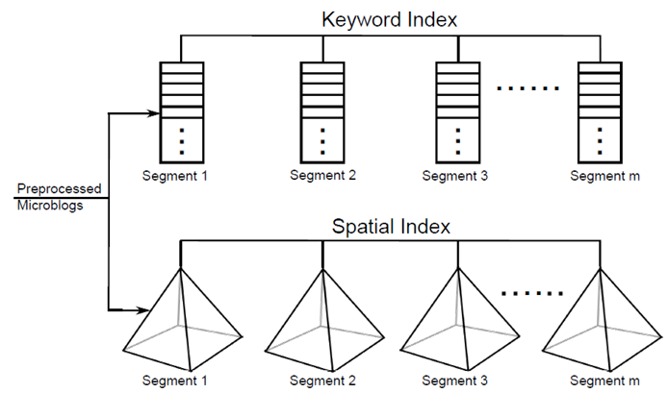
Taghreed Usecase: Microblogs Data Management at Scale
Memory Real-time Indexes
Two types:
  Inverted keyword index
  Quad-tree spatial index
Equipped with:
  Low-overhead structuring
    Efficient cell splits (spatial)
  Efficient update
  techniques
    Batch updates
    One-time segment deletion
On memory full, flush oldest segment as is
  Simple and efficient

Slide 68
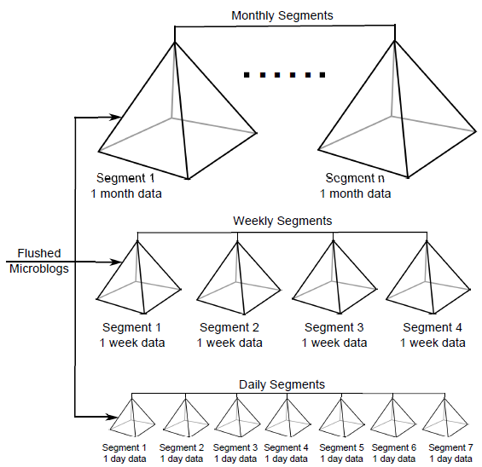
Taghreed Usecase: Microblogs Data Management at Scale
Disk Indexes
Two types
  Inverted keyword index
  Spatial index
Organized in temporal
hierarchy
  3 levels (days, weeks, and
  months)
  to handle arbitrarily large
  time periods
New segment added on
full memory

Slide 69
References
[1] T. Sakaki et. al. Earthquake Shakes Twitter Users: Real-Time Event Detection by Social Sensors. In WWW, 2010.
[2] V. K. Singh et. al. Situation Detection and Control using Spatio-temporal Analysis of Microblogs. In WWW, 2010.
[3] A. Popescu and M. Pennacchiotti. Detecting Controversial Events from Twitter. In CIKM, 2010.
[4] A. Marcus et. al. Twitinfo: Aggregating and Visualizing Microblogs for Event Exploration. In CHI, 2011.
[5] TweetTracker: Track, Analyze, and Understand Activity on Twitter. http://tweettracker.fulton.asu.edu, 2014.
[6] Topsy Analytics for Twitter Political Index. http://topsylabs.com/election/, 2014.
[7] K. Watanabe et. al. Jasmine: a Real-time Local-event Detection System based on Geolocation Information Propagated to Microblogs. In CIKM, 2011.
[8] R. Li et. al. TEDAS: A Twitter-based Event Detection and Analysis System. In ICDE, 2012.
[9] A. Ritter et. al. Open domain event extraction from twitter. In KDD, 2012
[10]

Slide 70
References
[10] Y. Hu et. al. ET-LDA: Joint Topic Modeling for Aligning Events and their Twitter Feedback. In AAAI, 2012.
[11] A. Cui et. al. Discover Breaking Events with Popular Hashtags in Twitter. In CIKM, 2012.
[12] H. Abdelhaq et. al. EvenTweet: Online Localized Event Detection from Twitter. In VLDB, 2013.
[13] T. Hua et. al. STED: Semi-supervised Targeted-interest Event Detectionin in Twitter. In KDD, 2013.
[14] H. Gu et. al. AnchorMF: Towards Effective Event Context Identification. In CIKM, 2013.
[16] M. Liu et. al. A Search and Summary Application for Traffic Events Detection based on Twitter Data. In SIGSPATIAL, 2014.
[17] A. McMinn et. al. An Interactive Interface for Visualizing Events on Twitter.In SIGIR, 2014.
[18] W. Feng et. al. STREAMCUBE: Hierarchical Spatio-temporal Hashtag Clustering for Event Exploration Over the Twitter Stream. In ICDE, 2015.

Slide 71
References
[19] D. Zhou et. al. An Unsupervised Framework of Exploring Events on Twitter: Filtering, Extraction and Categorization. In AAAI, 2015.
[20] A. Bermingham and A. F. Smeaton. Classifying Sentiment in Microblogs: Is Brevity an Advantage? In CIKM, 2010.
[21] X. Hu et. al. Enhancing Accessibility of Microblogging Messages Using Semantic Knowledge. In CIKM, 2011.
[22] E. Meij et. al. Adding Semantics to Microblog Posts. In WSDM, 2012.
[23] G. Mishne and J. Lin. Twanchor Text: A Preliminary Study of the Value of Tweets as Anchor Text. In SIGIR, 2012.
[24] E. Kim et. al. Topic-based Place Semantics Discovered from Microblogging Text Messages. In WWW Companion Volume, 2014.
[25] P. Bansal et. al. Towards Semantic Retrieval of Hashtags in Microblogs. In WWW Companion Volume, 2015.
[26] J. Sankaranarayanan et. al. TwitterStand: News in Tweets. In SIGSPATIAL, 2009.
[27] S. Counts and K. Fisher. Taking It All In? Visual Attention in Microblog Consumption. In ICWSM, 2011.

Slide 72
References
[28] MapD. http://mapd.com, 2016.
[29] T. Ghanem et. al. VisCAT: Spatio-Temporal Visualization and Aggregation of Categorical Attributes in Twitter Data. In SIGSPATIAL, 2014.
[30] A. Magdy et. al. Demonstration of Taghreed: A System for Querying, Analyzing, and Visualizing Geotagged Microblogs. In ICDE, 2015.
[31] J. Hannon et. al. Recommending Twitter Users to Follow Using Content and Collaborative Filtering Approaches. In RecSys, 2010.
[32] M. Enoki et. al. User Community Reconstruction using sampled microblogging data. In WWW Companion Volume, 2012.
[33] A. Magdy et. al. Taghreed: A System for Querying, Analyzing, and Visualizing Geotagged Microblogs. In SIGSPATIAL, 2014.
[34] N. Liu et. al. Identifying Domain-Dependent Influential Microblog Users: A Post-Feature Based Approach. In AAAI, 2014.
[35] J. Jiang et. al. Finding Top-k Local Users in Geo-Tagged Social Media Data. In ICDE, 2015.

Slide 73
References
[36] N. Vesdapunt and H. Garcia-Molina. Identifying Users in Social Networks with Limited Information. In ICDE, 2015.
[37] J. Sang et. al. A Probabilistic Framework for Temporal User Modeling on Microblogs. In CIKM, 2015.
[38] I. Bizid et. al. Identification of Microblogs Prominent Users during Events by Learning Temporal Sequences of Features. In CIKM, 2015.
[39] Y. Ikawa et. al. Location Inference Using Microblog Messages. In WWW, 2012.
[40] J. Mahmud et. al. Where Is This Tweet From? Inferring Home Locations of Twitter Users. In ICWSM, 2012.
[41] J. Lingad et. al. Location Extraction from Disaster-related Microblogs. In WWW Companion Volume, 2013.
[42] G. Li et. al. Effective Location Identification from Microblogs. In ICDE, 2014.
[43] R. Zhang et. al. Identification of Key Locations based on Online Social Network Activity. In ASONAM, 2014.
[44] K. Ryoo and S. Moon. Inferring Twitter User Locations with 10 km Accuracy. In WWW Companion Volume, 2014.

Slide 74
References
[45] O. Phelan et. al. Using Twitter to Recommend Real-Time Topical News. In RecSys, 2009.
[46] J. Hannon et. al. Recommending Twitter Users to Follow Using Content and Collaborative Filtering Approaches. In RecSys, 2010.
[47] S. Wu et. al. Making Recommendations in a Microblog to Improve the Impact of a Focal User. In RecSys, 2012.
[48] X. Chen et. al. Recommending Related Microblogs: A Comparison Between Topic and WordNet based Approaches. In AAAI, 2012.
[49] W. Zhao et. al. We Know What You Want to Buy: A Demographic-based System for Product Recommendation on Microblogs. In KDD, 2014.
[50] A. Magnuson et. al. Event Recommendation using Twitter Activity. In RecSys, 2015.
[51] A. Marcus et. al. Tweets as Data: Demonstration of TweeQL and TwitInfo. In SIGMOD, 2011.
[52] A. Magdy and M. Mokbel. Towards a Microblogs Data Management System. In MDM, 2015.

Slide 75
References
[53] Chun Chen, Feng Li, Beng Chin Ooi, and Sai Wu. TI: An Efficient Indexing Mechanism for Real-Time Search on Tweets. In SIGMOD, 2011.
[54] M. Busch et. al. Earlybird: Real-Time Search at Twitter. In ICDE, 2012.
[55] J. Yao et. al. Provenance-based Indexing Support in Micro-blog Platforms. In ICDE, 2012.
[56] L. Wu et. al. LSII: An Indexing Structure for Exact Real-Time Search on Microblogs. In ICDE, 2013.
[57] C. Budak et. al. GeoScope: Online Detection of Geo-Correlated Information Trends in Social Networks. In VLDB, 2014.
[58] A. Magdy et. al. Mercury: A Memory-Constrained Spatio-temporal Realtime Search on Microblogs. In ICDE, 2014.
[59] A. Skovsgaard et. al. Scalable Top-k Spatio-temporal Term Querying. In ICDE, 2014.
[60] Y. Li et. al. Real Time Personalized Search on Social Networks. In ICDE, 2015.
[61] A. Magdy et. al. Venus: Scalable Real-time Spatial Queries on Microblogs with Adaptive Load Shedding. In TKDE, 2015.

Slide 76
References
[62] R. Kallman et. al. H-store: a High-Performance, Distributed Main Memory Transaction Processing System. In VLDB, 2008.
[63] S. Alsubaiee et. al. AsterixDB: A Scalable, Open Source BDMS. In VLDB, 2014.
[64] Topsy Analytics: Find the insights that matter. http://www.topsy.com, 2014.
[65] M. Stonebraker and A. Weisberg. The VoltDB Main Memory DBMS. IEEE Data Engineering Bulletin, 36(2), 2013.
[66] Topsy Analytics for Twitter OSCARS Index. http://www.business2community.com/twitter/topsy-analytics-for-twitter-oscars-index-0377703, 2016.
[67] Building a complete Tweet index. https://blog.twitter.com/2014/building-a-complete-tweet-index, 2016.
[68] G. C. Rotta et. al. Visualization Techniques for the Analysis of Twitter Users' Behavior. In ICWSM, 2013.
[69] A. J. Jones and E. Carlson. TwitterViz: A Robotics System for Remote Data Visualization. In ICWSM, 2013.

Slide 77
References
[70] M. Rios and J. Lin. Visualizing the "Pulse" of World Cities on Twitter. In ICWSM, 2013.
[71] D. Cheng et. al. Tile based visual analytics for Twitter big data exploratory analysis. In BigData Conference, 2013.
[72] R. Kempter et. al. EmotionWatch: Visualizing Fine-Grained Emotions in Event-Related Tweets. In ICWSM, 2014.
[73] C. Efstathiades et. al. TwitterViz: Visualizing and Exploring the Twittersphere. In SSTD, 2015.

Slide 78

Thank you

