Slide 1

Spatial Concepts and Data Models

Slide 2
Outline
Spatial data models
Field data model (spatial raster data)
Object data model (spatial vector data)

Slide 3
Model
A theoretic description of something, or a set of plans for something

Slide 4


Model
A theoretic description of something, or a set of plans for something
Example: mask model
Mask Model (on paper)
Mask Realization (fabric instance)

Slide 5
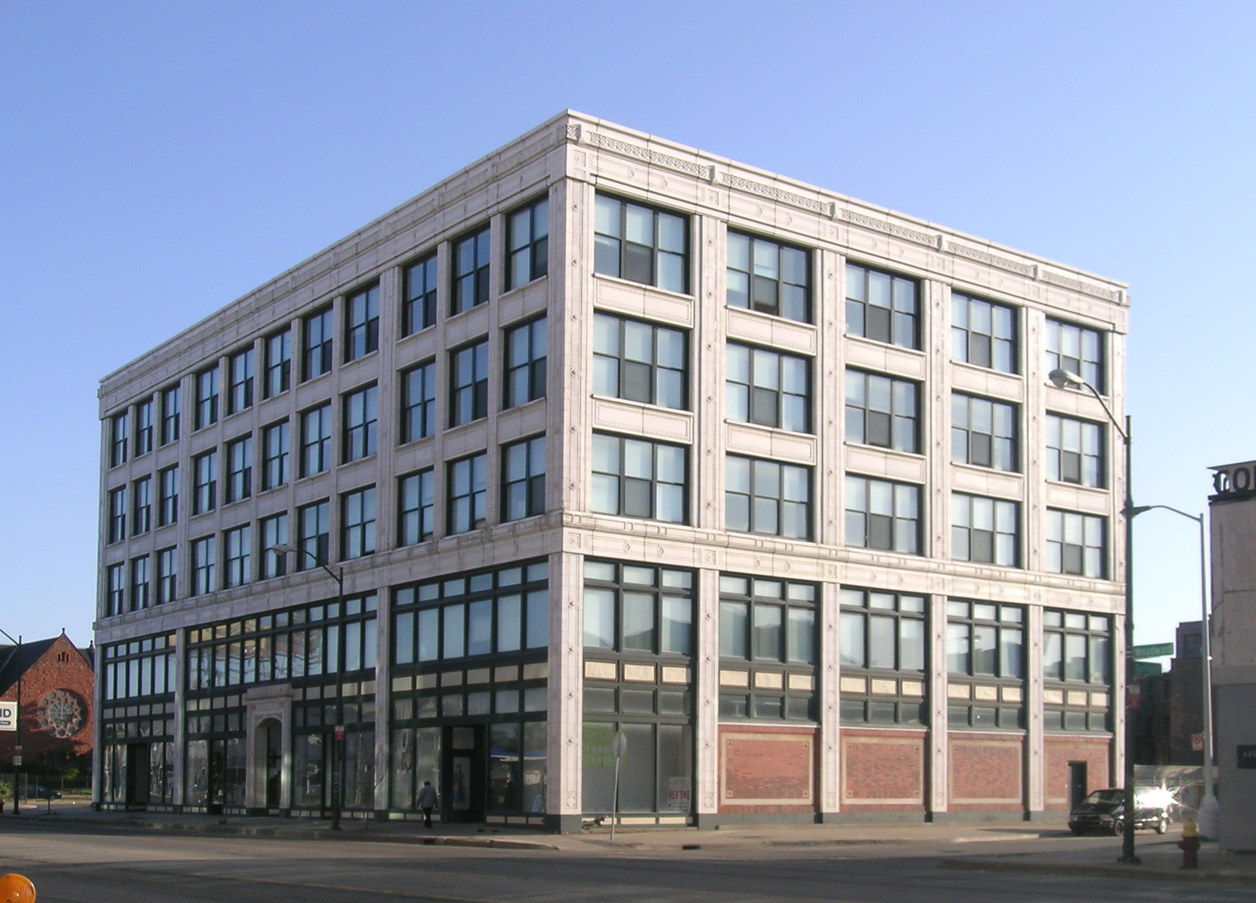
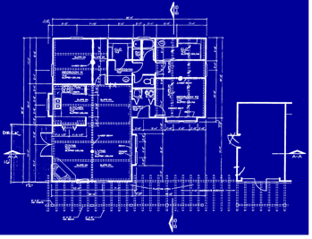
Model
A theoretic description of something, or a set of plans for something
Example: building model
Building
Blueprint
https://upload.wikimedia.org/wikipedia/commons/0/04/Garfield_Building_Detroit.jpg
http://causecapitalism.com/wp-content/uploads/2010/04/Blueprint.png

Slide 6
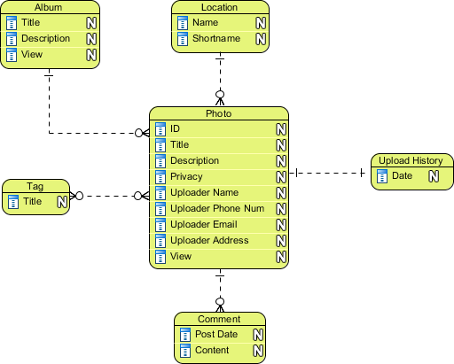
What is a Data Model?
What is a Data Model?
  Specify structure or schema of a data set
  Document description of data
  Facilitates early analysis of some properties
    e.g., querying ability, redundancy, storage space requirements, etc.
https://images.visual-paradigm.com
3

Slide 7
Why Data Models?
Data models facilitate
  Early analysis of properties, e.g. storage cost, querying ability, ...
  Reuse of shared data among multiple applications
  Exchange of data across organization
  Conversion of data to new software / environment
    Lessons from Y2K Crisis
4

Slide 8
Data Model Lessons – Y2K crisis for year 2000
In1960s and 1970s, many softwares without well-defined data models used the final 2 digits to represent years.
This may lead to erroneous behavior, for example:
A large amount of effort and hundreds of billions of dollars was spent in revising the software.
Abstract data type may have significantly reduced the costs.
5

Slide 9
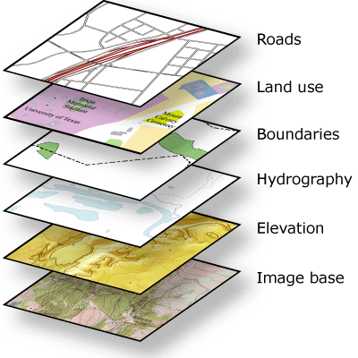
Data Model Examples
Geographic Information Science (GIS) organizes spatial set as a set of layers
Databases organize dataset as a collection of tables
http://desktop.arcgis.com/
6

Slide 10
Types of Data Models – Two Types
Generic data models
  Developed for business data processing
  Support simple abstract data types (ADTs), e.g. numbers, strings, date
  Not convenient for spatial ADTs, e.g. polygons
Application Domain specific models, e.g. spatial models
  Set of concepts developed in Geographic Information Science (GIS)
  Common spatial ADTs across different GIS applications
7

Slide 11
2.1 Models of Spatial Information
Two common models
  Field based
  Object based
Example: Land Uses in Minnesota
  Field view has a function
  Object view has 2 polygons
http-//www.mngeo.state.mn.us
9

Slide 12
2.1.1 Field based Model – Three Main Concepts
Spatial Framework
Field Functions
Field Operations
10

Slide 13
2.1.1 Field based Model – Three Main Concepts
Spatial Framework is a partitioning of space
10

Slide 14
2.1.1 Field based Model – Three Main Concepts
Spatial Framework is a partitioning of space
  e.g., Grid imposed by Longitude and Latitude
Longitude
10

Slide 15
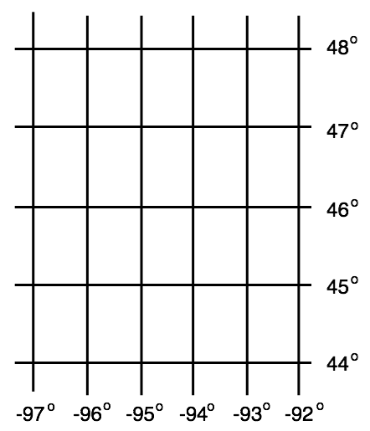
2.1.1 Field based Model – Three Main Concepts
Spatial Framework is a partitioning of space
  e.g., Grid imposed by Longitude and Latitude
Field Functions f:
  f: Spatial Framework → Attribute Domain
Latitude
Forested Area
Agricultural
Longitude
10

Slide 16
2.1.1 Field based Model – Three Main Concepts
Spatial Framework is a partitioning of space
  e.g., Grid imposed by Longitude and Latitude
Field Functions f:
  f: Spatial Framework → Attribute Domain
Latitude
1
Forested Area
2
Agricultural
Longitude
10

Slide 17
2.1.1 Field based Model – Three Main Concepts
Spatial Framework is a partitioning of space
  e.g., Grid imposed by Longitude and Latitude
Field Functions f:
  f: Spatial Framework → Attribute Domain
Latitude
Field
2
3
3
1
1
Forested Area
2
4
4
1
1
2
2
2
4
3
Agricultural
2
2
2
5
2
Longitude
10

Slide 18
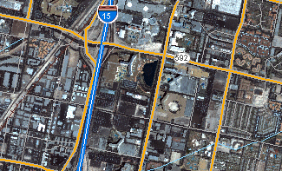
Raster Data Example
Field model represents raster data
Example: satellite imagery data
Basic unit: raster cell (or pixel)

Slide 19
2.1.1 Field based Model – Field Operations
Field Operations (operations between fields)
  Can be classified into four groups:
    Local
    Focal
    Zonal
    Global
11

Slide 20
Local Operation
Local operation: output at a given location depends only on the input at that location
Example: thresholding
  For each location (cell)
  if input > 2, then output = 1
  else, output = 0
Input
Output
12

Slide 21
Focal Operation
Focal operation: output at a given location depends on the input in a small neighborhood of the location
Example: FocalSum
  Different neighborhoods (e.g., Rook, Bishop and Queen)
Input
Output
12

Slide 22
Zonal Operation
Zocal operation: output at a given location depends on the input in a pre-defined zone around the location
Example: ZonalSum
Input
Zonal map
Output
13

Slide 23
Global Operation
Global operation: output at a given location depends on input in all locations
Example: distance from nearest facility
Location of facilities
Output
14

Slide 24
Quiz
Which type of operation is the following operations on elevation field classified?
(i) Identify peaks (points higher than its neighbors)
(ii) Identify mountain ranges (elevation over 2000 feet)
(iii) Identify the highest point in the whole area
(iv) Determine average elevation within a set of river basins
(a) Local
(b) Focal
(c) Zonal
(d) Global
15

Slide 25

2.1.2 Object Model
Object model concepts
  Objects: distinct identifiable things relevant to an application
  Objects have attributes and operations
  Attribute: a simple (e.g., numeric, string) property of an object
  Operations: function maps object attributes to other objects
Spatial attributes
Footprint
Address
Latitude
Longitude
Non-spatial attributes
Build ID
Year
Operations
Determine neighboring roads;
Determine nearby bus routes
Kenneth Keller Hall in UMN campus
17

Slide 26
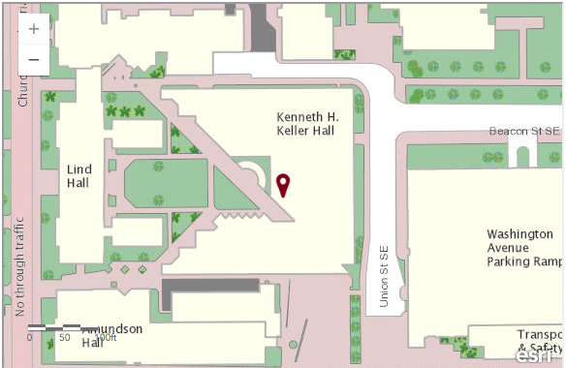
2.1.2 Object Model – Example of Keller Hall
Object: Kenneth Keller Hall in UMN campus
Spatial attributes
Footprint
Address: 200 Union St SE, Minneapolis, Minnesota, 55455
Latitude: 44.97
Longitude: -93.23
Non-spatial attributes
Build ID: 165
Year: 2010
Operations
Determine neighboring roads: Union St, Washington Ave, Church St…
Determine nearby bus routes: 2, 3,16
18

Slide 27
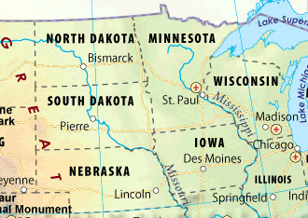
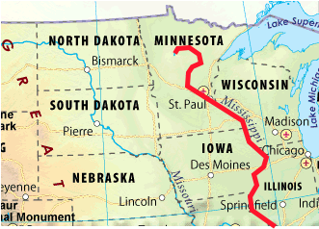
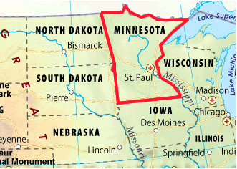
Classifying Spatial Objects
Spatial objects are objects with spatial attributes (and non-spatial attributes)
Spatial objects are of many types
    Simple
      0 dimensional (points)
, 1 dimensional (curves)
, 2 dimensional (surface)
St. Paul (center of city)
Mississippi River (center line)
Minnesota State
19

Slide 28

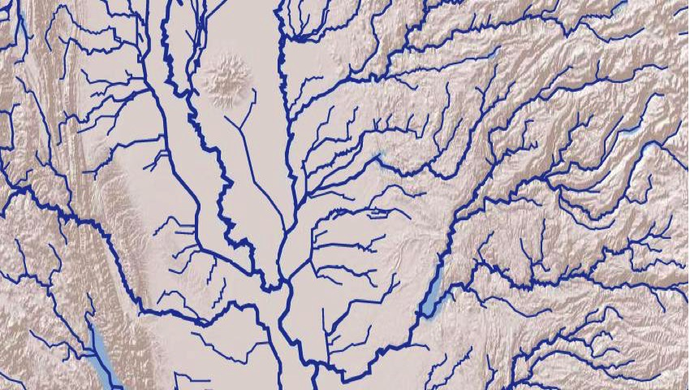

Classifying Spatial Objects - Continued
    Collections
      Multi point
, Multi linestring
, Multi polygon
Wind farm
Group of rivers
Hawaii
20

Slide 29
Spatial Object Types in OGIS Data Model
21

Slide 30
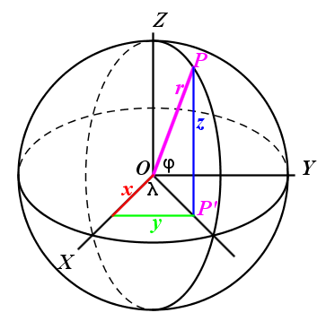
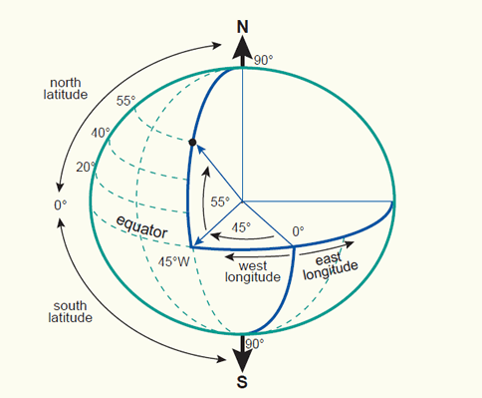

Spatial Reference System
Simple spatial reference system: spherical model
Globe is not a perfect sphere: elliptical model
Hundreds of reference systems are used in GIS softwares
  Global Positioning System (GPS) uses World Geodetic System (WGS)-84
22

Slide 31
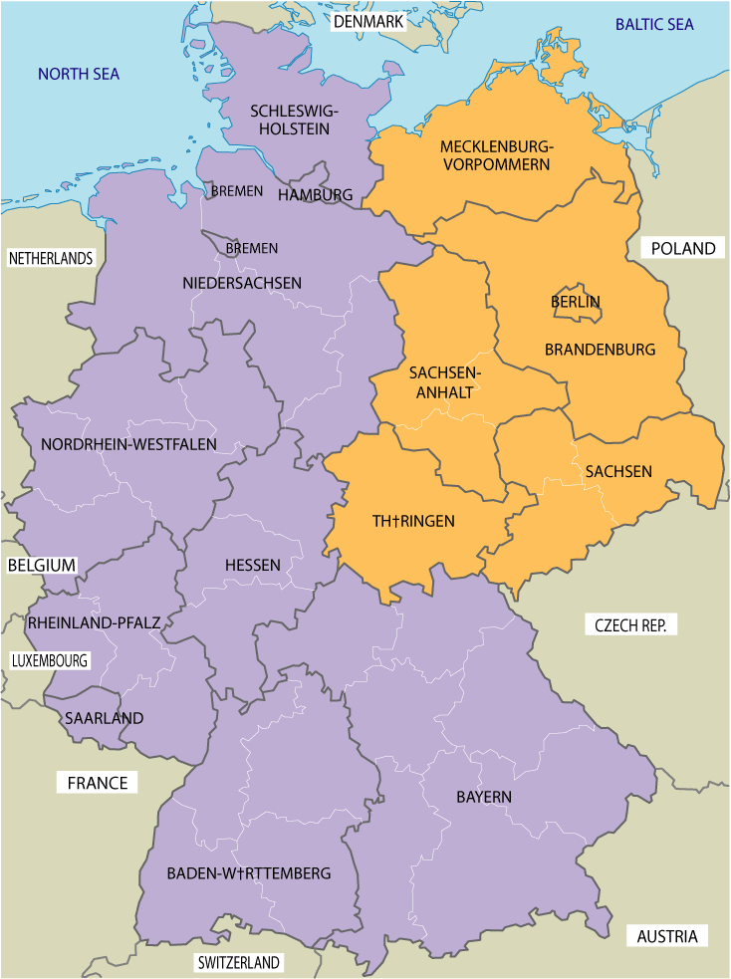
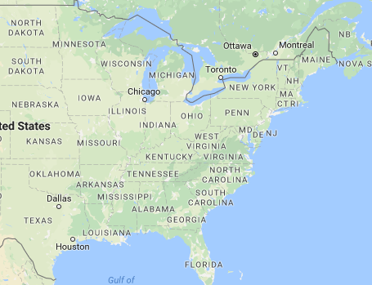
Classifying Operations on Spatial Objects
Classifying operations
  Set based: Union of East and West Germany
  Topological operations: Boundary of East Germany touches boundary of West Germany
  Directional: New York city is to east of Chicago
  Metric: Chicago is about 700 miles from New York city.
East
Germany
West
Germany
700 miles
Chicago
New York City
23

Slide 32
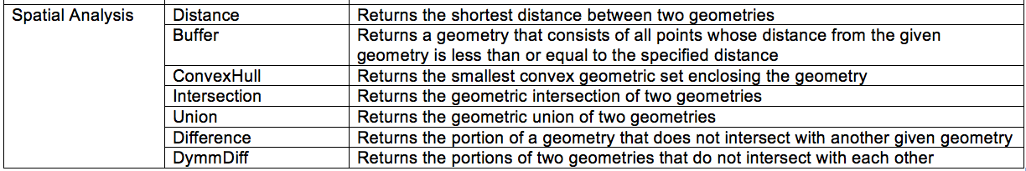
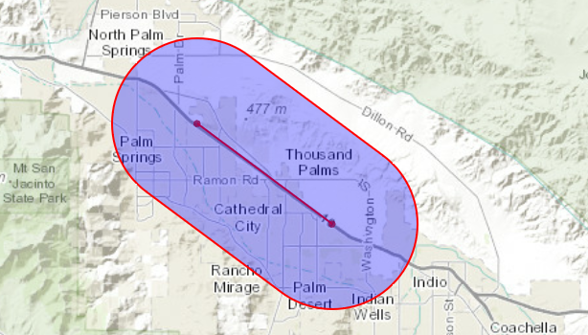
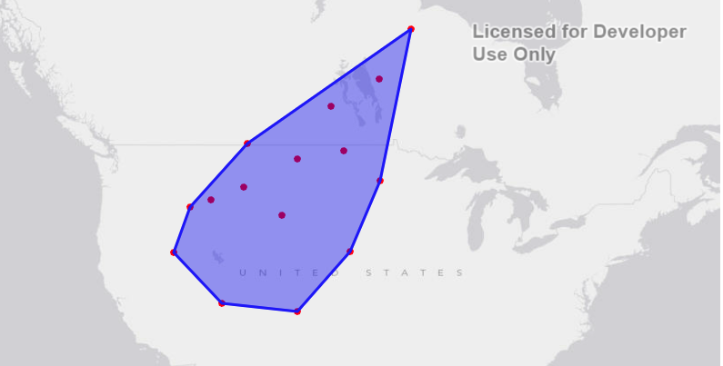
A sample of Spatial Analysis operations listed in the Open Geodata Interchange Standard (OGIS) for SQL
Buffer of a lineString
ConvexHull of a set of points
www.esri.com
24

Slide 33
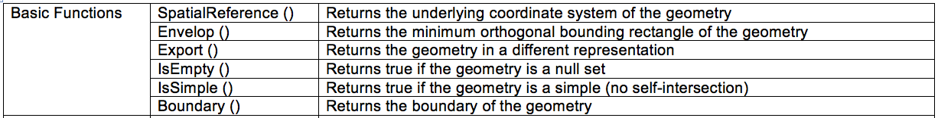
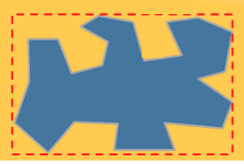
A sample of Basic function operations listed in the OGISfor SQL
Envelop (Minimum orthogonal bounding rectangle) of a polygon
25

Slide 34
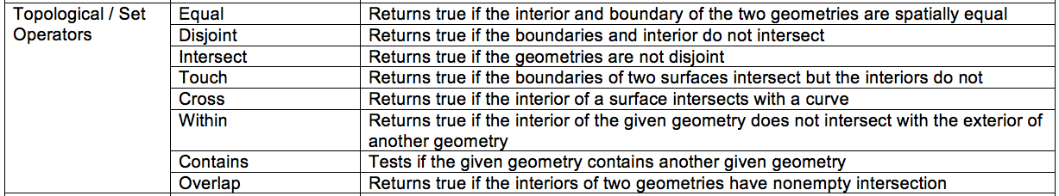
A sample of Topological / Set operations listed in the
Open Geodata Interchange Standard (OGIS) for SQL
26

Slide 35
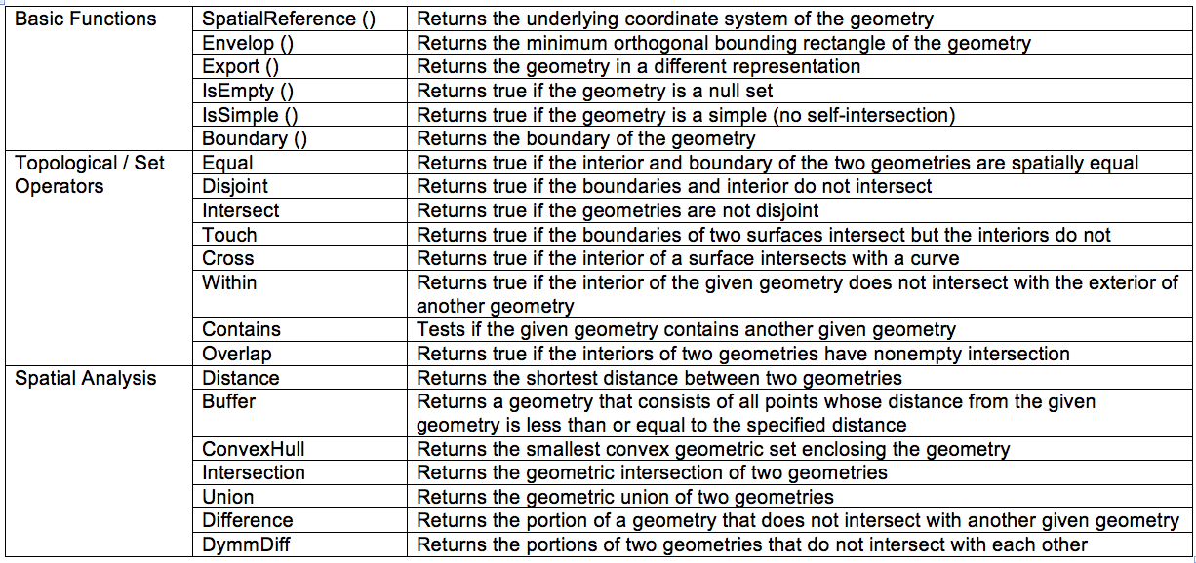
A sample of operations listed in the
Open Geodata Interchange Standard (OGIS) for SQL
17

Slide 36
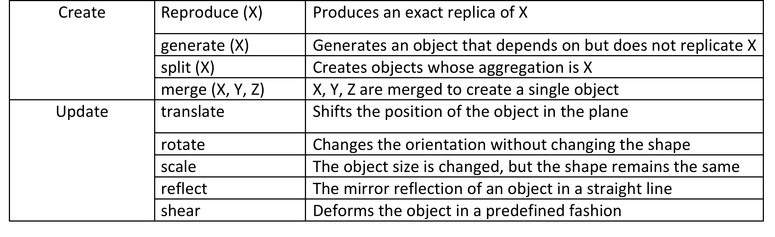
Representative Example of Dynamic Spatial Operations
27

Slide 37
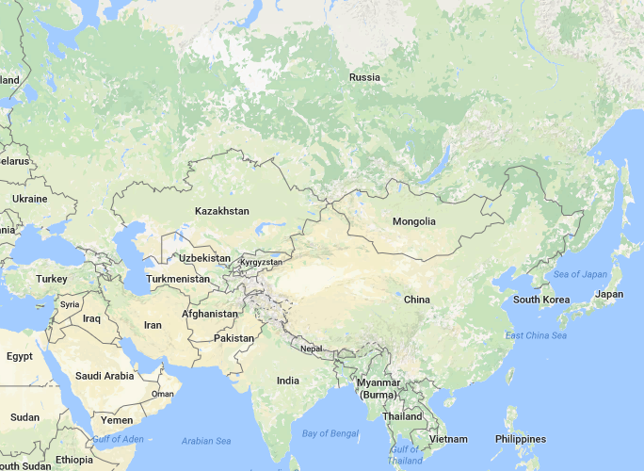

Topological Relationships
Topological Relationships
  Invariant under elastic deformation (without tear, merge).
  Two countries which touch each other in a planar paper map will continue to do so in spherical globe maps.
Topology is the study of topological relationships
Example queries with topological operations
  What is the topological relationship between two objects A and B ?
  Find all objects which have a given topological relationship to object A ?
Planar map
Spherical globe map
28

Slide 38
Topological Concepts
Interior, boundary, exterior
  Let A and B are two objects in a “Universe” U.
Red is interior of A: Interior(A)
U
Blue is boundary of A: Boundary(A)
A
B
White – Blue - Red is exterior of A: Exterior(A)
29

Slide 39
Nine-Intersection Model of Topological Relationships
Many topological relationship between A and B can be
  Specified using 9 intersection model
  A and B are spatial objects in a two dimensional plane.
  Can be arranged as a 3 by 3 boolean matrix
U
A
B
30

Slide 40
Specifying Topological Operation in 9-Intersection Model
Boolean intersection matrices for a few topological operations
A
B
32

Slide 41
Dimensional 9-intersection Model
Boolean 9-intersection model cannot distinguish the following “Cross” relationship:
    Mississippi River serves as a portion of the boundary of Minnesota
    Des Moines River just crosses the boundary of Minnesota
    But the boolean 9-intersection models of them are the same
33

Slide 42
Dimensional 9-intersection Model
Dimensional 9-intersection model
  F if no intersection
  0D if intersection is a finite set of points
  1D if intersection is a finite set of line strings
  2D if intersection is a finite set of polygons
34

Slide 43
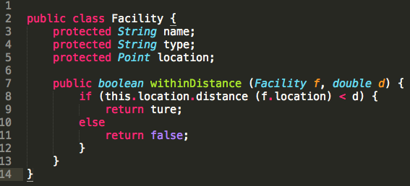
Using Object Model of Spatial Data
Many topological Relationship between A and B can be
  OGIS standard set of spatial data types and operations
  Similar to the object model in computer software
  Easily used with many computer software systems
  Programming languages like Java, C++, Visual basic
  Post-relational databases, e.g. OODBMS, ORDBMS
Facility object in Java
35

Slide 44
End of required Content

Slide 45

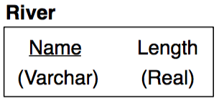
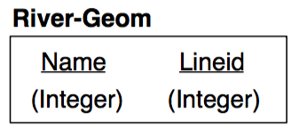
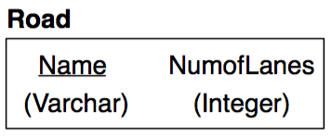
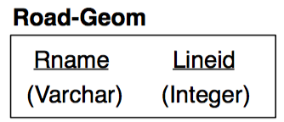
2.3 Extending ER with Spatial Concepts
Motivation
    ER Model is based on discrete sets with no implicit relationships
    Spatial data comes from a continuous set with implicit relationships
    Any pair of spatial entities (e.g., cities) has relationships like distance, direction, …
Explicitly drawing all spatial relationship
    Clutters ER diagram
    Generates additional tables in relational schema
  Misses implicit constraints in spatial relationships (e.g. distance)
59

Slide 46
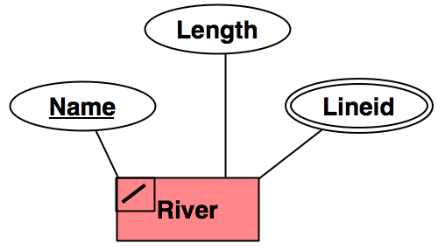
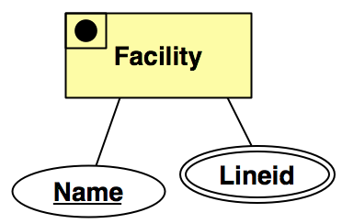
2.3 Extending ER with Spatial Concepts - Continued
Pictograms
    Label spatial entities along with their spatial data types
    Allows inference of spatial relationships and constraints
    Reduces clutter in ER diagram and relational schema
    Example: Fig. 2.7 (next slide)
60

Slide 47
ER Diagram with Pictograms: An Example
Fig 2.7
61

Slide 48
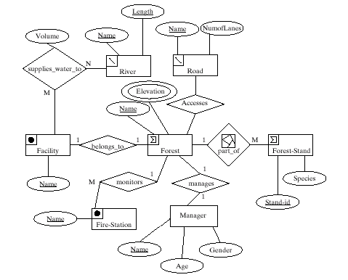
ERD with Pictograms & implicit spatial relationships
Fig 2.7
61

Slide 49
Specifying Pictograms
Grammar based approach
    Rewrite rule
    Like English syntax diagrams
Classes of pictograms
    Entity pictograms
      basic: point, line, polygon
      collection of basic
      ...
    Relationship pictograms
      partition, network
62

Slide 50
Entity Pictograms: Basic shapes, Collections
63

Slide 51
Entity Pictograms: Derived and Alternate Shapes
Derived shape example is city center point from boundary polygon
Alternate shape example: A road is represented as a polygon for construction
    or as a line for navigation
64

Slide 52
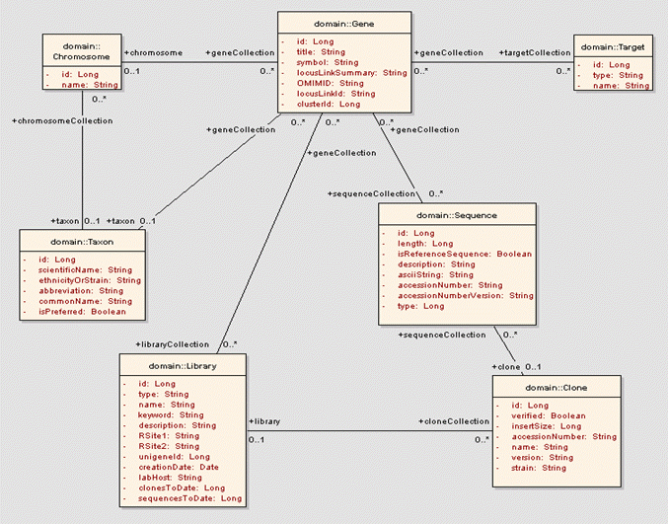
2.4 Conceptual Data Modeling with UML
Motivation
  ER Model does not allow user defined operations
  Object oriented software development uses Unified Modeling Language (UML)
  It is a standard consisting of several diagrams
    class diagrams are most relevant for data modeling
UML class diagrams concepts
  Attributes are simple or composite properties
  Methods represent operations, functions and procedures
  Class is a collection of attributes and methods
  Relationships relate classes
Example UML class diagram: Figure 2.8 (next slide)
65

Slide 53
UML Class Diagram with Pictograms: Example
Fig 2.8
66

Slide 54
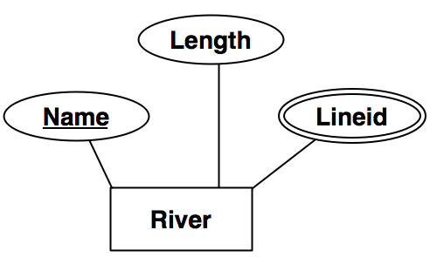
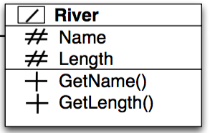
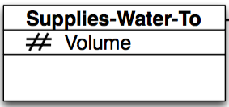
Comparing UML Class Diagrams to ER Diagrams
Concepts in UML class diagram vs. those in ER diagrams
  Class without methods is an Entity
  Attributes are common in both models
  UML does not have key attributes and integrity constraints
  ERD does not have methods
  Relationships properties are richer in ERDs
  Entities in ER diagram relate to datasets
  But UML class diagram can contain classes which have little to do with data
Entity
Class
67

Slide 55
Summary
A data model is a high level description of the data
  It can help in early analysis of storage cost, data quality
There are two popular models of spatial information
  Field based and Object based
Database are designed in 3-steps
  Conceptual (ER), Logical (relational model) and Physical (indexing)
Pictograms can simplify Conceptual data models
69

