Slide 1
On Spatial Joins in MapReduce
Ibrahim Sabek & Mohamed F. Mokbel
Presented by: Achyuth Madhav Diwakar

Slide 2
Problem Statement and Motivation
To develop a query optimizer for MapReduce based spatial join algorithms.
Traditional spatial join optimizations NOT suitable for MapReduce based algorithms

Slide 3
Related Work
Traditional Spatial Join Algorithms:
Numerous algorithms categorized based on indexing of inputs.
Non-indexed, one dataset indexed and both indexed
Several benchmarking studies performed to find the best algorithm for the given inputs.

Slide 4
Related Work
Big Spatial Data:
Research towards supporting range-queries, KNN, Spatial joins and computational geometry

Slide 5
Related Work
MapReduce based Spatial Join Algorithms
Standalone algorithms or part of spatial data engines like: Hadoop GIS or Spatial Hadoop
Developed for targeted scenarios
Spatial Hadoop assumes both datasets are spatially partitioned while other algorithms assume non-partitioned datasets.
Standard Approach: First partition and then join using any of the algorithms.
No query optimization efforts done at the time of this research

Slide 6
MapReduce - WordCount
Splits data
Generates Key-value pairs by mapping
Sorts the pairs by key
Reduces the pairs with same key into key, frequency pairs

Slide 7
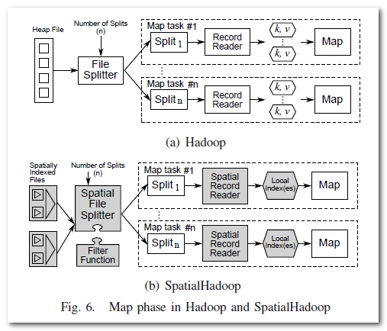
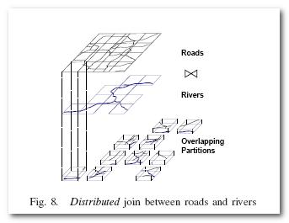
Hadoop & Spatial Hadoop
Involves partitioning of data
Join performed in the reduce phase by looking for overlapping MBRs
Can perform global joins and local joins
SpatialHadoop: A MapReduce Framework
for Spatial Data∗
Ahmed Eldawy Mohamed F. Mokbel

Slide 8
Spatial Join with MapReduce
Three cases based on input partitioning
R & S are two datasets stored in HDFS
Output: (r,s), r ∈ R and s ∈ S where r and s satisfy some spatial predicate

Slide 9
Partitioning Phase
To ensure that the HDFS blocks of both input files R and S are partitioned in a way that each block includes data that are spatially related
Performance depends on minimizing the number of partitions joined
Decision points perform that role

Slide 10
Case 1: No Spatial Partitioning
Default Hadoop HDFS partitioning: Fixed block sizes (say 128 MB) with no regard to spatial data.
Considered Non – partitioned
Partitioning Phase:
Should avoid nested loop joins!
Partitions the two input files R and S using the same partitioning scheme P
Both datasets must be taken together by size – proportional sampling and one in memory index P is built
Fire stations
Houses
Fig. from Dr. Magdy’s slides on spatial queries

Slide 11
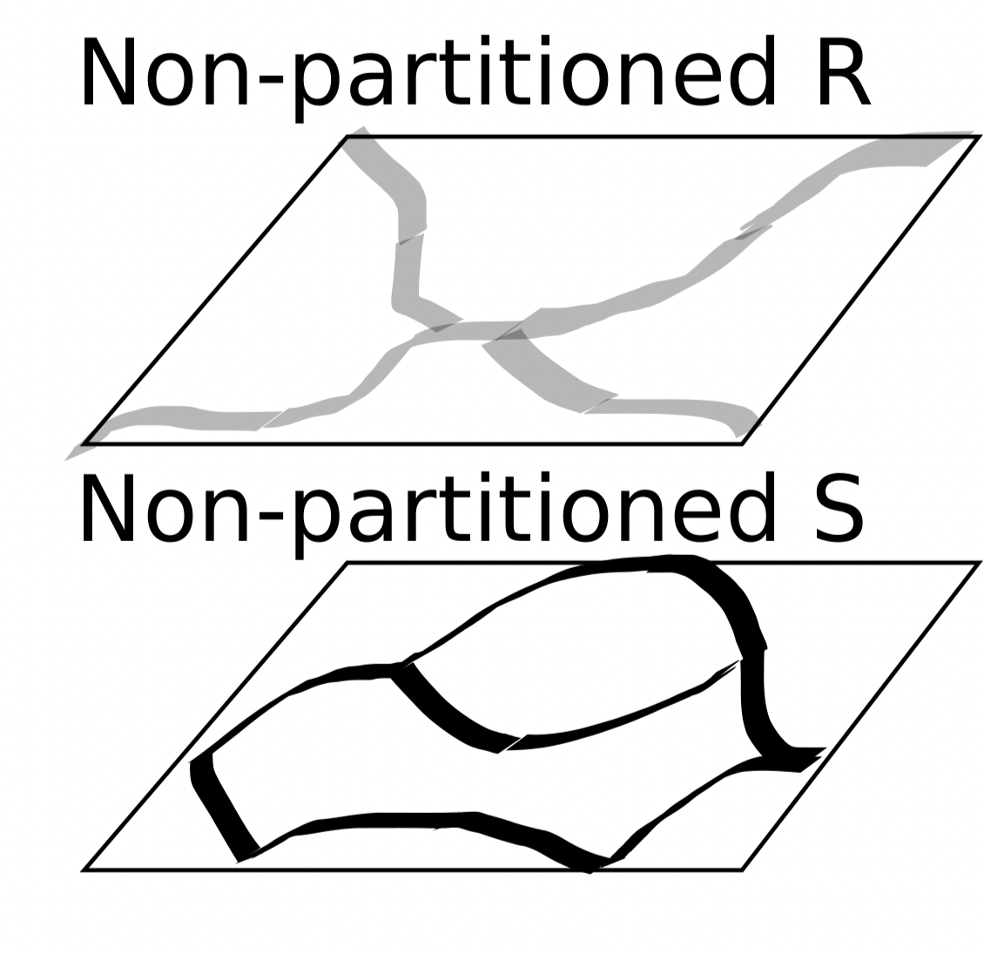
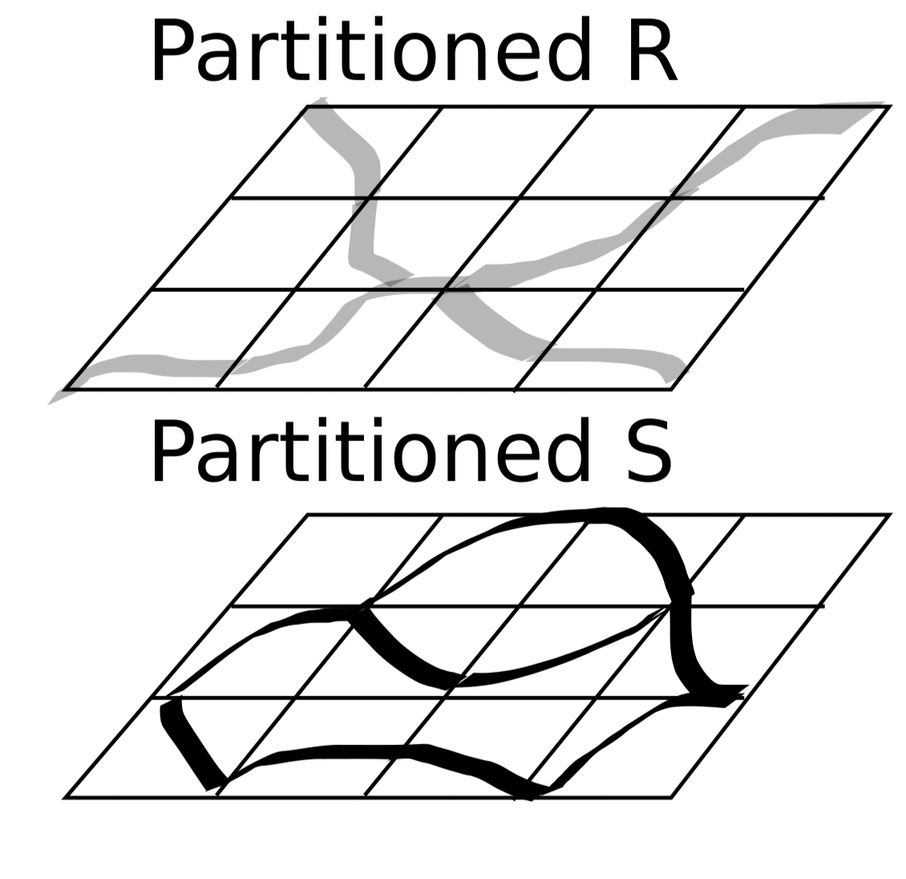
Case 1: No Spatial Partitioning
Decision Point 1: Partitioning Options
Option1:Grid: Creates equal sized cells
Option2:QuadTree: in-memory quad-tree using the sampled data.
Option 3: KDTree: constructs an in-memory KDTree using sampled data.
Option 4: STR: builds the in-memory index by bulk loading an R-tree using the STR bulk loading algorithm
Option 5: STR+. This technique is similar to STR, except that objects that overlap with multiple cells are replicated.

Slide 12
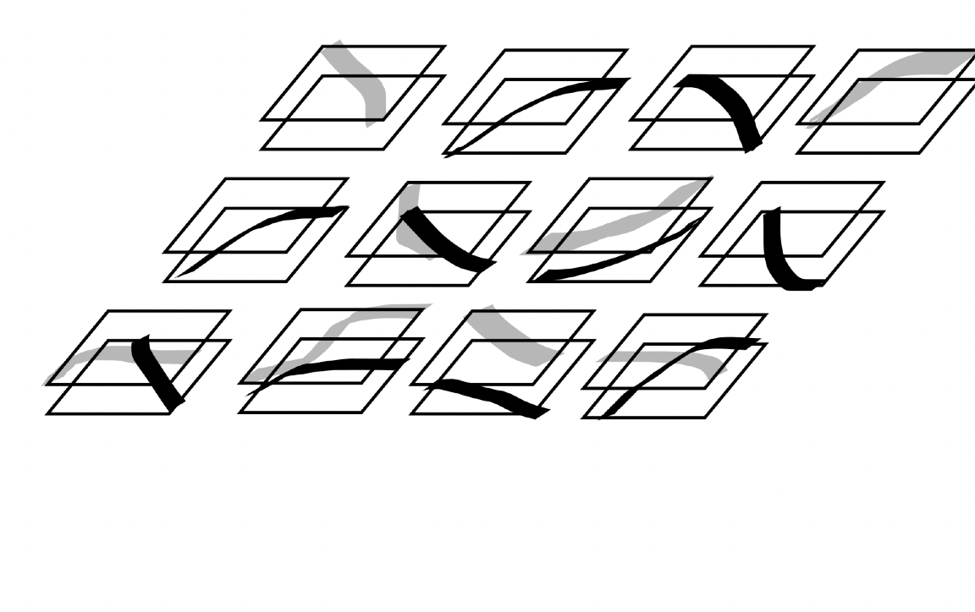
Case 1: No Spatial Partitioning
Joining Phase:
R & S will have the same MBRs.
Therefore, one-to-one join can be performed.
Duplicate avoidance technique to ensure only one pair of joined objects

Slide 13
Spatial Join with MapReduce

Slide 14
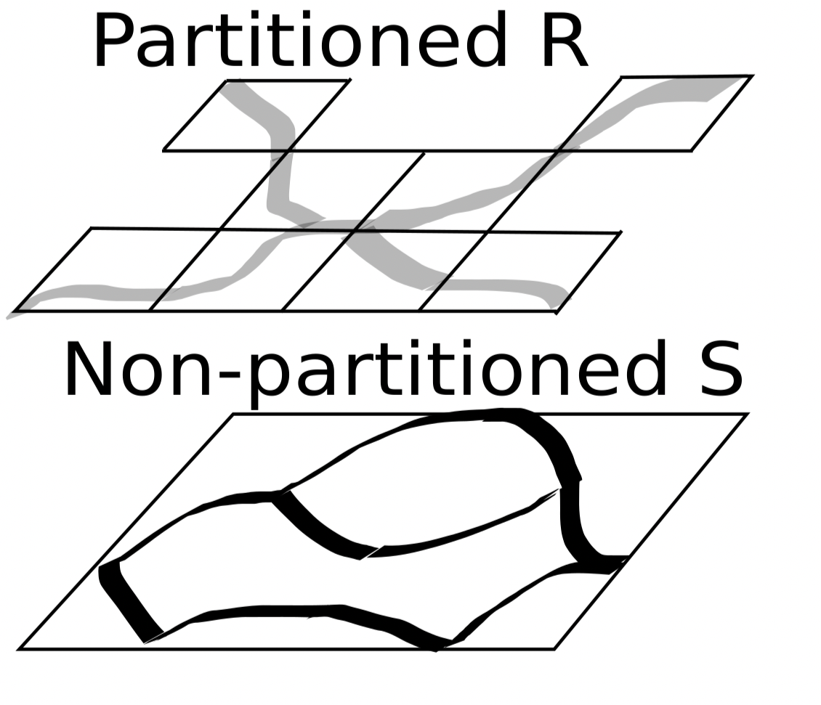
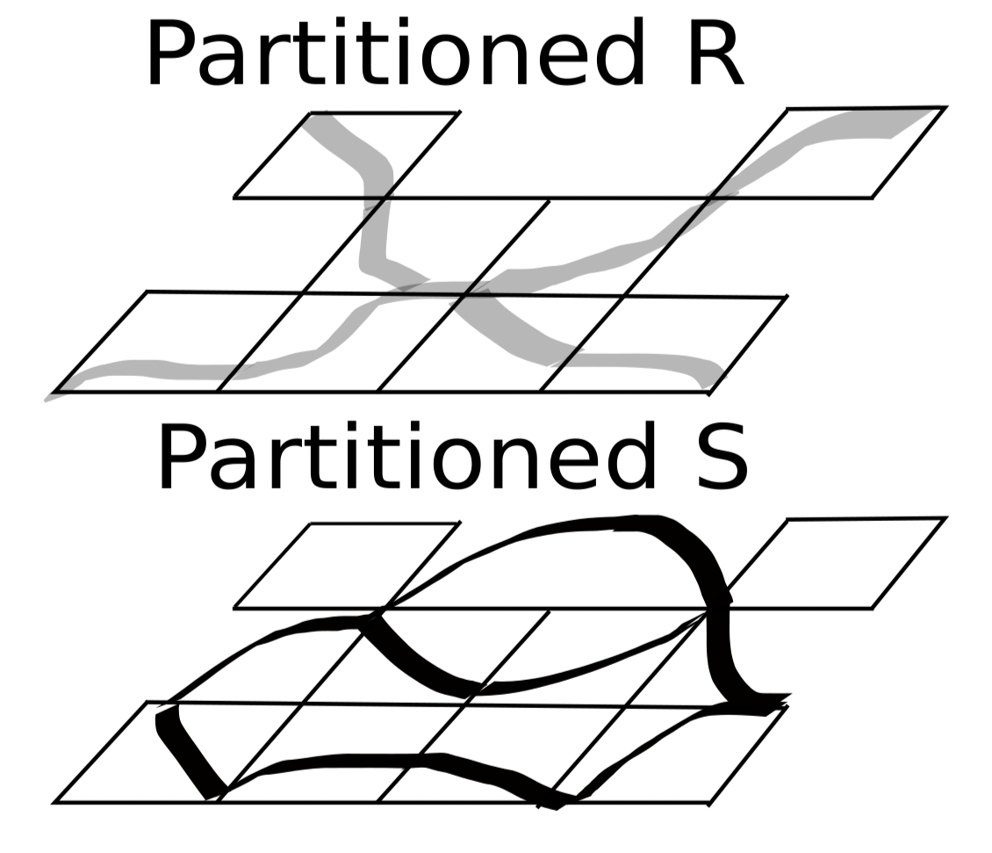
Case 2: One Spatial Partition
Partitioning Phase:
Decision Point 2: To ignore R-partitioning and repartition both like Case 1? OR Partition just S on the same scheme as R
Options:
Repartition R & S using options from Case 1
Partition S using the boundaries of R

Slide 15
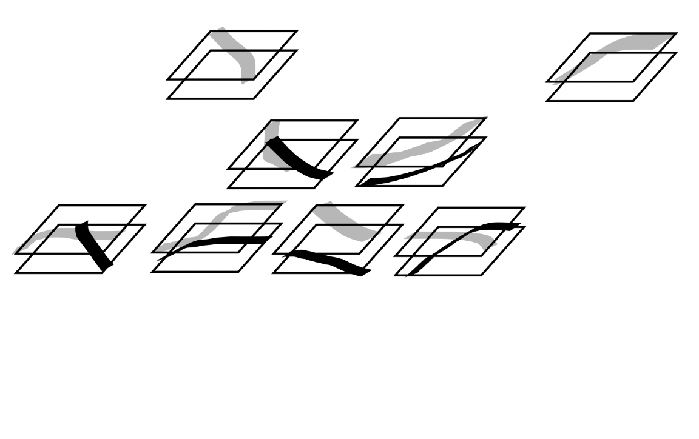
Case 2: One Spatial Partition
Joining Phase:
All options result in same partitioning scheme for R & S
One-to-one join on corresponding partitions

Slide 16
Spatial Join with MapReduce

Slide 17
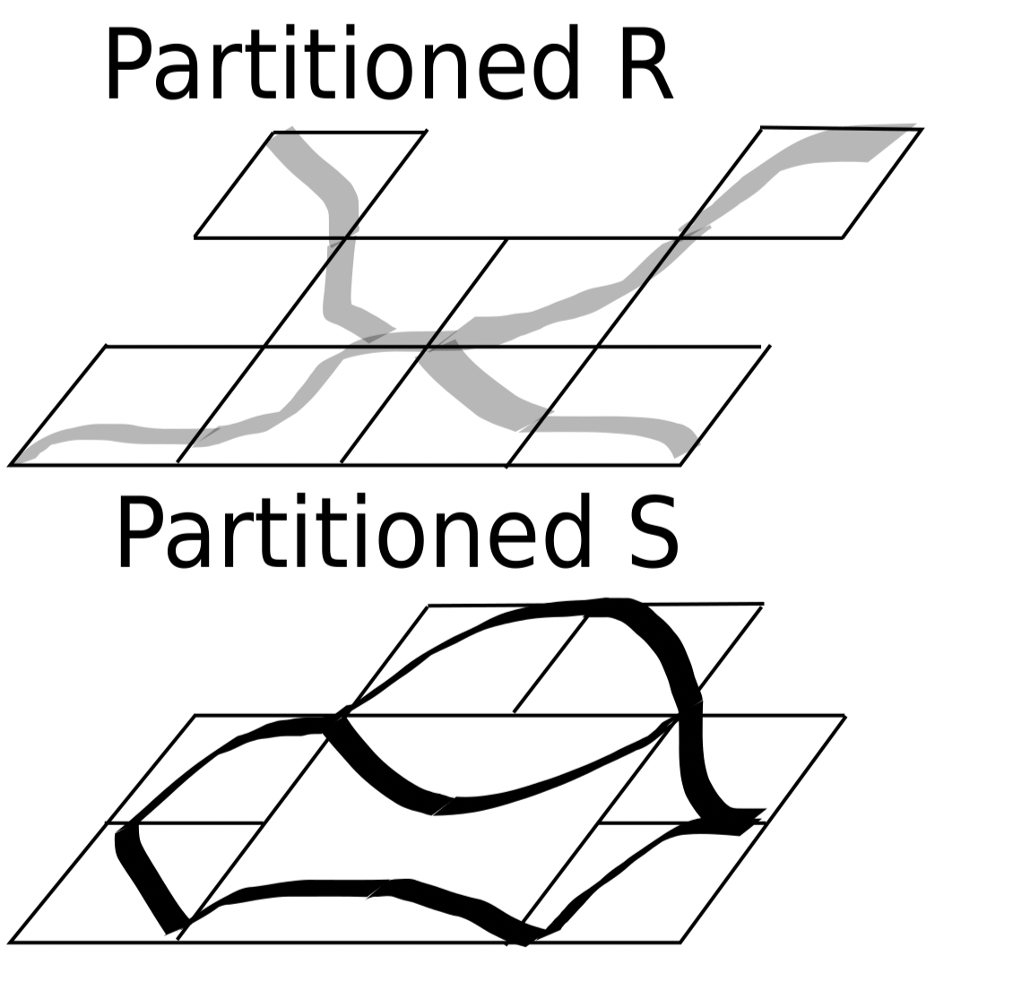
Case 3: Two Spatial Partitions
Partitioning Phase:
Decision Point 3:
To ignore R-partitioning and repartition both like Case 1? OR
Partition just S on the same scheme as R OR
Partition just R on the same scheme as S OR
Skip partitioning and join directly

Slide 18
Case 3: Two Spatial Partitions
Partitioning Phase:
Options:
Repartition R & S using options from Case 1
Results in one-to-one join
Partition S using the boundaries of R OR vice versa from Case 2
Results in one-to-one join
Perform join directly
Could be one-to-one or one-to-many join

Slide 19
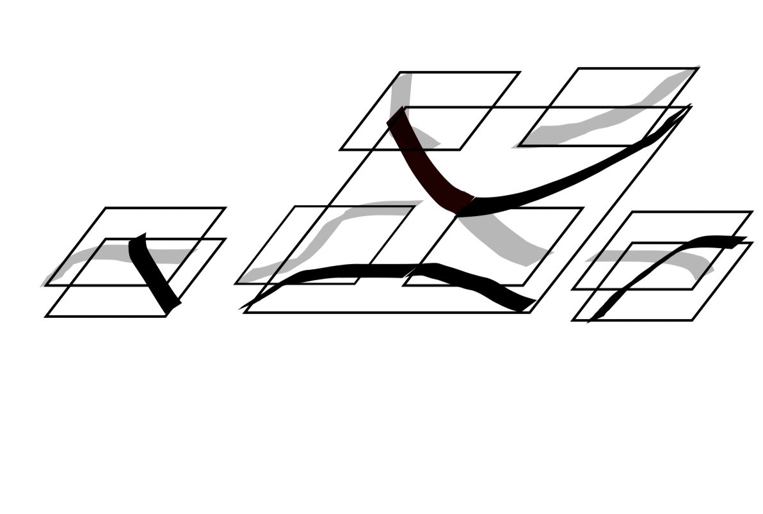
Case 3: Two Spatial Partitions
Joining Phase:
Direct join shown here
One-to-many join occurs

Slide 20
Optimizer Flavors
Cost based Optimizer:
Aims to find the least cost approach to do a spatial join for two input datasets R and S
Evaluates the cost of all possible options for the three decision points
Rule based Optimizer:
abstracts the developed cost model from cost based approach to three simple easy-to-check heuristic rules.

Slide 21
Cost Optimizer
Cost of Spatial Join
= Cost of Partitioning + Cost of Joining
Cost of Partitioning
= Cost of estimating the partitioning boundaries + Actual cost of partitioning
Cost of Joining
= cost of moving the pairs of overlapping partitions into the same node + Actual cost of joining

Slide 22
Evaluating Cost in Case 1
Estimation Cost:
ZERO for grid
Similar for all other options, calculated experimentally
Partitioning Cost:
Depends on the number of spatial partitions
Number of partitions determined by:
No. of partitions for larger input
Block Utilization: HDFS block util. as a range between 0 and 1
Data Replication: Avg. number of partitions that input ‘r’ would overlap with
Number of allocated partitions = 2N_{R}^{U}_{R}^{D}_{p}
Costs divided by KxH which is the number of running Map tasks
Decision Point 1: Partitioning Options
Option1:Grid
Option2:QuadTree
Option 3: KDTree
Option 4: STR
Option 5: STR+

Slide 23
Evaluating Cost in Case 1
Preparation Cost:
cost of shuffling the new spatial partitions of R and S such that all pairs of joined partitions are in the same machine
One-to-one join: need to shuffle only the partitions of one of these relations, say R
Joining Cost:
need to do an in-memory one-to- one join for all the spatial partitions in each input dataset
Costs divided by LxH which is the number of running Reduce tasks

Slide 24
Evaluating Cost in Case 2
Estimation Cost:
ZERO as partitions of R are being used
Partitioning Cost:
Calculated in a similar fashion as Case 1
Cost is halved as only one dataset is being partitioned
Costs divided by KxH which is the number of running Map tasks

Slide 25
Evaluating Cost in Case 2
Preparation Cost:
Similar to Case 1, except we know the exact number of partitions to move (Nr)
Joining Cost:
In memory one-to-one join
Costs divided by KxH which is the number of running Map tasks

Slide 26
Evaluating Cost in Case 3
Partitioning Cost:
ZERO as there is no partitioning
Joining Cost:
Here the number of overlapping partitions is estimated and a selectivity estimation is multiplied to the Nr X Ns.
Selectivity estimation is a factor from 0 to 1

Slide 27
Rule Based Query Optimizer
Cost-based optimizer is accurate but expensive as it collects and maintains statistics as well as estimates parameters to calculate its cost equations
Rule-based optimizer has thresholds which determine the partitioning decisions:
Rule 1: Nr and Ns are less than a given threshold t, then we partition both R and S on Grid (Option 1), otherwise, we partition both R and S on STR (Option 4)
Rule 2: Nr and Ns are less than a given threshold t, then we partition both R and S on Grid (Option 1), otherwise, we partition S on the same partitioning scheme of R (Option 6)

Slide 28
Rule based Query Optimizer
Rule 3: ^{if β}_{RS}^{N}_{S} ^{≤ 1} where ‘beta’ is the selectivity estimation and R is the larger dataset then partition is skipped
If Nr and Ns are both less than threshold ‘t’ then Grid partitioning is used
If both the above conditions fail, Case2 optimization is used where, S is partitioned on the scheme of R

Slide 29
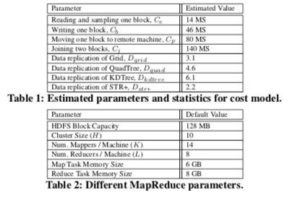
Experiments
Estimation of parameters for Cost Model
Map Reduce Parameters
Datasets. All experiments are based on collected data from Open- StreetMap

Slide 30
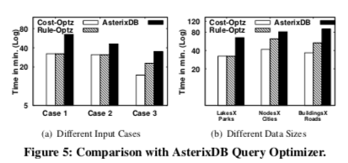
Experiments
Significantly outperforms AsterixDB as it is not designed for Spatial join optimizations
Buildings and Roads: AsterixDB selects STR type optimization whereas Cost-Optz selects Grid type optimization which is better for uniform distribution
Rule-Optz also selects STR but performs better due to SpatialHadoop efficiency

Slide 31
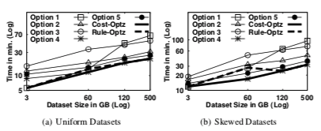
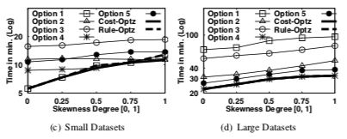
Experiments
Input Data Characteristics
Option1:Grid
Option2:QuadTree
Option 3: KDTree
Option 4: STR
Option 5: STR+

Slide 32
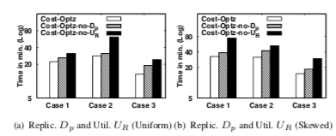
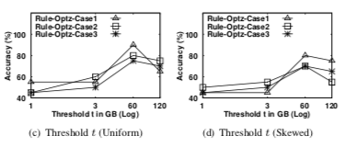
Experiments
Uniform vs. Skewed Datasets

Slide 33
Conclusions
Delivered a full-fledged query optimizer for MapReduce-based spatial join algorithms
Covers extensive cases through a thorough classification
detailed cost model is developed for each possible case
provided a rule-based query optimizer that abstracts the developed cost model
Exhaustive experiments based on a real deployment inside SpatialHadoop, and based on real datasets of up to 500GB

Slide 34
Thank You!

