Slide 1
MultiLyra: Scalable Distributed Evaluation of Batches of Iterative Graph Queries
Abbas Mazloumi, Xiaolin Jiang and Rajiv Gupta
Department of Computer Science and Engineering
University of California, Riverside
December 10^{st.} 2019

Slide 2
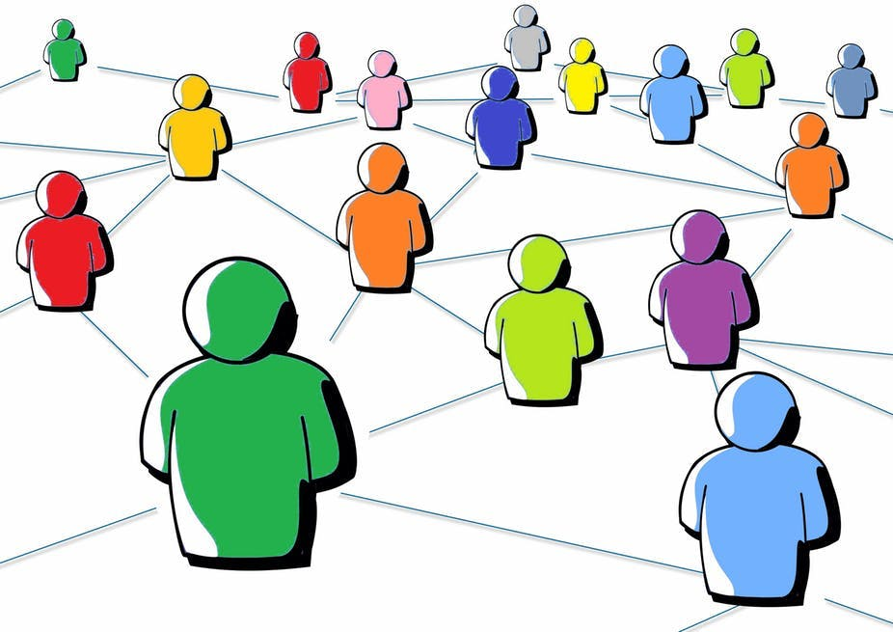
Large Graphs are Ubiquitous
Social Networks
Finding social behaviors like communities
Traffic Networks
Detecting malicious activities
Biology
Predicting diseases
Web Search
Page ranking
By Jamie posted in Blog Traffic
By Megan Deskin
http://10best4u.com/
https://theconversation.com/rethinking-ethics-in-social-network-research-88988
A Mazloumi et al, MultiLyra: Scalable Distributed Evaluation of Batches of Iterative Graph Queries
2 / 21

Slide 3
Graph Processing
Graph Algorithms are Iterative
Vertices are continuously processed until convergence
Highly Parallel
Vertex-centric approach – “Think as a vertex” philosophy
Process vertices in parallel, and communicate along the edges
Distributed Processing
Graph partitioning techniques
Distributed computation – GAS model
A Mazloumi et al, MultiLyra: Scalable Distributed Evaluation of Batches of Iterative Graph Queries
3 / 21

Slide 4
Outline
Background on PowerLyra
GAS model based recent graph processing distributed framework
Basic MultiLyra
Sharing the GAS model among a batch of graph queries
Unified active list for all queries
FQT & IQT Optimizations
Keep track of the status of each query
Reuse technique
Reusing results of previous batch of queries to speed up current batch
A Mazloumi et al, MultiLyra: Scalable Distributed Evaluation of Batches of Iterative Graph Queries
4 / 21
Notes:
MultiLyra by generalizing The GAS Model to handle a batch of queries

Slide 5
PowerLyra [EuroSys’15]
Distributed Vertex-centric Framework
Performing the processing from the vertex perspective of view
Graph is Partitioned Across Machines
For remote adjacent vertices, replicas or mirrors are created
Using hybrid-cut partitioning
All Machines Process Local vertices in parallel, and communicate with other machines
Using GAS model
A Mazloumi et al, MultiLyra: Scalable Distributed Evaluation of Batches of Iterative Graph Queries
5 / 21

Slide 6
GAS Computation Model
Gather data from predecessors
Send the partial gather from mirrors to local (G-Data)
Apply/Update vertex with new data
Send the updated data to mirrors and inform them to be active for the scatter (A-Mix)
Scatter data to successors
Send activation between machines (E-Active and G-Active)
Mirror
Mirror
Mirror
Mirror
Local
Local
Local
Local
Machine 2
Machine 2
Machine 1
Machine 2
Machine 1
Machine 2
Machine 1
Machine 1
A Mazloumi et al, MultiLyra: Scalable Distributed Evaluation of Batches of Iterative Graph Queries
6 / 21
Notes:
Gas model in general has 3 main conceptual phases. First in Gather phase, the data are collected from the predecessors.
In this phase the mirrors who collected the remote data will send the partial gather to the local machines.
Then this collected data will be used in Apply phase in order to update the vertex value. In case of consistency, the updated value will be send to mirrors and also an activation message will be sent along with the data.
Finally in Scatter phase those vertices which gets updated will activate their successors for the next iteration.

Slide 7
GAS Computation Model
Lots of communications in each phase
Two communications in Data Category for each active vertex
Three communication in Active Category for each active vertex
Locking and unlocking shared data structures
All phases performed in parallel, including updates
Synchronization overhead
At each phase and iteration boundaries, machines need to be synched
Can we amortize these overheads?
A Mazloumi et al, MultiLyra: Scalable Distributed Evaluation of Batches of Iterative Graph Queries
7 / 21

Slide 8
Basic MultiLyra
Amortizing the costs across multiple queries
Performing each phase for processing a batch of queries.
Having one unified active including the active vertices of all queries
Communication
Active Category: only one message is sent
Data Category: values of all queries are integrated as one larger message
Locking operations
Lock once for when processing/computing for all the queries in the batch
A Mazloumi et al, MultiLyra: Scalable Distributed Evaluation of Batches of Iterative Graph Queries
8 / 21
Notes:
In Active Category, only one message is needed to be sent, no matter how many queries are active, one message is enough
Data category messages are integrated as one larger message in order to minimize the number of communication

Slide 9
Basic MultiLyra
1: gData[]←∅
2: for P ∈ Predecessors(V) do
3: for qid ∈ batch do
4: gData[qid]←gData[qid] ∪ P.value[qid]
5: end for
4: end for
1: while !query_list.empty() do
2: batch ← get next k queries from query_list
3: unified_active_list ← all q ∈ batch 4: while !unified_avctive_list.empty() do
5: distribute_run(gather_phase)
6: distribute_run(apply_phase)
7: distribute_run(scatter_phase)
8: end while
9: end while
1: for qid ∈ batch do
2: V.value[qid]←f(gData[qid])
3: end for
1: if Changed(V) for any qid is true then
2: for S ∈ Successors(V) do
3: Activate(S) // put it in the unified list
4: end for
5: end if
A Mazloumi et al, MultiLyra: Scalable Distributed Evaluation of Batches of Iterative Graph Queries
9 / 21

Slide 10
Experimental Setup
Input Graphs:
Twitter (TT) 2.0B, 52.6M
LiveJournal (LJ) 69M, 4.8M
10K source-to-all queries
Divided to multiple batches
Algorithms
Single Source Shortest Path (SSSP)
Single Source Widest Path (SSWP)
Number of Paths (NP)
Viterbi (VT)
Cluster:
Using 4 machines
Each machine – 32 Intel Broadwell cores with 256 GB memory
Implementing:
Implemented Upon the PowerLyra
A Mazloumi et al, MultiLyra: Scalable Distributed Evaluation of Batches of Iterative Graph Queries
10 / 21

Slide 11
Basic MultiLyra
What parts of Basic are not scaling well?
A Mazloumi et al, MultiLyra: Scalable Distributed Evaluation of Batches of Iterative Graph Queries
11 / 21
Notes:
The most dominant performance obstacle in distributed graph processing is the number of communications needed by nodes in the cluster to exchange the remote data for an iterative graph algorithm.
Hypothetical ideal line shows the reduction achievable when the number of communication is reduced by a factor equal to the batch size.
The reduction in # of Comms achieved by Basic MultiLyra is not that far from the ideal line. Speed up in some point reaches its peak and then begins to slightly fall.

Slide 12
Basic MultiLyra Experimental Results
54%
A Mazloumi et al, MultiLyra: Scalable Distributed Evaluation of Batches of Iterative Graph Queries
12 / 21
Notes:
The time percentage spent in apply phase when the batch size varies:
TT: From around 20% in batch size 2 until around 60% in batch size 256
LJ: From around 40% in batch size 2 until around 70% in batch size 1024

Slide 13
Observations from Basic MultiLyra
Apply phase is the least scalable phase
Takes more than half of the execution time and it increases as batch size grows (around 54% on average)
Apply phase is responsible for 82% of Data Communication on average
Drawbacks of unified active list
Does not maintain the list of queries for which a vertex has been activated
No matter a vertex become active by what queries, computation/processing will be done for all queries in each step
Data communication also send the data needed for all queries
Performs the acts of each phase even if a query has already finished
Solution: keeping track of each query status
Unnecessary work in both computations and communications
A Mazloumi et al, MultiLyra: Scalable Distributed Evaluation of Batches of Iterative Graph Queries
13 / 21
Notes:
In Basic MultiLyra, each phase acts on behalf of all the queries in the batch for an active vertex
Data communication also send the data of all queries (even if a query is inactive and consequently its data is unchanged)
Basic MultiLyra, all queries in the batch share only one unified active list
Solution: keeping track of each query status

Slide 14
FQT & IQT
Finished Query Tracking (FQT)
Maintain a list of finished queries
Do computation only for queries that have not finished
Not sending data of finished queries leads to smaller Data messages
Inactive Query Tracking (IQT)
Maintain a list of active queries for each active vertex
Perform each phase only for those queries for which vertex is active
Send data for those queries for which the vertex is active and gets updated
A Mazloumi et al, MultiLyra: Scalable Distributed Evaluation of Batches of Iterative Graph Queries
14 / 21
Notes:
To improve upon Basic MultiLyra we develop two additional algorithms, FQT and IQT.

Slide 15
FQT & IQT
FQT adds a bit vector with size equal to the batch size
Needs to synced once per each iteration
IQT adds a bit vector with size = batch size for each vertex
Needs to be sent along with the activation message
A Mazloumi et al, MultiLyra: Scalable Distributed Evaluation of Batches of Iterative Graph Queries
15 / 21

Slide 16
FQT & IQT
FQT and IQT boost speedup
by maintaining the status of each query and removing unnecessary computation and communication
A Mazloumi et al, MultiLyra: Scalable Distributed Evaluation of Batches of Iterative Graph Queries
16 / 21

Slide 17
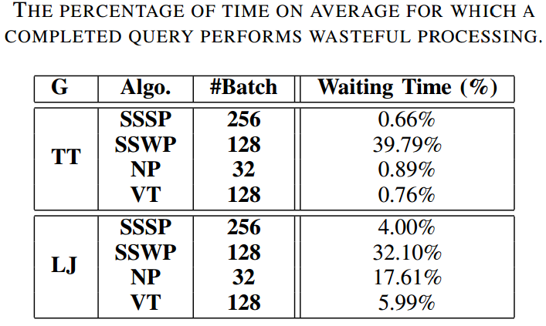
FQT & IQT
Only SSWP among the four algorithms could gain speedup from FQT
has more variance in each query’s finish time
A Mazloumi et al, MultiLyra: Scalable Distributed Evaluation of Batches of Iterative Graph Queries
16 / 21
Notes:
FQT: Only SSWP among the four algorithms could gain speedup since has more variance in each query finish times (waiting time around 36% on average)
Only SSWP among the four algorithms could gain speedup from FQT

Slide 18
FQT & IQT
NP is the only algorithm where FQT and IQT do not deliver speedups
Most of the queries are active in each iteration for active vertices
Provide few opportunities to exploit
A Mazloumi et al, MultiLyra: Scalable Distributed Evaluation of Batches of Iterative Graph Queries
16 / 21
Notes:
This is due to the nature of NP where the vertex values always increase till they hit a set upper limit and converge. Consequently, most of the queries are active in each iteration for active vertices and few opportunities exist for FQT and IQT to exploit.

Slide 19
Reuse Technique
Extracting the high-centrality vertices
During the run of the first batch of queries
By counting the number of updates for each vertex
Pick the top five high-centrality vertices
Construct an extra batch of five queries
Store the results distributed on each machine
Reusing the results of the second step
During the run of the remaining batches
When one of the five high-centrality vertices become active in a iteration, update the values of all vertices using the pre-computed results
A Mazloumi et al, MultiLyra: Scalable Distributed Evaluation of Batches of Iterative Graph Queries
17 / 21
Notes:
Reuse includes three steps. First, it extracts top high-centrality vertices during the run of the first batch. As the second step, it picks the top five to run a batch of five queries of the graph algorithm and maintains the results distributed on each machine (each machine maintains the results for it's local vertices). Then in the third step, we reuse results of these five queries during the run of remaining batches to accelerate the convergence of each query.

Slide 20
Reuse Technique
11.86x
11.07x
10.26x
8.08x
8.69x
7.35x
Reuse boosts the speedup extremely
A Mazloumi et al, MultiLyra: Scalable Distributed Evaluation of Batches of Iterative Graph Queries
18 / 21

Slide 21
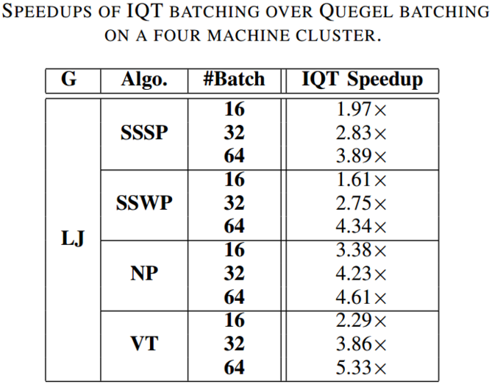
IQT vs Quegel [PVLDB’16]
Quegel
Shares computation and memory resources via pipelining
It’s query-centric
Does not integrate the messages
MultiLyra
Maintains the vertex-centric
Integrates the messages of all queries
Scales in performance with batch size
A Mazloumi et al, MultiLyra: Scalable Distributed Evaluation of Batches of Iterative Graph Queries
19 / 21

Slide 22
Conclusions
The number of communication are the most dominant performance obstacle
MultiLyra evaluates a batch of graph queries efficiently by amortizing communication and synchronization costs of query evaluation across multiple queries. (Maximum speedups ranging form 3.08x to 5.55x)
With applying further optimizations (i.e., FQT, IQT, and Reuse), the maximum speedup boosts to ranging from 7.35x to 11.86x
Removing unnecessary work which is done by already-finished or inactive queries (maintaining the status of each queries)
By reusing the pre-computed results of high-centrality vertices
A Mazloumi et al, MultiLyra: Scalable Distributed Evaluation of Batches of Iterative Graph Queries
20 / 21
Notes:
The number of communication is more important than the size of communication
The number of communication are the most dominant performance obstacle
MultiLyra evaluates a batch of graph queries efficiently by amortizing communication and synchronization costs of query evaluation across multiple queries. (Maximum speedups ranging form 3.08x to 5.55x)
With applying further optimizations i.e., FQT, IQT, and Reuse, the maximum speedup boosts to ranging from 7.35x to 11.86x
Removing unnecessary work which is done by already-finished or inactive queries

Slide 23
Thank you,
For your time and attendance.
A Mazloumi et al, MultiLyra: Scalable Distributed Evaluation of Batches of Iterative Graph Queries
21 / 21

