Slide 1
An Analysis of Using Many Small Programs in CS1
By: Joe Michael Allen¹, Frank Vahid^{1,2}, Alex Edgcomb^{1,2}, Kelly Downey¹, and Kris Miller¹ ¹Computer Science and Engineering, University of California, Riverside ²zyBooks, Los Gatos, California
This work was supported by the U.S. Dept. of Education (GAANN fellowship) and by Google.
OLP
MSP

Slide 2
Traditional: One Large Program (OLP) each week
Solution 50-200 lines
Long spec
OLP

Slide 3
Many Small Programs (MSPs) each week
Our approach: 5-7 MSPs
Solution 10-50 lines each
Short spec
Benefits
Less intimidating
Pivot if stuck
Build confidence, more practice
OLP
MSP
Enabled by new auto-graders
Easy to create / Instant feedback
zyLabs (zyBooks): ~30 min create lab

Slide 4
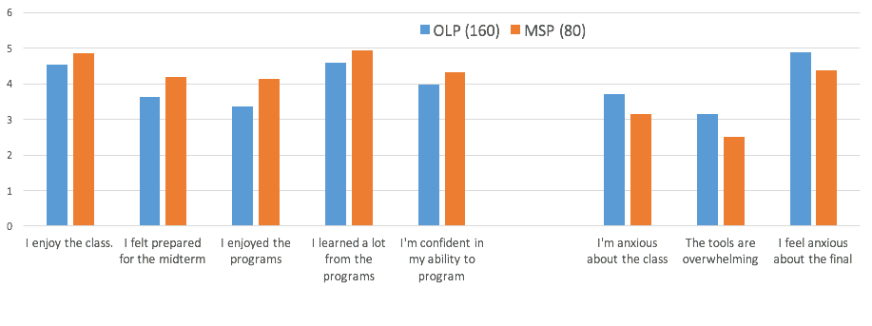
Previous: MSP impact on confidence/stress?
ASEE 2018 J.M. Allen, F. Vahid, K. Downey, A. Edgcomb. Weekly Programs in a CS1 Class: Experiences with Auto-graded Many-small Programs (MSP). ASEE Annual Conference, 2018. (Best paper nominee)
Controlled study, Spring 2017 UCR's CS1
1 MSP section (~80 students), 2 OLP sections (~160 students)
7 MSPs/week, 70 pts total, 50 pts full credit
Higher is better
Lower is better
All p values < 0.02

Slide 5
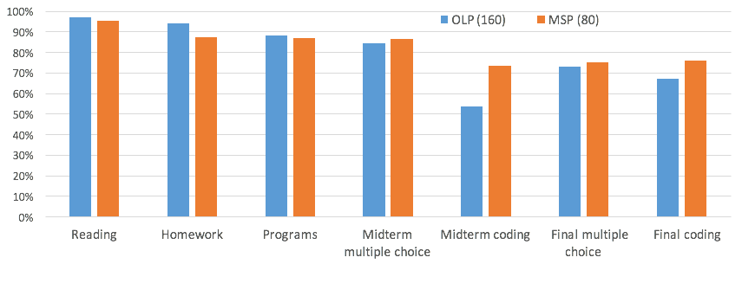
Previous: MSP impact on learning?
ASEE 2018 J.M. Allen, F. Vahid, K. Downey, A. Edgcomb. Weekly Programs in a CS1 Class: Experiences with Auto-graded Many-small Programs (MSP). ASEE Annual Conference, 2018. (Best paper nominee)
p < 0.001
p < 0.003
Dozens of schools have switched to MSPs, many using UCR's MSPs
(orig C++, now Java, Python, and C), reporting good results.

Slide 6
This paper: Answer common questions about MSP use
Time spent per week?
Time spent per MSP?
When do students start on MSPs?
What % completed each day?
Given full-credit threshold, do students complete more?
Do students switch among MSPs when stuck?
Are MSPs used to study for exams?
Won't MSP CS1 students do poorly in an OLP CS2?
"Fact-finding mission"

Slide 7
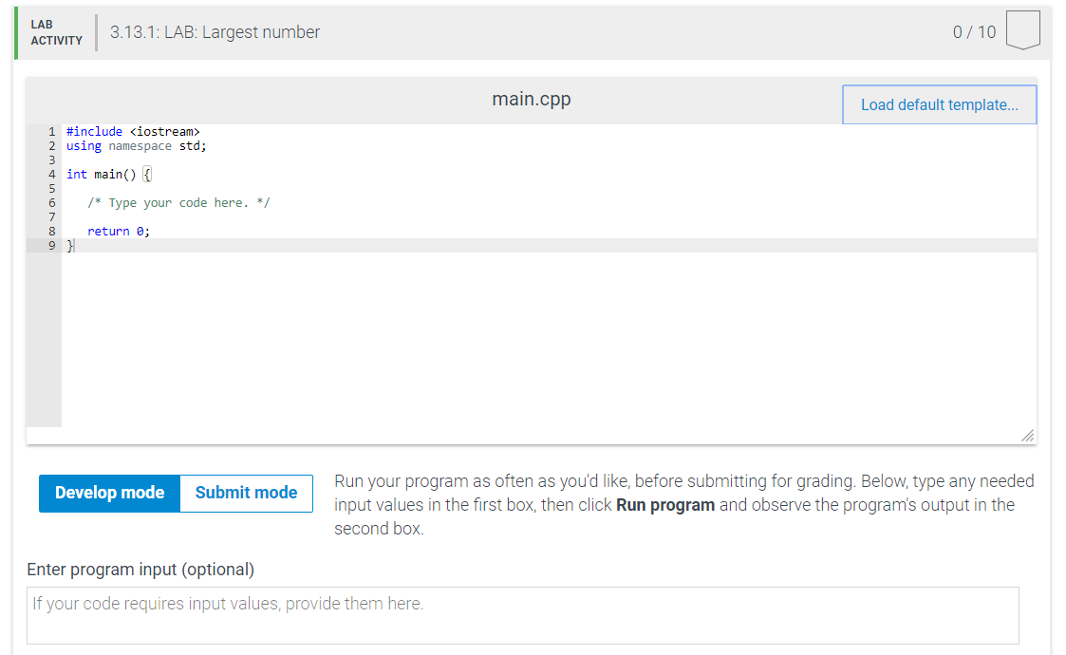
Data
UCR CS1 Spring 2017 MSP section: 76 students
Used zyLabs from zyBooks
Collected:
48,000 develop runs
16,000 submissions
Each has labID, userID, score, maxScore, time/date,
labID |userID|score|maxScore|timestamp

Slide 8
Q: How much time do students spend working on
MSPs each week?

Slide 9
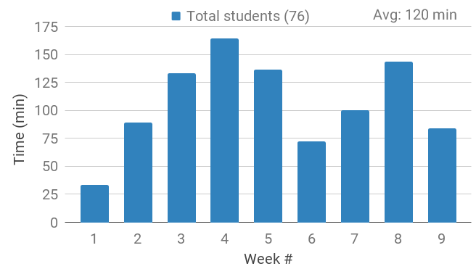
A: At least 120 min / week
NOTE: Underestimate.
Students with 0 subs or 0 time excluded. Avg is for weeks 2-8.

Slide 10
A: About 17 min per MSP
Average time spent per MSP - 17 min / MSP (weeks 1 and 9 excluded).

Slide 11
Q: How many days before the due date do
students start working on MSPs?

Slide 12
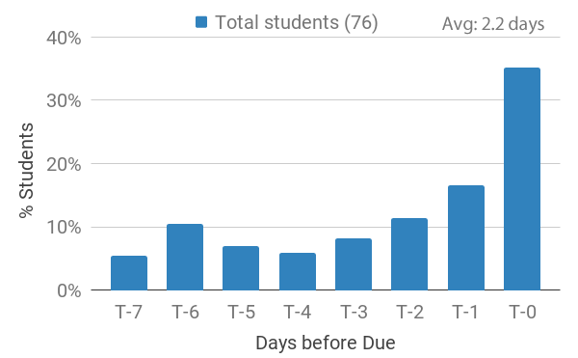
A: MSPs started 2.2 days before due date

Slide 13
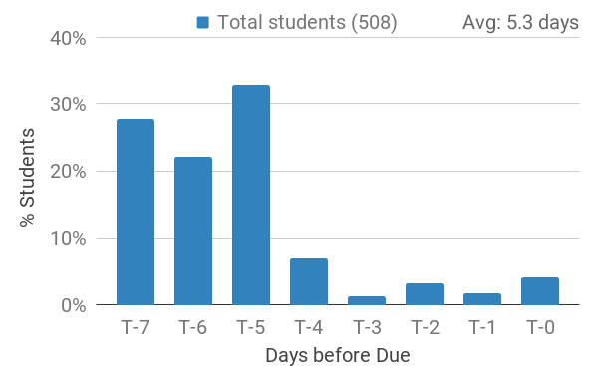
A: But with policy adjustment in Fall, started 5.3 days before

Slide 14
Q: What % of MSPs do students complete each day?

Slide 15
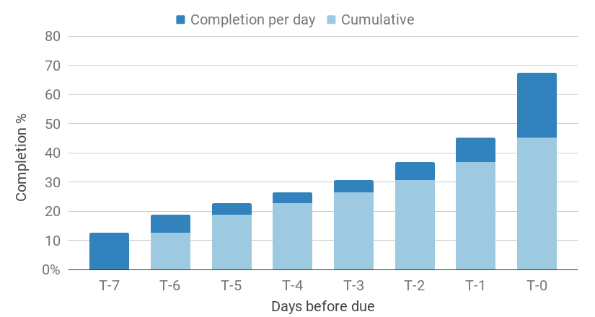
A: Completed ~10% of MSPs each day

Slide 16
Q: Given a full-credit threshold, do students complete more MSPs than required?

Slide 17
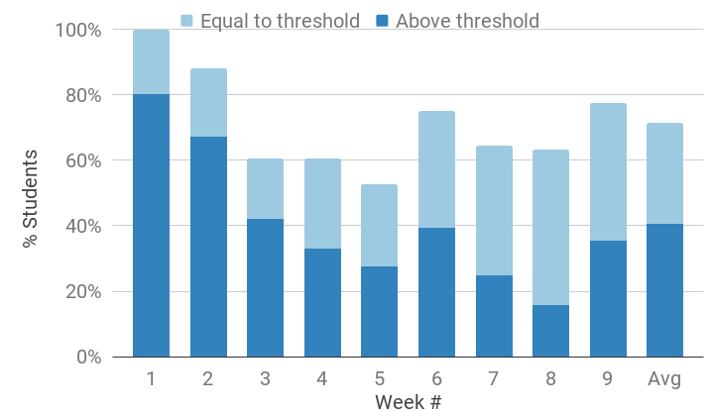
A: 40% of students completed more MSPs than required
No extra credit given for exceeding full-credit threshold

Slide 18
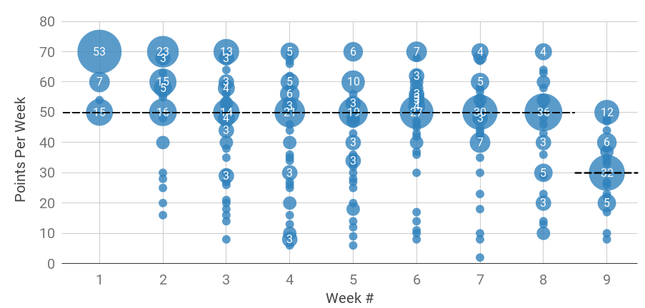
A: Total points per week -- Avg 13 more points
Bubble size represents number of students. Dashed line indicates full-credit threshold. Students who scored 0 points for a week excluded.

Slide 19
Q: Do students switch among MSPs when stuck?
"Pivot"

Slide 20
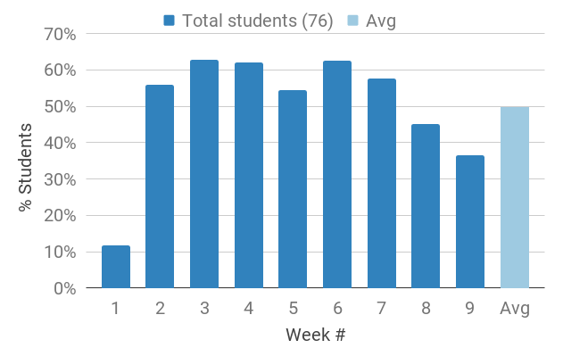
A: Each week, 50% of students pivoted (avg. 1.3 pivots)

Slide 21
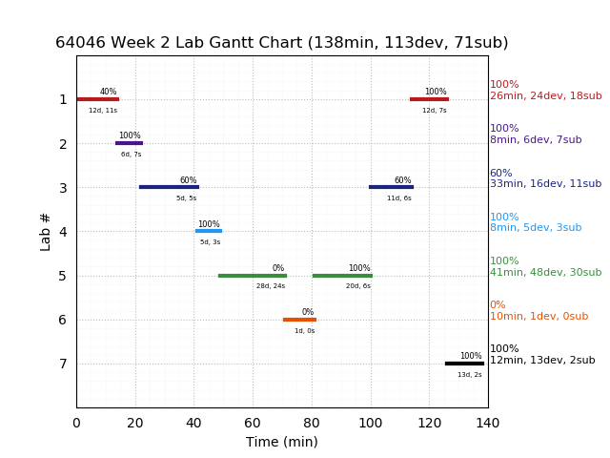
Pivot Pattern

Slide 22
Q: Do students use MSPs to study for exams?

Slide 23
A: Yes, students use MSPs to study for exams
Total number of students | 76
Total number of MSPs | 61
% of students that used MSPs to study for the midterm | 38%
% of students that used MSPs to study for the final | 37%
% of students that used MSPs to study for either exam | 54%
% of MSPs that were used to study for the midterm | 97%
% of MSPs that were used to study for the final | 90%
% of MSPs that were used to study for either exam | 98%

Slide 24
Q: Won't MSP CS1 students do poorly in an OLP CS2?

Slide 25
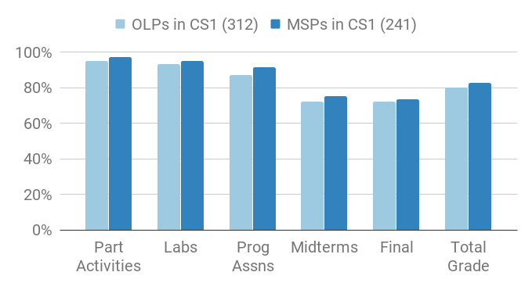
A: MSP CS1 students do fine in an OLP CS2, in fact slightly better
CS2 scores

Slide 26
Student Quotes
I enjoy the class a lot and I actually enjoy completing the more difficult labs. I would just like to use my laptop in-class to take notes.

Slide 27
Conclusion
OLP
MSP
Students make good use of MSPs
Previous work: +confidence/stress, +coding
Sufficient time
Started early
Completed more than necessary
Pivoted to help selves when stuck
Used MSPs to study for exams
And, MSP CS1 students do just as well as OLP CS1 students in an OLP CS2.
Many schools switching to auto-grading and MSPs, more analysis desirable...
CS2 scores

