Slide 1
Coral: An Ultra Simple Language for Learning to Program
Alex Edgcomb¹, Frank Vahid^{1,2}, Roman Lysecky^{1,3}
¹zyBooks
²Computer Science and Engineering, University of California, Riverside
³Electrical and Computer Engineering, University of Arizona
rlysecky@ece.arizona.edu
https://corallanguage.org

Slide 2
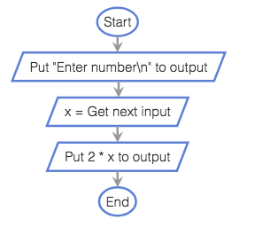
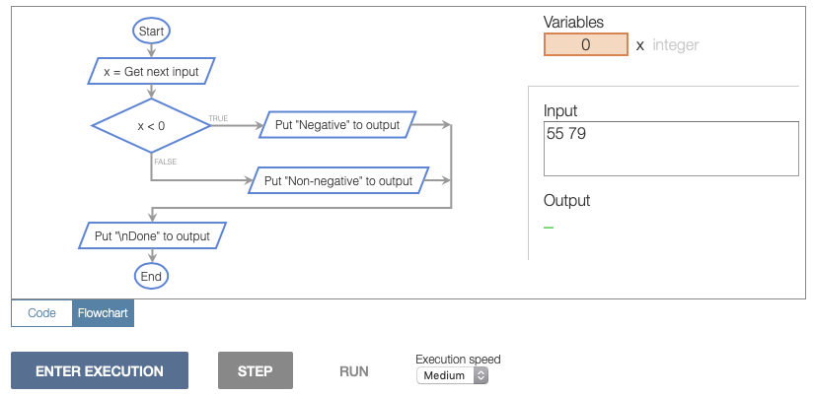
Coral language
Coral language
Designed with equivalent code and flowchart versions
Educational simulator designed hand-in-hand with language
Designed specifically for learning core programming concepts:
input/output, variables, assignments, expressions, branches, loops, functions, and arrays
Prepares students to transition to an industry language
Coral: Code view
integer x
Put "Enter number" to output
x = Get next input
Put 2 * x to output
Coral: Flowchart view

Slide 3
Why a new language?
CS0/CS1 courses often use an industry language
Created and used by professional programmers (e.g., Java, C++, Python)
Industry languages designed for professionals, not learners
Complex features can confuse new learners
One long-time instructor put it: "even Python has its ‘Gotchas’"
public class Demo {
public static void main(String[] args) {
Scanner scan = new Scanner(System.in);
System.out.println("Enter number: ");
int num = scan.nextInt();
scan.close();
System.out.println(2 * num);
}
}
Java concepts needed: classes, methods, parameters, …
x = int(input('Enter number: '))
print(2 * x)
Python concepts needed: functions, type casting, dynamic typing, …

Slide 4
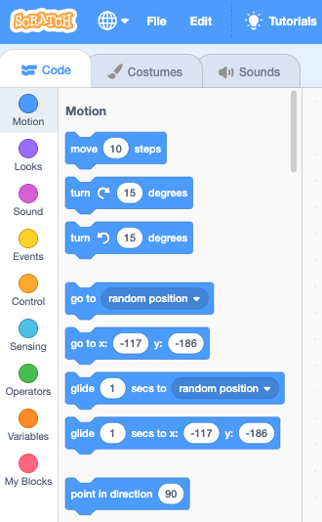
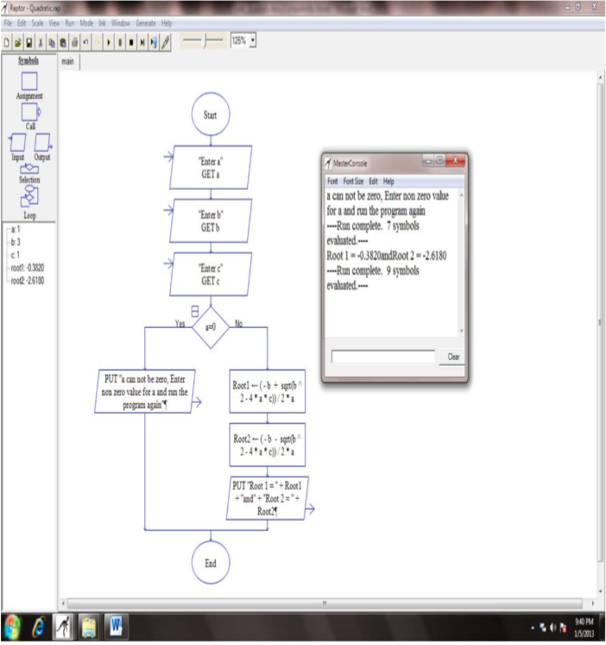
Why a new language?
Block-based programming (Scratch, Snap, Alice)
Simpler syntax visualized via connecting patterns
Helps attract people to computing, especially in K-12
Instructors/students often want a more serious feel for college courses
No direct lead into industry languages
Raptor flowchart languages
Flowchart visually captures the execution model
Helpful if a standard layout is used, but that's not typical
Windows-only application
No direct lead into industry languages

Slide 5
Coral language and simulator

Slide 6
Coral: Student usage data
Early data on student usage
ENGR 1: Required 1-unit Freshmen course on professional development
Fall 2018, 159 students
Assigned 28 sections (across 4 chapters) from the Programming Concepts zyBook that uses Coral
Reading: Consists of brief text, animations, and learning questions
Homework: Consist of about 5 levels that get incrementally harder and provide immediate feedback via auto-grading
Assignment | Due | Time Spent (Avg. Minutes)
Chapter 1: Basic input and output Chapter 2: Integer and floating-point variables | Middle of term | 80
Chapter 3: if-else and operators in branching Chapter 4: while and for loops | 5 days later | 88
Survey 1: Prior programming experience
Survey 2
Survey 3

Slide 7
Coral: Student survey responses
Survey Question | End of ch 2 | End of ch 4
The flowcharts were easy to understand. | 0.9 | 0.9
The code was easy to read and understand. | 0.8 | 0.9
The code was easy to write. | 0.3 | 0.2
I often struggled with writing the code for the challenge activities. | -0.3 | -0.1
I think I like programming. | 1.2 | 1.6
I often was frustrated by issues with the programming language. | 0.4 | 0.6
Both code and flowchart views easy to understand
Minor amount of frustration
Liked programming
Range: -3 (Strongly disagree) to +3 (Strongly agree)

Slide 8
Conclusions
Coral is an ultra-simple language that focuses on teaching core programming concepts
Coral may be useful in CS0 to give students a flavor for programming, or CS1 to teach core programming concepts before transitioning to an industry language
In 168 minutes, students with a little programming experience independently learned Coral
Students tended to report that the flowcharts and code were easy to read
Coral has been used by about 2600 students at 21 universities
Coral: Code view
integer x
Put "Enter number" to output
x = Get next input
Put 2 * x to output
Coral: Flowchart view

Slide 9
Thank you, Gracias, Danke, Merci, Tak, ありがとう, Kittos, Dank je, Grazie
https://corallanguage.org

