Slide 1
Weekly Programs in CS 1: Experiences with Many-Small Auto-Graded Programs
by Joe Michael Allen, Frank Vahid, Kelly Downey, and Alex Edgcomb
Dept. of Computer Science and Engineering
University of California, Riverside
This work was supported by the U.S. Dept. of Education (GAANN fellowship) and by Google
Notes:
Welcome everyone
Introduce self (name, year, university, research)
Introduce paper (name)
Thank U.S. Dept of EDU and Google
Hello everyone and welcome. My name is Joe Michael Allen and I am a 3rd year Ph.D. student studying Computer Science at the University of California, Riverside. My research revolves around STEM education with a focus on improving introductory programming courses, known as CS1. Today I will be presenting our paper: “Weekly Programs in CS1: Experiences with Many-Small Auto-Graded Programs.” Before I begin, I want to thank the U.S. Department of Education and Google for supporting this work.

Slide 2
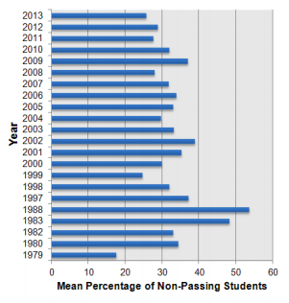
Problem
Mean Percentage of Non-Passing Students in CS1
CS 1 issues:
High student stress
Student dissatisfaction
Academic dishonesty
Low grades
High non-passing rates
~ 30% non-passing rate over the past 30 years
~28%
~55%
~18%
Watson, C. and Li, F. “Failure Rates in Introductory Programming Revisited, ” iTiCSE, 2014 http://dro.dur.ac.uk/19223/1/19223.pdf%3FDDD10%2Bd74ks0%2Bdcs0lw
Notes:
Problem: high non-passing rate of students in CS1
Watson & Li - Durham University – 161 institutions, 51 countries, over 30 years
Explain chart – 1979, 1988, 2013
Issues: high stress, dissatisfaction, dishonesty.
Lead to low grades, ultimately resulting in drop/fail
Become one more statistic in the 30%
Hello everyone, welcome and good morning. Today, I want to talk to you about a problem that we are facing in computer science; that problem being a high non-passing rate of students in CS1 courses. Let’s look at a worldwide study done by Watson and Li at Durham University in 2016. This study analyzed 161 CS1 courses taught in 51 different countries over the past 40 years to try and answer the question, “What are the pass and fail rates for introductory programming courses?” This chart summarizes their findings. The x-axis represents the failure rate percentage and the y-axis represents the year. For example, if we look at 1979 the average failure rate of CS1 students was about 18%. In 1988, the average failure rate was at a staggering 55%. Finally, more recently in 2013, the failure rate was about 28%. This study concluded that over the past 30 years, the average non-passing rate of CS1 students worldwide has remained the same at around 30%. Some other issues we see in CS1 are as follows. First, students in CS1 tend to have high stress when it comes to programming. As we know, programming is difficult and most students are not aware of the discipline they need to succeed, especially for an introductory course. Students are dissatisfied either with the course for being so challenging, or with themselves for struggling more than they expected. If a student is struggling, they are more likely to cheat; resulting in higher academic dishonesty. These issues I have just mentioned, along with a variety of others, lead to low grades in the course. These low grades ultimately result in students either dropping or failing the course; becoming one more statistic in the 30% of non-passing students.

Slide 3
Goal
Improve the student experience
Improve satisfaction & happiness
Without worsening performance
Problem: Weekly programming assignments
Large part of the students’ experience
Key source of issues – student struggle/fear
Notes:
Goal – fix problems by improve students’ experience
Improve satisfaction and happiness
Cannot worsen academic performance
Focused on weekly programming assignments
Large part of CS1 -> large part of student experience
Our goal with this research is to fix these problems and improve the student experience in CS1 courses. More specifically, we aim to find a solution that improves both student satisfaction and happiness without worsening academic performance.
We decided to focus on improving weekly programming assignments because they form a large part of the curriculum and thus form a large part of the student experience. These programming assignments can be large and daunting – causing students to struggle and fear continuing in the course.

Slide 4
Traditional approach
Wk 6 Program: Authoring assistant
(1) Prompt the user to enter a string of their choosing. Store the text in a string. Output the string. (1 pt) (2) Implement a printMenu() method, which outputs a menu of user options for analyzing/editing the string, and returns the user's entered menu option. Each option is represented by a single character.
If an invalid character is entered, continue to prompt for a valid choice. Hint: Implement Quit before implementing other options. Call printMenu() in the main() method. Continue to call printMenu() until the user enters q to Quit. (3 pts) (3) Implement the getNumOfNonWSCharacters() method. getNumOfNonWSCharacters() has a string as a parameter and returns the number of characters in the string, excluding all whitespace. Call getNumOfNonWSCharacters() in the main() method. (4 pts)
(4)…(5)...(6)...(7)...
One-large program:
One-large assignment each week
Teach many concepts
Multiple parts
More text
Larger solution size
One-large program
3.5 hrs
Notes:
Sample program - Lots of text & Many parts
Common characteristics: teach many concepts, multiple parts, lots of text, more solution LOC
CS1 - First time programming
Some do small into large
We may have a better approach
Traditionally, students are given weekly large programming assignments that look something like this. On the left, I have a sample program that is being used in CS1 courses around the nation. The first thing you may notice is the large amount of text. Second, you may see that there are many parts to solving this problem, in fact, this example has seven or more. This sample program shows some common characteristics that most large programming assignments share: they may teach many concepts at once, they may ask multiple parts, they tend to have lots of text, and by nature, they typically require a larger solution size; being 50 to 100 lines of code, or more. Keep in mind, this is all relative to a CS1 course; so, this may be the first time that students have ever programmed before. Also note, that some instructors may give smaller warm-up programs that lead up to assigning a large program like this one. Though these large assignments are currently the standard, we may have a better approach.

Slide 5
Our solution - MSPs
Many-small programs
Multiple small programs each week
Teach one specific concept
Short
Minimal text
Smaller solution size
Total time about same (~3.5 hrs)
One large program
Benefits
Less intimidating
Simpler labs build confidence
Pivot if stuck
More practice
Many-small programs
Made possible by program auto-grader (with easy web-based creation so any instructor or TA can create/modify)
Notes:
Our solution – MSPs
Opposed to large, characteristics: teach one specific concept, short, minimal text, smaller solution sizes
7 MSPs, but time spent was the same
Additional: less intimidating, build confidence, pivot, more practice
Possible thanks to zyBooks
Our solution is called Many Small Programs, or MSPs. Instead of assigning students one-large programming assignment each week, MSPs allow us to assign multiple small assignments each week instead. Opposed to large programming assignments, some characteristics of MSPs are that they teach one specific concept at a time, they are short in size, they have concise text, and they tend to have smaller solution sizes. For this experiment, we decided to give students seven MSPs each week. Though students had multiple MSPs each week, the total time spent on programming assignments remained about the same at three-and-a-half hours. Some additional benefits of MSPs are that they are less intimidating due to their small size. Next, the first couple MSPs tend to be simpler, providing students a sense of confidence when tackling later, more challenging problems. Furthermore, students can pivot, or move from problem to problem, if stuck instead of getting frustrated and leaving the problem incomplete. Finally, students get more practice on new concepts since they have more assignments to complete. All this was made possible by a program auto-grader that is published by zyBooks. This auto-grader is web-based and incredibly easy to use – allowing both the instructor or the TA to create and modify new MSPs.

Slide 6
MSPs - prompt
Notes:
Let’s take a look at some components
Prompt – detailed and concise
Title & few sentences – explanation, sample input/output, hints
Now that I have introduced you to MSPs, let’s take a look at some of the components that make up each MSP. The first part is the prompt. Notice that the prompt is detailed and concise. Each MSP usually has two/three sentences that consist of a problem explanation, sample input and output, and sometimes a hint for the students.

Slide 7
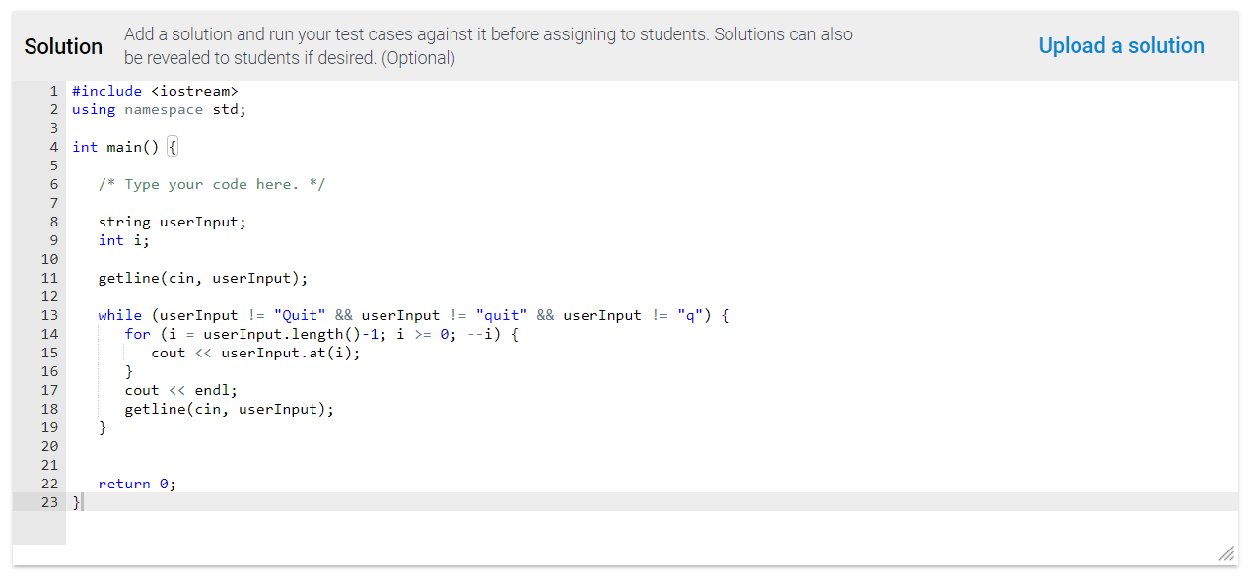
MSPs - solution
Notes:
Solution code
23 lines of code
61 new MSPs – average 34 lines of code
Next, is the solution code. You’ll see in this example that our solution is 23 lines of code including whitespace. In fact, we created 61 new MSPs in total for our experiment and on average, each solution is 34 lines of code including whitespace.

Slide 8
MSPs – lines of code (LOC)
Min LOC: 9
Average LOC: 34
Max LOC: 90
LOC
wk1
wk2
wk3
wk4
wk5
wk6
wk7
wk8
wk9
MSPs per week
Notes:
Scatter plot
X axis – MSP split by week & Y axis - LOC
Average 15-50 lines of code, few outliers
Weeks go on, average solution size gets larger
Min: 9, Max: 90, Average: 34
Here is a scatter plot to help visualize the lines of code for each MSP solution. The x-axis represents each MSP, divided by the week number, and the y-axis represents the number of lines of code. Most of our solutions are between 15 and 50 lines of code with a few outliers. If you look, as the weeks get higher, the average solution size increases as well. Our smallest solution has 9 lines of code, our largest solution has 90 lines of code, and the average over 61 MSP solutions is 34 lines of code, all including whitespace.

Slide 9
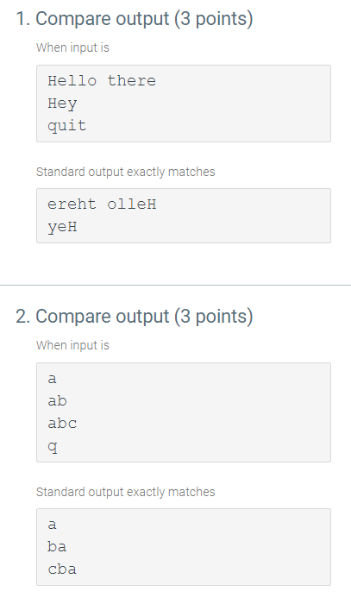
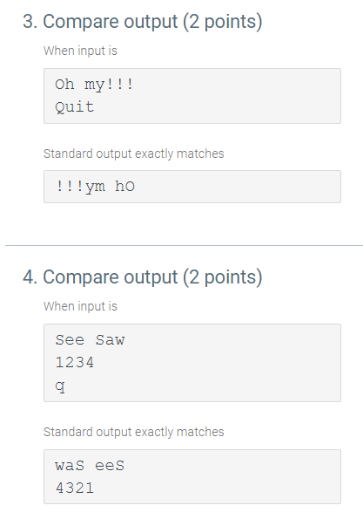
MSPs – test cases
Test cases:
10 points per MSP
Input/output tests
Unit tests
Notes:
Set of test cases – assess student solution
10 points for each MSP – 3/4 test cases on average
Input/output test cases and unit tests
Finally, each MSP has a set of test cases used to assess a student’s submission and award the necessary points. For our experiment, we assigned 10 points for each MSP spread out across three to four test cases on average. The two types of test cases we used are input/output tests and unit tests.

Slide 10
Experiment
CS 1 course at UCR during Spring 2017; 10 week quarter
One large program
Same online textbook
Same topics taught each week
Same midterm & final
Many-small programs
2 sections; 166 students
Instructor 1
No collaboration
Programming assignments: 25%, Midterm: 20%
1 section; 77 students
Instructor 2
Yes collaboration
Programming assignments: 15%, Midterm: 30%
Notes:
Experiment at UCR during Spring 2017
Control group on left, Experimental group on right
Differences: section size, instructor, collaboration, grade scale
Similarities: textbook, topics, exams
I would now like to introduce our experiment. We conducted our study on a CS1 course at the University of California, Riverside during the 10-week, Spring 2017 quarter. The control group on the left had students use the one-large program a week model and the experimental group on the right had students use MSPs. The control group consisted of two class sections with 166 students and the experimental group consisted of one class section with 77 students. Furthermore, the control group did not allow collaboration on weekly programming assignments while the experimental group did allow collaboration on MSPs. Lastly, there was a slight difference in the class grading scale; the details can be seen on the slide. Everything else in the class was kept the same including using the same book, teaching the same topics each week, and using the same midterm and final exams.

Slide 11
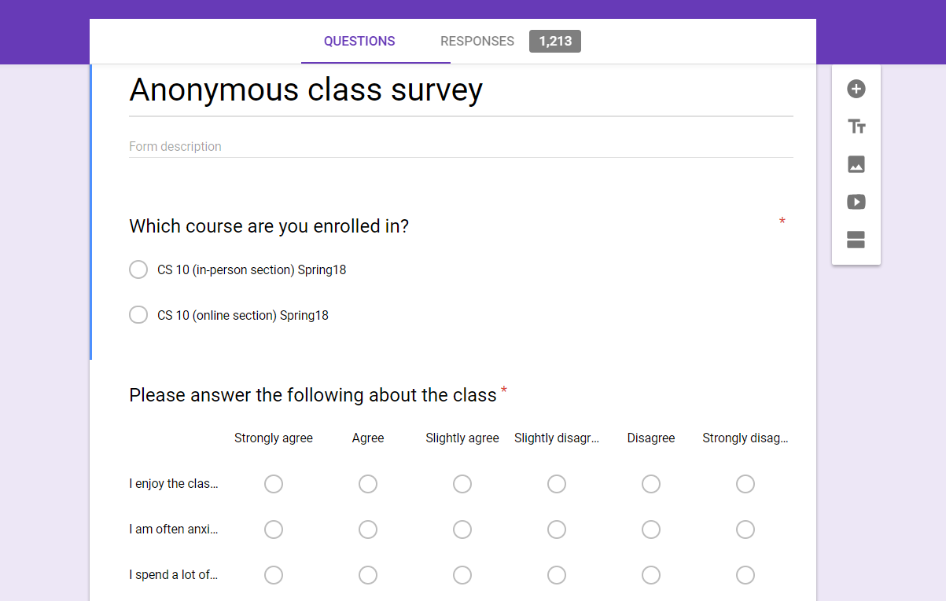
Methods
Student surveys (“Stress survey”)
Ask students about their experience
Given week 8 of the quarter
18 questions: Strongly agree (6) to Strongly disagree (0)
Bonferroni correction: Conservative interpretation of p-value
Student outcomes
Participation, Challenge, and Programming Activities, Midterm, Final, Total grade
Bonferroni correction
Notes:
Methods – two ways to gather data
Survey – week 8 - 18 questions (Strongly agree - strongly disagree)
Survey - random order, high/low response to be favorable
Bonferroni correction to be conservative and stop us from overstating our findings
Static analysis – grades at the end of quarter (read categories)
Our methods included two ways of gathering data. First, we had students fill out a survey during week 8 of the quarter to get feedback on their satisfaction. The survey contained 18 questions with responses ranging from Strongly agree to Strongly disagree. To avoid bias, the questions were asked in random order and phrased such that some required a higher response to be favorable and others required a lower response to be favorable. Note, we used the Bonferroni correction to be conservative and stop us from overstating our findings. Second, we performed a static analysis of student grades at the end of the quarter. We looked at student grades for participation, challenge, and programming activities, the midterm, the final, and the total grade in the class. We also used the Bonferroni correction with this analysis.

Slide 12
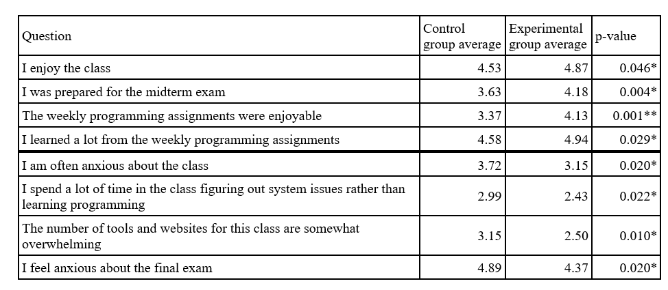
Results – Experimental group indicated better student satisfaction
*Note these questions are not presented in the same order they were given to the students
Notes:
Explain columns, question, average, check-mark, p-value
Reminder, questions not asked in this order
First questions higher is more favorable and experimental all favorable
Most happy to see “weekly more enjoyable…” since this is MSP change
Last questions lower is more favorable and experimental all favorable
Experimental had favorable for almost all 18 questions – refer to paper
First, let’s look at the results from the student surveys. For this talk, I only included the questions where the p-value is under 0.05. The first column indicates the question asked, for example “I enjoy the class.” The next column is the average for the control group. This value is out of 6 which represents Strongly Agree – so for this first row a value of 4.53 would indicate that the average response from the control group was “Agree.” The third column is the average for the experimental group. You will notice that there is a check-mark listed in the experimental group column; this is to provide a quick visual for which group has a more favorable response. In this case, the experimental group agrees more favorably with the statement “I enjoy the class.” The final column represents the p-value we calculated. As a reminder, these questions are not presented in the same order they were given to the students. These next questions are phrased such that a higher value is considered favorable. For all these questions, the experimental group had a more favorable response. We were most excited to see a more favorable response for the question, “The weekly programming assignments were enjoyable” since this directly relates to our change to MSPs. The last four questions here are phrased such that a lower response is considered favorable. You’ll see that the experimental group had a more favorable response to each question as well. In fact, we found that the experimental group had a more favorable response for almost all 18 questions in the survey. If you are interested in seeing the responses for all 18 questions, you can see the results shown in the full paper.

Slide 13
Results – Experimental group did not perform worse – in fact, did better
Notes:
Grade analysis – explain x and y axis
Blue column is control, red column is experimental
Experimental outperformed or performed same in all categories
Focus on left circle: midterm coding, and right circle: final coding
Most important part of programming course is programming
Programming assignments – same %, experimental better – indication MSPs positive impact on coding performance
Finally, I will share the results of our static grade analysis. The x-axis represents the grading categories we looked at: participation activities, midterm, final, etc. and the y-axis represents the grade percentage. The blue columns represent the control group and the red columns represent the experimental group. Looking at the chart, you can see that the experimental group either outperformed the control group or performed similarly in all categories. I really want to focus on the two circled categories: the one on left being the coding grade percentage on the midterm and the one on the right being coding grade percentage on the final. We are very happy to see that the experimental group using MSPs outperformed the control group in these two categories especially. To us, the most important part of a programming course is the programming; so if MSPs are helping students perform better on the coding portions of exams, we consider this change a success. We can see this even clearer by looking at the columns for the programming assignment grade percentages. Both the control group and the experimental group performed almost the same, yet as I just mentioned the experimental group performed much better on the coding portion of the exams.

Slide 14
Conclusion – MSPs improved the students’ experience
Students are happier
Student performance did not worsen
In fact performed better
Additional work: One-year results, CS2 performance, MSP variations
This work was supported by the U.S. Dept. of Education (GAANN fellowship) and by Google
Notes:
Changing does improve students’ experience
Students are happier
Students perform better
UCR CS1 has switched – 4 instructors and 1500 students
Shared with universities around the country – numerous have switched
Additional work – one year student stull do well, CS2 students do fine, variation with small + large
Happy with results and look forward to more research & fine-tuning
THANK YOU
To wrap up, based on the data we collected and the results I have shown, we can conclude that changing the traditional one-large programming assignment each week to MSPs did improve the students’ experience. Students self-reported being happier and more satisfied with the course as we saw from the results of our survey. In addition, based on the static grade analysis we saw that student performance did not worsen, and in fact improved in a couple of categories. Based on the results of this study, all CS1 courses at the university of California, Riverside have switched to using MSPs. To add some perspective, UCR’s CS1 course is taught by four instructors and serves around 1,500 students a year. In addition, we have shared these results with many other universities around the country and have already seen numerous universities decide to switch their CS1 curriculum to using MSPs. Since the publication of this work, we have done further analysis. For instance, students continue to perform well in CS1 after one year of using MSPs. We started analysis on student performance in CS2 after using MSPs and have seen that students are performing just fine, and in fact slightly better. Additionally, we have introduced some variations to MSPs such as combining mostly smaller programs with a few larger assignments. We are very happy to see such positive results from this work and we look forward to further analysis. Thank you.

Slide 15
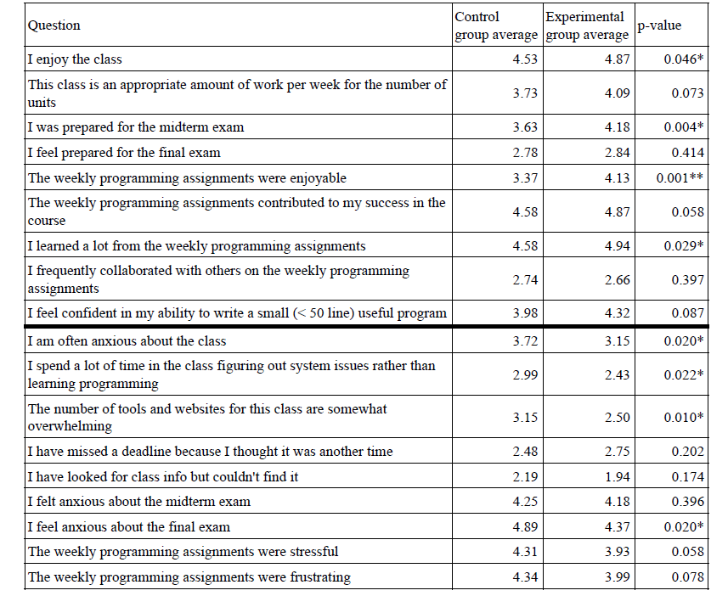
Notes:
Stress survey
Black is significant under Bonferroni
Blue is approaching significance (p < 0.05)
Convert to % using online tool and Experimental preferred 9% more
To remind you, the questions where higher is favorable are on top, and where lower is favorable are on the bottom. This slide shows the results of what we call the “Stress Survey.” Listed on here are all the questions that were asked to the students. The top half of the table are the questions where a higher number is better and the lower half of the table are the questions where a lower number is better. This black arrow indicated our p-value is lower than the Bonferroni correction thus it is interpreted as significant. These other blue arrows are nearing significance of 0.05, but are not considered significant under the bonferonni correction. Overall, on a lot of these questions, the experimental MSP group answered better. In fact, after z-scoring our values, we converted our final p-value into a percentage and found that the experimental group preferred the class 9% more than the control group.

