Slide 1
Serious Games for Building Skills in Introductory Algebra and Computer Science Courses
by Joe Michael Allen, Frank Vahid*, Shayan Salehian, Alex Edgcomb*
Dept. of Computer Science and Engineering
University of California, Riverside
*Also with zyBooks
Funding from the U.S. National Science Foundation (grant #1542851) and the U.S. Dept. of Education (GAANN fellowship)
Notes:
Introduce self and research
Give thanks to co-authors, NSF, and USDoE

Slide 2
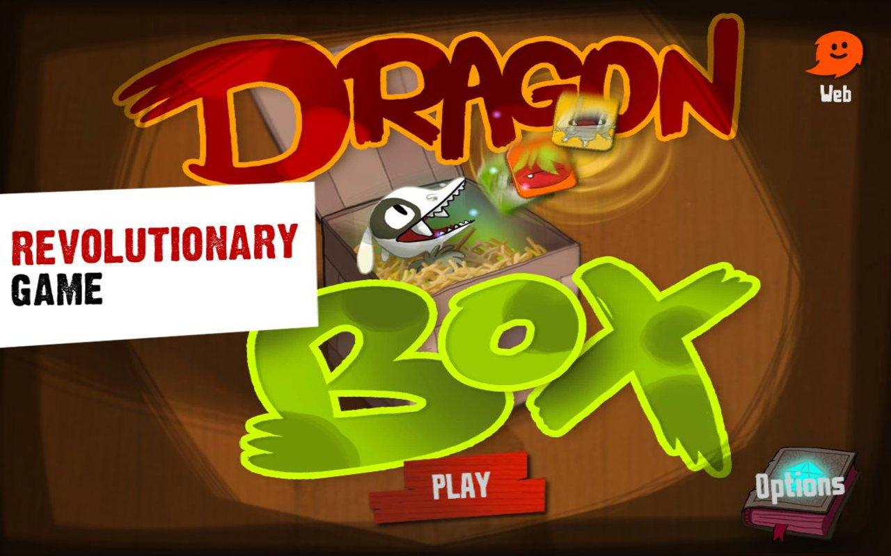
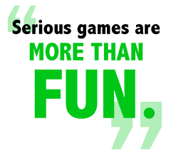
What are serious games?
Serious games are games with a purpose beyond entertainment
Notes:
Explain what serious games are
Use dragobBox

Slide 3
Serious games: taxonomy
Making games a "snap" with Stencyl: a summer computing workshop for K-12 (SIGCSE 2014, Jiangjiang Liu et al.)
Life’s a Game and the Game of Life: How Making a Game Out of it Can Change Student Behavior (SIGCSE 2013, Adrienne Decker and Elizabeth Lane Lawley)
Surveyed SIGCSE papers from 1995 - 2016
Notes:
Introduce the slide
Explain the categories and examples
To understand the current state of games used in computer science education, we surveyed SIGCSE conference paper submissions over the past 20 years. Paper submissions needed to meet the following criteria for inclusion in our survey: 1) the title of the paper included either “game” or “games” and 2) the paper was not about a panel discussion taking place at the conference. In total, we found 68 papers to include in our survey. From the papers surveyed, we created a taxonomy to categorize the common ways that games were being used for education. We recognized three major categories 1) Game development, 2) Adding gamification to the classroom, and 3) Game playing. Figure 1 summarizes these findings.

Slide 4
Game playing
Using Game Days to Teach a Multiagent System Class (SIGCSE 2004, Leen-Kiat Soh)
Design Insights into the Creation and Evaluation of a Computer Science Educational Game. (SIGCSE 2016, Britton Horn et al.)
Notes:
Explain the categories and examples – couldn’t find skill building
Explain what we are doing
Piano Example

Slide 5
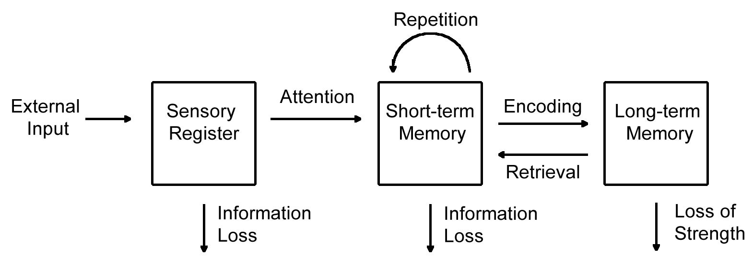
Memory model - short-term to long-term memory
Atkinson and Shifrin’s Memory model
Jonathan Sweller’s Cognitive Load Theory
Notes:
Introduce Sweller
Explain figure
Why this matters to game design

Slide 6
Solve for x game

Slide 7
Exponent multiply game

Slide 8
Interval notation game
Notes:
For Figure 5, note that we're making a CS version
Set notation => Boolean algebra

Slide 9
For-loop game

Slide 10
If/else conditional game

Slide 11
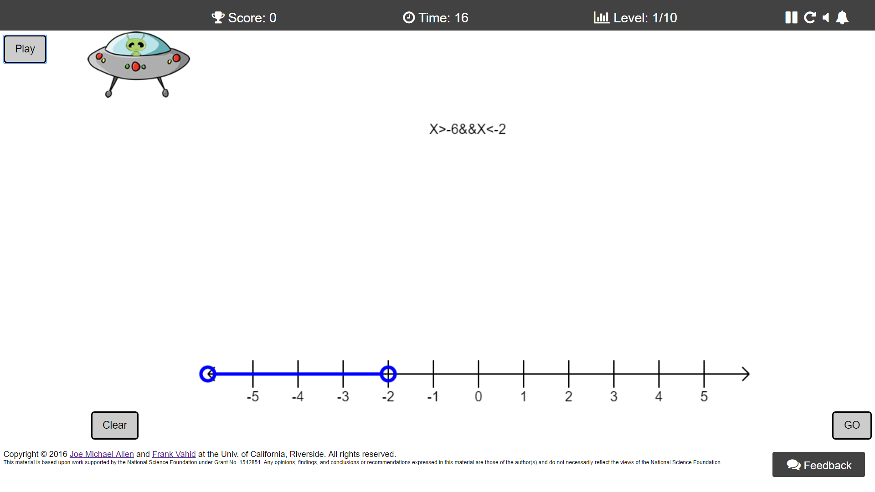
Future games
Set notation (CS-oriented)
Nested for-loops
Interval counting

Slide 12
Discussion
Preliminary Survey Data:
Ways to improve the games
“The game made me more focused on completing the game rather than understanding the concept”
Challenges
How to collect improvement data
Difficult to conduct a controlled study

Slide 13
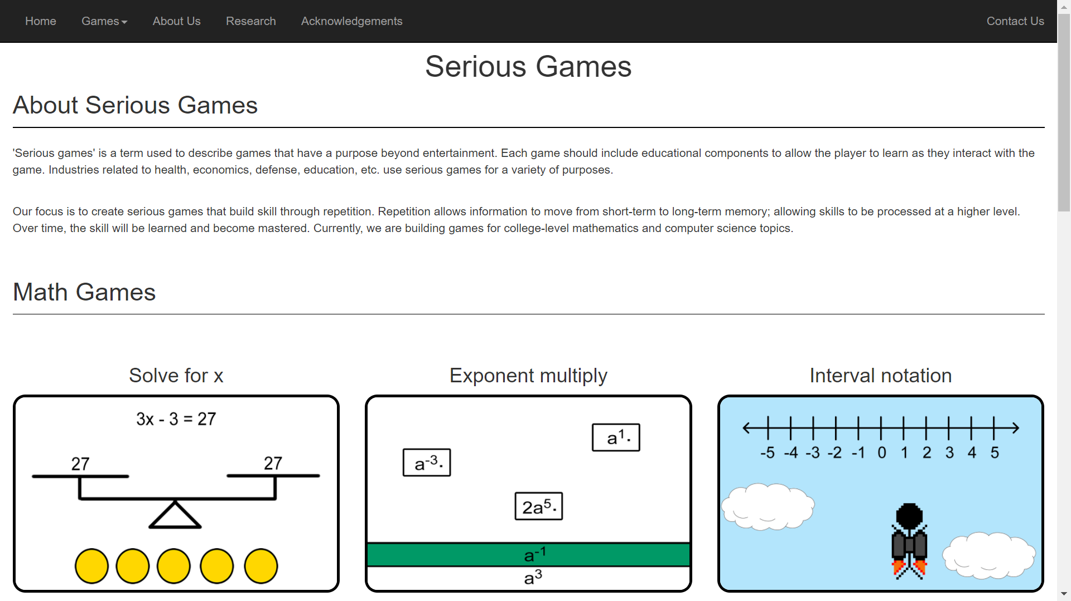
Our Website
http://www.cs.ucr.edu/~vahid/seriousGames/

