Slide 1
Zyante’s zyBooks: Animated Interactive Learning
Frank Vahid
Prof. of Computer Science and Eng.
Univ. of Calif., Riverside
Zyante co-founder

Slide 2
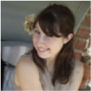
STEM attrition
X
X
X
X
X
X
X

Slide 3
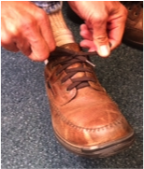
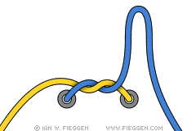
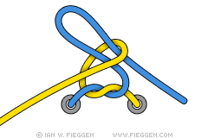
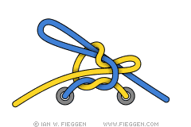
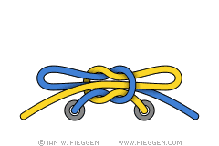
Teaching/learning mismatch
Standard Shoelace Knot
Also known as the "Around The Tree" shoelace knot" or simply the "Bowknot", this is probably the most common method for tying shoelaces: Make a loop with one end, wrap the other end around and pull a loop through the "hole" in the middle.
Step 1: Tie a Left-over-Right Starting Knot as shown, then make the right (blue) end into a "loop" by simply doubling it back onto itself.
Step 2: Take the left (yellow) end and pass it around to the right, going behind the right loop.
Step 3: Continue the left (yellow) end around the right loop to end up in front.
Step 4: Start to feed the left (yellow) lace into the "hole" that has just been made.
Step 5: With the left (yellow) lace now through the "hole", grab hold of both loops and start to pull the knot tight.
Step 6: Continue pulling on the loops until the knot is firmly tied.
You have to DO it to learn it.
zyBook
From scratch, for the web
http://www.fieggen.com/shoelace/standardknot.htm

Slide 4
zyBook: “Less text, more action”

Slide 5
zyBook: “Less text, more action”

Slide 6
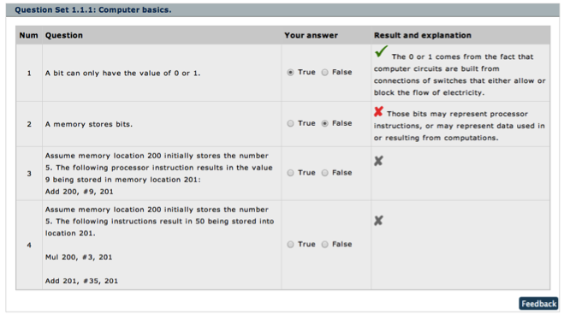
Questions: Better than reading

Slide 7
Questions: Better than reading

Slide 8
Tools: Master the hard stuff

Slide 9
Tools: Master the hard stuff

Slide 10
Animation: “worth 5,000 words”

Slide 11
Animation: “worth 5,000 words”

Slide 12
Integrated tools/homework: No “tool shock”

Slide 13
Integrated tools/homework: No “tool shock”

Slide 14
Teachers “see” their class Can configure content

Slide 15
Teachers “see” their class Can configure content

Slide 16
Users can contribute content

Slide 17
Users can contribute content

Slide 18
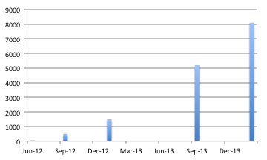
Struck a chord 2 NSF SBIR P1 grants, 2 seed rounds (Dec’13, Mar’14)
zyBooks
Sep’14
20,000 students
100 univs.
Also used in UT’s EdX MOOC
Prog. in C
60 univs
Prog. in C++
Prog in Python 2
Prog in Python 3
# students
40 univs
Prog. in Java
Prog. in MATLAB
Prog. Embedded
Systems
8 univs
3 univs
Discrete Mathematics
1univ
$35-$50
Controlled studies: 2x student engagement, 15%-60% learning outcome improvement – especially initially-weaker students (ASEE’14), cross-semester significantly fewer Fs/Ds

Slide 19
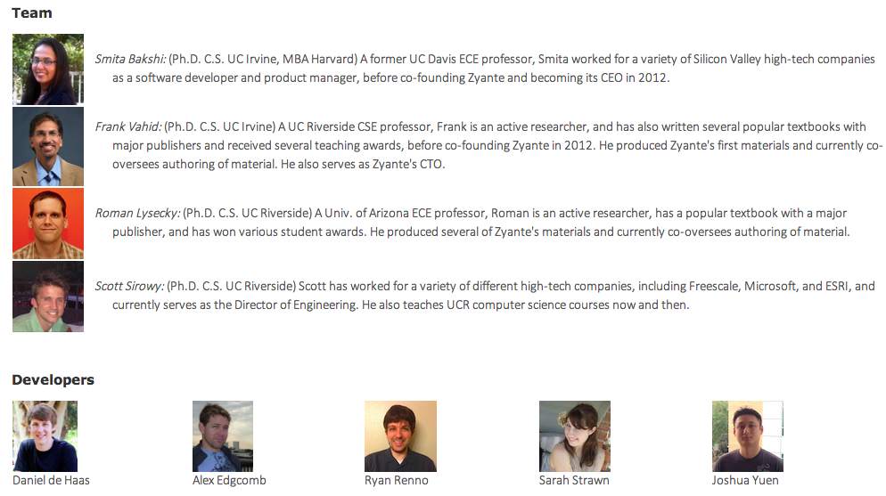
Zyante.com
2014
8 new zyBooks (inc. publisher deals)
More tools
Curated crowdsourcing

