Slide 1
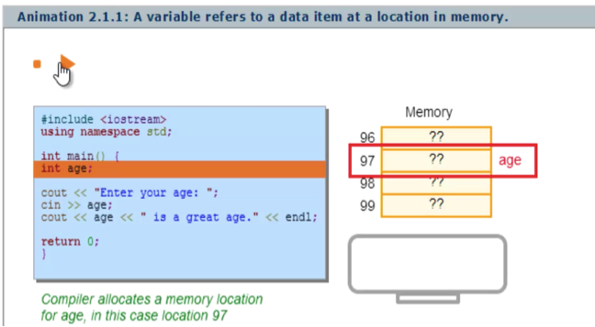
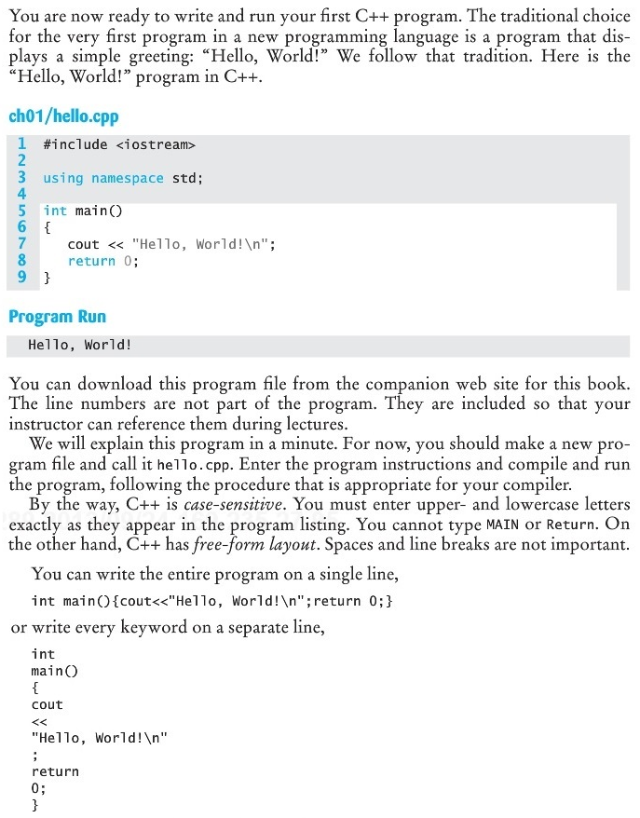
Effectiveness of Interactive Web-Native Content vs. Online Textbooks
Alex Edgcomb and Frank Vahid
Dept. of Computer Science and Engineering
University of California, Riverside
Also with Zyante Inc. (www.zyante.com)

Slide 2
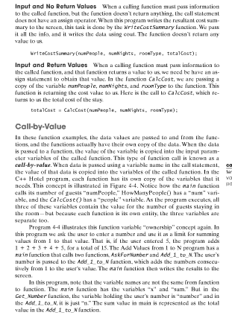
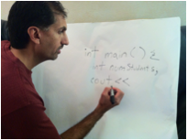
Traditional use of the web: e-books and video
X

Slide 3
Interactive tools teach key topics

Slide 4
Interactive tools teach key topics
Notes:
One of the powerful features of the web is to distribute info efficiently. That’s how folks have viewed online material; that’s a good feature: don’t have to carry a book and quick to jump around info. However, that’s not dramatically different.
Power of web is interactivity.

Slide 5
Notes:
Self-assessment with question sets

Slide 6
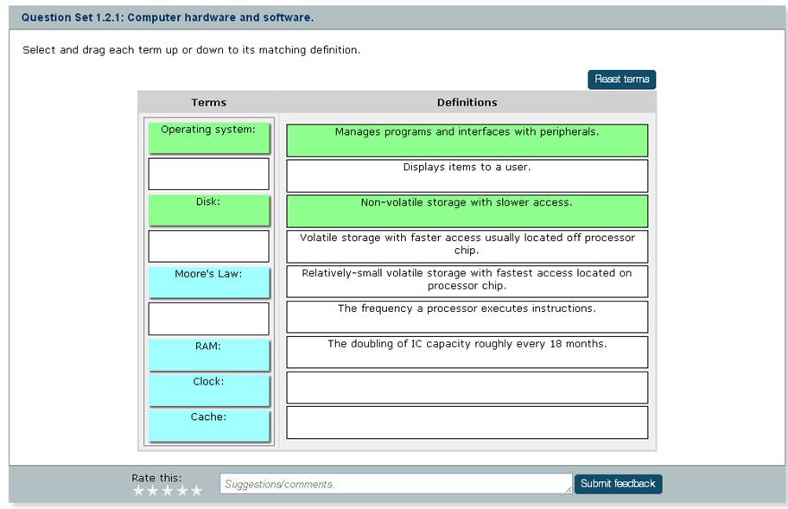

Slide 7
Self-assess with embedded question sets

Slide 8
Visualize the hard concepts

Slide 9
Visualize the hard concepts

Slide 10
Student activity completion
55%

Slide 11
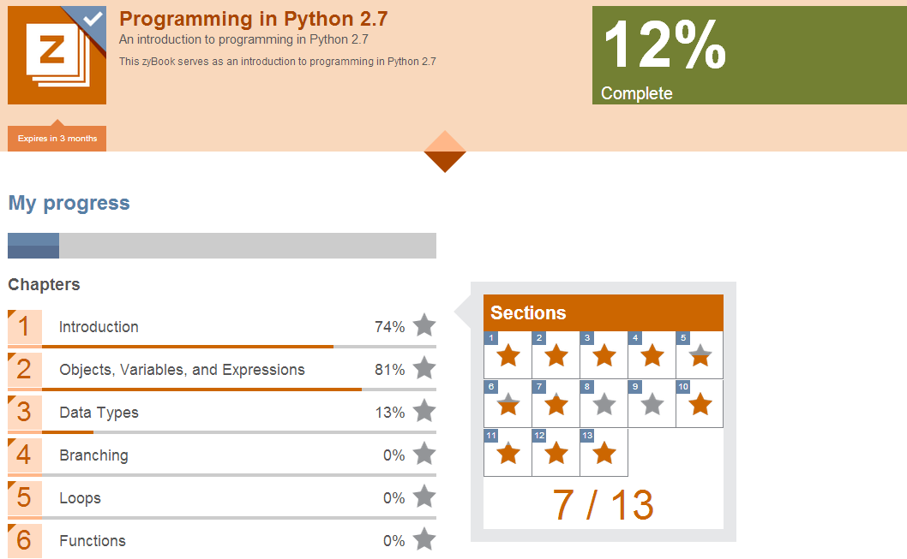
Zyante in 100 schools, 20k students
182,000+ interactive tools used
460,000+ animations viewed
9,094,000+ questions answered
Professor formed company. Materials released in 2013.

Slide 12
Is interactive content effective?
Traditional static textbook
vs.
Interactive web native

Slide 13
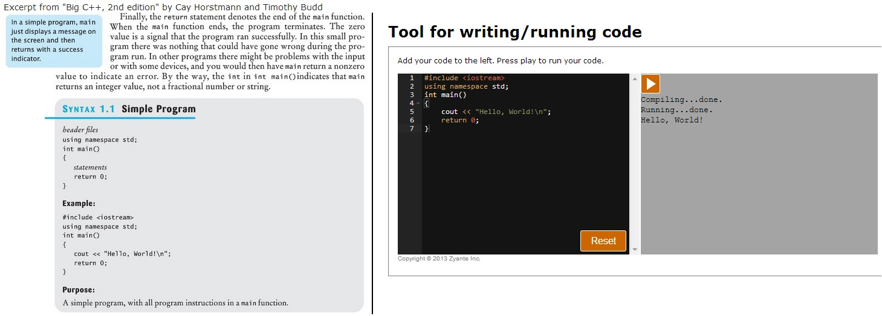
Traditional static textbook w/ easy-to-use IDE
Big C++, 2nd Edition by Cay Horstmann and Timothy Budd
1,236 words
Notes:
2 seniors in CS evaluated latest C++ traditional textbooks in English. Both concluded Big C++ was the best.

Slide 14
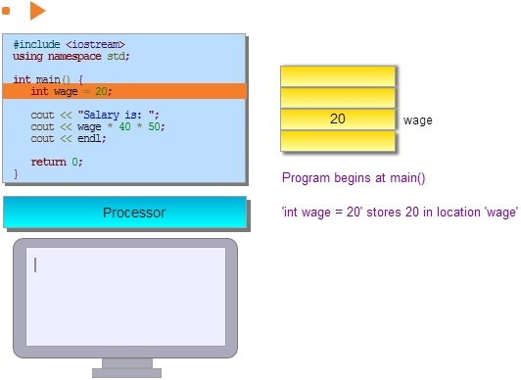
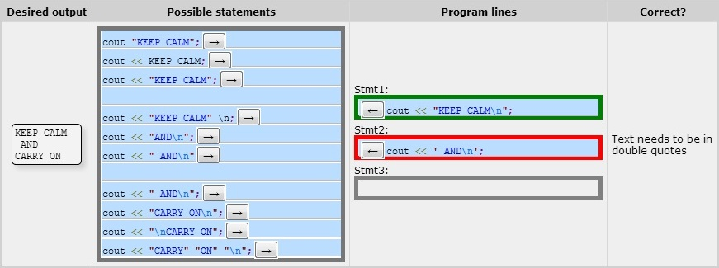
Interactive web-native content: Zyante’s Programming In C++
769 words, 1 animation, 3 programming exercises, and 3 questions sets

Slide 15
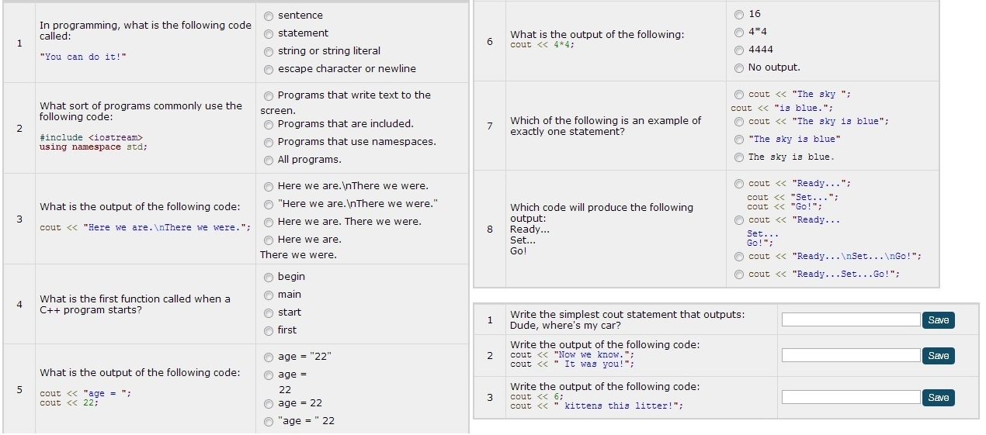
Experimental setup
Post-lesson quiz
136 participants
72% freshmen
79% engineers
Work as long as like
Work alone
Pre-lesson quiz, lesson on basic output in C++, then post-lesson quiz

Slide 16
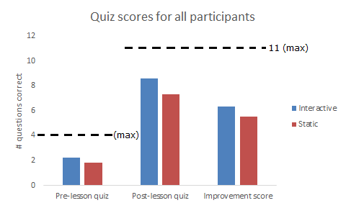
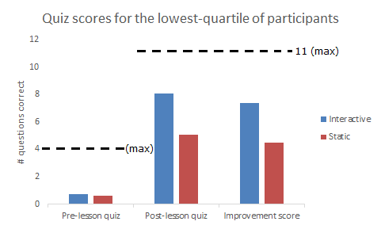
Results: Interactive vs. static content
64% better
(p-value < 0.001)
16% better
(p-value = 0.016)
(68)
(18)
(60)
(16)
Students chose to spend more time (p-value < 0.001) with interactive (17.5 mins) than static (9.4 mins).
Notes:
Student quote on interactive content: “I can learn by practicing and auto-check the answer right away … the activities are fun and helpful.”

Slide 17
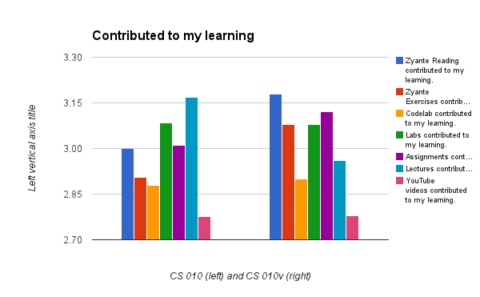
Further analysis
UCR book purchase rate:
70% buy required textbook
98% buy required zyBook
8.6% more students pass
(p-value = 0.08)
Traditional
textbook
Zyante
(133)
(124)
Notes:
Does this exist… (I’ve asked Adam Koehler for his class stats)
How many student’s actually purchase textbook?
UCR – 70% don’t buy textbook
Zyante – 98% buy zyBook?

Slide 18
Conclusion
Porting paper textbooks to electronic form, even with some additional tool support, may be a poor approach
Writing new material natively for the web, using less text and more interactive items, may enable higher learner engagement and more-effective learning

