Slide 1
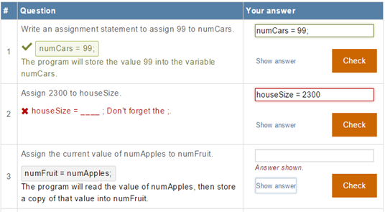
Getting Students to Earnestly
Do Reading, Studying, and Homework in an Introductory Programming Class
Alex Edgcomb^{1,2}, Frank Vahid^{2,1}, Roman Lysecky^{3,1}, and Susan Lysecky¹
¹zyBooks, Los Gatos, California
²Computer Science and Engineering, University of California, Riverside
³Electrical and Computer Engineering, University of Arizona
Notes:
1994: Read before class

Slide 2
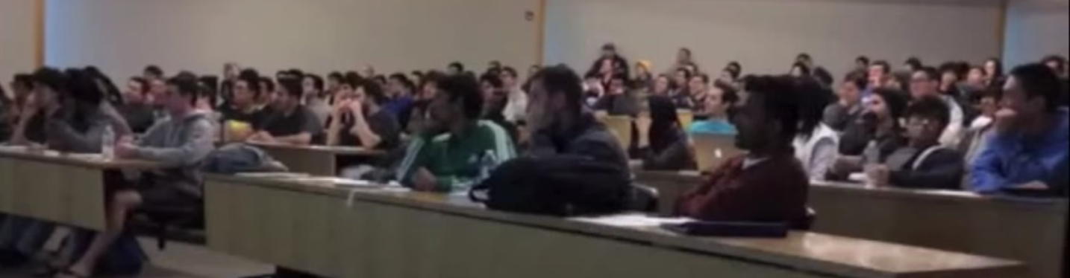
“Read before class” problem

Slide 3

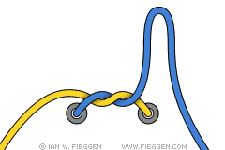

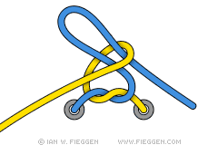

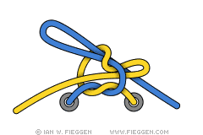
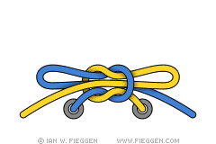
“Read before class” problem
Standard Shoelace Knot
Also known as the "Around The Tree" shoelace knot" or simply the "Bowknot", this is probably the most common method for tying shoelaces: Make a loop with one end, wrap the other end around and pull a loop through the "hole" in the middle.
Step 1: Tie a Left-over-Right Starting Knot as shown, then make the right (blue) end into a "loop" by simply doubling it back onto itself.
Step 2: Take the left (yellow) end and pass it around to the right, going behind the right loop.
Step 3: Continue the left (yellow) end around the right loop to end up in front.
Step 4: Start to feed the left (yellow) lace into the "hole" that has just been made.
Step 5: With the left (yellow) lace now through the "hole", grab hold of both loops and start to pull the knot tight.
Step 6: Continue pulling on the loops until the knot is firmly tied.
10%: Homeworks
10%: Quizzes
20%: Programs
30%: Midterm
30%: Final
http://www.fieggen.com/shoelace/standardknot.htm
Not everything is best taught by text/figure explanations
Points are the currency of academia
Notes:
Book author tools: text, figures.
Works, but grossly inefficient.
Consider how inefficient for tying shoe. Imagine how inefficient for many subjects, especially in science, engineering, technology, and math.
(Recall an EE prof colleague explaining “PID control” to me, understood every word, really clear. Came home to write it up, completely stuck).

Slide 4


Slide 5
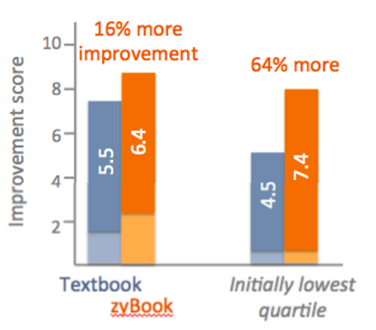
Interactive vs. static
p < 0.001
14%
Letter grade
14%
Exams
8%
zyBook
Textbook
128 students, randomly-assigned: zyBook or textbook
86% more time voluntarily spent, 24% more self-reported engagement
3 universities, 4 courses, 2000 students, only change: switch to zyBook
A. Edgcomb, F. Vahid. Effectiveness of Online Textbooks vs. Interactive Web-Native Content, Proceedings of ASEE Annual Conference, 2014 (best paper).
A. Edgcomb, F. Vahid, R. Lysecky, A. Knoesen, R. Amirtharajah, and M.L. Dorf. Student Performance Improvement using Interactive Textbooks: A Three-University Cross-Semester Analysis, Proc. of ASEE Annual Conference, Seattle, June 2015. (best paper)

Slide 6
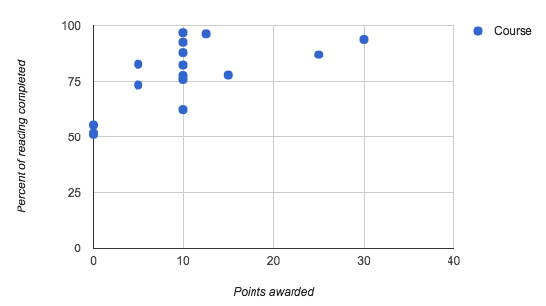
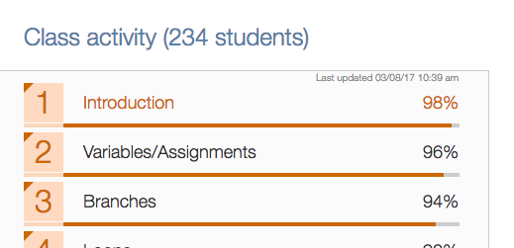
Students do the “reading”. 5-10 pts sufficient
16 courses
1,508 students

Slide 7
Won’t students cheat the system to get their points?

Slide 8
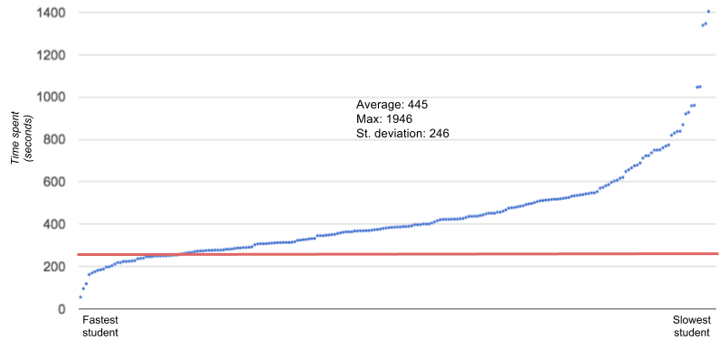
Most students spend an earnest amount of time reading (130 students; 1 book section)

Slide 9
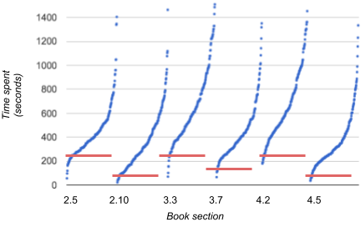
Most students spend an earnest amount of time reading

Slide 10

Short answer: Earnest vs not earnest
Earnest
Not earnest
Highly earnest: 80%-100%
Moderately earnest: 60%-80%
Moderately unearnest: 40%-60%
Highly unearnest: 20%-40%
Cheating the system: 0% -20%

Slide 11
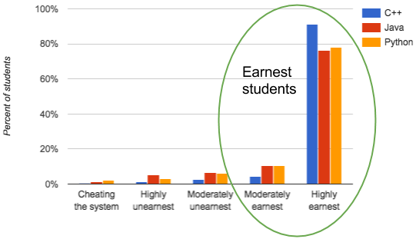
Short answer questions:
Most students were earnest
723 students
3 courses/universities

Slide 12
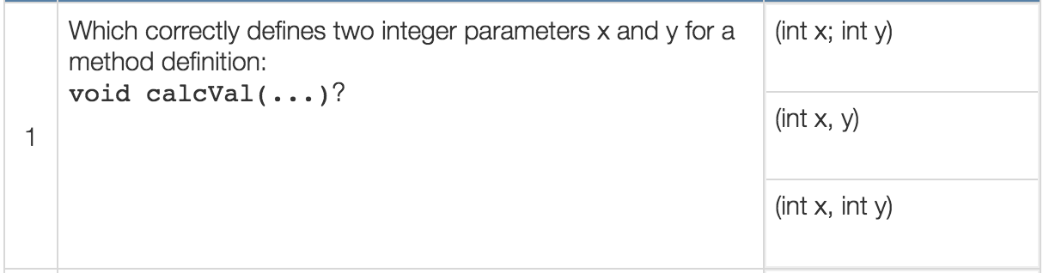
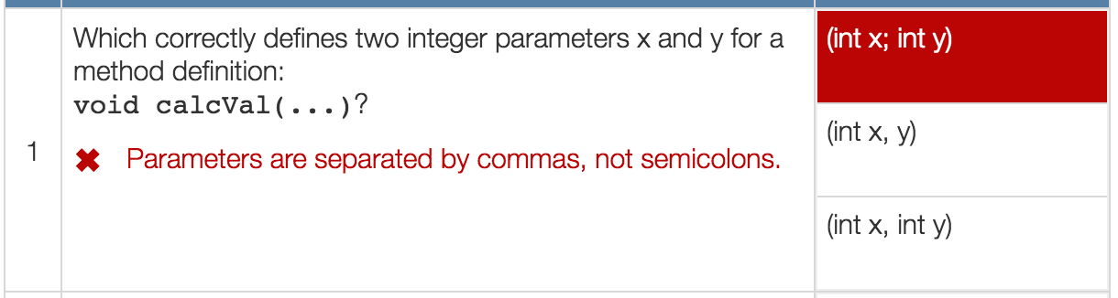
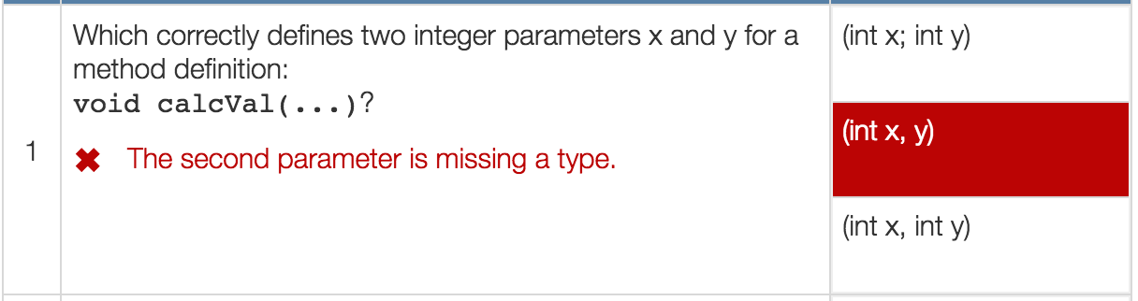
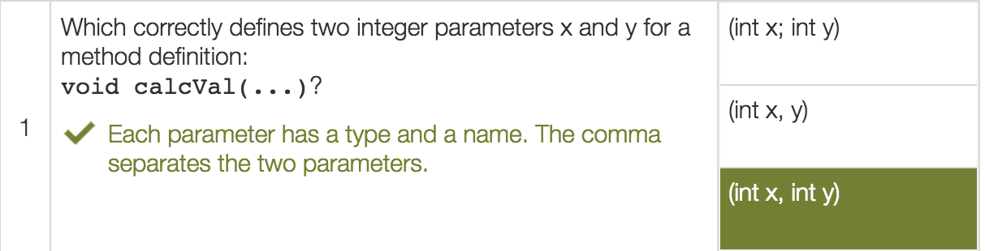
Multiple choice: Earnest vs not earnest
Earnest: 3+ seconds
Not earnest

Slide 13
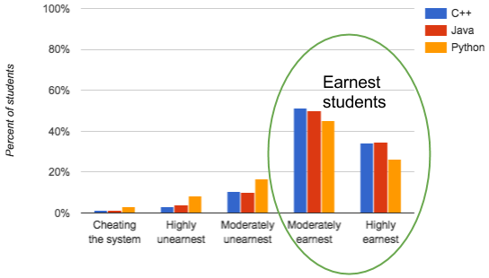
Multiple choice questions:
Most students were earnest
723 students
3 courses/universities

Slide 14
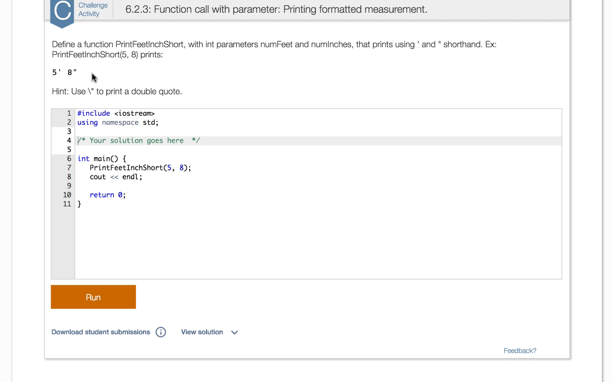
Integrated homework system

Slide 15
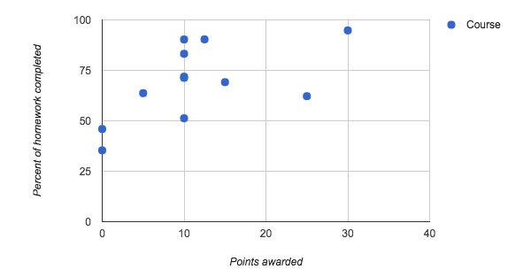
Homeworks: Completion rates vs. course points
11 courses
1,280 students

Slide 16
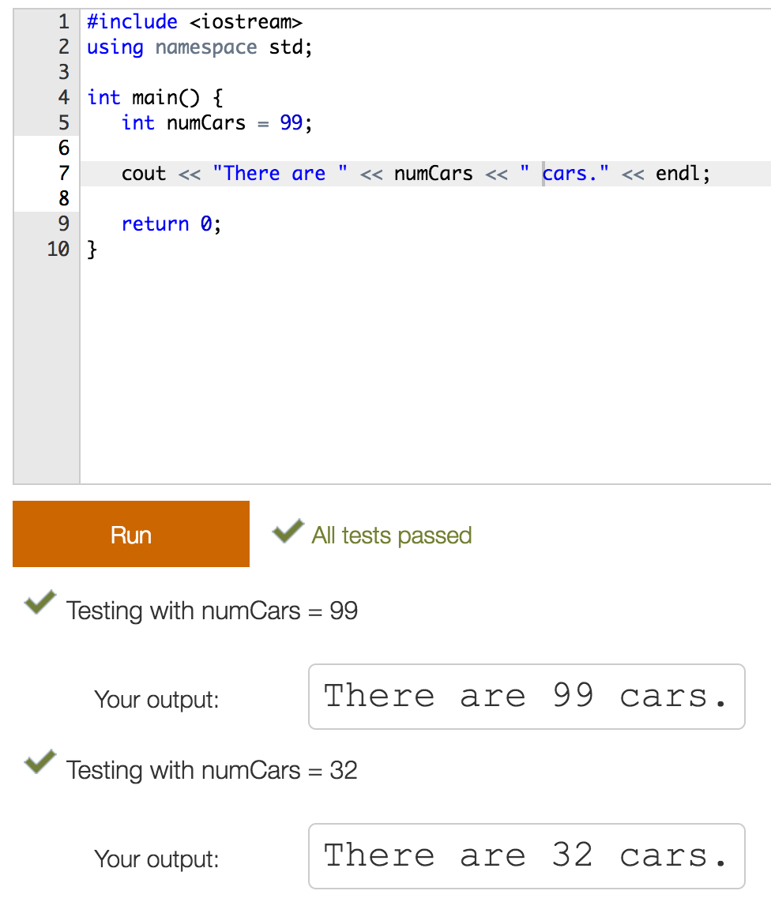
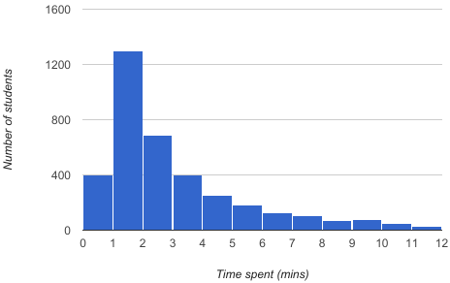
Programming homework: Most students spend an appropriate amount of time
262 students across 16 homework problems

Slide 17
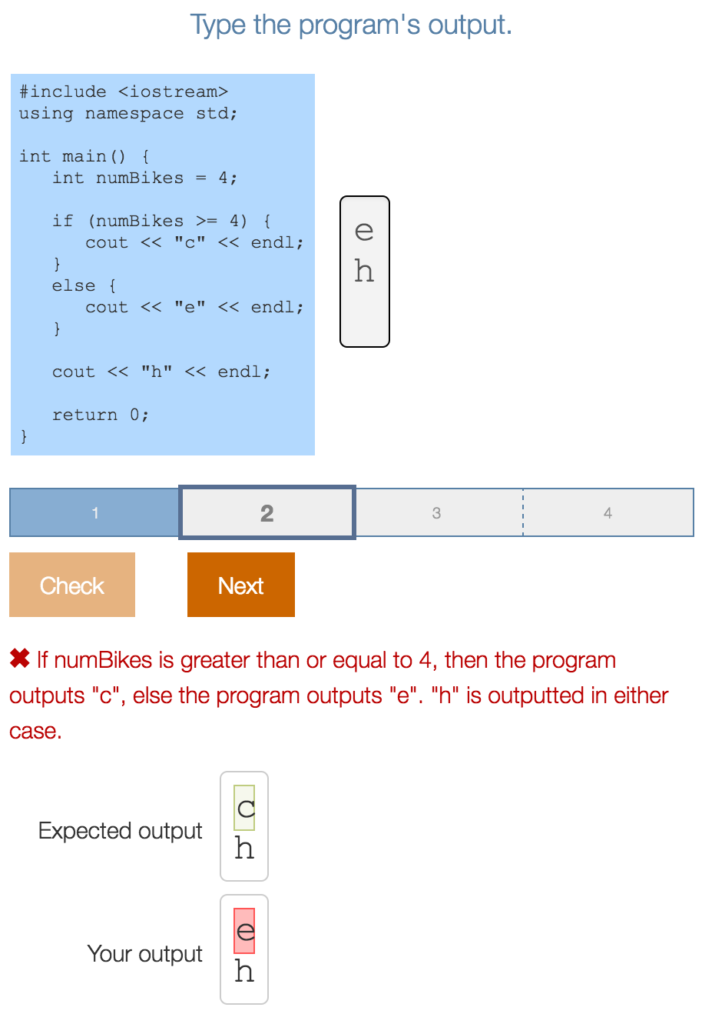
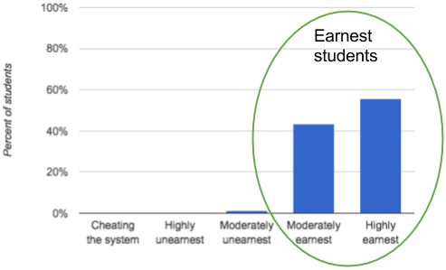
Program output homework:
Vast majority were earnest
12 progressions; 57 levels total; 259 students

Slide 18
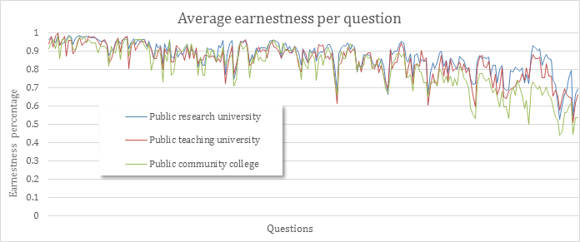
Earnestness trend throughout material

Slide 19
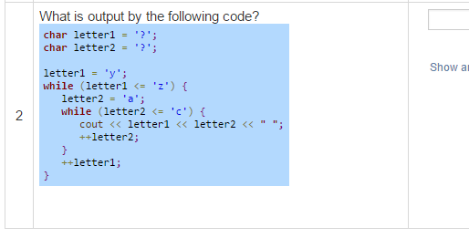
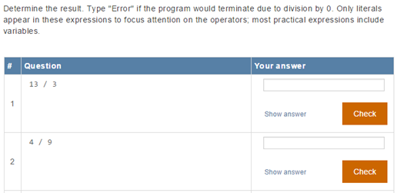
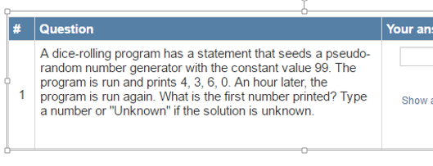
Student earnestness identified potential issues
Very
detailed
?
Learning moment:
Tricky on purpose

Slide 20
Authoring high-earnestness content
Efficiency
  Useful activities
  Concise text
Understandability
  Proper “tool” choice
  Small steps
“Automobile manufacturers have installed special switches in order to prevent injuries inflicted upon children, such injuries being caused by a vehicle’s automatic windows rolling up on a child’s head and thus hurting the child”
“Car makers use special switches that prevent windows rolling up on a child’s head.”
If I had more time, I would have written a shorter letter (Blaise Pascal).
“I wish I had this last semester”, “It truly helped me to understand on a deeper level”, “I really enjoyed it”, “I don’t know what I was so afraid of” “I feel like it’s working with me rather than talking to me”
Notes:
1-page syllabus

Slide 21
Conclusion
Give course points (only 5-10 needed): Currency of academia
Build content that student’s value: concise, engaging
Most students were earnest
  Only 2% cheated the system
Gratefully acknowledge NSF: SBIR 1315094 / 1430537 and a Google faculty research award

Slide 22
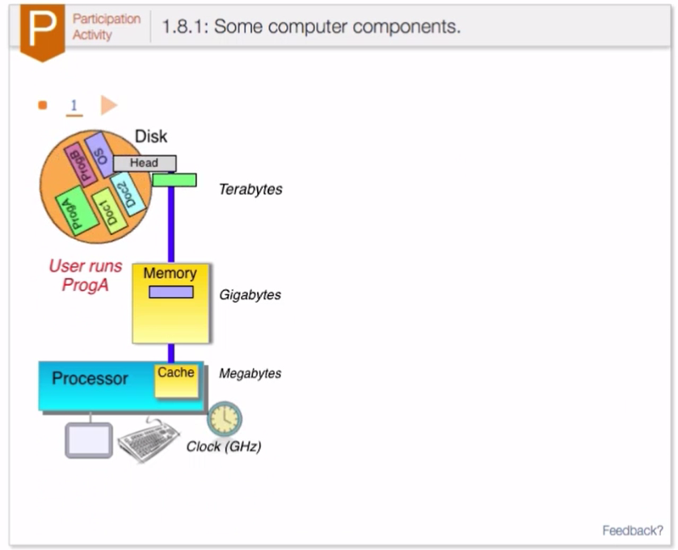
Interactive material

Slide 23
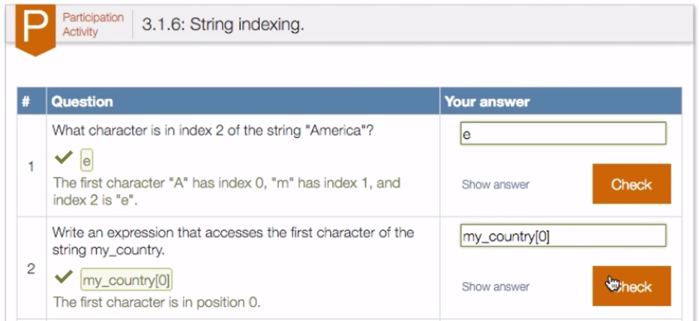
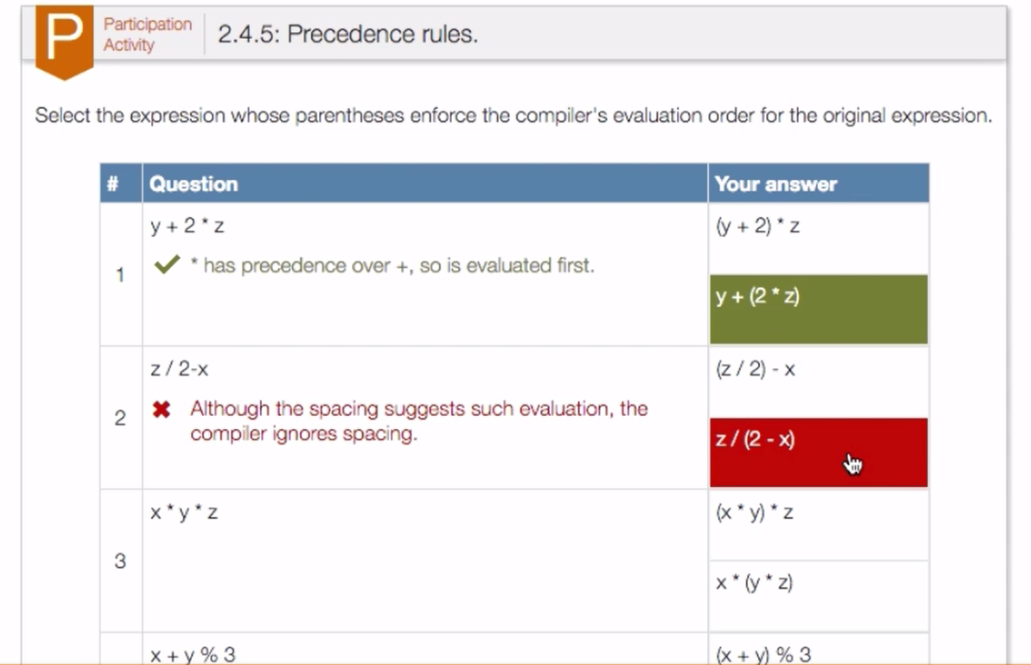
Interactive material

