Slide 1

Searching and Exploring Biomedical Data
Vagelis Hristidis
School of Computing and Information Sciences
Florida International University

Slide 2
Roadmap
Why is it challenging to search EMRs?
XOntoRank: Leveraging Ontologies to improve sensitivity in EMR search
ObjectRank: Use authority flow to rank EMR entities
BioNav: Using MeSH to explore the results of PubMed queries

Slide 3
Roadmap
Why is it challenging to search EMRs?
XOntoRank: Leveraging Ontologies to improve sensitivity in EMR search
ObjectRank: Use authority flow to rank EMR entities
BioNav: Using MeSH to explore the results of PubMed queries

Slide 4
ELECTRONIC MEDICAL RECORDS (EMRs)
Adoption of EMRs hard due to political reasons
  No unique patient id
  Confidentiality
  HIPAA (Health Insurance Portability and Accountability Act)
Move towards XML-based format.
One of most promising:
Health Level 7’s Clinical Document Architecture (CDA).
EMRs pose new challenges for Computer Scientists
  Confidentiality, authentication, secure exchange
  Storage, Scalability
  Dictionaries, terms disambiguation
  Search for interesting patterns (Data Mining)
  Data Integration, Schema mapping
  Searching and Exploring

Slide 5
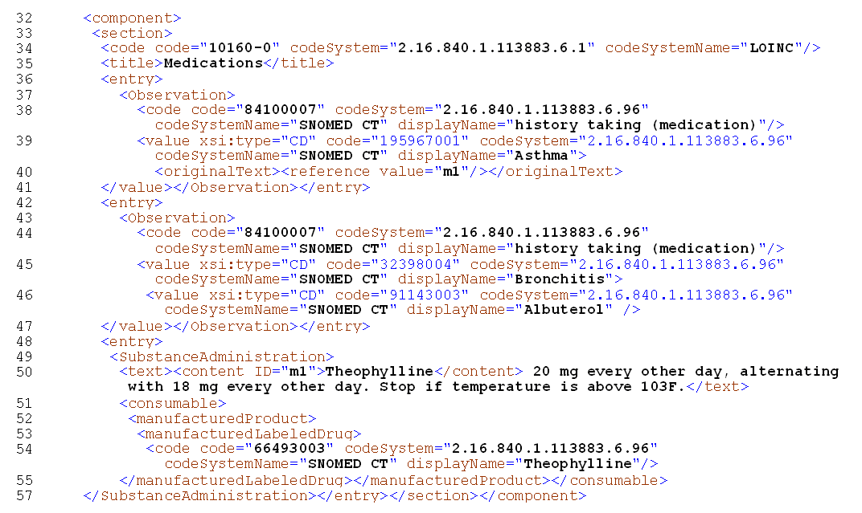
SAMPLE CDA FRAGMENT

Slide 6
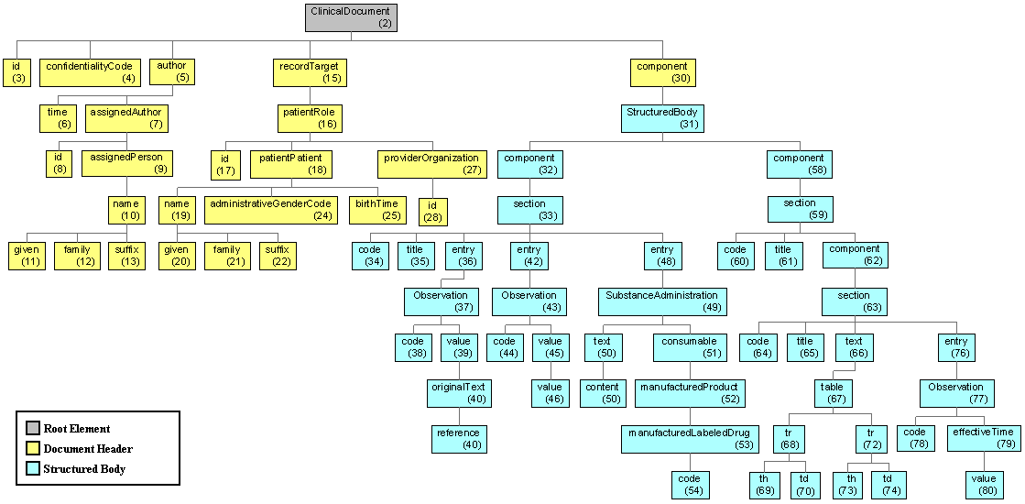
CDA Document – Tree View

Slide 7
LIMITATIONS OF
Traditional IR General XML Search
Text-based search engines do not exploit the XML tags, hierarchical structure of XML
Whole XML document treated as single unit - unacceptable given the possibly large sizes of XML documents
Proximity in XML can also be measured in terms of containment edges
EMRs have known but complex semantics
EMRs include free text, numeric data, time sequences, negative statements.
Routine references in EMRs to external information sources like dictionaries and ontologies.

Slide 8
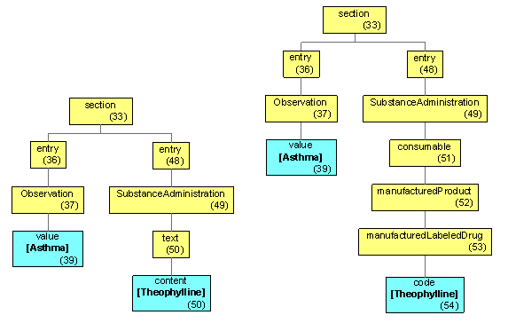
Syntax vs. Semantics in Schema
Example – query “Asthma Theophylline”
More details at [Hristidis et al. NSF Symposium on Next Generation of Data Mining ’07]

Slide 9
Roadmap
Why is it challenging to search EMRs?
XOntoRank: Leveraging Ontologies to improve sensitivity in EMR search
ObjectRank: Use authority flow to rank EMR entities
BioNav: Using MeSH to explore the results of PubMed queries

Slide 10
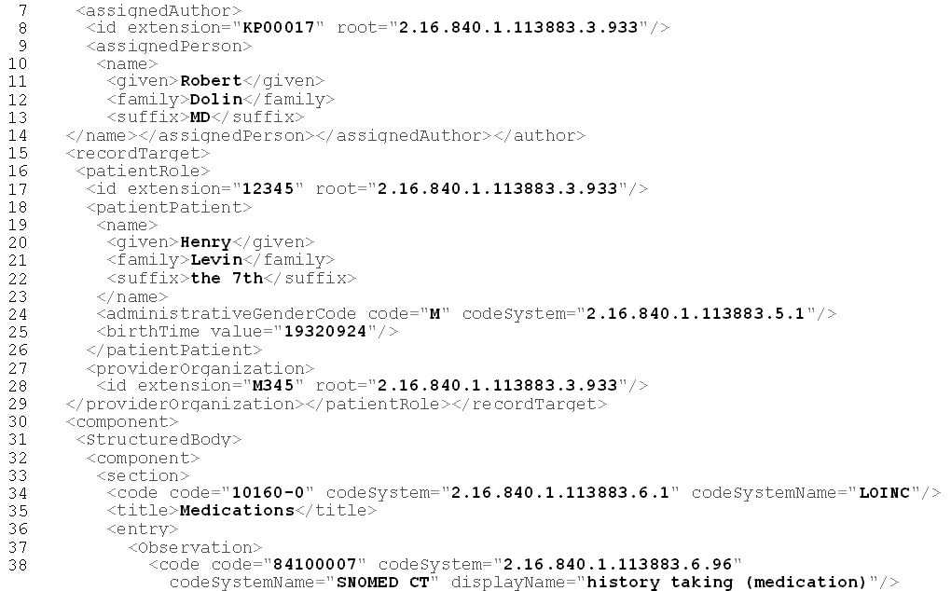
XOntoRank: Leverage Ontological Knowledge
Algorithm to enhance keyword search using ontological knowledge (e.g., SNOMED) [ICDE’08 poster, ICDE’09 full paper]

Slide 11
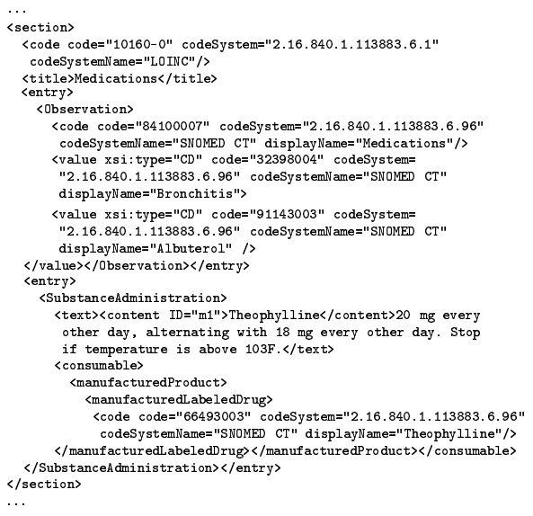
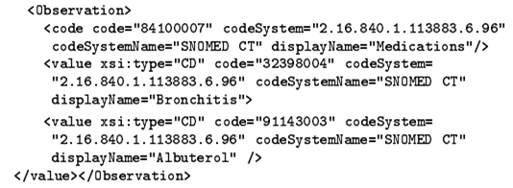
Example 1
q = {“bronchitis”, “albuterol”}
result =
Observation
code
value
Bronchitis
value
Albuterol

Slide 12
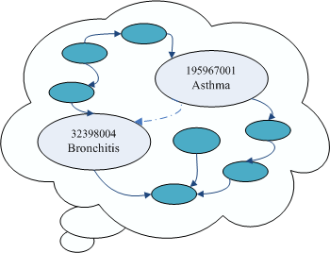
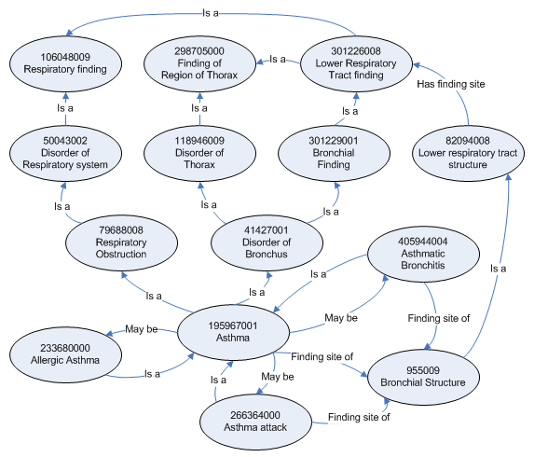
Example 2
q = {“asthma”, “albuterol”}
result = ???

Slide 13

XOntoRank
A CDA node may be associated to a query keyword w through ontology.
XOntoRank first assigns scores to ontological concepts
  OntoScore OS(): Semantic relevance of a concept c in the ontology to a query keyword w.
Then, given these scores, assign Node Scores NS() to document nodes
Other aggregation functions are possible.

Slide 14
Computing OntoScore of Concept Given Query Keyword
Three ways to view the ontology graph:
  As an unlabeled, undirected graph.
  As a taxonomy.
  As a complete set of relationships.

Slide 15
Roadmap
Why is it challenging to search EMRs?
XOntoRank: Leveraging Ontologies to improve sensitivity in EMR search
ObjectRank: Use authority flow to rank EMR entities
BioNav: Using MeSH to explore the results of PubMed queries

Slide 16
Authority Flow Ranking in EMRs
Query: “pericardial effusion”
A subset of the electronic health record dataset.
Work under submission.

Slide 17
Authority Flow Ranking
Schema of the EMR dataset

Slide 18
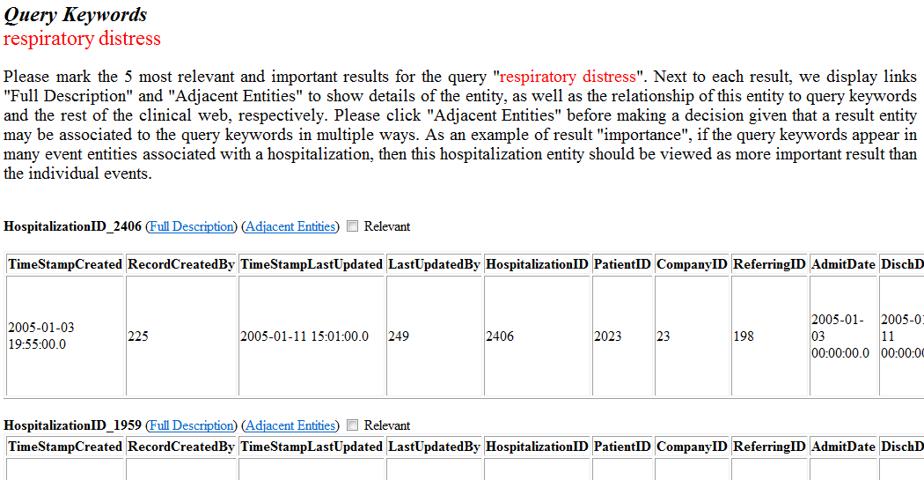
User Study

Slide 19
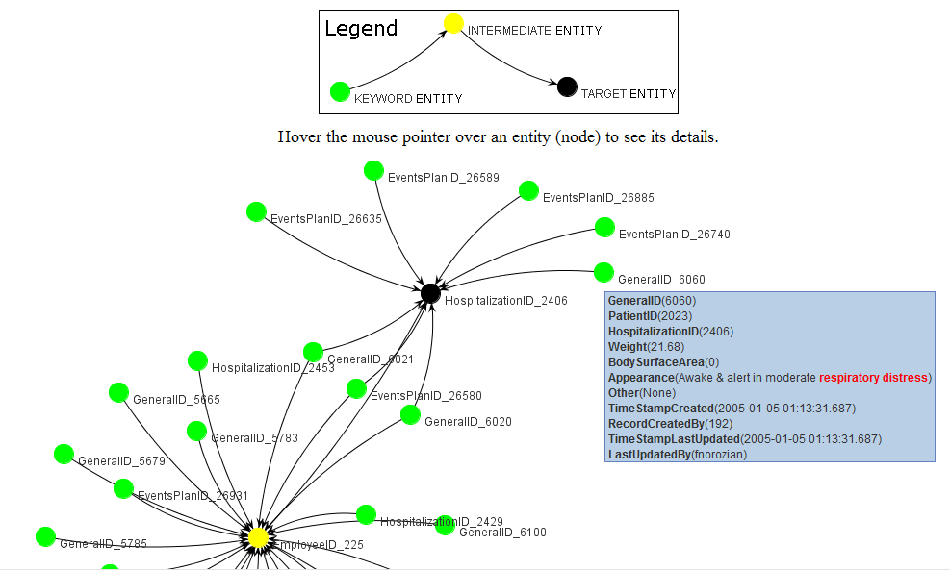
Explaining Subgraph

Slide 20
User Study Results
  Mean Sensitivity Mean Specificity
BM25: Traditional Information Retrieval Ranking Function
CO: Clinical ObjectRank (Authority Flow)

Slide 21
Roadmap
Why is it challenging to search EMRs?
XOntoRank: Leveraging Ontologies to improve sensitivity in EMR search
ObjectRank: Use authority flow to rank EMR entities
BioNav: Using MeSH to explore the results of PubMed queries

Slide 22
Biological Databases (cont’d) – Results Navigation [ICDE09, TKDE 2010]
With SUNY Buffalo.
Demo at http://db.cse.buffalo.edu/bionav/
Most publications in PubMed annotated with Medical Subject Headings (MeSH) terms.
Present results in MeSH tree.
Propose navigation model and smart expansion techniques that may skip tree levels.

Slide 23
BioNav: Exploring PubMed Results
MESH (313)
Query Keyword: prothymosin
Number of results: 313
Navigation Tree stats:
  # of nodes: 3941
  depth: 10
  total citations: 30897
Big tree with many duplicates!
Amino Acids, Peptides, and Proteins (310)
Proteins (307)
Nucleoproteins (40)
Histones (15)
4 more nodes
45 more nodes
2 more nodes
Biological Phenomena, … (217)
Cell Physiology (161)
Cell Growth Processes (99)
15 more nodes
3 more nodes
Genetic Processes (193)
Gene Expression (92)
Transcription, Genetic (25)
1 more node
10 more nodes
95 more nodes
Static Navigation Tree
for query “prothymosin”

Slide 24
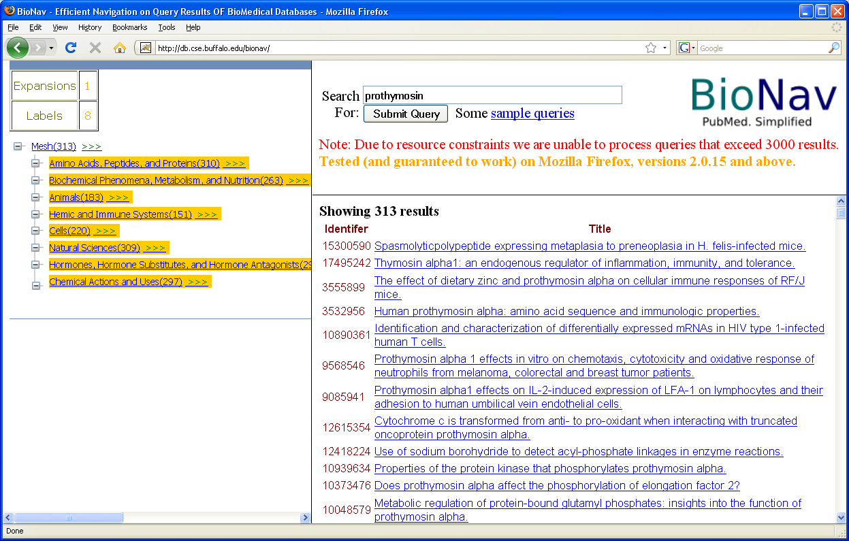
BioNav: Exploring PubMed Results
Reveal to the user a selected set of descendent concepts that:
Collectively contain all results
Minimize the expected user navigation cost
Not all children of the root are necessarily revealed as in static navigation.

Slide 25
BioNav Evaluation

Slide 26
References
Abhijith Kashyap, Vagelis Hristidis, Michalis Petropoulos, and Sotiria Tavoulari. Effective Navigation of Query Results Based on Concept Hierarchies. IEEE Transactions on Knowledge and Data Engineering (TKDE) 2010
Fernando Farfán, Vagelis Hristidis, Anand Ranganathan, and Michael Weiner. XOntoRank: Ontology-Aware Search of Electronic Medical Records. IEEE International Conference on Data Engineering (ICDE) 2009
Abhijith Kashyap, Vagelis Hristidis, Michalis Petropoulos, and Sotiria Tavoulari. BioNav: Effective Navigation on Query Results of Biomedical Databases. IEEE International Conference on Data Engineering, ICDE 2009
Vagelis Hristidis, Fernando Farfán, Redmond P. Burke, Anthony F. Rossi, Jeffrey A. White. Information Discovery on Electronic Medical Records. National Science Foundation Symposium on Next Generation of Data Mining and Cyber-Enabled Discovery for Innovation (NGDM) 2007
Supported by
NSF IIS-0811922: Information Discovery on Domain Data Graphs, 2008-2011
NSF CAREER IIS-0952347, 2010-2015

