Slide 1
Top 40 Motifs from Artificial Book with Different Masking Ratios
Dataset: 128-page of our artificial book (14-segment display).
Note that there are 12,800 random characters in the book.

Slide 2
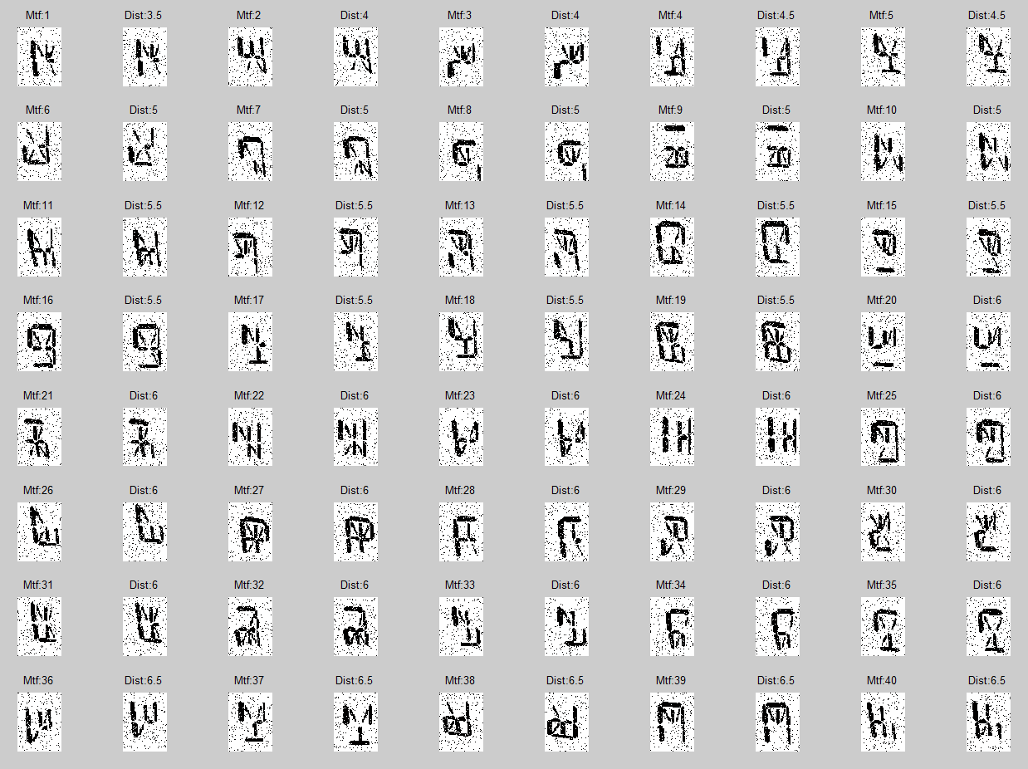
Top 40 Motifs when pmask=60%

Slide 3
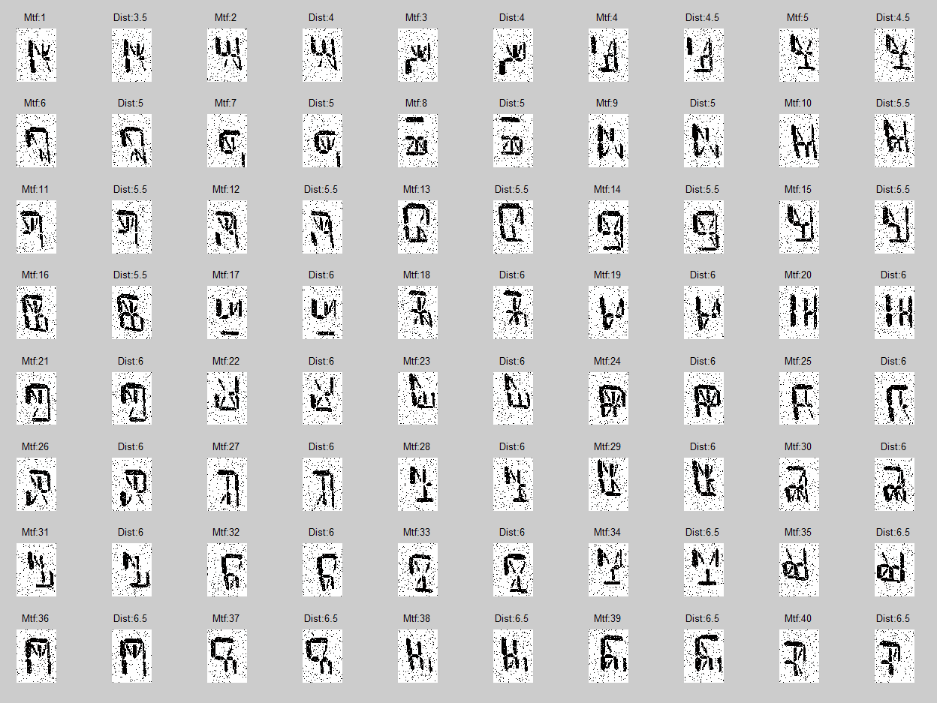
Top 40 Motifs when pmask=50%

Slide 4
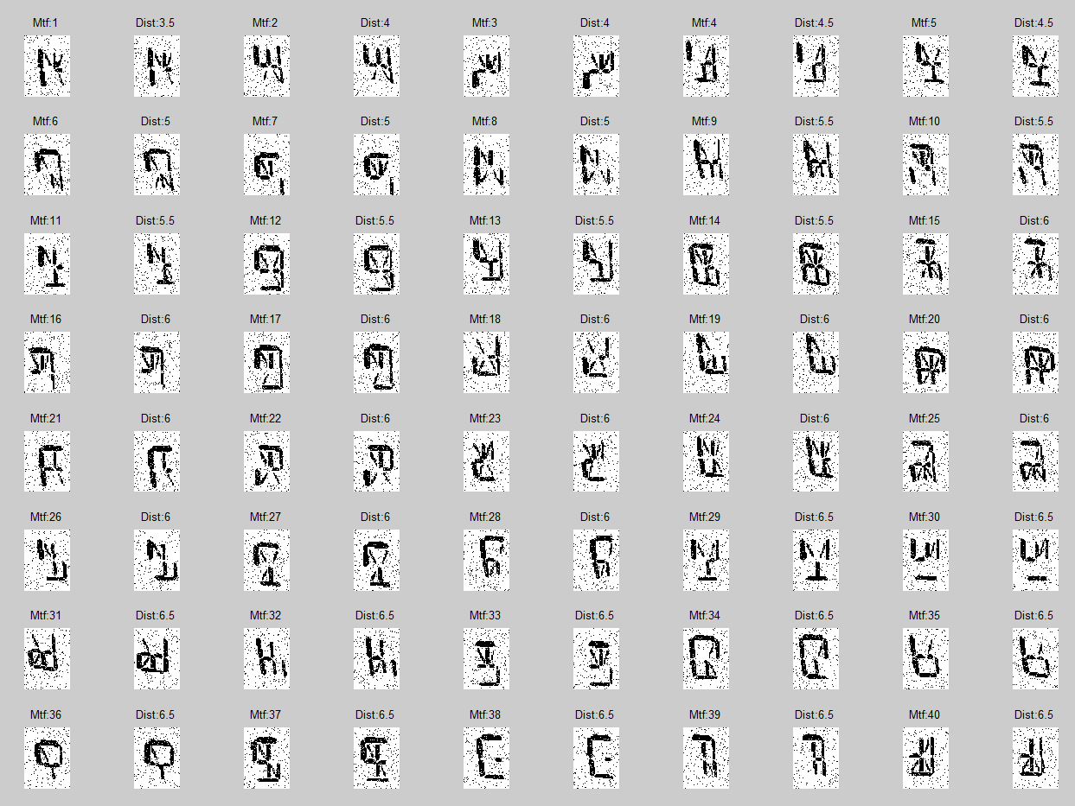
Top 40 Motifs when pmask=40%

Slide 5
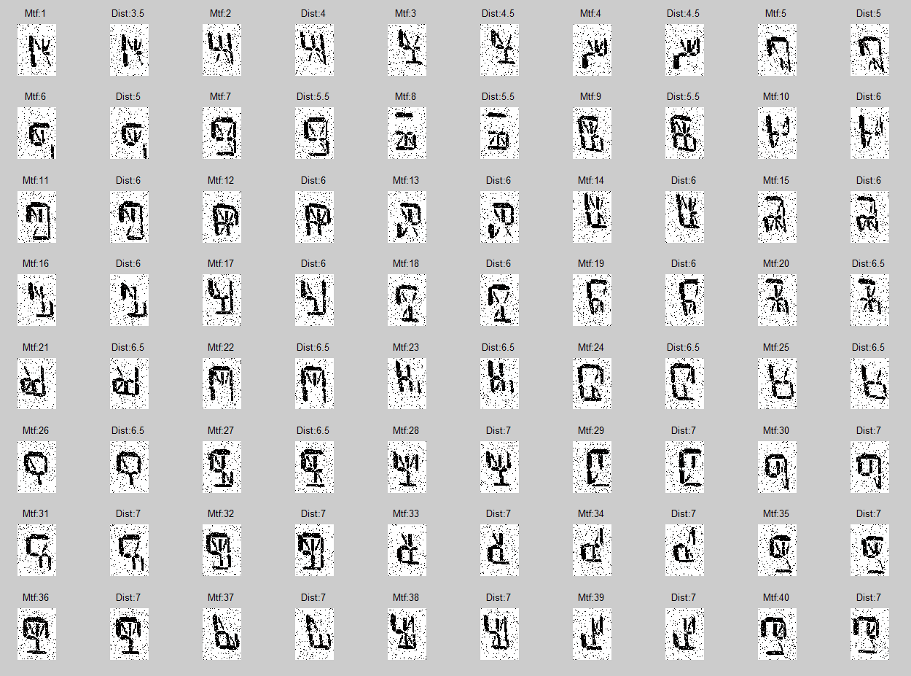
Top 40 Motifs when pmask=30%

Slide 6
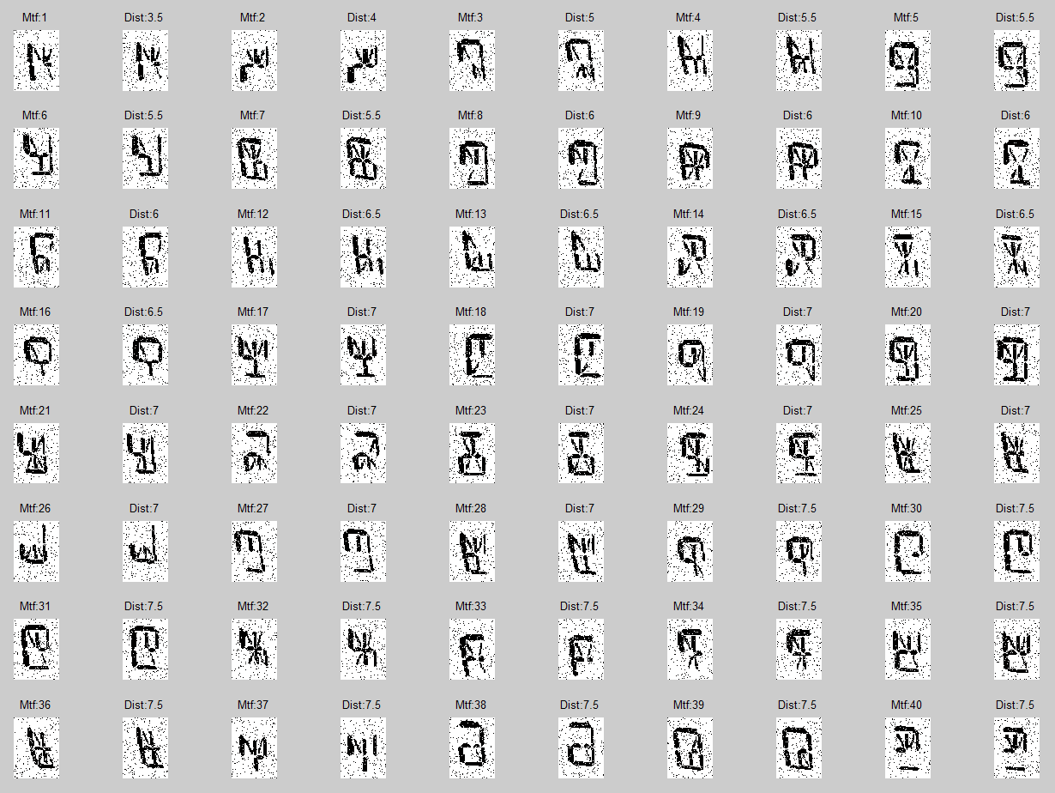
Top 40 Motifs when pmask=20%

Slide 7
Average Motifs Distance
On 128 pages dataset
 | Top 10 Motifs |  | Top 20 Motifs |  | Top 40 Motifs
Masking Ratio | Total Dist | Error | Total Dist | Error | Total Dist | Error
60 | 45.5 | 1.00 | 101.0 | 1.00 | 223.5 | 1.00
50 | 46.0 | 0.83 | 103.0 | 1.01 | 226.5 | 1.02
40 | 46.5 | 0.67 | 104.5 | 1.02 | 230.5 | 1.03
30 | 49.0 | 0.50 | 109.5 | 1.08 | 246.0 | 1.08
20 | 52.5 | 0.33 | 119.0 | 1.15 | 265.0 | 1.18
Total Random Distance
 | 10 pairs | 20 Pairs | 40 Pairs
 | 400 | 800 | 1600
Do you want me to vary plot on different size of dataset?
But I don’t sure whether it is sense when we plot different size in the same figure.

Slide 8
Effect of Masking Ratio to Average Distance
Average Distance of Top 20 Motifs
25
Mask 60%
Mask 50%
20
Mask 40%
Mask 30%
15
Mask 20%
Average Distance
10
5
0
2
4
8
16
32
64
128
256
512
Number of pages
Baseline at 60%
Average Distance on Different Masking Ratio
1.8
Mask 60%
1.6
Mask 50%
Mask 40%
Ratio to 60% masking ratio
Mask 30%
1.4
Mask 20%
1.2
1
2
4
8
16
32
64
128
256
512
Number of pages

Slide 9
Effect of Parameters to Avg Distance

Slide 10
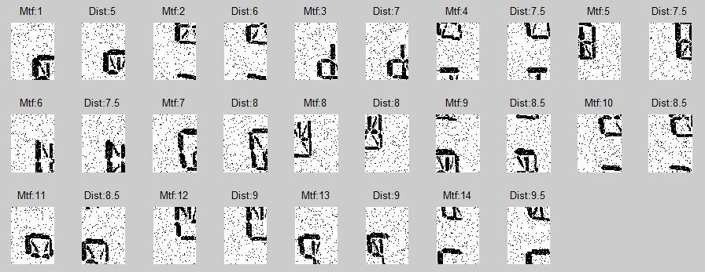
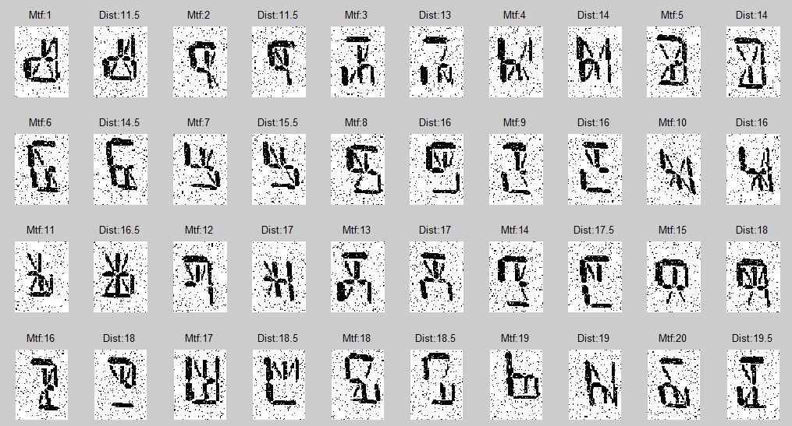
Top 20 Motifs when pmask=60%
Top 14 Motifs from Brute Force: Run through all sliding windows
Avg distane = 7.5
Poor quaility
Very very slow
Running Time
1 Page : 1 hour+
2 Pages : 4.5 hours
4 Pages : ~ 18 hours
8 Pages : ~ 70 hours (3 days)
Avg distance = 15.50
Worse distance
Higher quality motifs

Slide 11
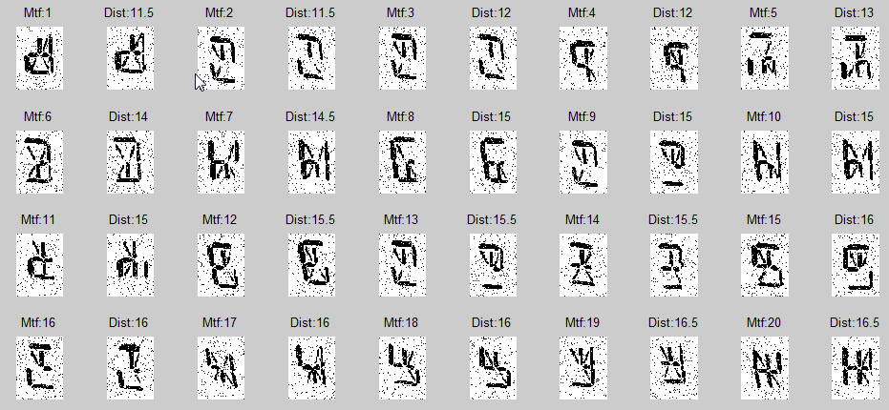
Top 20 Motifs from Brute Force: Run only on potential windows
Avg distance = 14.60
Running time is not bad
Top 20 Motifs when pmask=60%
Avg distance = 15.50

