Slide 1
Theoretical Analysis

Slide 2
Objective
Our algorithm use some kind of hashing technique, called random projection.
In this slide, we will show that if a user want to find motif with high chance, how many non-motif will be occur in hashing process.
We assume that we have a lot of potential windows and there is only 1 motif (pair of very similar images) among these windows.

Slide 3
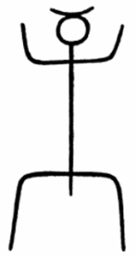
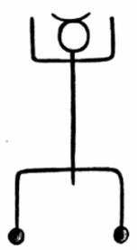
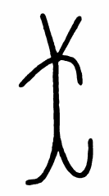
Basic Notation
Motif is a pair of similar images.
Let say the different is less than 10%.
User-defined window size S_{x} by Sy.
Let N = S_{x} * Sy.
Non-motif is a pair of any images which are not the motif.
Usually the different is not small.

Slide 4
Assumption / Notations
User defines size of windows N. (N=S_{x}*S_{y})
There is only 1 motif in the dataset. User want to the motif to collide in the same bucket with confidence conf. (conf ≥ 90%)
The distance, the number of different black pixel, of the motif is small.
The distance of all pair images except the motif is defined by its distribution. The mean and stdev of the distribution are µ and σ, respectively.
Images has the same number of black pixel. Not require.
The distribution of distance is a normal distribution. Not require.
Black pixels inside the windows are uniformly distributed for any windows except the motif.

Slide 5
Other Notations
The other notations we use in our analysis are followings:
s is the masking ratio. The ratio of removing black pixel in hashing process.
t is the number of iteration indicates that how many times we do random projection.
d is the distance between pair of images.

Slide 6
*Theoretical Statement*
If the motif collide with confidence at least conf, other non-motif pair will have a chance to collide ≤ 1-(1-Q)^{t} where
Notations:
The distance distribution of other non-motif with mean µ and stdev σ. Two hidden parameters are masking ratio, s, and the number of iteration, t.
Note that parameter conf is used to find the best s or t (by fixing another).

Slide 7
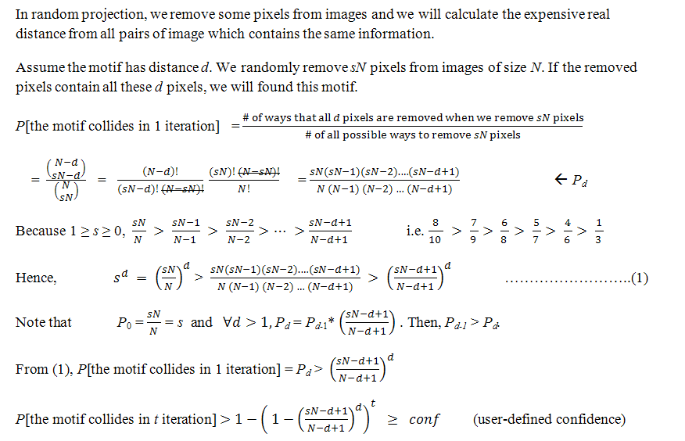
Detail: How confident will the motif collide? (1)

Slide 8
Detail: How confident will the motif collide? (2)
Next, we will use parameters s and t to find the probability that any non-motif pair of windows will accidentally collide. (false positive)

Slide 9
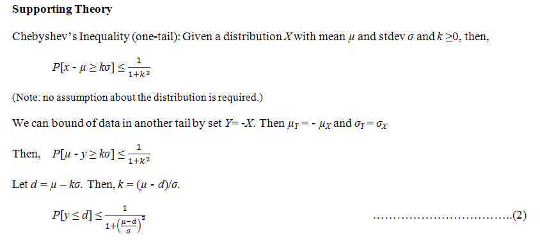
Detail: How about non-motif? (1)

Slide 10
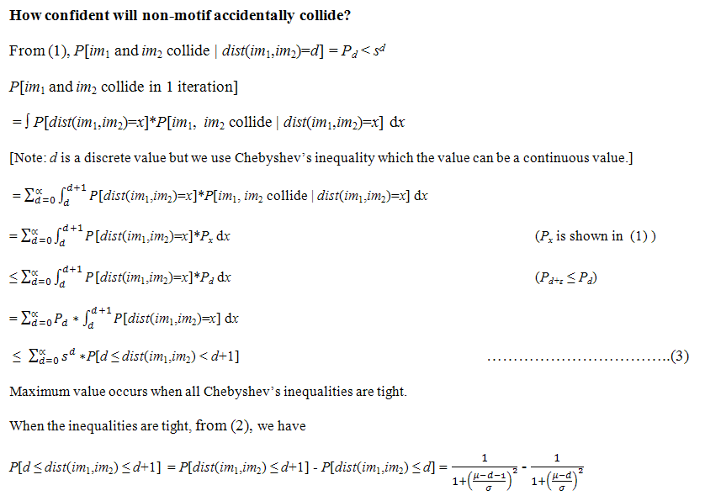
Detail: How about non-motif? (2)

Slide 11
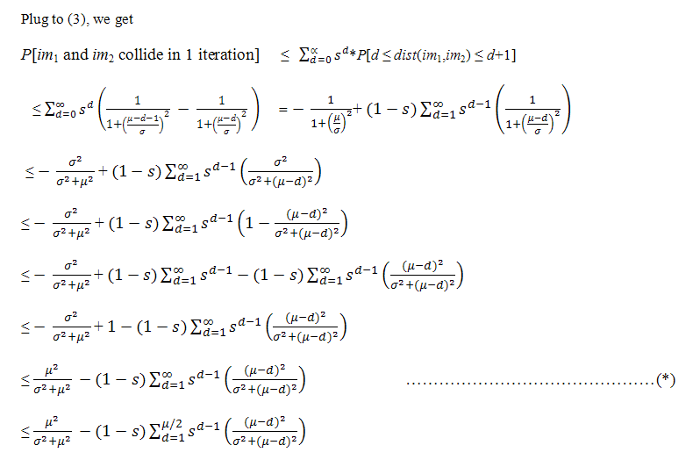
Detail: How about non-motif? (3)

Slide 12
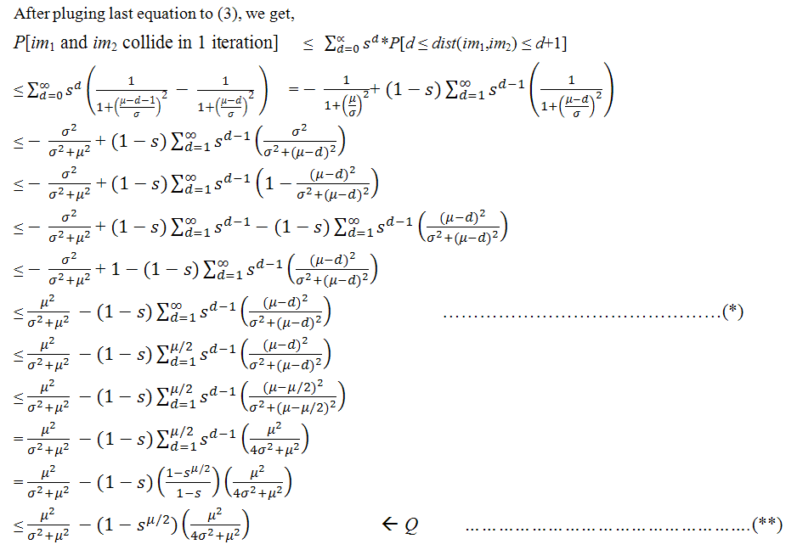
Detail: How about non-motif? (4)
Note that this step is loose.

Slide 13
Detail: Conclusion
Theoretical statement is proved.
User-define parameters
conf: confidence which the motif will collide.
N: size of windows (width*hight)
the distribution of the distance of non-motif windows. (µ and σ)
A hidden parameter
Either s, masking ratio, or t, the number of iteration.
After this proof
- we can easily modify use our algorithm to set parameters automatically by trying the best value of one parameter. It can guarantee the number of false positive and find the motif with high probability.

Slide 14
The probability of the collision of non-motif
Plot by using close-form from equation (**).
Fix confidence to find the correct motif = 99%
Fix size of windows at 400 or 20x20.
About the distribution of distance, fix µ=100 and σ=10
Vary masking ratio.
For any ratio, find the best number of iteration to have a 99% chance to find motif.
Vary number of iterations.
For any number, find the best masking ratio to have a 99% chance to find motif.
motif distance = 1
motif distance = 2
motif distance = 4
motif distance = 8
Probability that non-motif collide
Probability that non-motif collide
Minimum = 0.064 = 6.4%
Minimum = 0.066 = 6.6%
Masking Ratio
Number of iterations

Slide 15
The probability of the collision of non-motif
Better result by using summation-form from equation (*) with the same parameters.
Fix confidence to find the correct motif = 99%
Fix size of windows at 400 or 20x20.
About the distribution of distance, fix µ=100 and σ=10
Vary masking ratio.
For any ratio, find the best number of iteration to have a 99% chance to find motif.
Vary number of iterations.
For any number, find the best masking ratio to have a 99% chance to find motif.
motif distance = 1
motif distance = 2
motif distance = 4
motif distance = 8
Probability that non-motif collide
Probability that non-motif collide
Minimum = 0.003 = 0.3% (at d=1)
Minimum = 0.003 = 0.3% (at d=1)
Masking Ratio
Number of iterations

Slide 16
More Explanation
In real book, there are only small number of images (usually < 10 in average) in each page of the book. Some pages may contain a hundred images but many of them contain only 1-2 images or none. Hence, there are not many potential windows in the book. For example, the 100-pages book may ideally have 1,000 potential windows or less.
From our theoretical upper bound using close-form, the false positive is occurred around 6.4%. It is 500,000*0.064 = 32,000 pairs. If we use the summation-form upper bound, the false positive is 0.3%; it is 500,000*0.003 = 1,500 pairs.
The result is not so good but it is reasonable for finding motif in a 100-pages book. Note that we use only few assumption to find the upper bound.

Slide 17
Further Analysis
Possible Solution 1: Make upper bound tighter by tighter the equation (**)
Possible Solution 2: Use more assumption such as normal or Gaussian distribution.
For the previous case, we set µ=100 and σ=10 and motif distance d <10. It is very very small chance that any distance less than 10 (< µ-9σ).
Possible Solution 3: Use stronger bound like Chernoff’s inequality but it is still required more assumption.

Slide 18
Thank you for reading
Please feel free to download our source code and enjoy to find motifs

