Slide 1
Examples of Motifs
This presentation provide examples of motifs discovered by our algorithm.

Slide 2
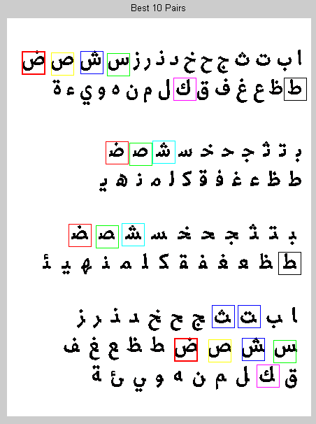
Arabic Alphabet

Slide 3
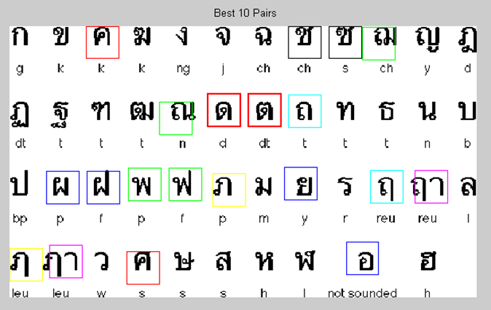
Thai Alphabet

Slide 4
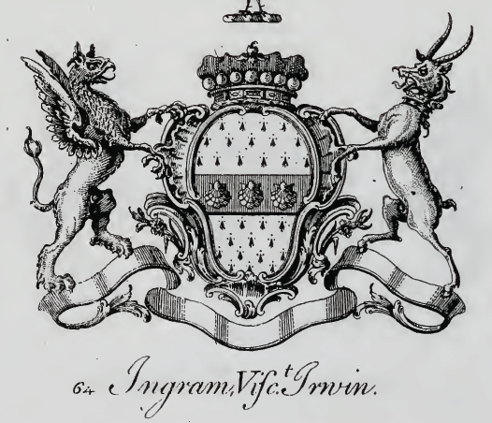
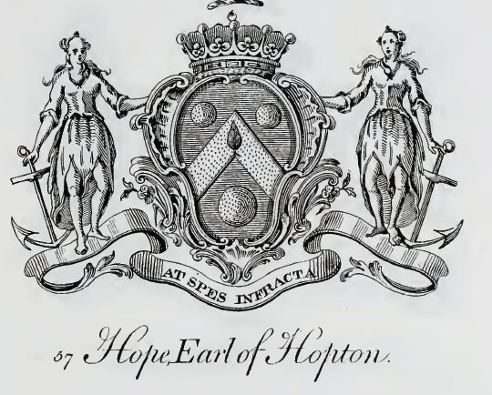
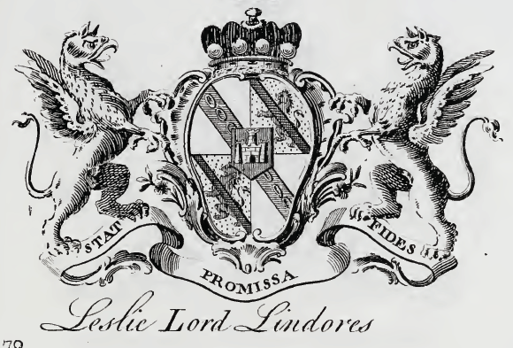
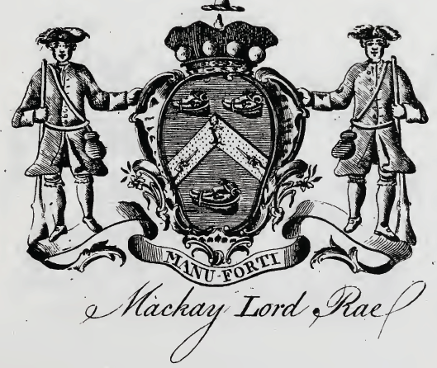
Peerage of Scotland (1)
Book: The Peerage of Scotland: Genealogical and Historical accounts …
URL: http://www.archive.org/details/peerageofscotlan00jalm

Slide 5
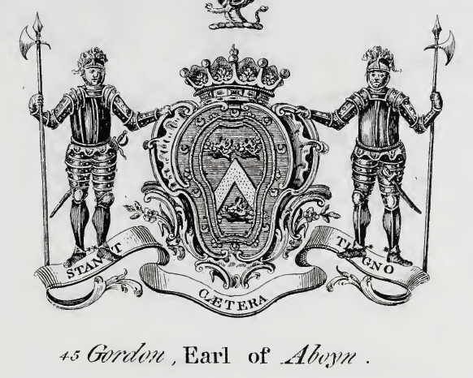
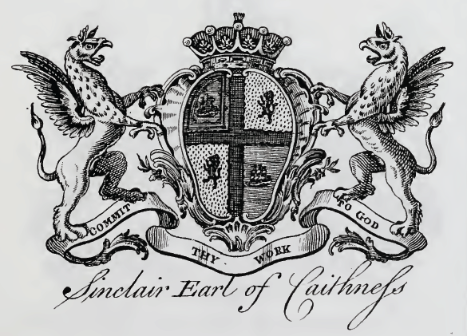
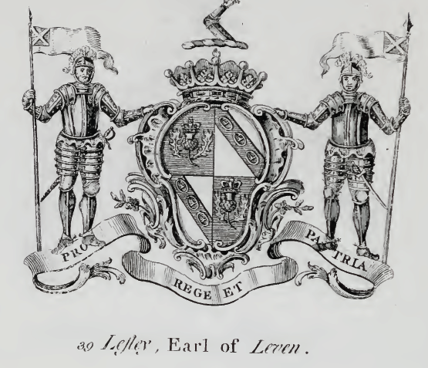
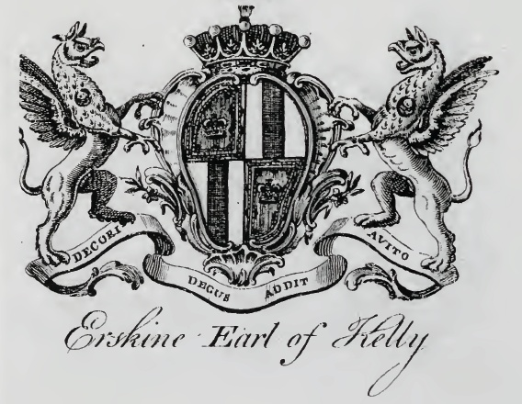
Peerage of Scotland (2)
Book: The Peerage of Scotland: Genealogical and Historical accounts …
URL: http://www.archive.org/details/peerageofscotlan00jalm

Slide 6
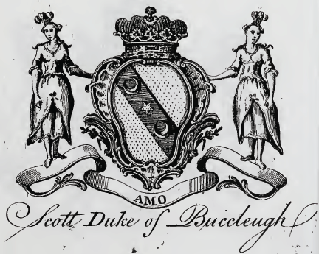
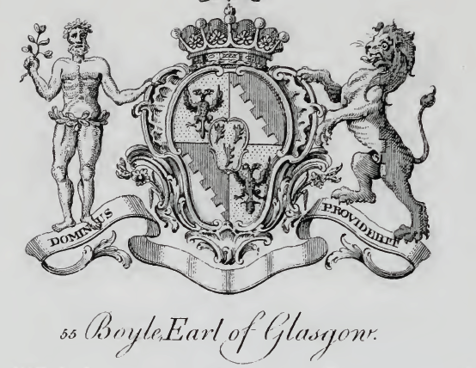
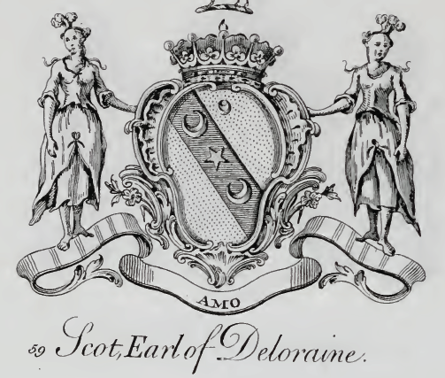
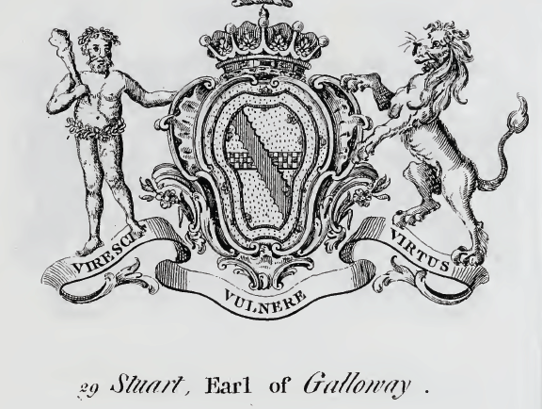
Peerage of Scotland (3)
Book: The Peerage of Scotland: Genealogical and Historical accounts …
URL: http://www.archive.org/details/peerageofscotlan00jalm

Slide 7
Motif Join across Books

Slide 8
Petroglyph books
Motif 1-4
Motif 5-8
Motif 9-12
Motif 13-16
Motif 20-24
Motif 25-28
Motif 41-44
Motif 57-60
Motif 61-64
Motif 77-80
1st Book: Petroglyphs by Koch-Grunberg, Theodor (2852 images)
2nd Book: Selected Petroglyph Catalog
by Wilson G. Turner (233 images)

Slide 9
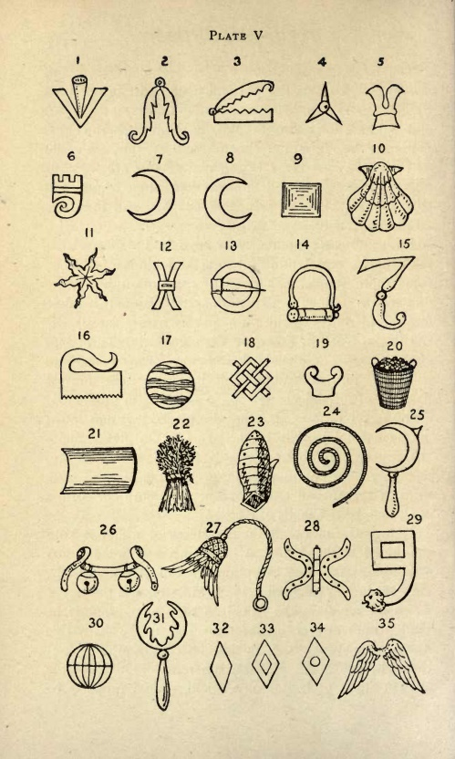
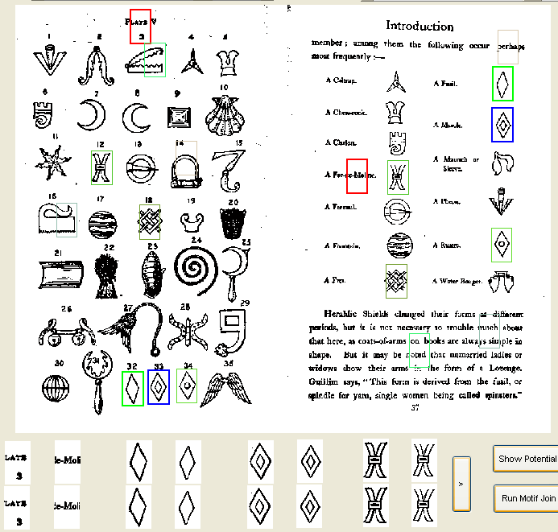
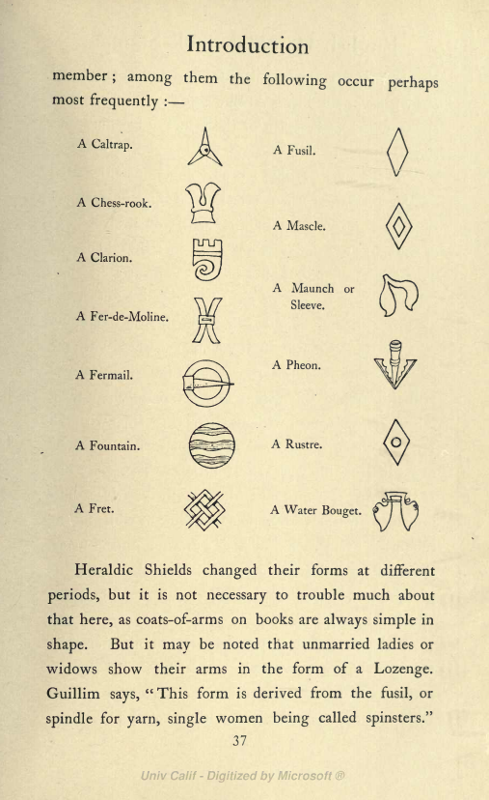
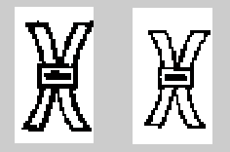
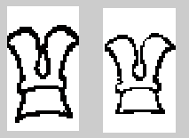
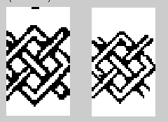
Heraldry Shield Books
http://www.archive.org/stream/britishheraldry00daveuoft#page/28/mode/1up
http://www.archive.org/stream/englishheraldicb00daverich#page/37/mode/1up

Slide 10
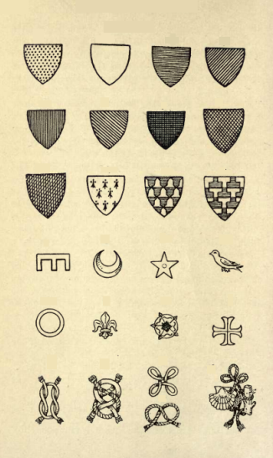
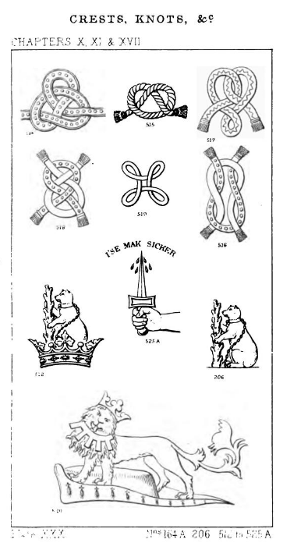
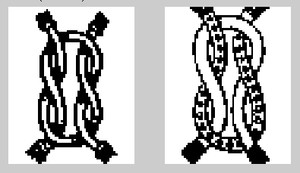
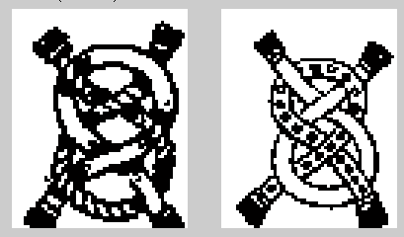
http://www.archive.org/stream/scottishheraldry00john#page/78/mode/2up
http://www.archive.org/stream/amanualheraldry00boutgoog#page/n297/mode/1up

Slide 11
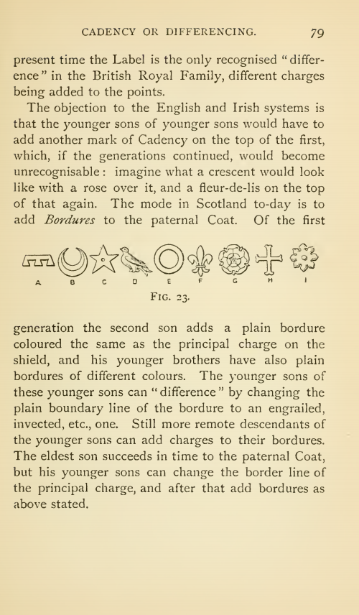
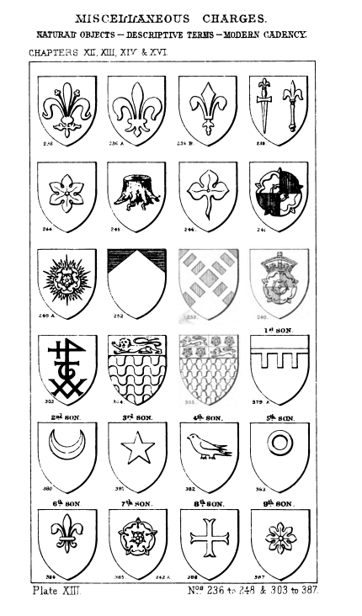
http://www.archive.org/stream/amanualheraldry00boutgoog#page/n113/mode/1up
http://www.archive.org/stream/scottishheraldry00john#page/79/mode/1up

Slide 12
Thank you
Please feel free to download our source code and enjoy to find motifs

