Slide 1
More Motifs

Slide 2
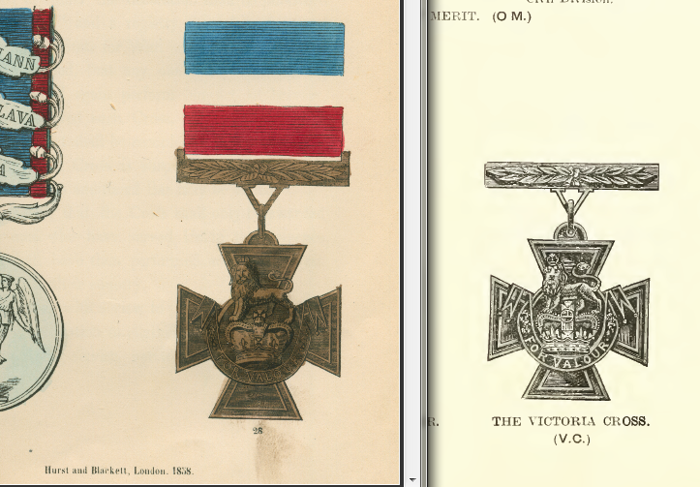

Slide 3
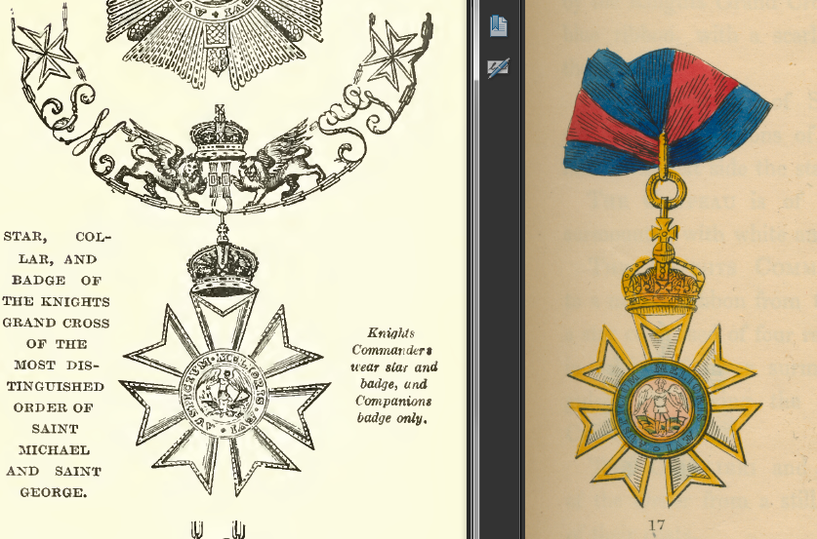

Slide 4
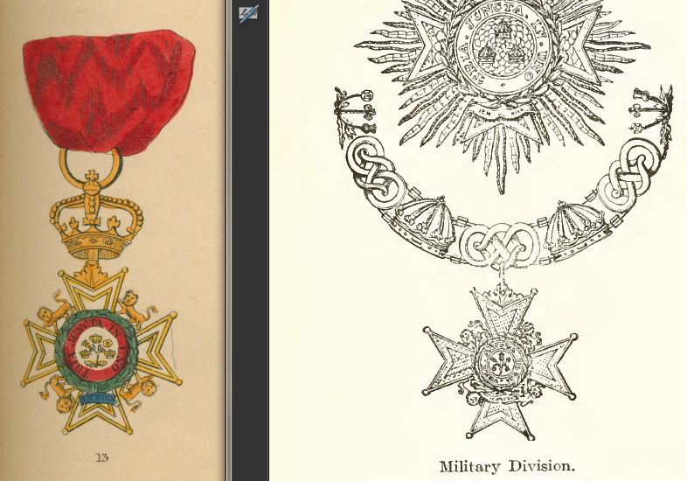

Slide 5
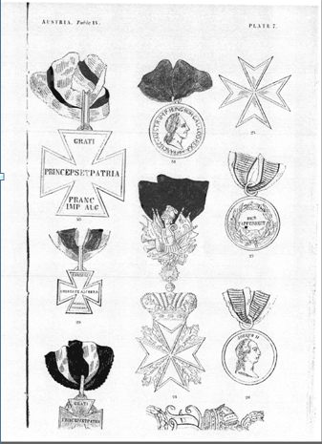
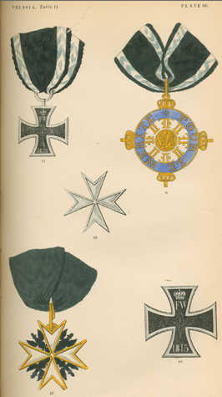

Slide 6
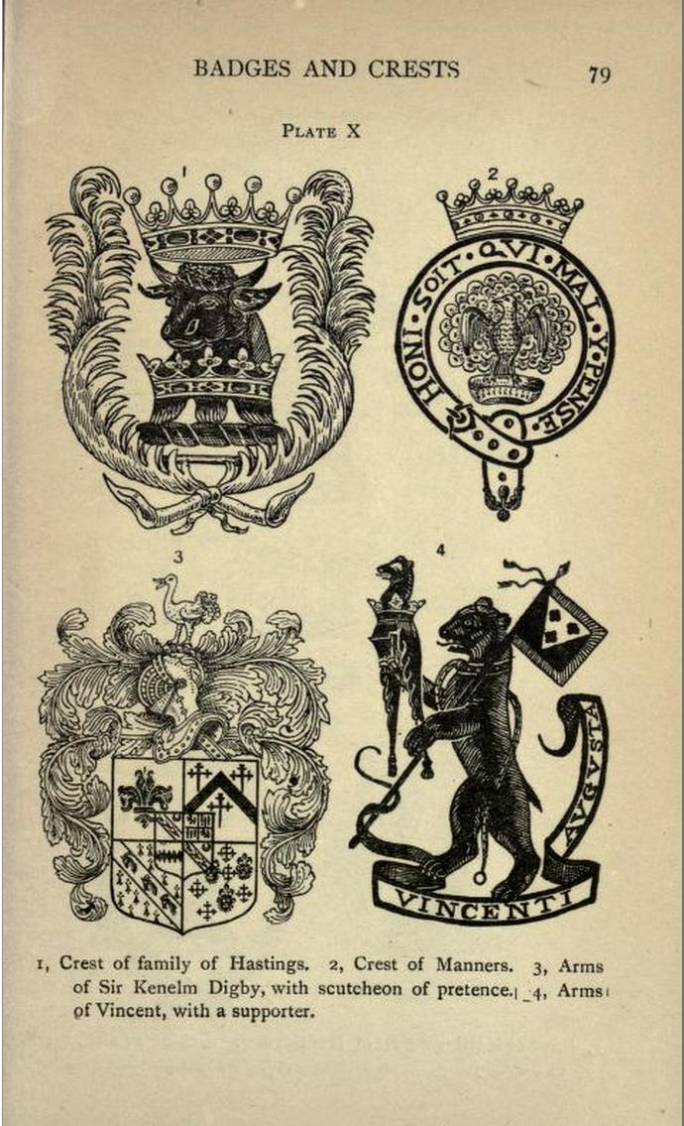
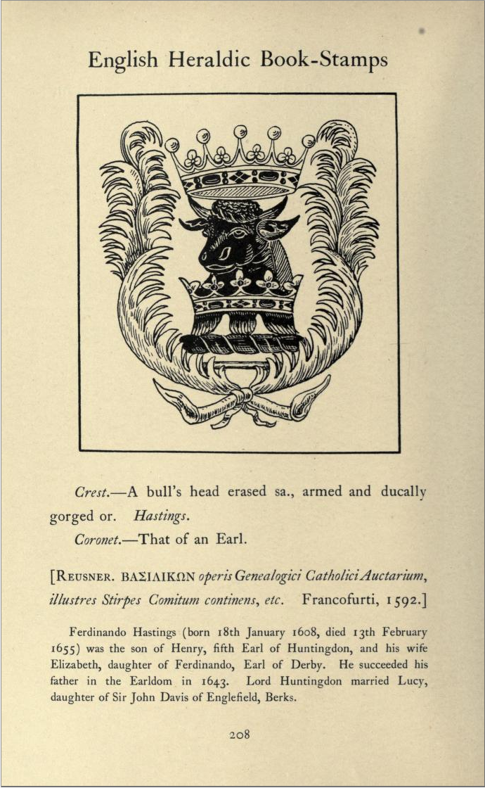
http://www.archive.org/stream/britishheraldry00daveuoft#page/79/mode/1up
http://www.archive.org/stream/englishheraldicb00daverich#page/208/mode/1up

Slide 7
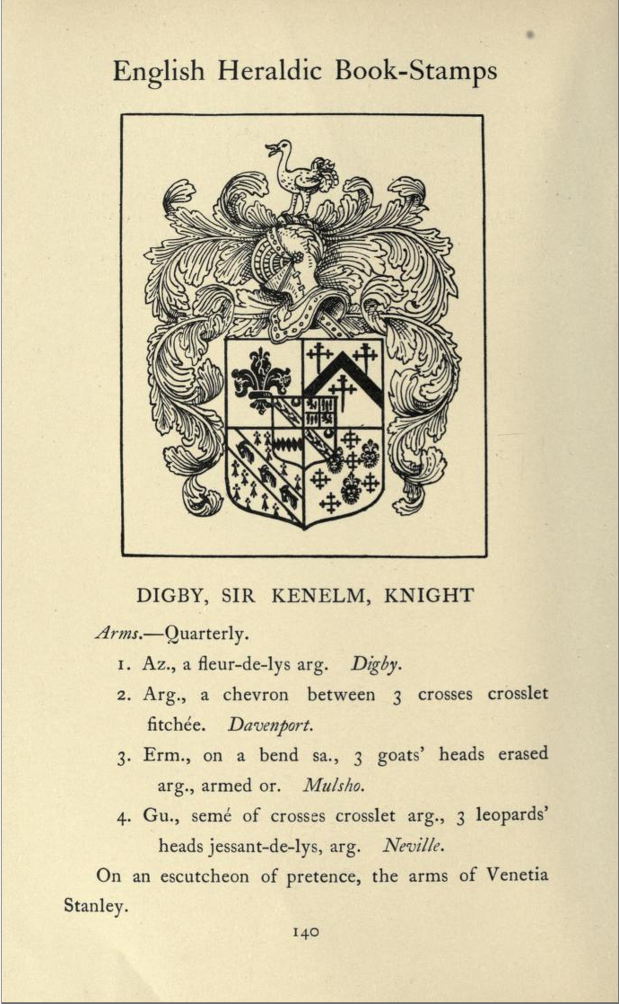
http://www.archive.org/stream/britishheraldry00daveuoft#page/79/mode/1up
http://www.archive.org/stream/englishheraldicb00daverich#page/140/mode/1up

Slide 8
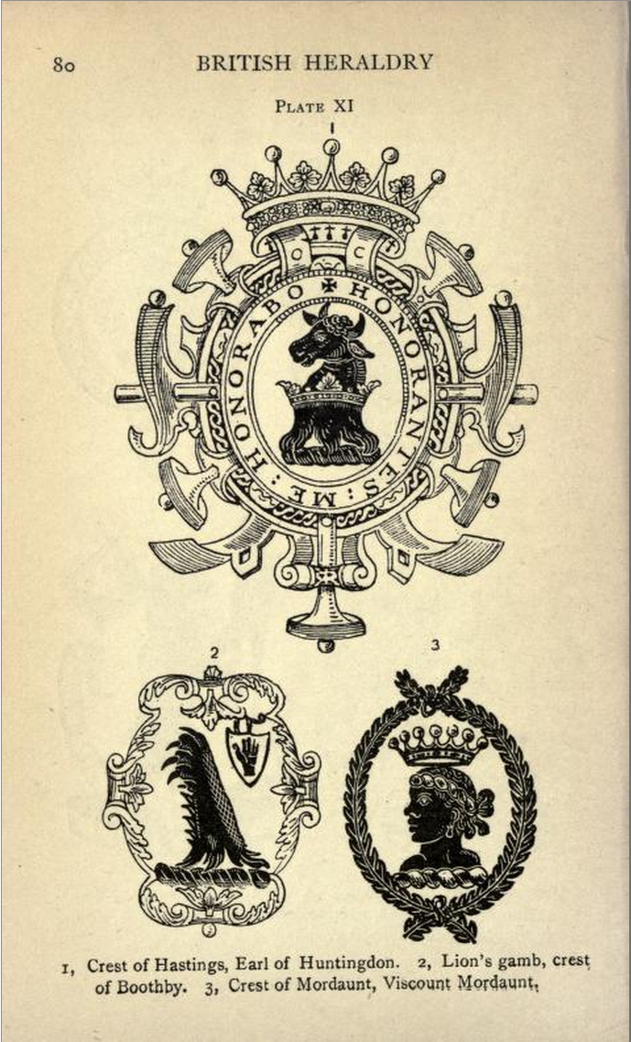
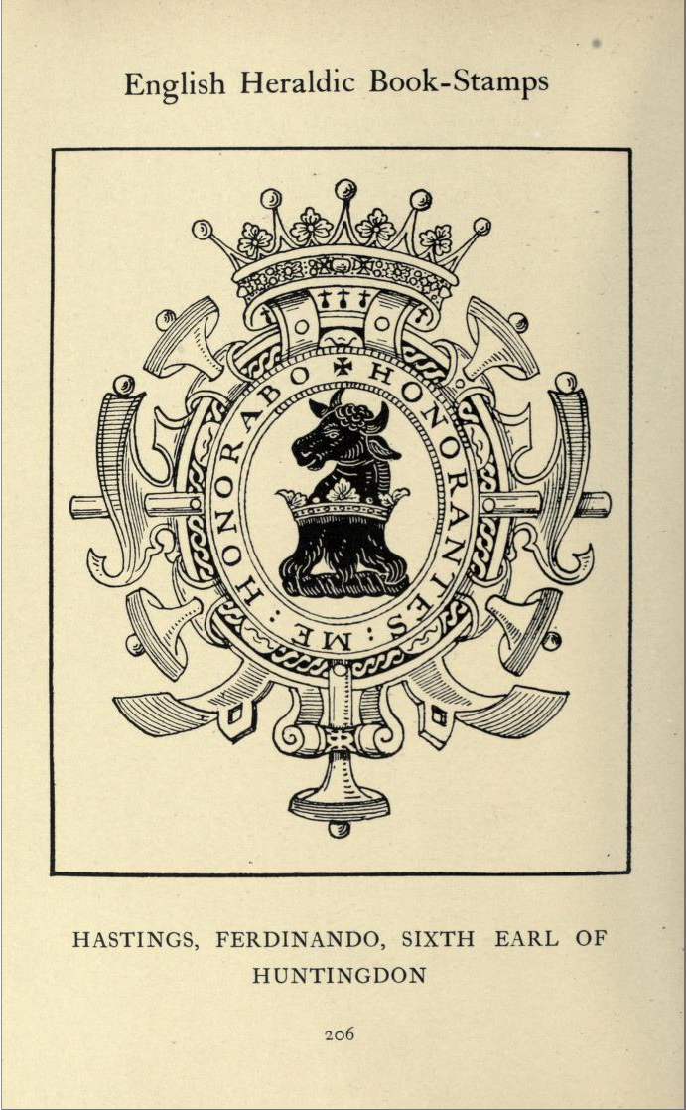
http://www.archive.org/stream/britishheraldry00daveuoft#page/80/mode/1up
http://www.archive.org/stream/englishheraldicb00daverich#page/206/mode/1up

Slide 9
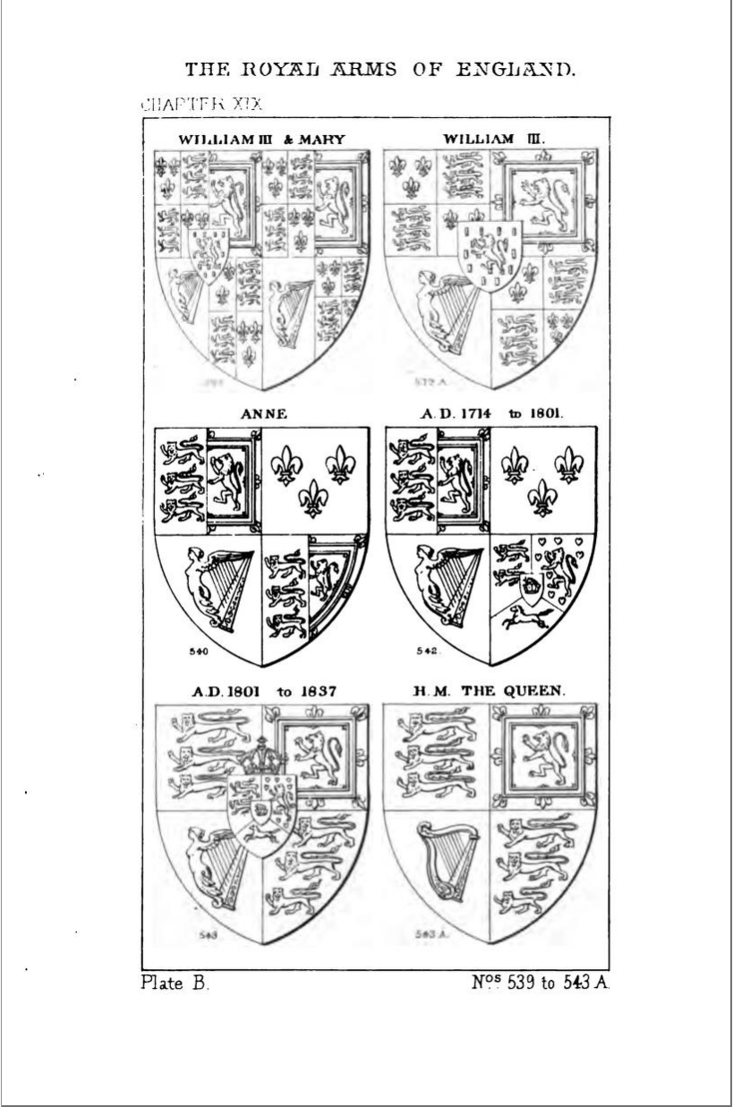
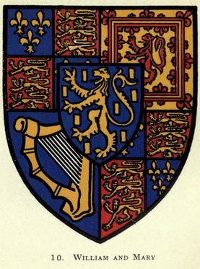
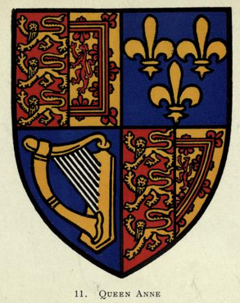
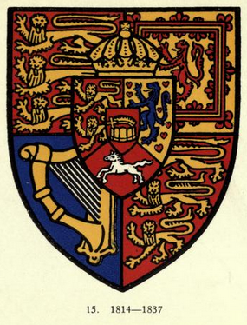
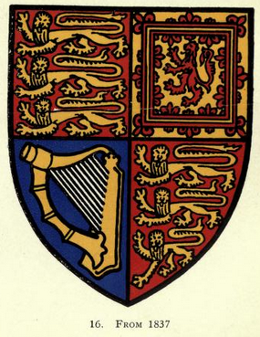
Similar pairs

Slide 10
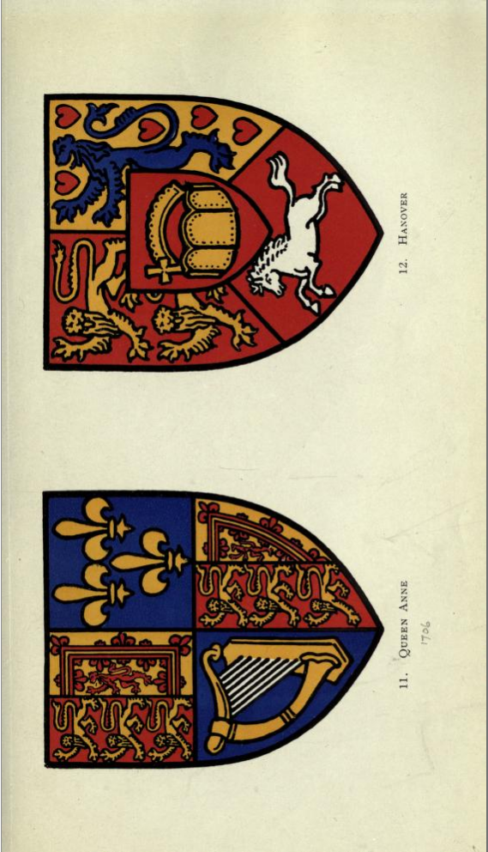
http://www.archive.org/stream/leopardsofenglan00dorlrich#page/n58/mode/1up
http://www.archive.org/stream/amanualheraldry00boutgoog#page/n329/mode/1up

Slide 11
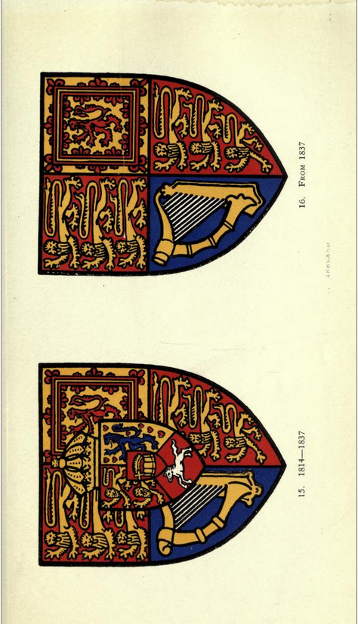
http://www.archive.org/stream/leopardsofenglan00dorlrich#page/n66/mode/1up
http://www.archive.org/stream/amanualheraldry00boutgoog#page/n329/mode/1up

Slide 12
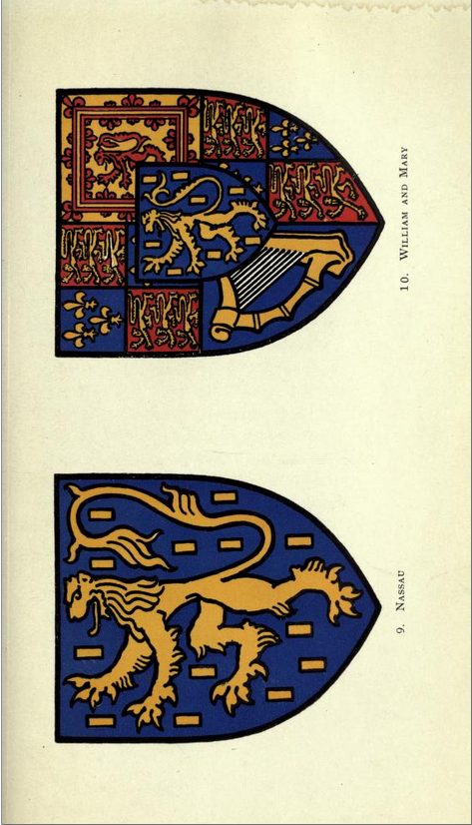
http://www.archive.org/stream/leopardsofenglan00dorlrich#page/n54/mode/1up
http://www.archive.org/stream/amanualheraldry00boutgoog#page/n329/mode/1up

Slide 13
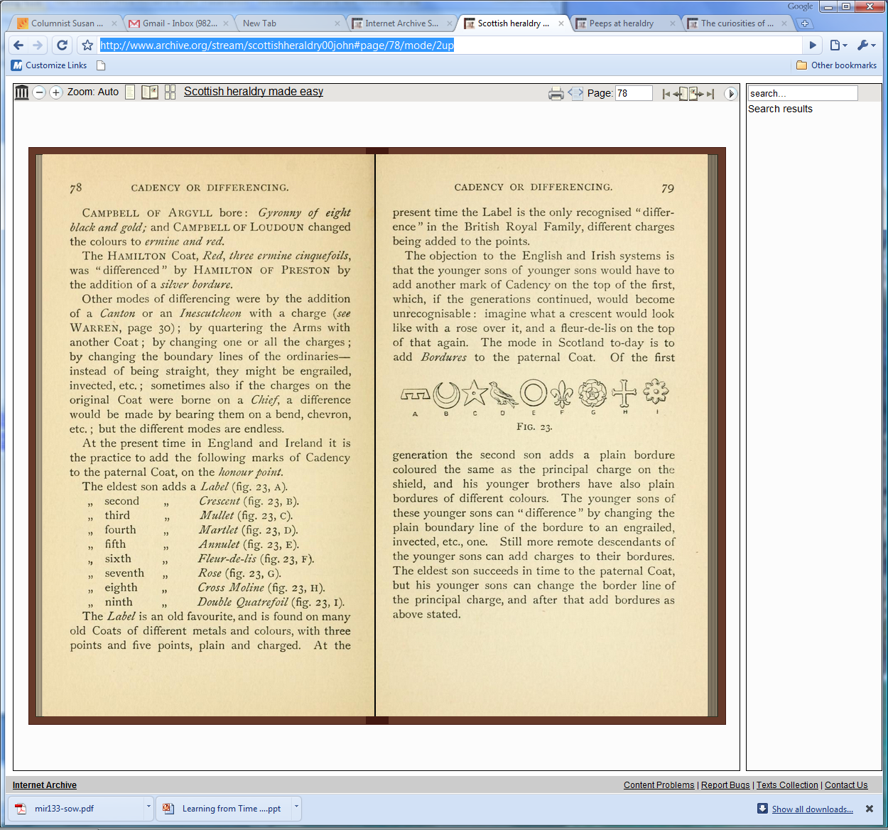
http://www.archive.org/stream/scottishheraldry00john#page/78/mode/2up

Slide 14
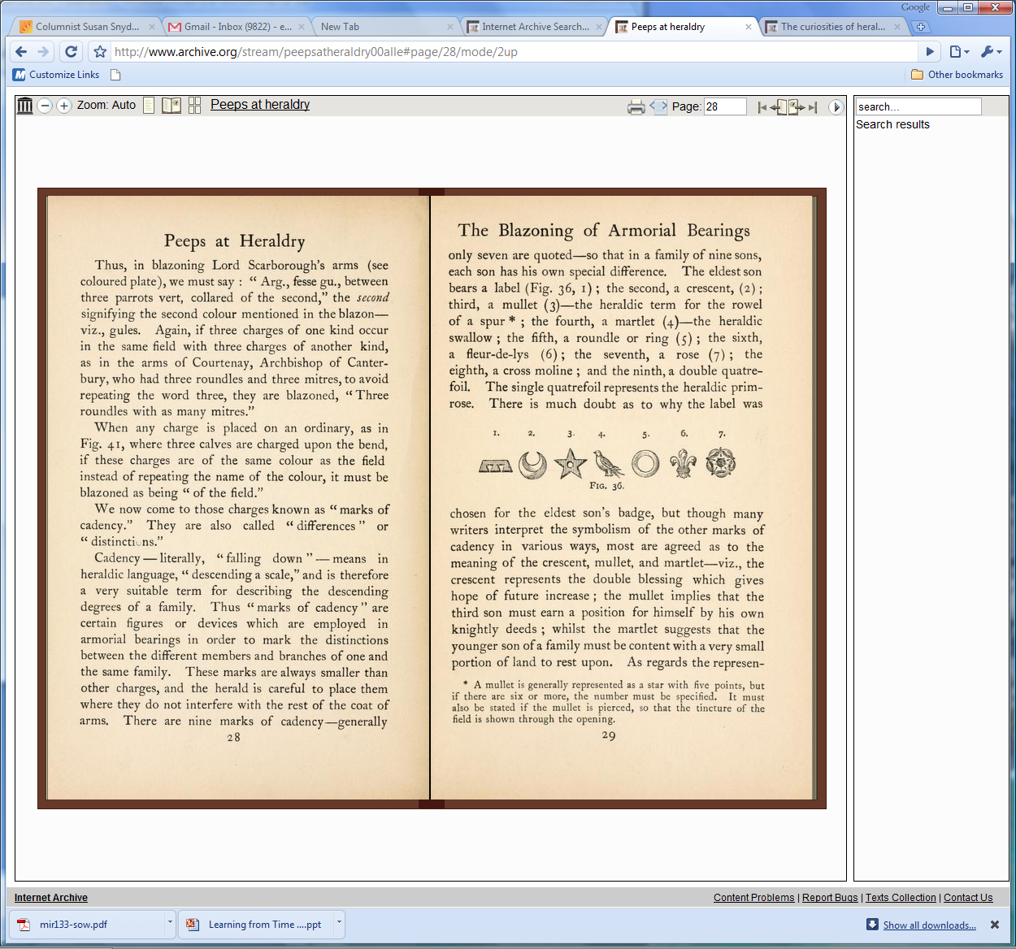
http://www.archive.org/stream/peepsatheraldry00alle#page/28/mode/2up

Slide 15
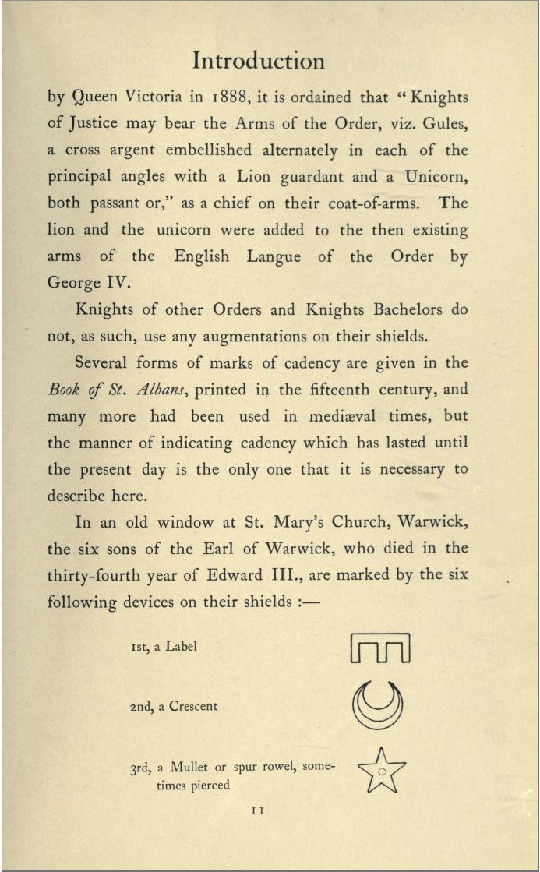
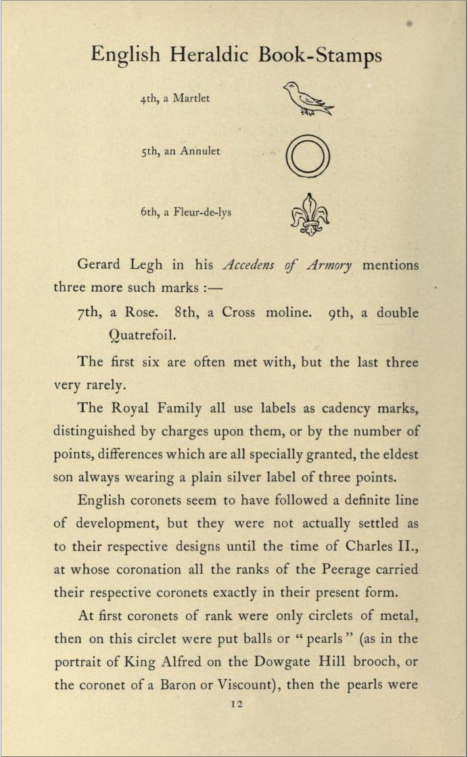
http://www.archive.org/stream/englishheraldicb00daverich#page/11/mode/1up
http://www.archive.org/stream/englishheraldicb00daverich#page/12/mode/1up

