Slide 1
Motifs across 4 heraldry books (More results)
June 14th, 2010

Slide 2
Book3 v.s. Book4
Parameters Note: Resize 85%, 100%; Window Size: 50x110; Running Time 10 sec

Slide 3
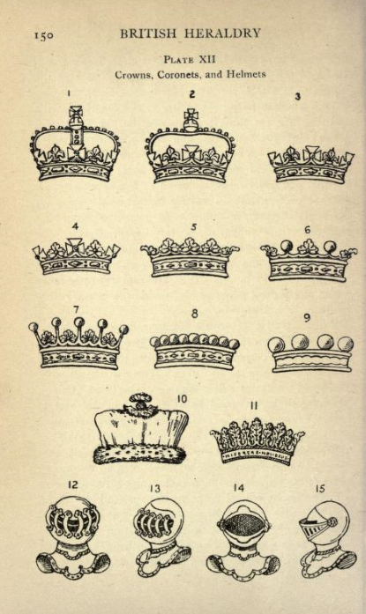
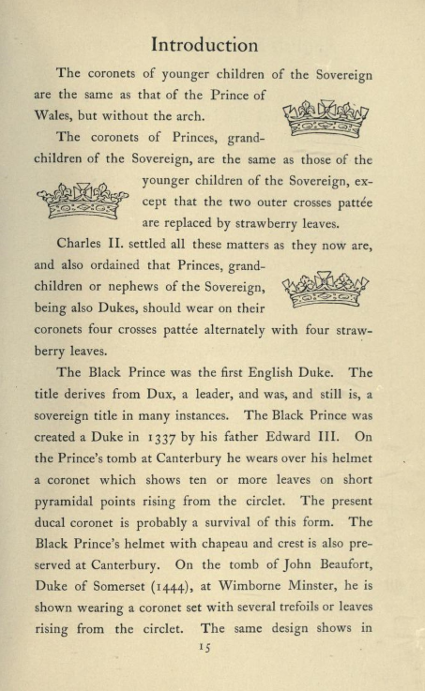
http://www.archive.org/stream/britishheraldry00daveuoft#page/150/mode/1up
Note: They are a bit different from other
http://www.archive.org/stream/englishheraldicb00daverich#page/15/mode/1up

Slide 4
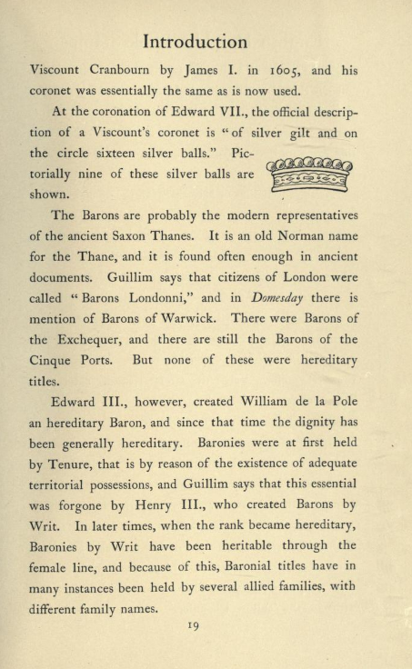
http://www.archive.org/stream/britishheraldry00daveuoft#page/150/mode/1up
http://www.archive.org/stream/englishheraldicb00daverich#page/19/mode/1up

Slide 5
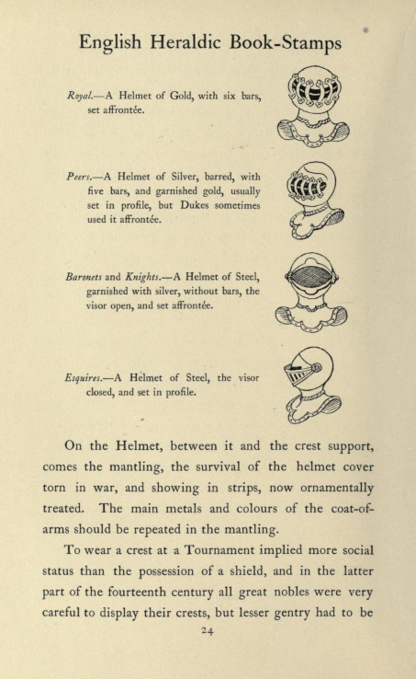
http://www.archive.org/stream/britishheraldry00daveuoft#page/150/mode/1up
http://www.archive.org/stream/englishheraldicb00daverich#page/24/mode/1up

Slide 6
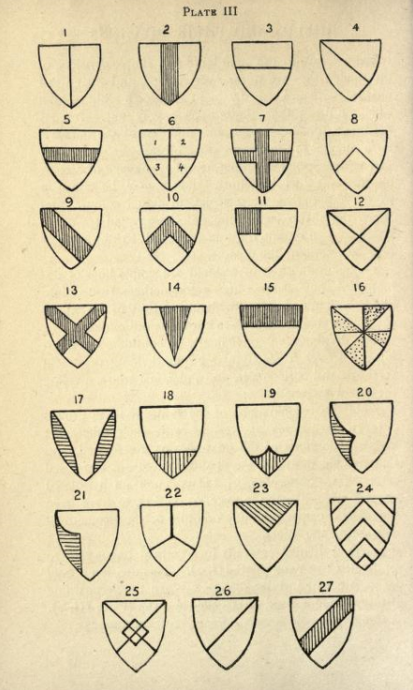
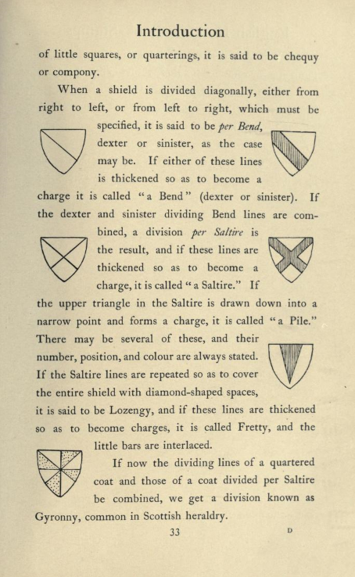
http://www.archive.org/stream/britishheraldry00daveuoft#page/18/mode/1up
http://www.archive.org/stream/englishheraldicb00daverich#page/34/mode/1up

Slide 7
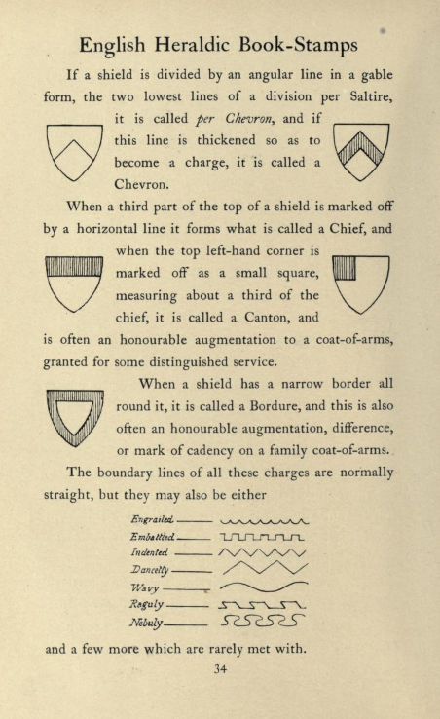
http://www.archive.org/stream/britishheraldry00daveuoft#page/18/mode/1up
http://www.archive.org/stream/englishheraldicb00daverich#page/34/mode/1up

