Slide 1
How to use Motif Join UI

Slide 2
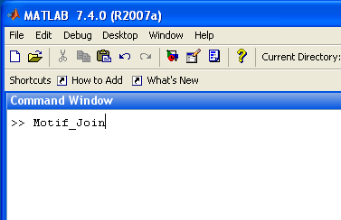
1. Open Command Window and type Motif_Join to call Motif_Join.m

Slide 3
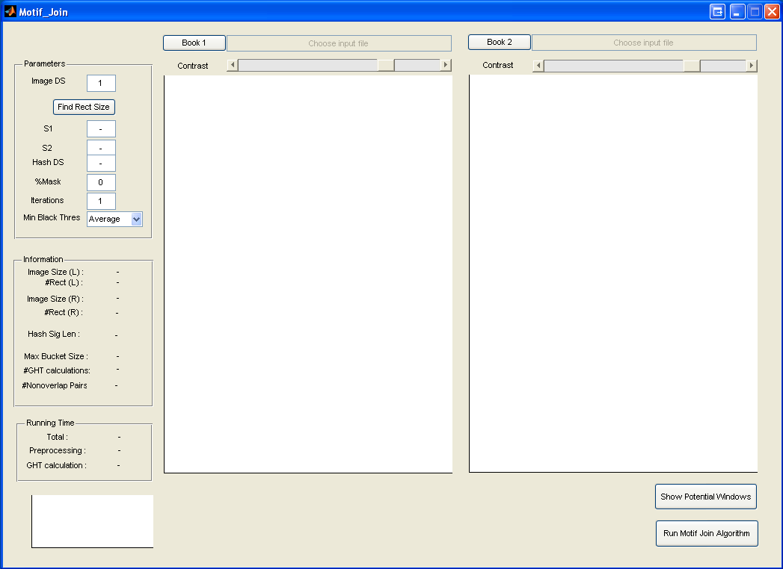
2. This is UI of Motif_Join.

Slide 4
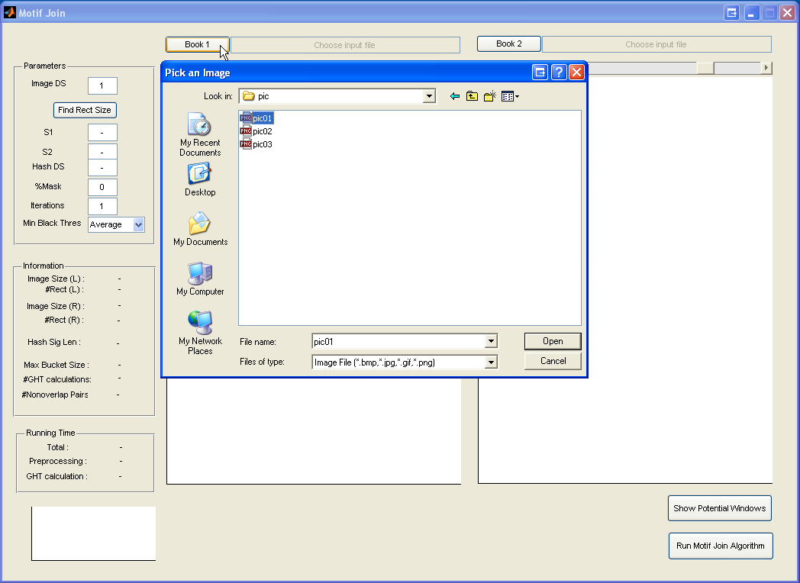
3. Click Book 1 button to load a document to the left book (Book 1).
1
2
Choose pic01.png as your document.
3

Slide 5
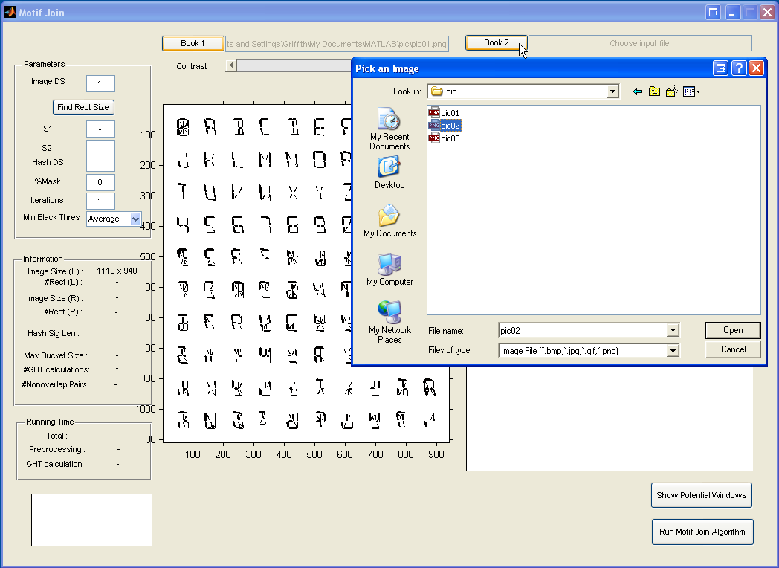
4. Click Book 2 button to load a document to the right book (Book 2).
1
2
Choose pic02.png as another document.
3

Slide 6
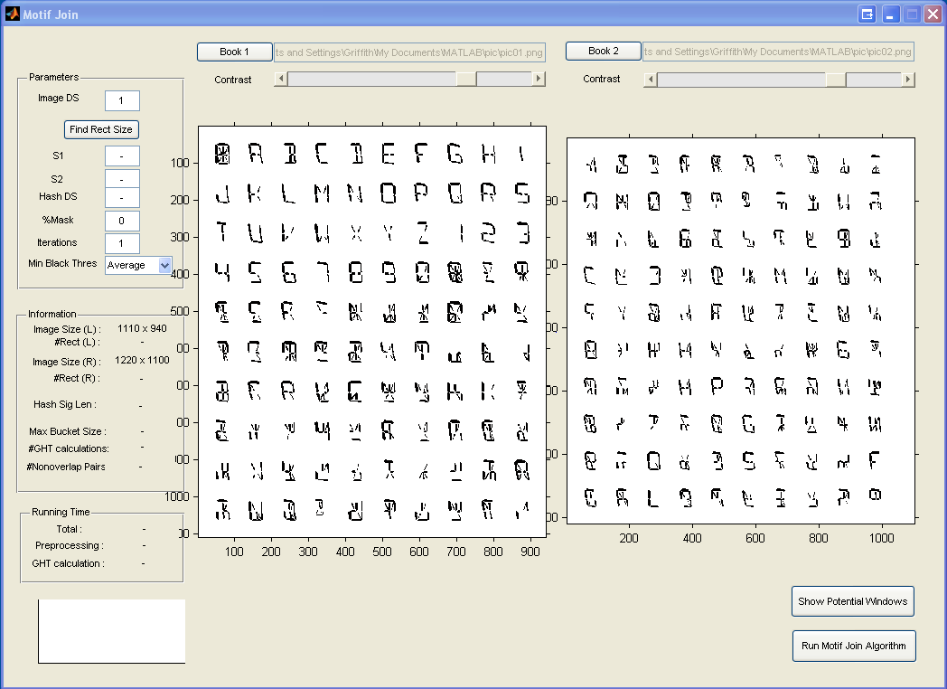
6. Your screen should look like this.
For converting a colorful image to a b/w image, you can set contract by using this bar.
BTW, for this example, you don’t need it.

Slide 7
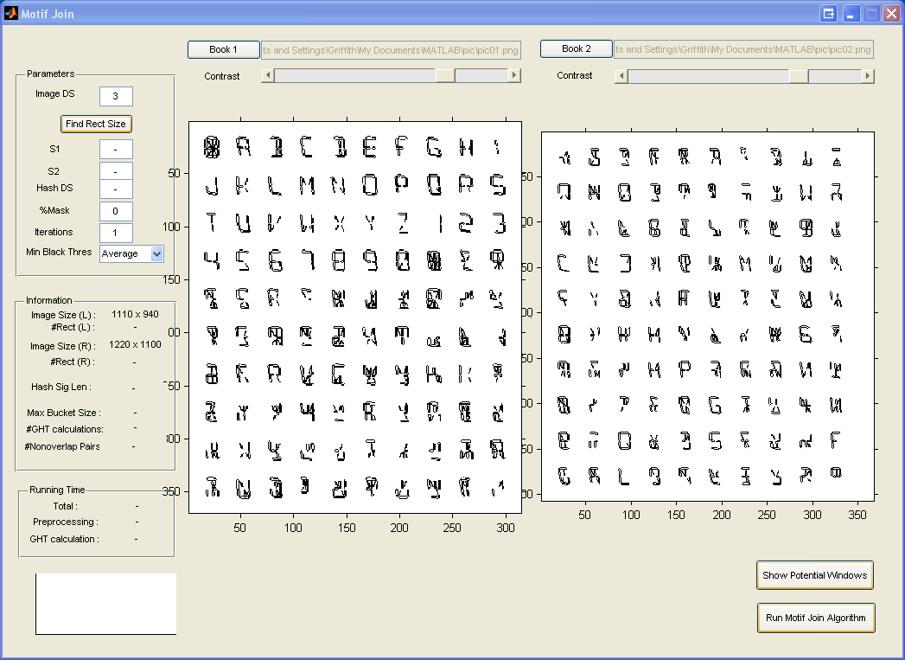
7. Downsampling both images by input small number in the Image DS. Note: To activate the effect, click anywhere on screen.
Input 3 here.
Before
1
After
2
Click anywhere in this rectangle to activate.

Slide 8
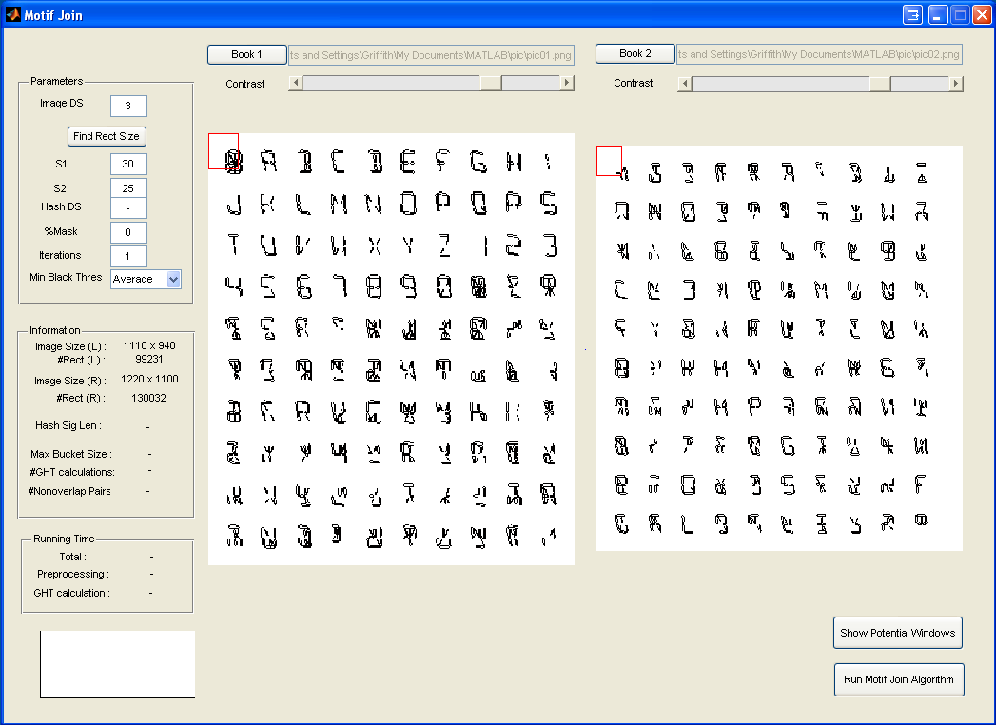
8. Input size of window in S1 and S2.
1
2
Input 30 and 25 here.
This box is appeared.

Slide 9
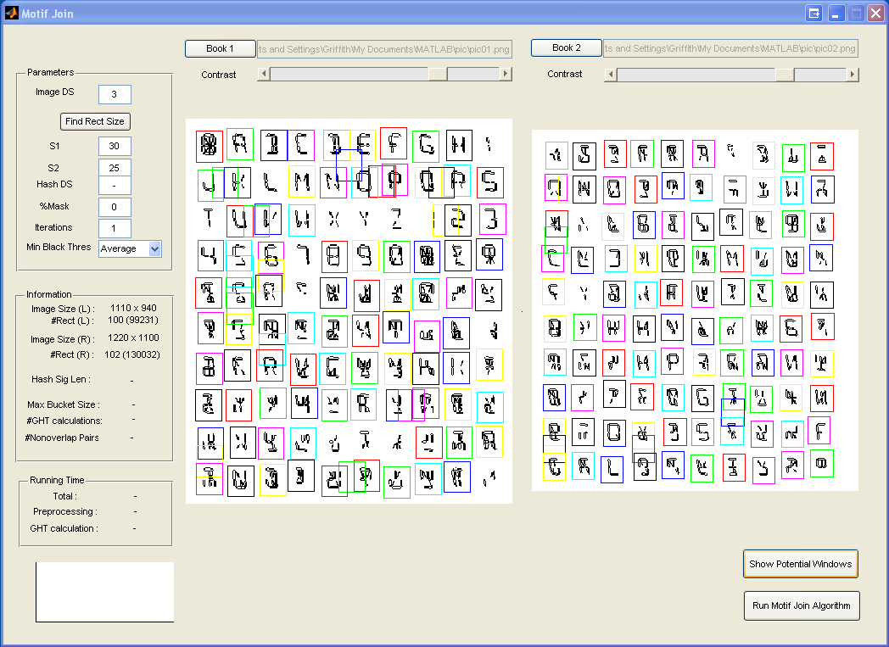
9. (Option) You can see all potential windows by click on Show Potential Windows.
Click here.
1

Slide 10
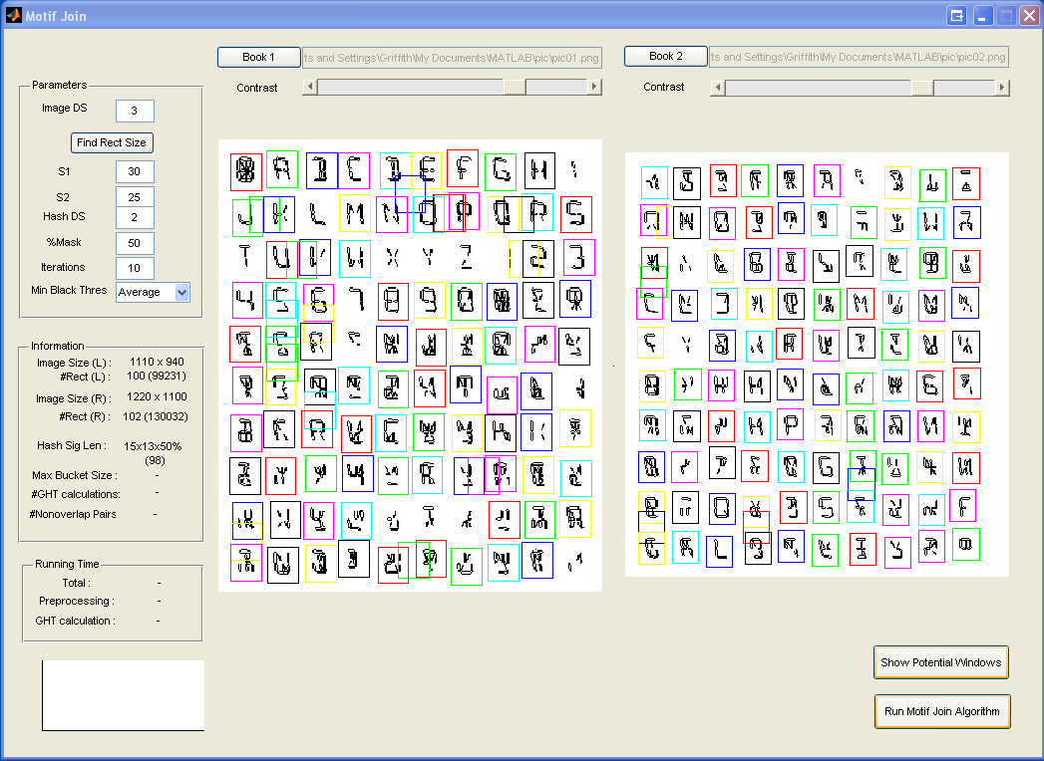
10. To find motif join, please input parameters Hash DS, %Mask and Iterations. Click Run Motif Join Algorithm and wait for a second.
1
Then,
Please input Hash DS = 2, %Mask = 50 and Iterations = 10.
Click here. Then, wait a second.
2

Slide 11
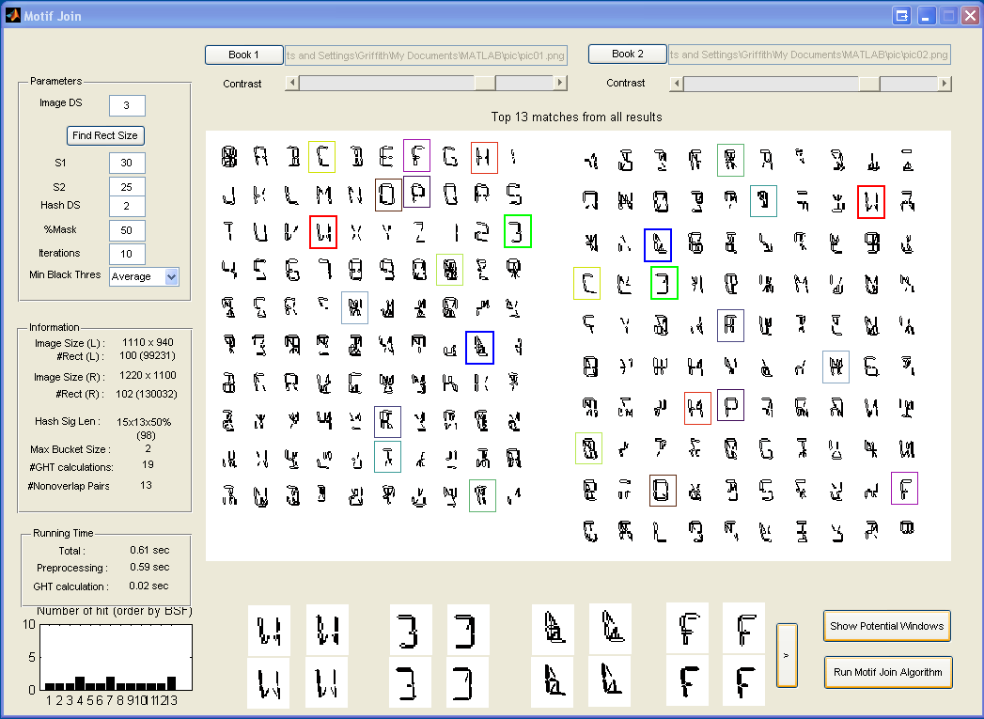
11. Now you can see motif joins in the screen. Note that the results are depended on randomization.

Slide 12
12. More explanation.
Click here.
Motif join
4th motif join (downsampling scale). One is from the left image and another is from the right image.
1st motif join (original scale). One is from the left image and another is from the right image.
Click here to see more motif join.

Slide 13
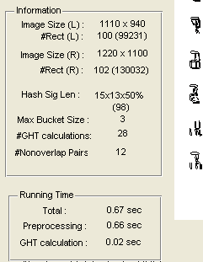
13. More explanation.
Size of image on the left (pixel²)
No. of potential windows (No. of all windows) in the left image.
In parenthesis, length of hash signature after random projection.
Number of motif join found.
Total running time.

Slide 14
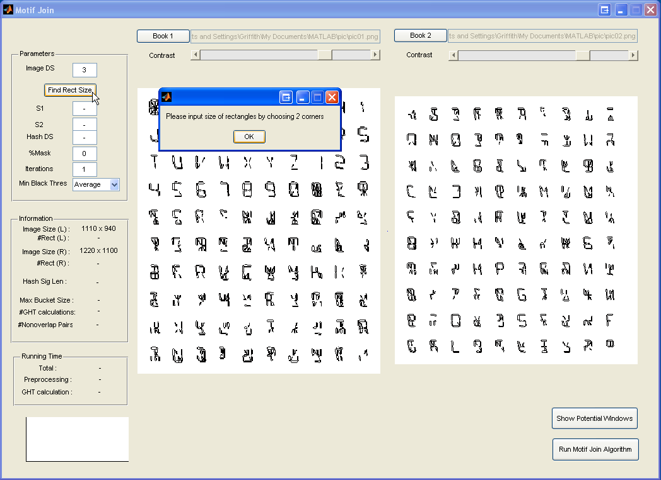
Option: Input size of window by 2 clicks. 8. Input size of window in S1 and S2.
Click here.
1
Click here once.
2
Click here once.
Click here.
3
4
Size of windows is the same as the size of the rectangle created by the first click (3), top-left corner, and the second click (4), bottom-right corner.
Next, after you define the window size, you can find potential windows or find motif joins.

Slide 15
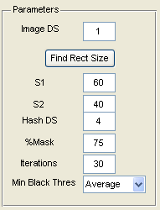
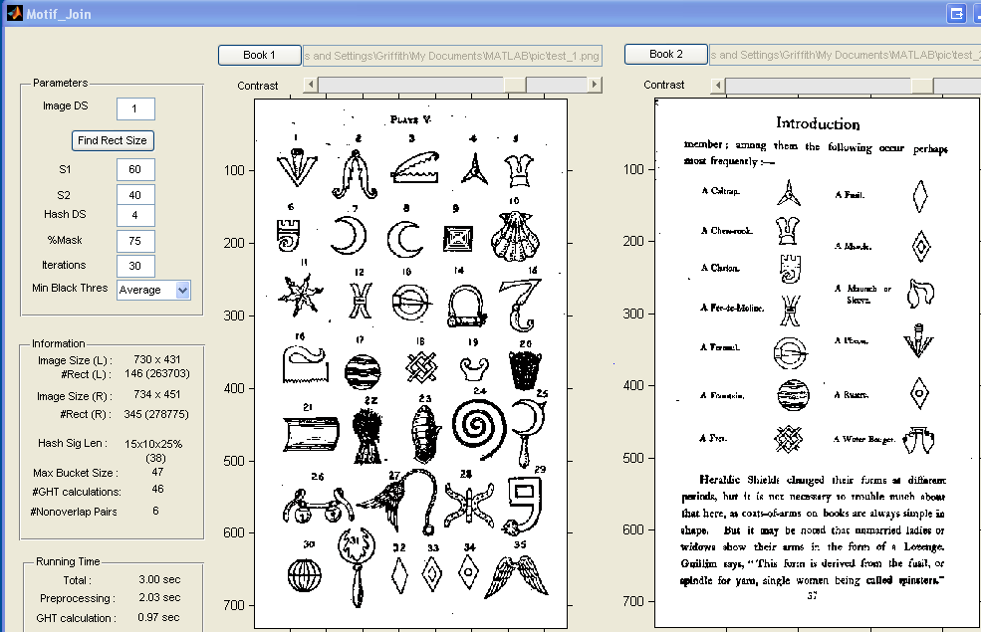
14. Test on a page from real book
Try this parameters
Open file test_1.png and test_2.png
2
1
You can try on different contrast (option).
Source: http://www.archive.org/stream/britishheraldry00daveuoft#page/28/mode/1up
Source: http://www.archive.org/stream/englishheraldicb00daverich#page/37/mode/1up

Slide 16
Congraturation !
Please feel free to download our source code and enjoy to find motifs
Note: If you want to find motifs from books of size more than 10 pages, we recommend that you should use command-line-version instead of UI.

