Slide 1
Mining Historical Archives for Near-Duplicate Figures
Thanawin Rakthanmanon, Qiang Zhu, and Eamonn J. Keogh

Slide 2
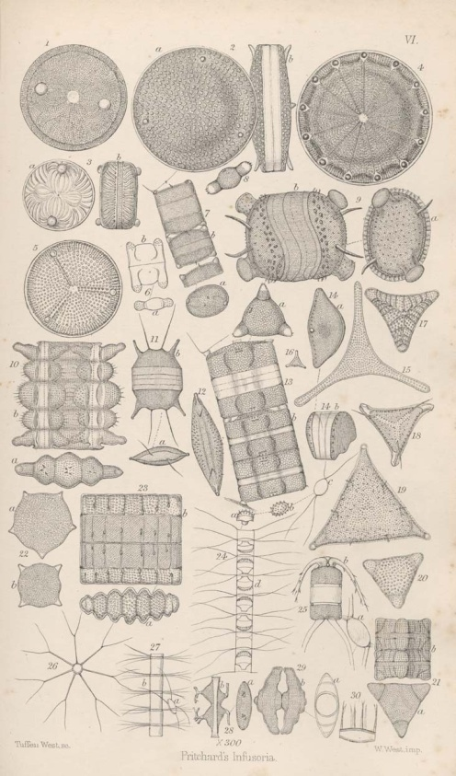
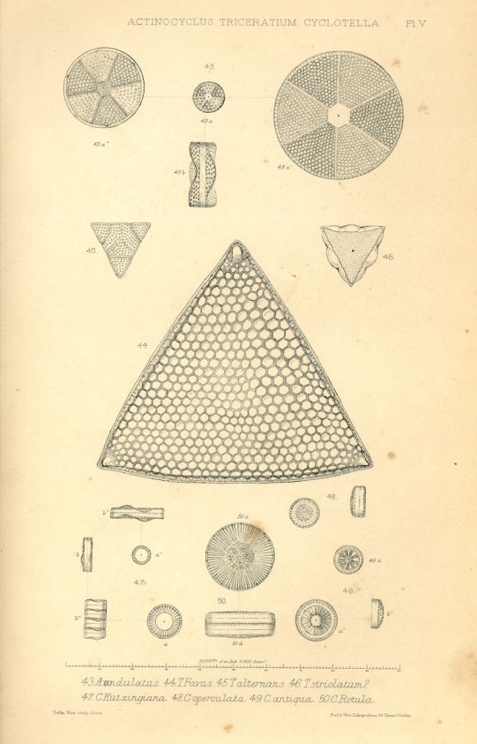
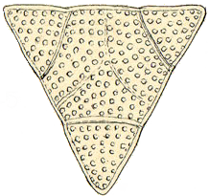
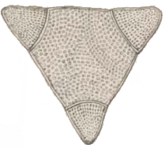
Figure 1. Two plates from 19th-century texts on Diatoms.
Plate 6 of [15] and plate 5 of [20]. middle) A zoom-in of the same species, Biddulphia alternans appearing in both texts.
 | Biddulphia alternans (J.W. Bailey) Van Heurck Synonym(s): Triceratium alternans J.W. Bailey Image source:digitised drawing Literature reference: J. Ralfs in Pritchard: A History of Infusoria (1861) , plate 6, fig. 21a View type: Valve view Scale: Image height equivalent 59µm; Image width equivalent 76µm
Biddulphia alternans (J.W. Bailey) Van Heurck
Synonym(s):
Triceratium alternans J.W. Bailey
Image source:digitised drawing
Literature reference: W. Smith: British Diatomaceae Vol.1 (1853) , plate 5, fig. 45
View type: Valve view
Scale: Image height equivalent 53µm; Image width equivalent 57µm

Slide 3
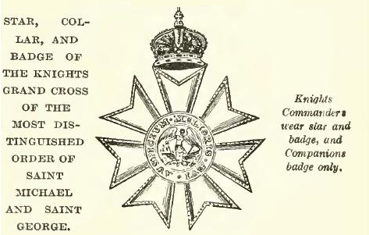

Figure 2. left) A figure from page 7 of [6], a 1915 text on
peerage. The original text is monochrome. right) A figure
from page 109 of [3], an 1858 text on honors and decorations.
[3] Burke, J. B. 1858. Book of Orders of Knighthood and Decorations of Honour of all Nations, London: Hurst and Blackett.
[6] Dod, C. R. and Dod, R. P. 1915. Dod’s Peerage, Baronetage and Knightage of Great Britain and Ireland for 1915, London: Simpkin, Marshall, Hamilton, Kent. ltd.

Slide 4
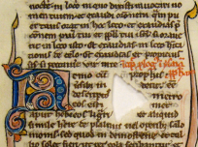
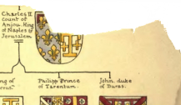
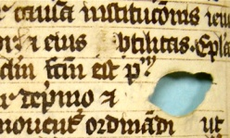
Figure 3. Examples of texts with “holes”.

Slide 5
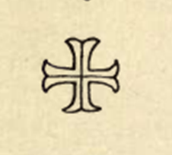
Figure 4. The distance measure we use is offset-invariant, so the distance between any pair of windows, left, center or right above, is exactly zero. This simple fact can be exploited to greatly reduce the search space of motif discovery. Since a pattern from another book that matches one of the above with a distance X must match all with distance X, we only need to include any one of the above in our search.

Slide 6
Figure 5. An illustration of our notation. Here the document D consists of two pages, separated by null values. Intuitively we expect the “T” shape in window W_{a} to match the shape shown in W_{b}. However, note that the trivial matching pair of W_{c} and W_{d} (also pair W_{e} and W_{f}) are actually more similar, and need to be excluded to prevent pathological results.
W_{b}
=W_{20,3}
W_{a}
=W_{3,2}
1
D
0
-1
W_{c}
W_{d}
W_{e}
W_{f}

Slide 7
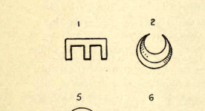
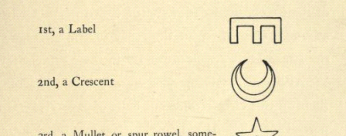
Figure 6. An illustration of a pathological solution to finding the top two motif pairs between two century-old texts. top) The desirable solution finds the crescent and label (rotated “E”). bottom) A redundant and undesirable solution that we must explicitly exclude is finding one pattern (the label) twice.

Slide 8
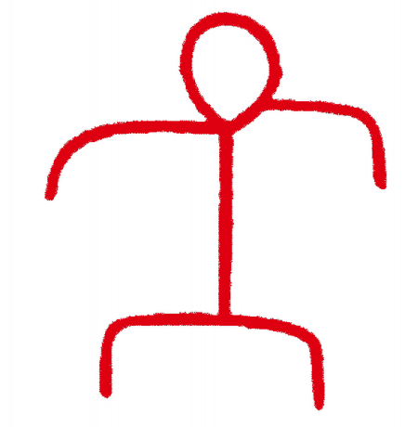
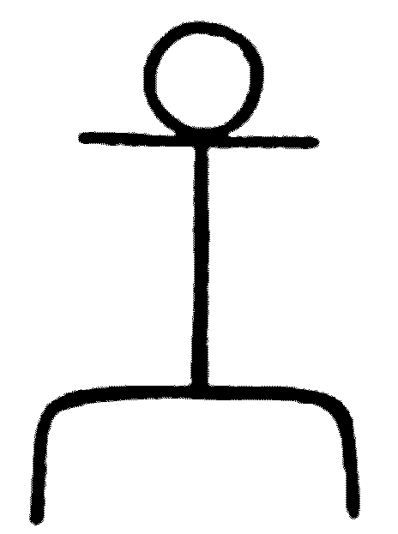
Figure 7. A) Two figures from table 16 of a 1907 text on Native American rock art [13] (one image recolored red for clarity). B) No matter how we shift these two figures, no more than 16% of their pixels overlap. C) Downsampled versions of the figures share 87.2% of their pixels (D).
A
B
C
D

Slide 9
Figure 8. A) If we randomly choose some locations (masks) on the underlying bitmap grid on which the two figures (B) shown in Figure 7 lie, and then remove those pixels from the figures, then the distance between the edited figures (C) can only stay the same or decrease. Several random attempts at removing ¼ of the pixels in the two figures eventually produced two identical edited figures (D).
A
B
C
Mask template
D

Slide 10
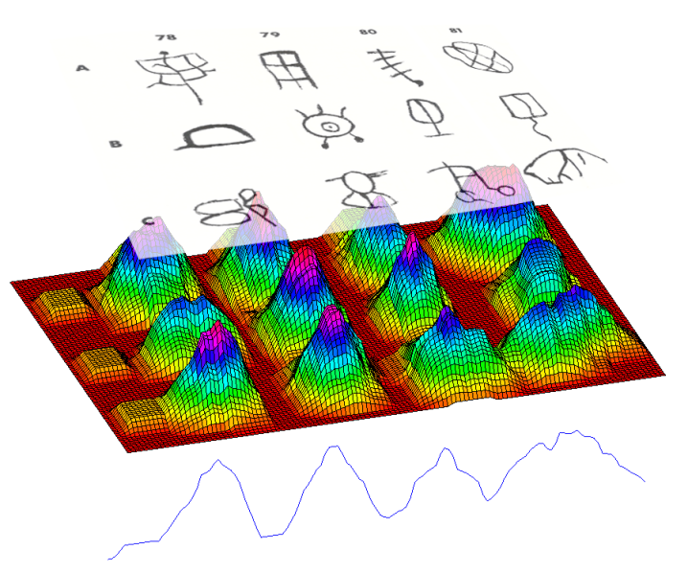
Figure 9. The summation of the number of black pixels in windows. Only windows corresponding to peaks above the threshold (the red line) need to be tested. The arrows show the center position of six potential windows.

Slide 11
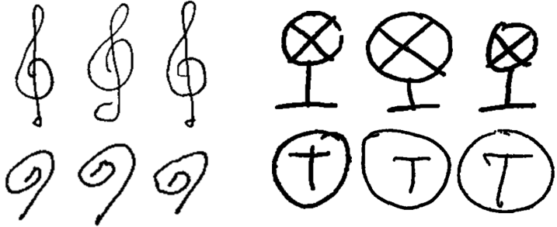
Figure 10. Samples showing the interclass variability in the hand-drawn datasets. left) Samples from the music datasets. right) Samples from the architectural dataset.

Slide 12
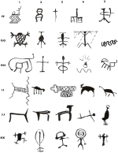
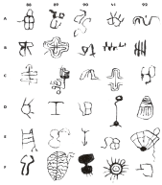
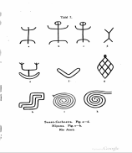
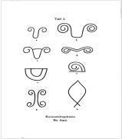
Figure 11. left) Two typical pages from Californian petroglyphs [21]. right) Two typical pages from [13]. Note that the minor artifacts are from the original Google scanning.
[13] Koch-Grünberg, T. 1907. Südamerikanische Felszeichnungen (South American petroglyphs), Berlin, E. Wasmuth A-G.
[21] Smith, G. A. and Turner, W. G. 1975. Indian Rock Art of Southern California with Selected Petroglyph Catalog, San Bernardino County, Museum Association.

Slide 13




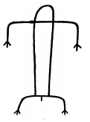


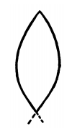


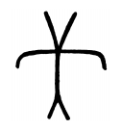

Figure 12. Six random motif pairs from the top fifty pairs created by joining the two texts [13] and [21]. Note that these results suggest that our algorithm is robust to line thickness, solid vs. hollow shapes, and various other distortions.
[13] Koch-Grünberg, T. 1907. Südamerikanische Felszeichnungen (South American petroglyphs), Berlin, E. Wasmuth A-G.
[21] Smith, G. A. and Turner, W. G. 1975. Indian Rock Art of Southern California with Selected Petroglyph Catalog, San Bernardino County, Museum Association.

Slide 14
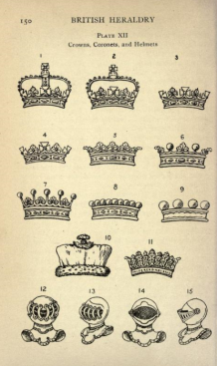
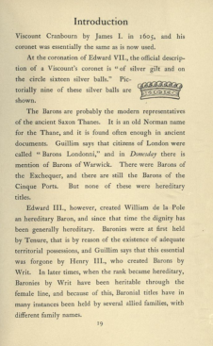
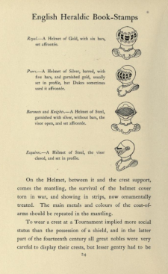
Figure 13. The top two inter-book motifs discovered when linking a 1921 text, British Heraldry [4] (left), with a 1909 text, English Heraldic Book-Stamps, Figured and Described [5] (center), and (right).
[4] Davenport, C. 1912. British Heraldry, Methuen.
[5] Davenport, C. 1909. English heraldic book-stamps, figured and described, London: Archibald Constable. ltd.

Slide 15
Figure 14. A zoom-in of the motifs discovered in Figure 13.

Slide 16
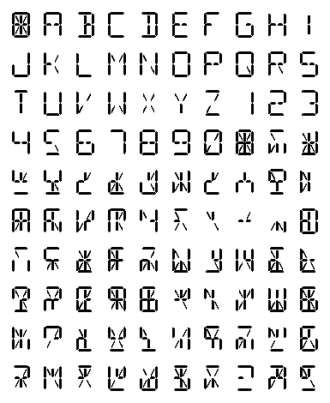
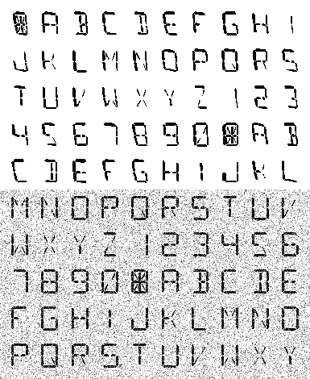


Figure 15. left) The 14-segment template used to create characters. We can turn on/off each segment independently to generate a vast alphabet. middle) An example of a page which is generated from the process. right) A page of the book after adding polynomial distortion (top half), and Gaussian noise with mean 0 and variance 0.10 (bottom half).

Slide 17
Figure 16. Time to discover motifs in books of increasing size. Our algorithm can find a motif in 512 pages in 5.5 minutes and 2048 pages in 33 minutes. (inset) As a sanity check we confirmed that the discovered motifs are plausible, as here (noise removed for clarity).

Slide 18
Figure 17. Effect of Gaussian noise. Our algorithm can handle significant amounts of noise. An example of a page containing noise at var=0.10 is shown in Figure 15.right.

Slide 19
Figure 18. The total execution time of three search algorithms: an exact motif search, an exact motif search on just the potential windows, and our algorithm ApproxMotif.
3.0
4
x 10
2.5
2.0
Exact search(all Windows)
1.5
Execution Time (sec)
Exact search(potential Windows)
1.0
0.5
ApproxMotif
0
1
2
4
8
16
32
64
128
256
512
Number of Pages
We compared the running times of:
  1. Exact motif search over the entire document by applying best known motif discovery technique in [27]
  2. Exact motif search over just the potential windows
  3. Our proposed algorithm, ApproxMotif
[27] Mueen, A. and Keogh, E. J., and Shamlo, N. B. 2009. Finding Time Series Motifs in Disk-Resident Data. ICDM, 367-376.

Slide 20
Figure 19. The effect of parameters on our algorithm. We test on artificial books with polynomial distortion and each result is averaged over ten runs. The bold/red line represents the parameters learned from just the first two pages.
600
A
400
C
60%
50%
11 iterations
400
40%
Number of Iterations
Masking Ratio
30%
200
10 iterations
200
20%
9 iterations
0
0
1
2
4
8
16
32
64
128
256
512
1
2
4
8
16
32
64
128
256
512
Execution Time (sec)
400
B
400
D
HDS = 3
DS=4
Hash Downsampling
Downsampling
DS=5
200
HDS = 2
200
DS=3
HDS = 1
0
0
1
2
4
8
16
32
64
128
256
512
1
2
4
8
16
32
64
128
256
512
Number of Pages
Number of Pages

Slide 21
Figure 20. The average distance from top-20 motifs from our algorithm and the exact search algorithm. The bold/red line shows the default parameters. This shows that the quality of motifs is not sensitive to different parameter settings and very close to the result from the exact search algorithm.
30
Mask 60%
25
Mask 50%
Masking Ratio
20
Mask 40%
Mask 30%
Average Distance
Mask 20%
15
Exact search
10
A
5
0
30
2
4
8
16
32
64
128
256
512
25
Hash Downsampling
Number of Iterations
Iteration=5
20
HDS=2 (4:1)
Iteration=9
Average Distance
HDS=3 (9:1)
Iteration=10
15
Exact search
Iteration=11
10
Iteration=20
B
C
Exact search
5
0
2
4
8
16
32
64
128
256
512
2
4
8
16
32
64
128
256
512
Number of pages
Number of pages

