Slide 1

A Network Model for the Utility Domain
Petko Bakalov, Erik Hoel, Sangho Kim

Slide 2
The context
Utility companies (water, gas, electric ,fiber, telco) have dramatically increased the autonomous capabilities of their networks
  Switching operations (reconfiguration of the network topology) are performed by autonomous devices (e.g., SCADA) in order to optimize performance and efficiency
Distributed generation (e.g., solar power) and storage (batteries, electric cars) introduce additional complexities impacting the flow of and modeling of resources in the network
Optimization of these complex dynamic systems requires a much higher fidelity of modeling than in the past; e.g.,
  Transformer banks, substations, underground
  Order of magnitude larger than previously – e.g., 100M+ features

Slide 3
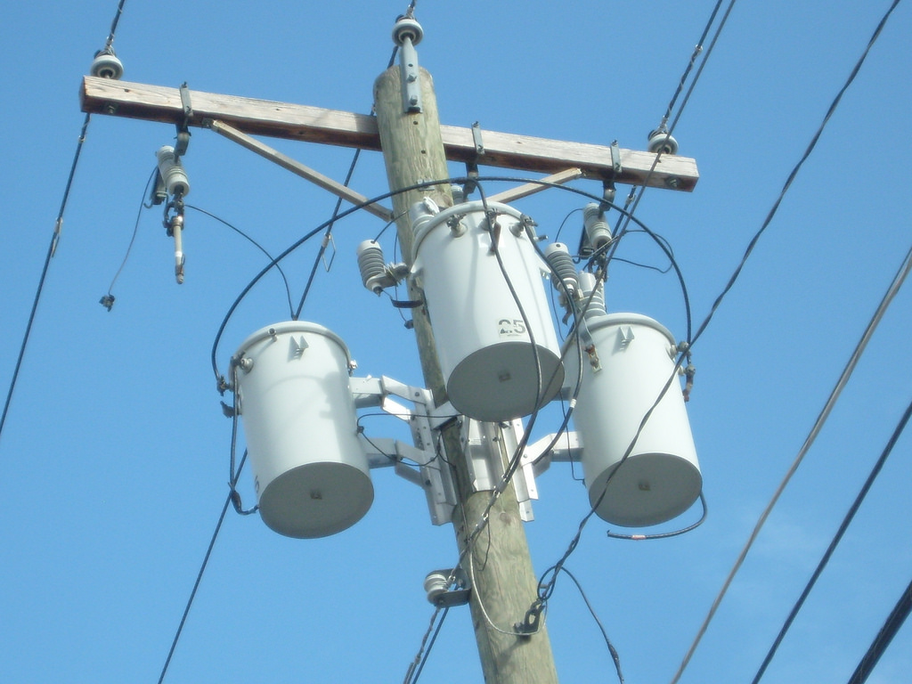
Example: transformer bank
Phase A
Phase B
Phase C
Transformer units
Arrestors
Fuses
Three phases
  A, B, C
Fuse
Arrestor
Transformer unit

Slide 4
Transformers wye-wye configuration
F
Fuse
ABCN
ABCN
A
Arrestor
T
F
A
F
B
F
C
Transformer
A
B
C
A
A
A
B
A
C
N
H1
T
H2
H1
T
H2
H1
H2
T
X3
X2
X1
X3
X2
X1
X3
X2
X1
a
b
n
c
a
b
c
n
abcn
abcn
4

Slide 5
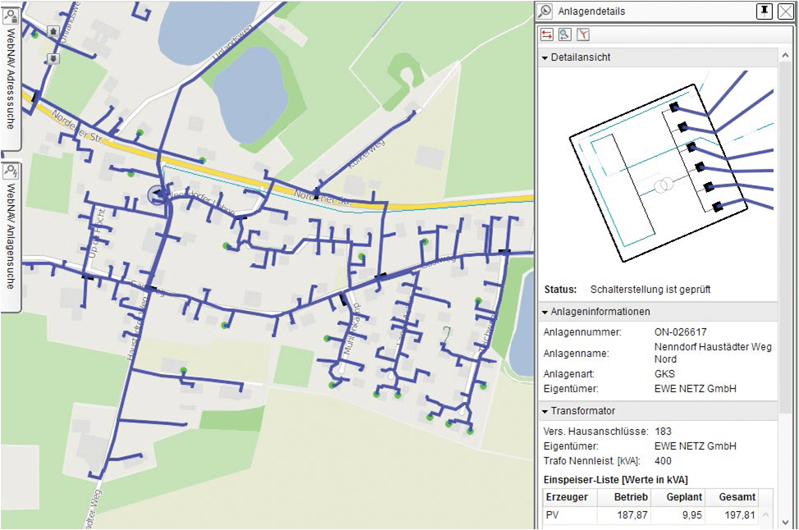
The problem
The problem: current network models have limitations and constraints that limit their ability to effectively and accurately model the rapidly increasing complexity and sophistication of the utility networks
The goal: Introduces a new utility-centric graph information model that can support the complex modeling of utility infrastructures

Slide 6
The problem
Transportation networks
Low junction valence
High depth first search analysis
~10M features
Utility networks
Medium junction valence
Mixture of BFS and DFS analysis
~100M features
Continually edited and autonomously reconfigured
Social networks
High junction valence
Shallow depth, wide breadth first search analysis
~1B features
Junction valence

Slide 7
Outline
Overview of the utility network model
Network index
  Logical structure
  Physical storage
Network index maintenance
  Establishing connectivity
  Maintaining connectivity
Experimental results

Slide 8
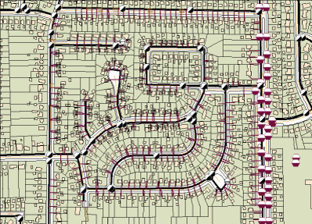
Network model definition
A mechanism for defining and managing connectivity information between features in a geodatabase
A feature is graphic representation of a real-world object
  Lines (e.g., pipes, power lines, telephone cables)
  Points (e.g., valves, transforms, switchgear)

Slide 9
Feature Sources
Network Index (Graph)
Point Features
Junction
Attributes
Edge
Attributes
Line Features
Edge
Containment
Table Sources
Junction
Associations
Metadata
Connectivity
Model
Attribute
Model
Containment

Slide 10
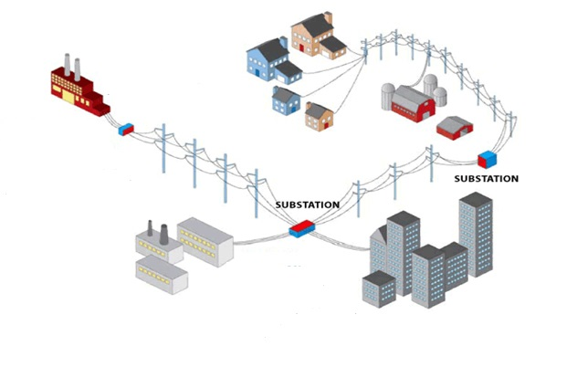
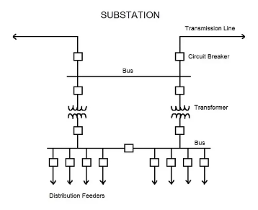
Network index elements
The connectivity information is explicitly represented with network elements that are found in an associated network index (graph)
Three types of network
elements in the index:
  Junctions
  Edges
  Containment
Junctions
Edge
Containment

Slide 11
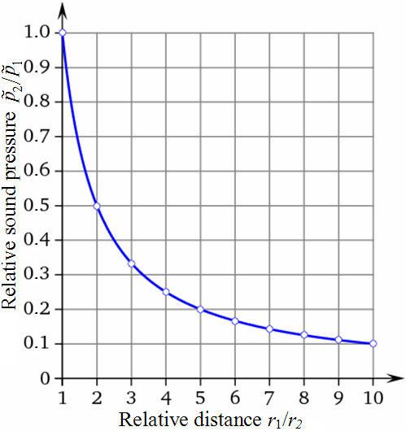
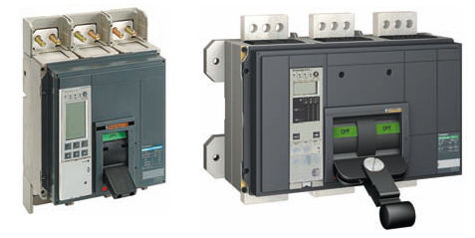
Network index attributes
Network attributes are properties of the network elements that control traversability
  Cost. Certain attributes are used to measure and model impedances, such as voltage drop
  Descriptors. Those are attributes that describe characteristics of the network or its elements – such as open/closed switch

Slide 12
Network model maintaining the index
Build – the process of discovering geographic coincidence between features that are persisted as junction and edges in the network index
As edits are made to the features, the network index becomes stale
We keep track of the modified features
  Employ the dirty area concept (an envelope encompassing the edited feature)
  When a feature is modified, a dirty area is created
The build process incrementally maintains the network index based upon the present dirty areas

Slide 13
Outline
Overview of the utility network model
Network index
  Logical structure
  Physical storage
Network index maintenance
  Establishing connectivity
  Maintaining connectivity
Experimental results

Slide 14
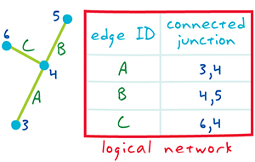
Network index logical structure
Network Index
Connectivity between the features in the model using foreign keys
Those are referred as EIDs
  Junction EIDs
  Edge EIDs
  Containment EDs
Very compact representation

Slide 15
Network index logical structure
Typically stored in RDBMS
The information in the network topology is stored in a set of binary and relational tables
Network index
Feature Source
Connectivity
Tables
Element Mapping Table
Network
Attribute
Tables
Feature Source
Feature Source
Reverse Mapping Tables
Containment& Structural attachment
Tables
Metadata
Tables

Slide 16
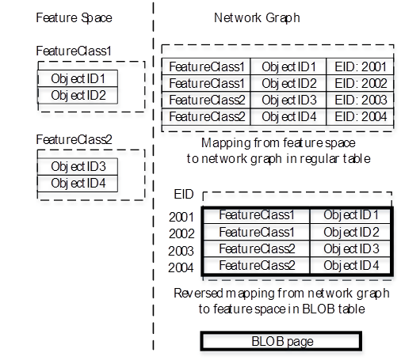
Logical network model element mapping
The Element mapping tables contains the mapping information between feature space and network elements.
Foreword element mapping – done using regular database table.
Reverse element mapping – done using binary table

Slide 17
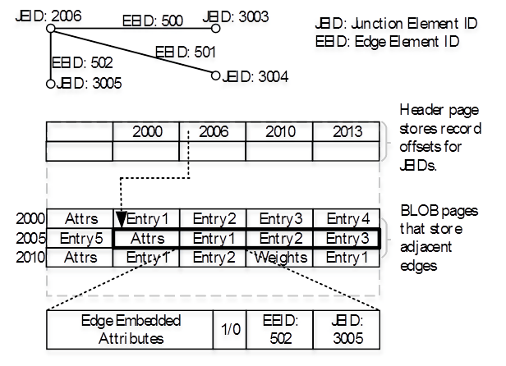
Logical network model connectivity table
The schema structure is designed to answer the most common adjacency query during analysis
“find the edges and junctions connected to a given junction”
For each junction, we store adjacent edge IDs, and also the IDs of the junctions at the other end of the edges
  This includes the from and to edges

Slide 18
Physical storage model fixed length binary records
A BLOB table is essentially a contiguous binary stream of records, in which the physical storage is divided into multiple BLOB pages
Each record in the fixed size BLOB has a fixed size so the page number and the offset of the record in respect to the beginning of the page can be directly calculated

Slide 19
Physical storage model variable length binary records
The connectivity and relationship information have variable length by nature
We fix the number of records per page - 4K
We need a fixed length index structure (or header) at the beginning of each BLOB page to store the record offsets

Slide 20
Outline
Overview of the utility network model
Network index
  Logical structure
  Physical storage
Network index maintenance
  Establishing connectivity
  Maintaining connectivity
Experimental results

Slide 21
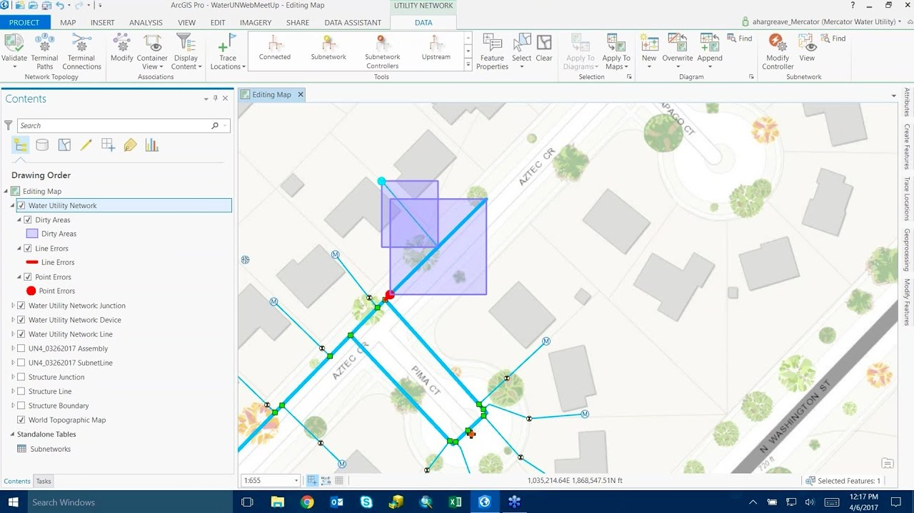
Build algorithm
Initial build of the network index
  Simply a special case of a rebuild over a dirty region that encompasses the entire network
  Network index is empty prior
  to the initial build
Incremental (re)builds
  Rebuilt region corresponds to
  the dirty regions
  When we rebuild the dirty
  regions, the resulting network
  index is completely correct

Slide 22
Build algorithm step 1: data extraction
Extract the geometry of all features in the network model.
Decompose line geometry into its constituent vertices
Store the points and vertices in a single table with X,Y attributes.

Slide 23
Build algorithm step 2: connectivity analysis
Sort the vertex information in the table by coordinate values so that the coincident vertexes are grouped together
Analyze each group of coincident vertexes according to the connectivity model

Slide 24
Build algorithm
Step 3: junction creation
Create junction elements and populate vertex information table from the extracted connectivity nodes
For each connectivity node
Create a junction element
If there is a point feature in node
Associate the junction with the point
For each line vertex
Tag the record with the junction element

Slide 25
Build algorithm step 4: edge creation
Create edge elements from vertex information table
Sort the vertex information table using FID
For each adjacent pair of records
If the pair involves the same line feature
Create an edge between them

Slide 26
Outline
Overview of the utility network model
Network index
  Logical structure
  Physical storage
Network index maintenance
  Establishing connectivity
  Maintaining connectivity
Experimental results

Slide 27
Experimental results build algorithm profiling
Expensive steps are reading and writing to the RDBMS
Sorting takes only 3% of the total time

Slide 28
Experimental results page size sensitivity
The increase of the page size improves the performance of the analytical operation
However BLOBs take more time to be transmitted over the network
Optimal size page - 64 KB

Slide 29
Experimental results cache size sensitivity
Because we performed spatial clustering the trace was able to stay focused only on the most recently picked pages
The LRU cache replacement policy was performing extremely well.

Slide 30
(we’re hiring)

