Slide 1
Molecular Evolution and Reconstruction of Evolutionary Trees

Slide 2
Outline
Evolutionary/Phylogenetic Tree Reconstruction
“Out of Africa” hypothesis
Did we evolve from Neanderthals?
Distance Based Phylogeny
Neighbor Joining Algorithm
Additive Phylogeny
Least Squares Distance Phylogeny
UPGMA
Character Based Phylogeny
Small Parsimony Problem
Fitch and Sankoff Algorithms
Large Parsimony Problem
Maximum Likelihood Method
Evolution of Wings
HIV Evolution
Evolution of Human Repeats

Slide 3
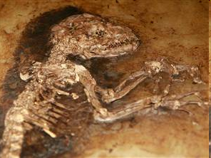
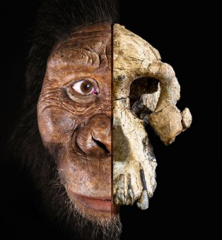
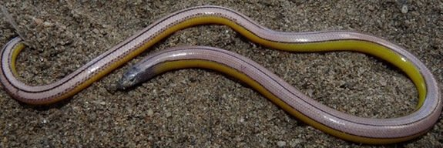
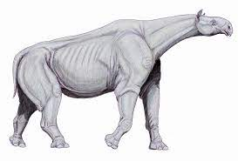
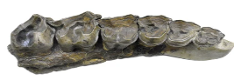
(Early) Evolutionary Studies
Anatomical features were the dominant criteria used to derive evolutionary relationships between species since Darwin till early 1960s
The evolutionary relationships derived from these relatively subjective observations were often inconclusive. Some of them were later proved incorrect
(Left) 47 million year old primate fossil found 5/17/09. (Right) 3.8 million year old human ancestor skull reported 8/28/19
(L) Legless lizards have ear opening and movable eyelids 9/20/13. (R) Largest land animal Paraceratherium was ided with molars 6/17/21
Notes:
As large as 4 African elephants hornless rhino

Slide 4
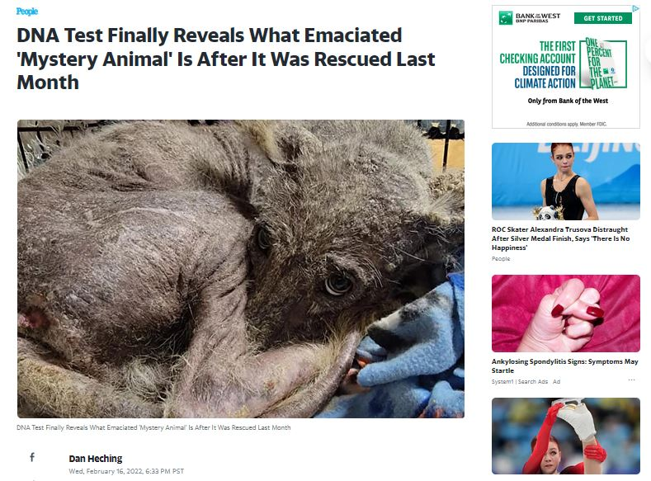
DNA Test Finally Reveals What Emaciated ‘Mystery Animal’ Is After It Was Rescued Last Month

Slide 5
Evolution and DNA Sequence Analysis: the Giant Panda Riddle
For roughly 100 years scientists were unable to figure out which family the giant panda belongs to
Giant pandas look like bears but have features that are unusual for bears and typical for raccoons, e.g., they do not hibernate
In 1985, Steven O’Brien and colleagues solved the giant panda classification problem using DNA sequences and algorithms

Slide 6
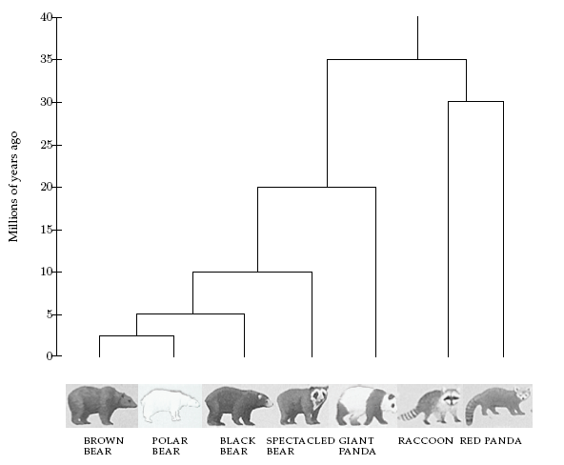
Evolutionary Tree of Bears and Raccoons

Slide 7
Evolutionary Trees: DNA-based Approach
40 years ago: Emile Zuckerkandl and Linus Pauling brought reconstructing evolutionary relationships with DNA into the spotlight
In the first few years after Zuckerkandl and Pauling proposed using DNA for evolutionary studies, the possibility of reconstructing evolutionary trees by DNA analysis was hotly debated
Now it is a dominant approach to study evolution.

Slide 8
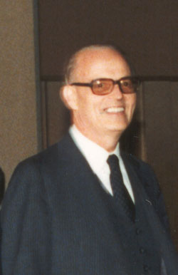
Emile Zuckerkandl on human-gorilla evolutionary relationships:
From the point of hemoglobin structure, it appears that gorilla is just an abnormal human, or man an abnormal gorilla, and the two species form actually one continuous population.
Emile Zuckerkandl,
Classification and Human Evolution, 1963

Slide 9

Gaylord Simpson vs. Emile Zuckerkandl:
From the point of hemoglobin structure, it appears that gorilla is just an abnormal human, or man an abnormal gorilla, and the two species form actually one continuous population.
Emile Zuckerkandl,
Classification and Human Evolution, 1963
From any point of view other than that properly specified, that is of course nonsense. What the comparison really indicate is that hemoglobin is a bad choice and has nothing to tell us about attributes, or indeed tells us a lie.
Gaylord Simpson, Science, 1964

Slide 10
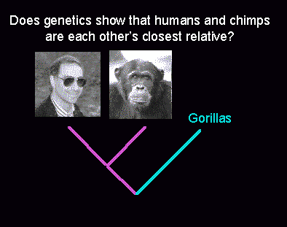
Who are closer?

Slide 11
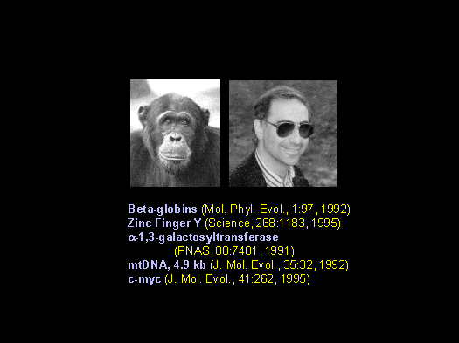
Human-Chimpanzee Split?

Slide 12
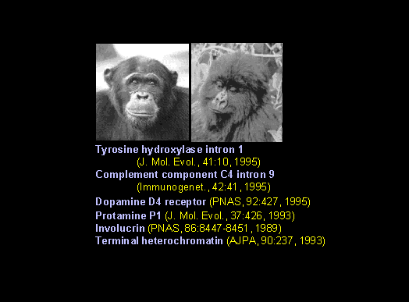
Chimpanzee-Gorilla Split?

Slide 13
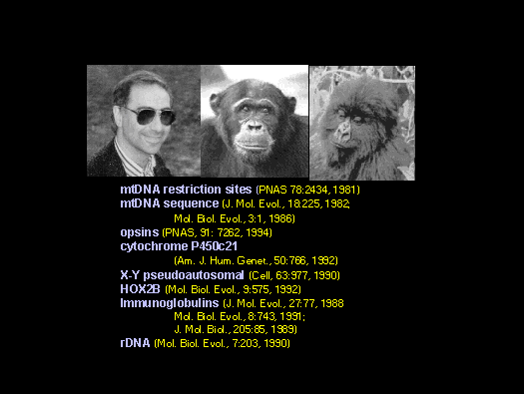
Three-way Split?

Slide 14
Out of Africa Hypothesis
Around the time the giant panda riddle was solved, a DNA-based reconstruction of the human evolutionary tree led to the Out of Africa Hypothesis that claims our most ancient ancestor lived in Africa roughly 150,000 years ago

Slide 15
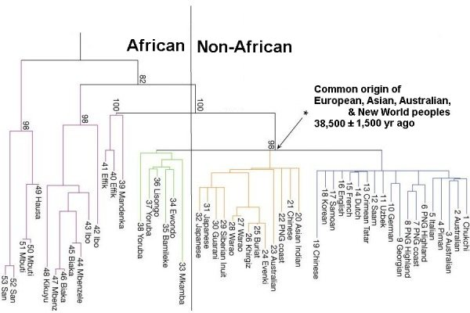
Human Evolutionary Tree (cont’d)
http://www.mun.ca/biology/scarr/Out_of_Africa2.htm

Slide 16
The Origin of Humans:
”Out of Africa” vs Multiregional Hypothesis
Out of Africa:
  Humans evolved in Africa ~150,000 years ago
  Humans migrated out of Africa, replacing other humanoids around the globe
  There is no direct descendence from Neanderthals
Multiregional:
  Humans migrated out of Africa mixing with other humanoids on the way
  There is a genetic continuity from Neanderthals to humans
  Humans evolved in the last two million years as a single species. Independent appearance of modern traits in different areas

Slide 17
mtDNA Analysis Supports the
“Out of Africa” Hypothesis
African origin of humans inferred from:
  African population was the most diverse
  (sub-populations had more time to diverge)
  The evolutionary tree separated one group of Africans from a group containing all five populations
  Tree was rooted on branch between groups of greatest difference

Slide 18
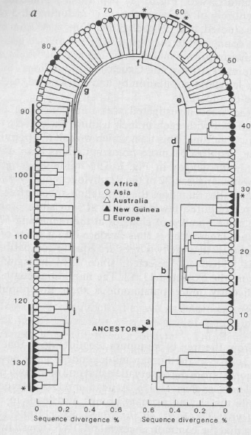
Evolutionary Tree of Humans (mtDNA)
The evolutionary tree separates one group of Africans from a group containing populations from all five continents
Vigilant, Stoneking, Harpending, Hawkes, and Wilson (1991)

Slide 19
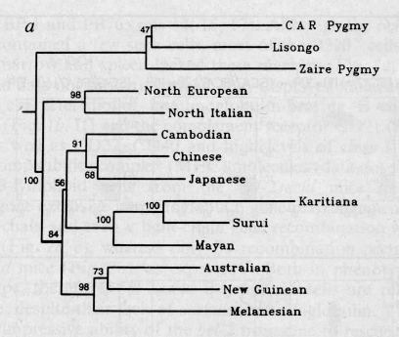
Evolutionary Tree of Humans: (Microsatellites)
Neighbor joining tree for 14 human populations genotyped with 30 microsatellite loci

Slide 20
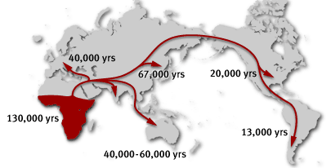
Human Migration Out of Africa
1. Yorubans
2. Western Pygmies
3. Eastern Pygmies
4. Hadza
5. !Kung
1
2
3
4
5
http://www.becominghuman.org

Slide 21
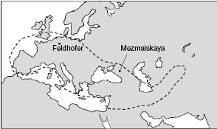
Two Neanderthal Discoveries
Feldhofer, Germany
Mezmaiskaya, Caucasus
Distance: 2500km

Slide 22
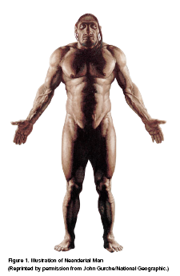
Two Neanderthal Discoveries
Is there a connection between Neanderthals and today’s Europeans?
If humans did not evolve from Neanderthals, whom did we evolve from?

Slide 23
Multiregional Hypothesis?
May predict some genetic continuity from the Neanderthals through to the Cro-Magnons (i.e., anatomically modern humans or AMHs) up to today’s Europeans
Can explain the occurrence of varying regional characteristics

Slide 24
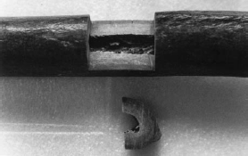

Sequencing Neanderthal’s mtDNA
mtDNA from the bone of Neanderthal is used because it is up to 1,000x more abundant than nuclear DNA
DNA decay overtime and only a small amount of ancient DNA can be recovered (upper limit: 100,000 years)
PCR of mtDNA (fragments are too short, human DNA may be mixed in)

Slide 25
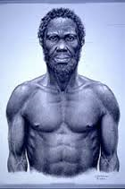
Neanderthals vs Humans:
Surprisingly large divergence
  AMH vs Neanderthal:
    22 substitutions and 6 indels in a 357bp region
  AMH vs AMH
    only 8 substitutions
  However, a draft Neanderthal genome was sequenced in 2010, suggesting 1% - 4% contribution to non-African human genomes and some evidence of interbreeding (2022 Nobel Prize, Svante Paabo!)

Slide 26
Evolutionary Trees
How are these trees built from DNA sequences?

Slide 27
Evolutionary Trees (or Phylogenetic Trees or Phylogenies)
How are these trees built from DNA sequences?
In an evolutionary tree,
  leaves represent existing species (or taxa)
  internal vertices represent ancestors (and speciation events)
  root represents the oldest evolutionary ancestor
  edges (and subtrees under them) are sometimes called lineages

Slide 28
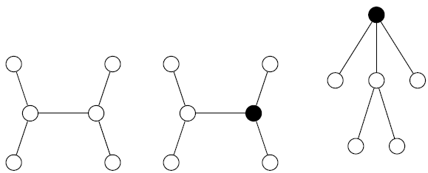
Rooted and Unrooted Trees
  In an unrooted tree, the position of the root (“oldest ancestor”) is unknown. Otherwise, they are like rooted trees. We are especially interested in degree-3 (unrooted) trees because they correspond to binary phyolegenies

Slide 29
Distances in Trees
Edges may have weights reflecting:
  Number of mutations in the evolutionary process from one species to another
  Time estimate for evolution from one species into another
In an (unrooted or rooted) tree T, we often compute
d_{ij}(T) - the length of the path between leaves i and j
d_{ij}(T) is called the tree distance between i and j

Slide 30
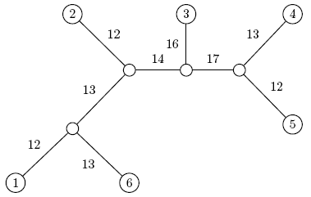
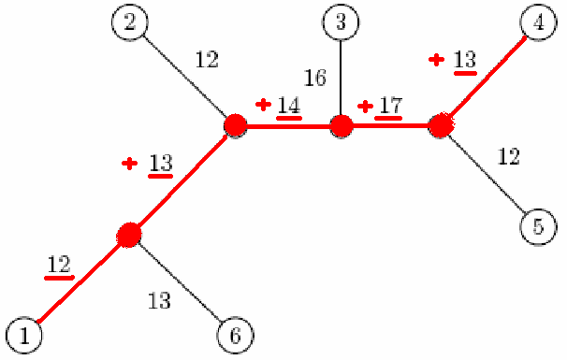
Distance in Trees: an Example
j
i
d_{1,4} = 12 + 13 + 14 + 17 + 12 = 68

Slide 31
Distance Matrix
Given n species, we can compute an n x n distance matrix D
D_{ij} may be defined as the (weighted) edit distance between the same gene in species i and j, where the gene of interest is sequenced for all n species
D_{ij} – edit distance between i and j
(min number of edit operations to transform one sequence into the other)
An alignment displays how to edit one sequence into the other using operations insertion, deletion, and substitutions. The largest score implies the smallest editing cost. So, the (weighted) edit distance basically complements the optimal alignment score, and can thus be viewed as the alignment cost.
ACTGGA T
AGT GACT

Slide 32
Edit Distance vs. Tree Distance
Given n species, we can compute the n x n distance matrix D
D_{ij} may be defined as the (weighted) edit distance between the same gene in species i and species j, where the gene of interest is sequenced for all n species
D_{ij} – edit distance between i and j
Note the difference from
d_{ij}(T) – tree distance between i and j

Slide 33
Fitting Distance Matrix
Given n species, we can compute the n x n distance matrix D
Evolution of these genes is described by a tree that we don’t know
We need an algorithm to construct a tree that best fits the distance matrix D

Slide 34
Fitting Distance Matrix
Fitting means D_{ij} = d_{ij}(T)
Length of path in an (unknown) tree T
Edit distance between species (known)

Slide 35
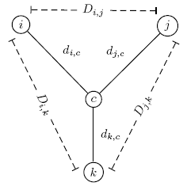
Reconstructing a 3 Leaved Tree
Tree reconstruction for any 3x3 matrix is straightforward
We have 3 leaves i, j, k and a center vertex c
Observe:
d_{ic} + d_{jc} = D_{ij}
d_{ic} + d_{kc} = D_{ik}
d_{jc} + d_{kc} = D_{jk}

Slide 36
Reconstructing a 3 Leaved Tree (cont’d)
d_{ic} + d_{jc} = D_{ij}
+ d_{ic} + d_{kc} = D_{ik}
2d_{ic} + d_{jc} + d_{kc} = D_{ij} + D_{ik}
2d_{ic} + D_{jk} = D_{ij} + D_{ik}
d_{ic} = (D_{ij} + D_{ik} – D_{jk})/2
Similarly,
d_{jc} = (D_{ij} + D_{jk} – D_{ik})/2
d_{kc} = (D_{ki} + D_{kj} – D_{ij})/2

Slide 37
Trees with > 3 Leaves
A degree-3 tree with n leaves has 2n-3 edges
This means fitting a given tree to a distance matrix D requires solving a system of “n choose 2” equations with 2n-3 variables
This is not always possible to solve for n > 3

Slide 38
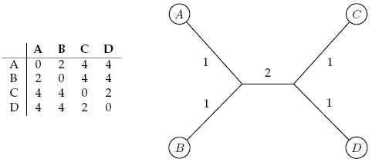

Additive Distance Matrices
Matrix D is ADDITIVE if there exists a tree T with d_{ij}(T) = D_{ij}
NON-ADDITIVE otherwise

Slide 39
Distance Based Phylogenetic Reconstruction
Goal: Reconstruct an evolutionary tree from a distance matrix
Input: n x n distance matrix D
Output: weighted tree T with n leaves fitting D
If D is additive, this problem has a solution and there is a simple algorithm to solve it

Slide 40
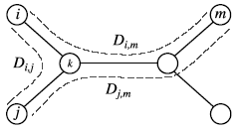
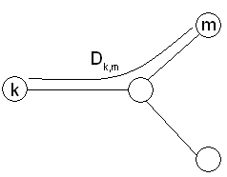
Using Neighboring Leaves to Construct the Tree
Find neighboring leaves i and j with parent k
Remove the rows and columns of i and j
Add a new row and column corresponding to k, where the distance from k to any other leaf m can be computed as:
D_{km} = (D_{im} + D_{jm} – D_{ij})/2
Compress i and j into k, and iterate algorithm for rest of tree

Slide 41
Finding Neighboring Leaves
To find neighboring leaves we could simply select a pair of closest leaves

Slide 42
Finding Neighboring Leaves
To find neighboring leaves we could simply select a pair of closest leaves
WRONG!

Slide 43
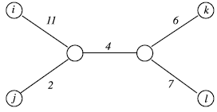
Finding Neighboring Leaves
Closest leaves aren’t necessarily neighbors
i and j are neighbors, but (d_{ij} = 13) > (d_{jk} = 12)
Finding a pair of neighboring leaves is
a nontrivial problem!

Slide 44
Neighbor Joining Algorithm
In 1987, Naruya Saitou and Masatoshi Nei developed a neighbor joining algorithm (NJ) for phylogenetic tree reconstruction
Finds a pair of leaves that are close to each other but far from the other leaves: implicitly finds a pair of neighboring leaves
Advantage: works well for additive and other non-additive matrices, it does not have the flawed molecular clock assumption
More details in the old slides

Slide 45
Degenerate Triples
A degenerate triple is a set of three distinct species/taxa 1≤i,j,k≤n where D_{ij} + D_{jk} = D_{ik}
Species j in a degenerate triple i,j,k lies on the evolutionary path from species i to species k (or is attached to this path by an edge of length 0)

Slide 46
Looking for Degenerate Triples
If distance matrix D has a degenerate triple i,j,k then j can be “removed” from D thus reducing the size of the problem
If distance matrix D does not have a degenerate triple i,j,k, one can “create” a degenerative triple in D by shortening all hanging edges (in the tree)

Slide 47
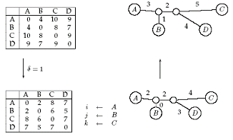
Shortening Hanging Edges to Produce Degenerate Triples
Shorten all “hanging” edges (edges that connect leaves) until a degenerate triple is found

Slide 48
Finding Degenerate Triples
If there is no degenerate triple, all hanging edges are reduced by the same amount δ, so that all pair-wise distances in the matrix are reduced by 2δ.
Eventually this process collapses one of the leaves (when δ = length of shortest hanging edge), forming a degenerate triple i,j,k and reducing the size of the distance matrix D.
The attachment point for j can be recovered in the reverse transformations by saving D_{ij} for each collapsed leaf.

Slide 49
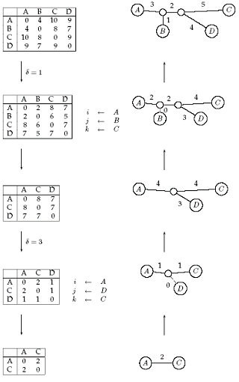
Reconstructing Trees for Additive Distance Matrices

Slide 50
Additive Phylogeny Algorithm
AdditivePhylogeny(D)
if D is a 2 x 2 matrix
T = tree of a single edge of length D_{1,2}
return T
if D is non-degenerate
δ = trimming parameter of matrix D
for all 1 ≤ i ≠ j ≤ n
D_{ij} = D_{ij} - 2δ
else
δ = 0

Slide 51
AdditivePhylogeny (cont’d)
Find a triple i, j, k in D such that D_{ij} + D_{jk} = D_{ik}
x = D_{ij}
Remove j^{th} row and j^{th} column from D
T = AdditivePhylogeny(D)
Add a new vertex v to T at distance x on the path from i to k
Add j back to T by creating an edge (v,j) of length 0
for every leaf l in T
if distance from l to j in the tree ≠ D_{l,j}
output “matrix is not additive”
return
Extend all “hanging” edges by length δ
return T

Slide 52
The Four Point Condition
AdditivePhylogeny provides a way to check if distance matrix D is additive
An even more efficient additivity test is the “four-point condition”
Let 1 ≤ i,j,k,l ≤ n be four distinct leaves in some (unknown) tree. This quartet induces an (unknown) 4-leaf tree (or 4-tree) where the neighboring pairs are, e.g., i,j and k,l

Slide 53
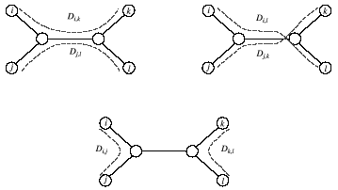
The Four Point Condition (cont’d)
Compute: 1. D_{ij} + D_{kl}, 2. D_{ik} + D_{jl}, 3. D_{il} + D_{jk}
2
3
1
2 and 3 represent the same number: the length of all edges with 2 X the middle edge
1 represents a smaller number: the length of all edges – the middle edge

Slide 54
The Four Point Condition: Theorem
The four point condition for the quartet i,j,k,l is satisfied if two of these sums are the same, with the third sum smaller than the first two
Theorem (Buneman): An n x n matrix D is additive if and only if the four point condition holds for every quartet 1 ≤ i,j,k,l ≤ n
Proof in old slides

Slide 55
Tree reconstruction based on Buneman’s Theorem
Consider leaves 1,2,3,4. If
then their quartet tree is:
Now we insert leaf 5 into the tree, and consider quartet 1,2,3,5. If
then we insert leaf 5 between ancestor A and leaf 3. But If
then leaf 5 could be inserted either between A and B or between B and
2 or between B and 4. So, we need to further consider a quartet 1,2,4,5
and decide the precise edge to insert 5.
1
2
A
B
5
3
5
4
5
5

Slide 56
Least Squares Distance Phylogeny Problem
If the distance matrix D is NOT additive, then we look for a tree T that approximates D the best:
Squared Error : ∑_{i,j} (d_{ij}(T) – D_{ij})²
Squared Error is a measure of the quality of fit between the distance matrix and the tree: we want to minimize it.
Least Squares Distance Phylogeny Problem: Finding the best approximate tree T for a given non-additive matrix D (which is NP-hard).
In practice, heuristic algorithms like NJ are used.

Slide 57
UPGMA: Unweighted Pair Group Method with Arithmetic Mean
UPGMA is a hierarchical clustering algorithm that:
  computes the distance between clusters using average pairwise distance (avg link)
  assigns a height to every vertex in the tree, effectively assuming the presence of a molecular clock and thus dating every vertex

Slide 58
Clustering in UPGMA
Given two disjoint clusters C_{i}, C_{j} of taxa,
1
d_{ij} = ––––––––– Σ_{{p ∈Ci, q ∈Cj}}d_{pq}
|C_{i}| × |C_{j}|
Note that if C_{k} = C_{i} ∪ C_{j}, then distance to another cluster C_{l} is:
d_{il} |C_{i}| + d_{jl} |C_{j}|
d_{kl} = ––––––––––––––
|C_{i}| + |C_{j}|

Slide 59
The UPGMA Algorithm
Initialization:
Assign each taxon x_{i} to its own cluster C_{i}
Define a leaf for each taxon, with height 0
Iteration:
Find two clusters C_{i} and C_{j} such that d_{ij} is the minimum
Let C_{k} = C_{i} ∪ C_{j}
Add a vertex connecting C_{i}, C_{j} and place it at height d_{ij} /2
Delete C_{i} and C_{j}
Termination:
When a single cluster remains

Slide 60
The UPGMA Algorithm (cont’d)
1
4
3
2
5
1
4
2
3
5

Slide 61
UPGMA’s Weakness
The algorithm produces an ultrametric tree: the distance from the root to every leaf is the same
    UPGMA assumes a constant molecular clock: all taxa/species represented by the leaves in the tree are assumed to accumulate mutations (and thus evolve) at the same rate. This is a major pitfall of UPGMA

Slide 62
UPGMA’s Weakness: Example
Correct tree
UPGMA
3
2
4
1
4
2
3
1
This is called long branch attraction

Slide 63

Alignment Matrix vs. Distance Matrix
Sequence a gene of length l nucleotides (or amino acids) in n species to generate an n x m (multiple) alignment matrix
CANNOT be transformed back into alignment matrix because information was lost on the forward transformation
Transform into
n x n distance matrix D

Slide 64
Character-Based Phylogenetic Reconstruction
A potentially better technique:
  Character-based reconstruction algorithms use the n x m alignment matrix
  (n = # species, m = #characters)
  directly instead of using distance matrix
  GOAL: Determine a tree and the character strings at the internal nodes of the tree that would best explain the n observed character strings at the leaves (species)

Slide 65
Character-Based Tree Reconstruction (cont’d)
Characters may be nucleotides, where A, G, C, T are the states of this character, or amino acids. Other characters may be the # of eyes or legs or the shape of a beak or a fin.
By setting the length of an edge in the tree to the (weighted) Hamming distance, we may define the parsimony score (actually cost) of the tree as the sum of the lengths (i.e., weights) of the edges.

Slide 66
Parsimony Approach to Evolutionary Tree Reconstruction
Applies Occam’s razor principle to identify the simplest explanation for the data
Assumes the observed character differences at the leaves resulted from the fewest possible mutations in the tree
Seeks the tree that yields lowest possible parsimony score - sum of cost of all mutations found in the tree
Suffers from long branch attraction described on slide 61 and is statistically inconsistent, but still among the most popular methods in practice

Slide 67
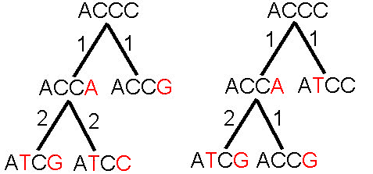

Parsimony and Tree Reconstruction

Slide 68
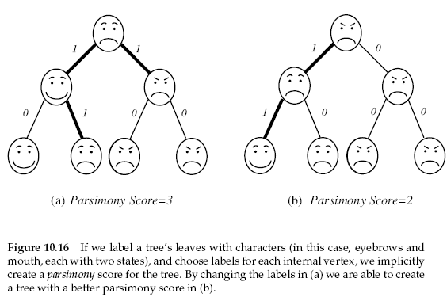
Character-Based Tree Reconstruction (cont’d)

Slide 69
Small Parsimony Problem
Input: Tree T with each leaf labeled by an m-character string.
Output: Labeling of all internal nodes of the tree T minimizing the parsimony score (i.e., total Hamming distance or number of mutations).
We can assume that every leaf is labeled by a single character, because the characters in the string are independent in this problem.

Slide 70
Weighted Small Parsimony Problem
A more general version of the Small Parsimony Problem
Input includes a k*k scoring matrix describing the cost of transformation/mutation from each of the k states into another one
Weighted Hamming distance is used instead
For the Small Parsimony problem, the scoring matrix is based on Hamming distance
d_{H}(v, w) = 0 if v=w
d_{H}(v, w) = 1 otherwise
Equivalent to calculating the Tree Score of a multiple sequence alignment under a given evolutionary tree

Slide 71
Scoring Matrices
Small Parsimony Problem
Weighted Parsimony Problem
 | A | T | G | C
A | 0 | 1 | 1 | 1
T | 1 | 0 | 1 | 1
G | 1 | 1 | 0 | 1
C | 1 | 1 | 1 | 0
 | A | T | G | C
A | 0 | 3 | 4 | 9
T | 3 | 0 | 2 | 4
G | 4 | 2 | 0 | 4
C | 9 | 4 | 4 | 0

Slide 72
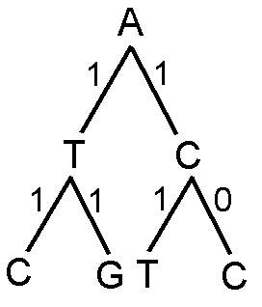
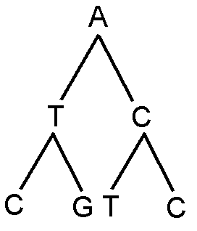
Unweighted vs. Weighted
Small Parsimony Scoring Matrix
 | A | T | G | C
A | 0 | 1 | 1 | 1
T | 1 | 0 | 1 | 1
G | 1 | 1 | 0 | 1
C | 1 | 1 | 1 | 0
Small Parsimony Score:
5

Slide 73
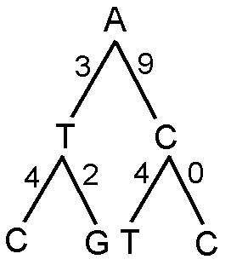
Unweighted vs. Weighted
Weighted Parsimony Scoring Matrix
 | A | T | G | C
A | 0 | 3 | 4 | 9
T | 3 | 0 | 2 | 4
G | 4 | 2 | 0 | 4
C | 9 | 4 | 4 | 0
Weighted Parsimony Score: 22

Slide 74
Weighted Small Parsimony Problem: Formulation
Input: Tree T with each leaf labeled by a state and a k x k scoring matrix (δ_{ij}), assuming the character has k states
Output: Labeling of each internal vertex of the tree T with a state minimizing the total weighted parsimony score

Slide 75
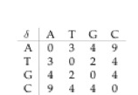
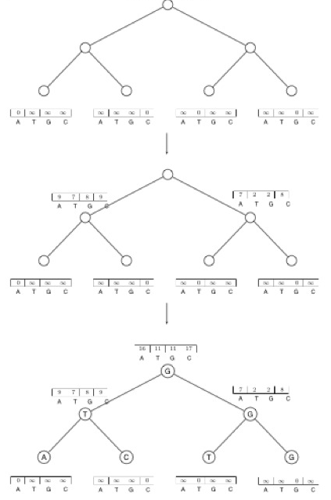
Sankoff’s Algorithm
Consider each state at a node and check every state of each child to determine the minimum score under the given state
An example

Slide 76
Sankoff Algorithm: Dynamic Programming
Calculate and keep track of the score for every possible label/state at each vertex
  s_{t}(v) = minimum parsimony score of the subtree rooted at vertex v if v has state t
The score at each vertex is based on scores of its children:
  s_{t}(parent) = min_{i} {s_{i}( left child ) + δ_{i, t}} +
  min_{j} {s_{j}( right child ) + δ_{j, t}}

Slide 77
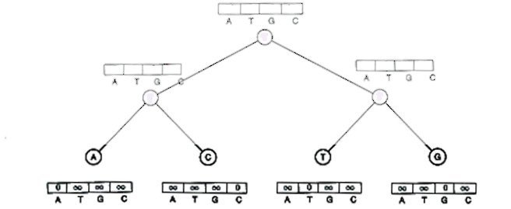
Sankoff Algorithm (cont.)
Begin at leaves:
  If leaf has the state in question, score is 0
  Else, score is ∞

Slide 78
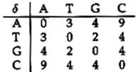
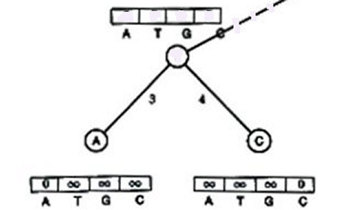
Sankoff Algorithm (cont.)
  s_{t}(v) = min_{i} {s_{i}(u) + δ_{i, t}} + min_{j} {s_{j}(w) + δ_{j, t}}
 | s_{i}(u) | δ_{i, A} | sum
A | 0 | 0 | 0
T | ∞ | 3 | ∞
G | ∞ | 4 | ∞
C | ∞ | 9 | ∞
 | s_{i}(u) | δ_{i, A} | sum
A
T
G
C
 | s_{i}(u) | δ_{i, A} | sum
A | 0 | 0 | 0
T | ∞ | 3 | ∞
G | ∞ | 4 | ∞
C | ∞ | 9 | ∞
s_{A}(v) = min_{i}{s_{i}(u) + δ_{i, A}} + min_{j}{s_{j}(w) + δ_{j, A}}
s_{A}(v) = 0

Slide 79
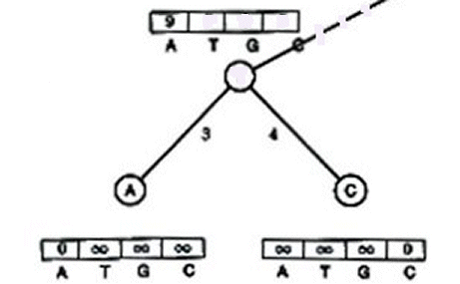
Sankoff Algorithm (cont.)
  s_{t}(v) = min_{i} {s_{i}(u) + δ_{i, t}} + min_{j}{s_{j}(w) + δ_{j, t}}
 | s_{j}(w) | δ_{j, A} | sum
A | ∞ | 0 | ∞
T | ∞ | 3 | ∞
G | ∞ | 4 | ∞
C | 0 | 9 | 9
 | s_{j}(w) | δ_{j, A} | sum
A
T
G
C
 | s_{j}(w) | δ_{j, A} | sum
A | ∞ | 0 | ∞
T | ∞ | 3 | ∞
G | ∞ | 4 | ∞
C | 0 | 9 | 9
s_{A}(v) = min_{i}{s_{i}(u) + δ_{i, A}} + min_{j}{s_{j}(w) + δ_{j, A}}
s_{A}(v) = 0
+ 9 = 9

Slide 80
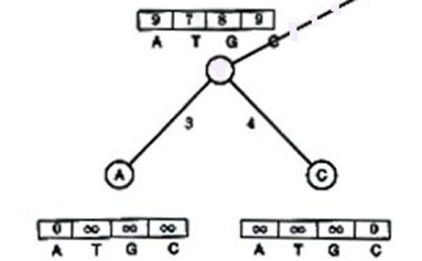
Sankoff Algorithm (cont.)
  s_{t}(v) = min_{i} {s_{i}(u) + δ_{i, t}} + min_{j}{s_{j}(w) + δ_{j, t}}
Repeat for T, G, and C

Slide 81
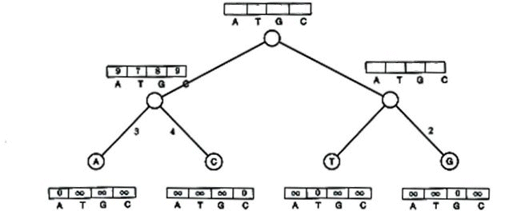
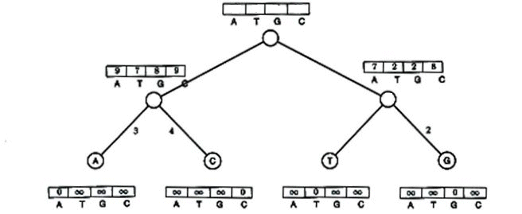
Sankoff Algorithm (cont.)
Repeat for right subtree

Slide 82
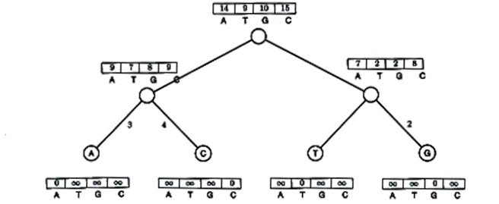
Sankoff Algorithm (cont.)
Repeat for root

Slide 83
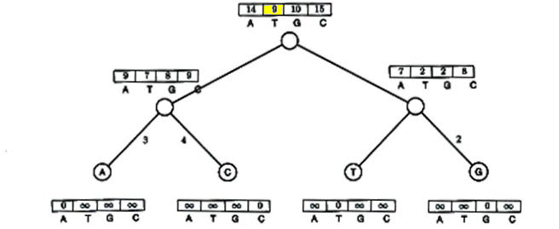

Sankoff Algorithm (cont.)
Smallest score at root is minimum weighted parsimony score
In this case, 9 – so label with T

Slide 84
Sankoff Algorithm: Traveling down the Tree
The scores at the root vertex have been computed by going up the tree
After the scores at root vertex are computed the Sankoff algorithm moves down the tree and assign each vertex with the optimal state (backtracing)

Slide 85
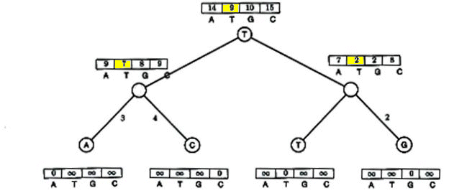

Sankoff Algorithm (cont.)
9 is derived from 7 + 2
So left child is T,
and right child is T

Slide 86
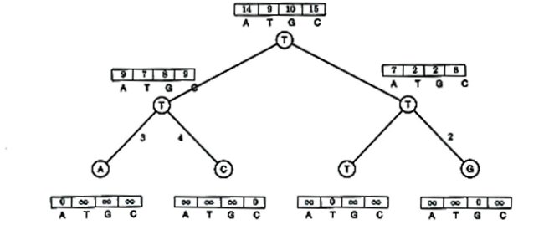
Sankoff Algorithm (cont.)
And the tree is thus labeled…

Slide 87
Fitch’s Algorithm
Solves the Small Parsimony problem
Dynamic programming in essence
Assigns a set of states to every vertex in the tree
Each leaf has an input state
If the two children’s sets of states overlap, it’s the common set of them
If not, it’s the combined set (union) of them

Slide 88

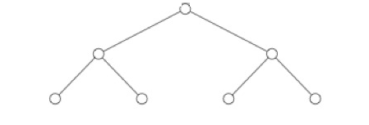

Fitch’s Algorithm (cont’d)
An example:
a
c
t
a
{a,c}
{t,a}
a
c
t
a
a
a
a
a
{a,c}
{t,a}
a
a
a
c
t
a
c
t

Slide 89
Fitch Algorithm
1) Assign a set of possible states to every vertex, traversing the tree from leaves to root
Each node’s set is either the intersection or union of its children’s sets (a leaf’s set consists of its label)
  E.g., if the node we are looking at has a left child labeled {A, C} and a right child labeled {A, T} (or {T}), the node will be given the set {A} (or {A,C,T}).

Slide 90
Fitch Algorithm (cont.)
2) Assign labels to each vertex, traversing the tree from root to leaves
Assign the root an arbitrary state from its set of states
For all other vertices, if its parent’s label is in its set of states, assign it its parent’s label
Else, choose an arbitrary state from its set as its label

Slide 91









Fitch Algorithm (example)

Slide 92
Fitch vs. Sankoff
Both have an O(nk) running time
Are they actually different?
Let’s compare …

Slide 93
Fitch
As seen previously:

Slide 94
Comparison of Fitch and Sankoff
As seen earlier, the scoring matrix for the Fitch algorithm is merely:
So let’s do the same problem using Sankoff algorithm and this scoring matrix
 | A | T | G | C
A | 0 | 1 | 1 | 1
T | 1 | 0 | 1 | 1
G | 1 | 1 | 0 | 1
C | 1 | 1 | 1 | 0

Slide 95

Sankoff

Slide 96
Sankoff vs. Fitch
The Sankoff algorithm gives the same set of optimal labels as the Fitch algorithm
For Sankoff algorithm, letter t is optimal for vertex v if s_{t}(v) = min_{1<i<k}s_{i}(v)
  Denote the set of optimal letters at vertex v as S(v)
    If S(left child) and S(right child) overlap, S(parent) is the intersection
    Else it’s the union of S(left child) and S(right child)
    This is also the Fitch recurrence
The two algorithms are identical

Slide 97
The Large Parsimony Problem
(i.e., parsimony approach to phylogenetic reconstruction)
Input: An n x m matrix M describing n species, each represented by an m-character string
Output: A tree T with n leaves labeled by the n rows of matrix M, and a labeling of the internal vertices such that the parsimony score is minimized over all possible trees and all possible labelings of the internal vertices

Slide 98
Large Parsimony Problem (cont.)
Possible search space is huge, especially as n increases
  (2n – 3)!! possible rooted trees
  (2n – 5)!! possible unrooted trees
Problem is NP-hard
  Exhaustive search only possible for small n (< 10)
Branch-and-bound or heuristics are often used
A variant is the Perfect Phylogeny problem as described in the old slides

Slide 99
Nearest Neighbor Interchange: A greedy algorithm
A typical local search algorithm
Only evaluates a subset of all possible trees
Defines a neighbor of a tree as one reachable by a nearest neighbor interchange (or NNI) operation
  A rearrangement of the four subtrees connected by each internal edge
  Only three different rearrangements per edge

Slide 100

Nearest Neighbor Interchange (cont.)

Slide 101
Nearest Neighbor Interchange (cont.)
Start with an arbitrary (random) tree and check its neighbors
Move to a neighbor if it provides the best improvement in the parsimony score
No way of knowing if the result is the most parsimonious tree
Could be stuck in local optimum (like other hill climbing algorithms)
Could be employed in more sophisticated local search algorithms like simulated annealing

Slide 102

Nearest Neighbor Interchange

Slide 103

Subtree Pruning and Regrafting (or Subtree-Transfer):
Another branch swapping algorithm
http://artedi.ebc.uu.se/course/BioInfo-10p-2001/Phylogeny/Phylogeny-TreeSearch/SPR.gif

Slide 104

Tree Bisection and Reconnection:
Yet another branch swapping algorithm
Most extensive swapping routine

Slide 105

Maximum Likelihood

Slide 106
A Nucleotide Substitution Model
Assume same rates for A→B and B→A
Assume all mutations equally likely: Rate α
The Jukes-Cantor (JC) model is given below
Another popular (more general) model is Kimura 2-parameter (K2P)
 | A | C | G | T
A | -3α | α | α | α
C | α | -3α | α | α
G | α | α | -3α | α
T | α | α | α | -3α

Slide 107

Maximum Likelihood

Slide 108

Maximum Likelihood

Slide 109

Maximum Likelihood

Slide 110

Assessing Reliability: Bootstrap

Slide 111

Assessing Reliability: Bootstrap

Slide 112

Assessing Reliability: Bootstrap

Slide 113

Assessing Reliability: Bootstrap

Slide 114

Phylogeny Flowchart

Slide 115
Homoplasy
Given:
  1: CAGCAGCAG
  2: CAGCAGCAG
  3: CAGCAGCAGCAG
  4: CAGCAGCAG
  5: CAGCAGCAG
  6: CAGCAGCAG
  7: CAGCAGCAGCAG
Most would group 1, 2, 4, 5, and 6 as having evolved from a common ancestor, with a single mutation leading to the presence of 3 and 7

Slide 116

Homoplasy
But what if this was the real tree?

Slide 117
Homoplasy
6 evolved separately from 4 and 5, but parsimony would group 4, 5, and 6 together as having evolved from a common ancestor
Homoplasy: Independent (or parallel) evolution of same/similar characters
Parsimony results minimize homoplasy, so if homoplasy is common, parsimony may give wrong results

Slide 118
Contradicting Characters
An evolutionary tree is more likely to be correct when it is supported by multiple characters, as seen below
Lizard
Human
MAMMALIA
Hair
Single bone in lower jaw
Lactation
etc.
Frog
Dog
Note: In this case, tails are homoplastic

Slide 119
Problems with Parsimony
Important to keep in mind that reliance on purely one method for phylogenetic analysis provides incomplete picture
When different methods (parsimony, distance-based, etc.) all give same result, more likely that the result is correct

Slide 120


How Many Times Evolution Invented Wings?
Whiting, et. al. (2003) looked at winged and wingless stick insects

Slide 121
Reinventing Wings
Previous studies had shown winged → wingless transitions
Wingless → winged transition much more complicated (need to develop many new biochemical pathways)
Used multiple tree reconstruction techniques, all of which required re-evolution of wings

Slide 122

Most Parsimonious Evolutionary Tree of Winged and Wingless Insects
The evolutionary tree is based on both DNA sequences and presence/absence of wings
Most parsimonious reconstruction gave a wingless ancestor

Slide 123
Will Wingless Insects Fly Again?
Since the most parsimonious reconstructions all required the re-invention of wings, it is most likely that wing developmental pathways are conserved in wingless stick insects

Slide 124
Phylogenetic Analysis of HIV Virus
Lafayette, Louisiana, 1994 – A woman claimed her ex-lover (who was a physician) injected her with HIV+ blood
Records show the physician had drawn blood from an HIV+ patient that day
But how to prove the blood from that HIV+ patient ended up in the woman?

Slide 125
HIV Transmission
HIV has a high mutation rate, which can be used to trace paths of transmission
Two people who got the virus from two different people will have very different HIV sequences
Three different tree reconstruction methods (including parsimony) were used to track changes in two genes in HIV (gp120 and RT)

Slide 126
HIV Transmission
Took multiple samples from the patient, the woman, and controls (non-related HIV+ people)
In every reconstruction, the woman’s sequences were found to be evolved from the patient’s sequences, indicating a close relationship between the two
Nesting of the victim’s sequences within the patient sequence indicated the direction of transmission was from patient to victim
This was the first time phylogenetic analysis was used in a court case as evidence (Metzker, et. al., 2002)

Slide 127


Evolutionary Tree Leads to Conviction

Slide 128
Alu Repeats
Alu repeats are most common repeats in human genome (about 300 bp long)
About 1 million Alu elements make up 10% of the human genome
They are retrotransposons
  they don’t code for protein but copy themselves into RNA and then back to DNA via reverse transcriptase
  Alu elements have been called “selfish” because their only function seems to be to make more copies of themselves

Slide 129
What Makes Alu Elements Important?
Alu elements began to replicate 60 million years ago. Their evolution can be used as a fossil record of primate and human history
Alu insertions are sometimes disruptive and can result in genetic disorders
Alu mediated recombination can cause cancer
Alu insertions can be used to determine genetic distances between human populations and human migratory history

Slide 130

Diversity of Alu Elements
Alu Diversity on a scale from 0 to 1
  Africans 0.3487 origin of modern humans
  E. Asians 0.3104
  Europeans 0.2973
  Indians 0.3159

Slide 131


Minimum Spanning Trees
The first algorithm for finding a MST was developed in 1926 by Otakar Borůvka. Its purpose was to minimize the cost of electrical coverage in Bohemia.
The Problem
  Connect all of the cities but use the least amount of electrical wire possible. This reduces the cost.
We will see how building a MST can be used to study evolution of Alu repeats

Slide 132



What is a Minimum Spanning Tree?
A Minimum Spanning Tree of a graph
--connect all the vertices in the graph and
--minimizes the sum of edges in the tree

Slide 133
How can we find a MST?
Prim algorithm (greedy)
  Start from a tree T with a single vertex
  Add the shortest edge connecting a vertex in T to a vertex not in T, growing the tree T
    This is repeated until every vertex is in T
Prim algorithm can be implemented in O(m logm) time (m is the number of edges).

Slide 134








Prim’s Algorithm Example

Slide 135


Why Prim Algorithm Constructs Minimum Spanning Tree?
Proof:
  This proof applies to a graph with distinct edges
  Let e be any edge that Prim algorithm chose to connect two sets of nodes. Suppose that Prim’s algorithm is flawed and it is cheaper to connect the two sets of nodes via some other edge f
  Notice that since Prim algorithm selected edge e we know that cost(e) < cost(f)
  By connecting the two sets via edge f, the cost of connecting the two vertices has gone up by exactly cost(f) – cost(e)
  The contradiction is that edge e does not belong in the MST yet the MST can’t be formed without using edge e

Slide 136

An Alu Element
SINEs are flanked by short direct repeat sequences and are transcribed by RNA Polymerase III

Slide 137

Alu Subfamilies

Slide 138

The Biological Story: Alu Evolution

Slide 139

Alu Evolution

Slide 140

Alu Evolution: The Master Alu Theory

Slide 141

Alu Evolution: Alu Master Theory Proven Wrong

Slide 142

Minimum Spanning Tree As An Evolutionary Tree

Slide 143


Alu Evolution: Minimum Spanning Tree vs. Phylogenetic Tree
A timeline of Alu subfamily evolution would give useful information
  Problem - building a traditional phylogenetic tree with Alu subfamilies will not describe Alu evolution accurately
Why can’t a meaningful typical phylogenetic tree of Alu subfamilies be constructed?
  When constructing a typical phylogenetic tree, the input is made up of leaf nodes, but no internal nodes
  Alu subfamilies may be either internal or external nodes of the evolutionary tree because Alu subfamilies that created new Alu subfamilies are themselves still present in the genome. Traditional phylogenetic tree reconstruction methods are not applicable since they don’t allow for the inclusion of such internal nodes

Slide 144
Constructing MST for Alu Evolution
Building an evolutionary tree using an MST will allow for the inclusion of internal nodes
  Define the length between two subfamilies as the Hamming distance between their sequences
  Root the subfamily with highest average divergence from its consensus sequence (the oldest subfamily), as the root
  It takes ~4 million years for 1% of sequence divergence between subfamilies to emerge, this allows for the creation of a timeline of Alu evolution to be created
Why an MST is useful as an evolutionary tree in this case
  The less the Hamming distance (edge weight) between two subfamilies, the more likely that they are directly related
  An MST represents a way for Alu subfamilies to have evolved minimizing the sum of all the edge weights (total Hamming distance between all Alu subfamilies) which makes it the most parsimonious way and thus the most likely way for the evolution of the subfamilies to have occurred.

Slide 145

MST As An Evolutionary Tree

Slide 146
Sources
http://www.math.tau.ac.il/~rshamir/ge/02/scribes/lec01.pdf
http://bioinformatics.oupjournals.org/cgi/screenpdf/20/3/340.pdf
http://www.absoluteastronomy.com/encyclopedia/M/Mi/Minimum_spanning_tree.htm
Serafim Batzoglou (UPGMA slides) http://www.stanford.edu/class/cs262/Slides
Watkins, W.S., Rogers A.R., Ostler C.T., Wooding, S., Bamshad M. J., Brassington A.E., Carroll M.L., Nguyen S.V., Walker J.A., Prasas, R., Reddy P.G., Das P.K., Batzer M.A., Jorde, L.B.: Genetic Variation Among World Populations: Inferences From 100 Alu Insertion Polymorphisms

