Slide 1
Graph Algorithms and Fragment Assembly

Slide 2
Outline
Introduction to Graph Theory
Eulerian & Hamiltonian Cycle Problems
Benzer Experiment and Interval Graphs
DNA Sequencing
The Shortest Superstring & Traveling Salesman Problems
Sequencing by Hybridization and de Bruijn Graphs
Fragment Assembly and Repeats in DNA
Fragment Assembly Algorithms

Slide 3
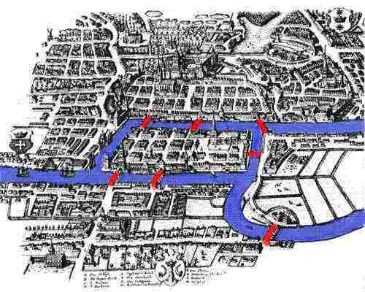
The Bridge Obsession Problem
Find a tour crossing every bridge just once
Leonhard Euler, 1735
Bridges of Königsberg

Slide 4
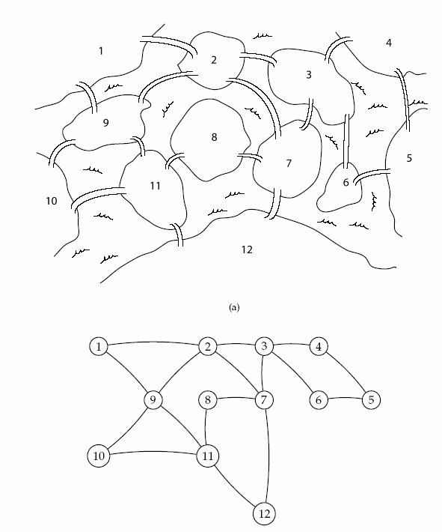
Eulerian Cycle Problem
Find a cycle that visits every edge exactly once
Linear time
More complicated Königsberg

Slide 5
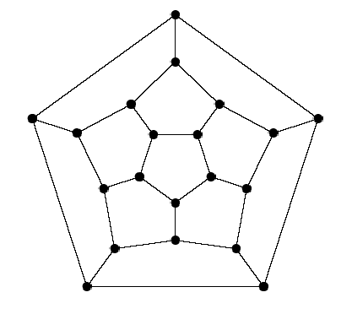
Hamiltonian Cycle Problem
Find a cycle that visits every vertex exactly once
NP–complete
Game invented by Sir
William Hamilton in 1857

Slide 6
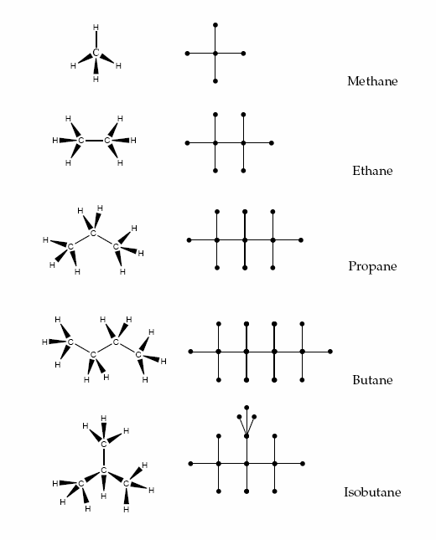
Mapping Problems to Graphs
Arthur Cayley studied chemical structures of hydrocarbons in the mid-1800s
He used trees (acyclic connected graphs) to enumerate structural isomers

Slide 7
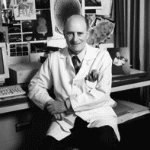
Beginning of Graph Theory in Biology
Benzer’s work
Developed deletion mapping
“Proved” linearity of genomes
Demonstrated internal structure of the genome
Seymour Benzer, 1950s

Slide 8
Viruses Attack Bacteria
Normally bacteriophage T4 (a virus) kills bacteria
However if T4 is mutated (e.g., an important gene is deleted) it gets disabled and loses ability to kill bacteria
Suppose the bacteria is infected with two different mutants each of which is disabled – would the bacteria still survive?
Amazingly, a pair of mutated viruses can kill a bacteria even if each of them is disabled
How can it be explained?

Slide 9
Benzer’s Experiment
Idea: infect bacteria with pairs of mutant T4 bacteriophage (virus)
Each T4 mutant has an unknown interval deleted from its genome
If the two intervals overlap: the T4 pair is missing part of its genome and is disabled – bacteria survive
If the two intervals do not overlap: T4 pair has its entire genome and is enabled – bacteria die

Slide 10
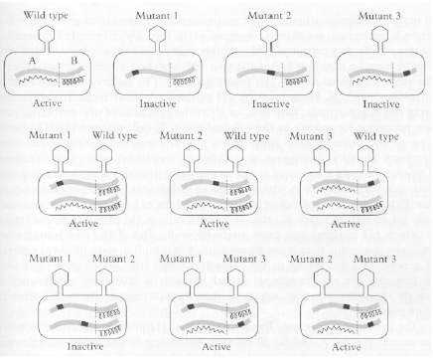
Complementation between pairs of mutant T4 bacteriophages

Slide 11
Benzer’s Experiment and Graphs
Construct an interval graph: each T4 mutant is a vertex, place an edge between mutant pairs where bacteria survived (i.e., the deleted intervals in the pair of mutants overlap)
Interval graph structure reveals whether the T4 DNA is linear or branched

Slide 12
Interval Graph: Linear Genome

Slide 13
Interval Graph: Branched Genome

Slide 14
Interval Graph: Comparison
Linear genome
Branched genome

Slide 15
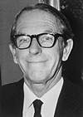
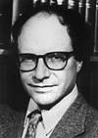
DNA Sequencing: History
Sanger method (1977): labeled ddNTPs terminate DNA copying at random points
Gilbert method (1977):
chemical method to cleave DNA at specific points (G, G+A, T+C, C)
  Both methods generate labeled fragments of varying lengths that are further electrophoresed

Slide 16
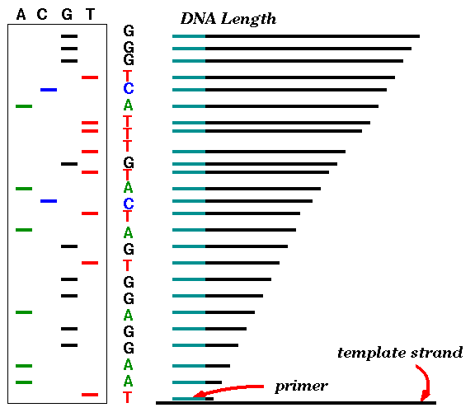
Sanger Method: Generating Reads
Start at primer (restriction site)
Grow DNA chain
Include ddNTPs
Stops reaction at all possible points
Separate products by length, using gel electrophoresis

Slide 17
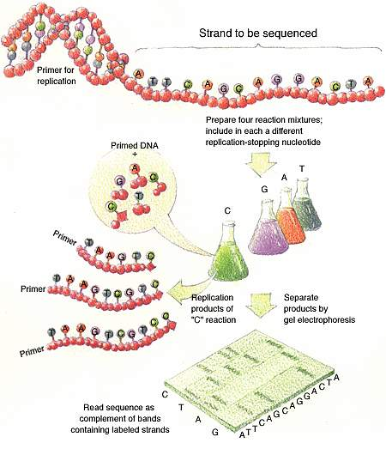
DNA Sequencing (Shotgun)
Shear DNA into millions of small fragments
Read 500 – 700 nucleotides at a time from the small fragments (by e.g. Sanger method)

Slide 18
Fragment (or Genome) Assembly
Computational Challenge: Assemble individual short fragments (reads) into a single genomic sequence (“superstring”)
Until late 1990s, the shotgun fragment assembly of human genome was viewed as an intractable problem

Slide 19
Shortest Superstring Problem
Problem: Given a set of strings, find a shortest string that contains all of them
Input: Strings s₁, s₂,…., s_{n}
Output: A string s that contains all strings
s₁, s₂,…., s_{n} as substrings, such that the length of s is minimized
Complexity: NP–hard
Note: this formulation does not take into account sequencing errors

Slide 20
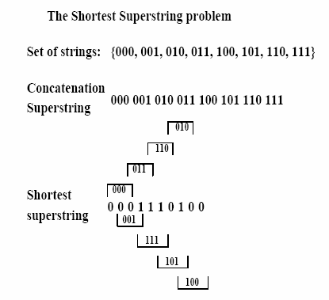
Shortest Superstring Problem: Example

Slide 21
Reducing SSP to TSP
Define overlap( s_{i}, s_{j} ) as the length of the longest (proper) prefix of s_{j} that matches a suffix of s_{i}.
aaaggcatcaaatctaaaggcatcaaa
aaaggcatcaaatctaaaggcatcaaa
What is overlap ( s_{i}, s_{j} ) for these strings?

Slide 22
Reducing SSP to TSP
Define overlap( s_{i}, s_{j} ) as the length of the longest (proper) prefix of s_{j} that matches a suffix of s_{i}.
aaaggcatcaaatctaaaggcatcaaa
aaaggcatcaaatctaaaggcatcaaa
aaaggcatcaaatctaaaggcatcaaa
overlap=12

Slide 23
Reducing SSP to TSP
Define overlap( s_{i}, s_{j} ) as the length of the longest (proper) prefix of s_{j} that matches a suffix of s_{i}.
aaaggcatcaaatctaaaggcatcaaa
aaaggcatcaaatctaaaggcatcaaa
aaaggcatcaaatctaaaggcatcaaa
Construct a complete graph with n vertices representing the n strings s₁, s₂,…., s_{n}.
Insert edges of length overlap ( s_{i}, s_{j} ) between vertices s_{i} and s_{j}.
Find the longest path that visits every vertex exactly once (i.e., a Hamiltonian path). This is the max Traveling Salesman Problem (TSP), which is also NP–hard.

Slide 24
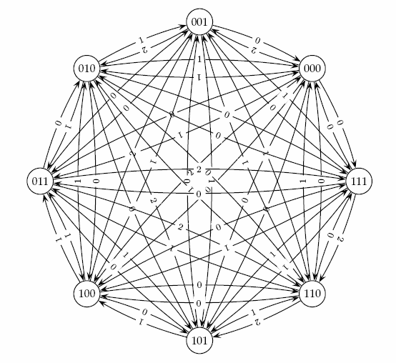

Reducing SSP to TSP (cont’d)
2

Slide 25
SSP to TSP: An Example
S = { ATC, CCA, CAG, TCC, AGT }
SSP
AGT
CCA
ATC
ATCCAGT
TCC
CAG
TSP
ATC
0
2
1
1
AGT
1
CCA
1
2
2
2
CAG
1
TCC
ATCCAGT

Slide 26
Approximation Algorithms for SSP
EMV’23, 2.466
EMV’23, 3.396

Slide 27

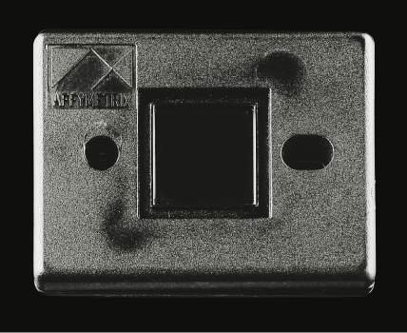
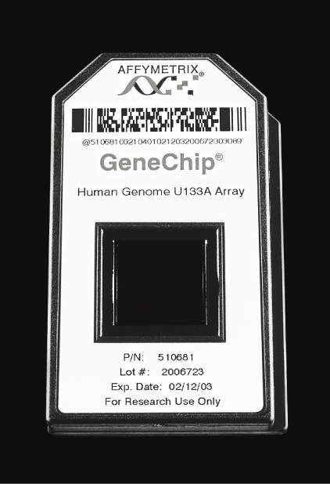
Sequencing by Hybridization (SBH): History
1988: SBH suggested as an an alternative sequencing method. Nobody believed it will ever work
1991: Light directed polymer synthesis developed by Steve Fodor and colleagues
1994: Affymetrix develops first 64-kb DNA microarray
First microarray
prototype (1989)
First commercial
DNA microarray
prototype w/16,000
features (1994)
500,000 features
per chip (2002)

Slide 28
How SBH Works
Attach all possible DNA probes (oligos) of length l to a flat surface, each probe at a distinct and known location. This set of probes is called the DNA array.
Apply a solution containing fluorescently labeled DNA fragment (single strand) to the array.
The DNA fragment hybridizes with those probes that are complementary to substrings of length l of the fragment.

Slide 29
How SBH Works (cont’d)
Using a spectroscopic detector, determine which probes hybridize to the DNA fragment to obtain the l–mer composition of the target DNA fragment.
Apply the combinatorial algorithm (below) to reconstruct the sequence of the target DNA fragment from the l–mer composition.

Slide 30
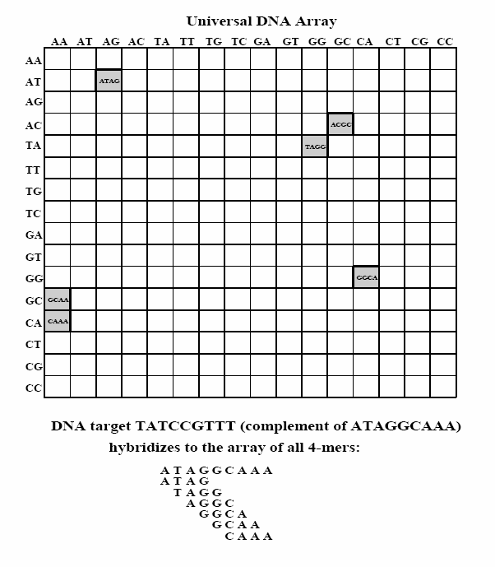
Hybridization on DNA Array

Slide 31
l-mer composition
Spectrum(s, l ) - unordered multiset of all possible (n – l + 1) l-mers in a string s of length n
The order of individual elements in Spectrum(s, l ) does not matter
For s = TATGGTGC all of the following are equivalent representations of Spectrum(s, 3 ):
{TAT, ATG, TGG, GGT, GTG, TGC}
{ATG, GGT, GTG, TAT, TGC, TGG}
{TGG, TGC, TAT, GTG, GGT, ATG}

Slide 32
l-mer composition
Spectrum(s, l ) - unordered multiset of all possible (n – l + 1) l-mers in a string s of length n
The order of individual elements in Spectrum(s, l ) does not matter
For s = TATGGTGC all of the following are equivalent representations of Spectrum(s, 3 ):
{TAT, ATG, TGG, GGT, GTG, TGC}
{ATG, GGT, GTG, TAT, TGC, TGG}
{TGG, TGC, TAT, GTG, GGT, ATG}
We usually choose the lexicographically maximal representation as the canonical one

Slide 33
Different sequences – the same spectrum
Different sequences may have the same spectrum:
Spectrum(GTATCT,2)=
Spectrum(GTCTAT,2)=
{AT, CT, GT, TA, TC}

Slide 34
The SBH Problem
Goal: Reconstruct a string from its l-mer spectrum (which is a multiset)
Input: A multiset S, representing all l-mers from an (unknown) string s
Output: String s such that Spectrum(s,l ) = S

Slide 35
SBH: Hamiltonian Path Approach
S = { ATG AGG TGC TCC GTC GGT GCA CAG }
H
ATG
AGG
TGC
TCC
GTC
GGT
GCA
CAG
ATG
C
A
G
G
T
C
C
Path visited every VERTEX once

Slide 36
SBH: Hamiltonian Path Approach
A more complicated graph:
S = { ATG TGG TGC GTG GGC GCA GCG CGT }

Slide 37
SBH: Hamiltonian Path Approach
S = { ATG TGG TGC GTG GGC GCA GCG CGT }
Path 1:
ATGCGTGGCA
Path 2:
ATGGCGTGCA
But the problem is NP-complete in general!

Slide 38
SBH: Eulerian Path Approach
S = { ATG, TGG, TGC, GTG, GGC, GCA, GCG, CGT }
Vertices correspond to (l – 1) – mers : { AT, TG, GC, GG, GT, CA, CG }.
Edges correspond to l – mers from S. Multi-edges are allowed.
This data structure is now called a de Bruijn graph.
GT
CG
AT
TG
GC
CA
Path visits every EDGE once!
GG

Slide 39
SBH: Eulerian Path Approach
S = { ATG, TGG, TGC, GTG, GGC, GCA, GCG, CGT } may result in two different paths:
GT
CG
GT
CG
AT
TG
GC
AT
TG
GC
CA
CA
GG
GG
ATGGCGTGCA
ATGCGTGGCA

Slide 40
Euler Theorem
A graph is balanced if for every vertex the number of incoming edges equals to the number of outgoing edges:
in(v)=out(v)
Theorem: A connected graph is Eulerian (i.e., contains a Eulerian cycle) if and only if each of its vertices is balanced.

Slide 41
Euler Theorem: Proof
Eulerian → balanced
For every edge entering v (incoming edge), there exists an edge leaving v (outgoing edge). Therefore
in(v)=out(v)
Balanced → Eulerian
???

Slide 42
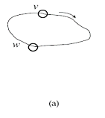
Algorithm for Constructing an Eulerian Cycle
Start with an arbitrary vertex v and form an arbitrary cycle with unused edges until a dead end is reached. Since the graph is Eulerian, this dead end is necessarily the starting point, i.e., vertex v.

Slide 43
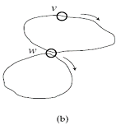
Algorithm for Constructing an Eulerian Cycle (cont’d)
b. If cycle from (a) above is not an Eulerian cycle, it must contain a vertex w, which has untraversed edges. Perform step (a) again, using vertex w as the starting point. Once again, we will end up in the starting vertex w.

Slide 44
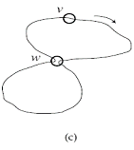
Algorithm for Constructing an Eulerian Cycle (cont’d)
c. Combine the cycles from (a) and (b) into a single cycle and iterate step (b).

Slide 45
Euler Theorem: Extension
Theorem: A connected graph has an Eulerian path if and only if it contains two (complementary) semi-balanced vertices and all other vertices are balanced.

Slide 46
Some Difficulties with SBH
Fidelity of Hybridization: difficult to detect differences between probes hybridized with perfect matches and 1 or 2 mismatches
Array Size: Effect of low fidelity can be decreased with longer l-mers, but array size increases exponentially in l. Array size is limited with current technology
Practicality: SBH is still impractical. As DNA microarray technology improves, SBH may become practical in the future
Practicality again: Although SBH is still impractical, it spearheaded expression analysis and SNP analysis techniques. Moreover, de Bruijn graphs are widely used in modern genome assemblers

Slide 47
Traditional DNA Sequencing
DNA
Shake
DNA fragments (clones)
Known
location
(restriction
site)
Vector:
Circular genome
(bacterium, plasmid)
+
=
Insert

Slide 48
Different Types of Vectors
VECTOR | Size of insert (bp)
Plasmid | 2,000 - 10,000
Cosmid | 40,000
BAC (Bacterial Artificial Chromosome) | 70,000 - 300,000
YAC (Yeast Artificial Chromosome) | > 300,000 Not used much recently
A physcal map for the clones is built, and then each clone is fragemented again, sequenced by Sanger method, and assembled

Slide 49
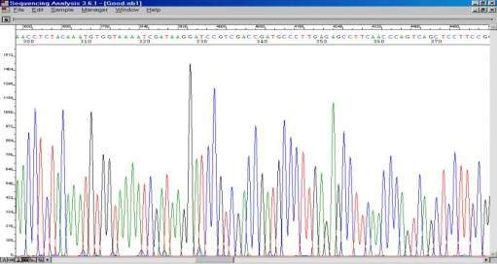
Electrophoresis Diagrams

Slide 50
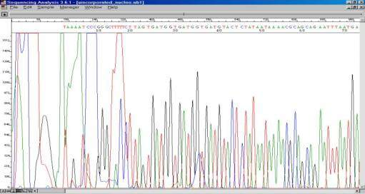
Challenges to Read Reading

Slide 51
Reading an Electropherogram
Filtering
Smoothening
Correction for length compressions
A method for calling the nucleotides – PHRED

Slide 52
Shotgun Sequencing
genomic segment
cut many times at random (Shotgun)
Get one or two reads (double barreled) from each fragment
~500 bp
~500 bp

Slide 53
Fragment (or Genome) Assembly
reads
Cover region with ~7-fold redundancy
Overlap reads and extend to reconstruct the original genomic region

Slide 54
Read Coverage
C
Length of genomic segment: L
Number of (sequenced) reads: n Coverage C = n l / L
Length of each read: l
How much coverage is enough?
Lander-Waterman model:
Assuming uniform distribution of reads, C=10 results in 1 gapped region per 1,000,000 nucleotides

Slide 55
Challenges in Fragment Assembly
Repeats: A major problem for fragment assembly
> 50% of human genome are repeats:
- over 1 million Alu repeats (about 300 bp)
- about 200,000 LINE repeats (1000 bp and longer)
Repeat
Repeat
Repeat
Green and blue fragments are interchangeable when
assembling repetitive DNA

Slide 56
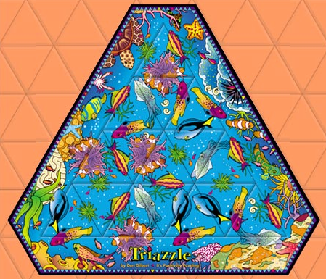
Triazzle: A Fun Example
The puzzle looks simple
BUT there are repeats!!!
The repeats make it very difficult.
Try it – only $7.99 at
www.triazzle.com

Slide 57
Repeat Types
Low-complexity DNA (e.g., ATATATATACATA…)
Microsatellite repeats (a₁…a_{k})^{N} where k ~ 3-6 bps
  (e.g., CAGCAGTAGCAGCACCAG)
Transposons/retrotransposons
  SINE Short Interspersed Nuclear Elements
(e.g., Alu: ~300 bps long, 10⁶ copies)
  LINE Long Interspersed Nuclear Elements
  ~500 - 5,000 bps long, 200,000 copies
  LTR retroposons Long Terminal Repeats (~700 bps) at each end
Gene families genes duplicate & then diverge
Segmental duplications ~very long, very similar copies

Slide 58
Overlap-Layout-Consensus
Assemblers: ARACHNE, PHRAP, CAP, TIGR, CELERA
Overlap: find potentially overlapping reads
Layout: merge reads into contigs and
contigs into supercontigs (scaffolds)
Consensus: derive the DNA sequence and correct sequencing errors
..ACGATTACAATAGGTT..

Slide 59
Overlap
Find the best match between some suffix of one read and some prefix of another
Due to sequencing errors, we need to use dynamic programming to find the optimal overlap alignment
Apply a fast filtration method to filter out pairs of reads that do not share a significantly long common substring

Slide 60
Overlapping Reads
Sort all k-mers in reads (k ~ 24)
Find pairs of reads sharing a k-mer
Extend to full alignment – throw away if not >95% similar
TACA
TAGATTACACAGATTAC
T GA
||
|||||||||||||||||
| ||
TAGT
TAGATTACACAGATTAC
TAGA

Slide 61
Overlapping Reads and Repeats
A k-mer that appears N times initiates N² comparisons
For an Alu that appears 10⁶ times → 10¹² comparisons – too much
Solution:
Discard all k-mers that appear more than
t × Coverage (e.g., t ~ 10)

Slide 62
From Overlapping Reads to Layout
Create local multiple alignments from the overlapping reads
TAGATTACACAGATTACTGA
TAGATTACACAGATTACTGA
TAG TTACACAGATTATTGA
TAGATTACACAGATTACTGA
TAGATTACACAGATTACTGA
TAGATTACACAGATTACTGA
TAG TTACACAGATTATTGA
TAGATTACACAGATTACTGA

Slide 63
Finding Overlapping Reads (cont’d)
Correct errors using multiple alignment
C: 20
C: 20
C: 35
C: 35
T: 30
C: 0
C: 35
C: 35
TAGATTACACAGATTACTGA
C: 40
C: 40
TAGATTACACAGATTACTGA
TAG TTACACAGATTATTGA
TAGATTACACAGATTACTGA
TAGATTACACAGATTACTGA
A: 15
A: 15
A: 25
A: 25
-
A: 0
A: 40
A: 40
A: 25
A: 25
Score alignments
Accept alignments with good scores

Slide 64
Layout
Repeats are a major challenge
Do two aligned fragments really overlap, or are they from two copies of a repeat?
Solution: repeat masking – hide the repeats!!!
But masking results in a high rate of misassembly (up to 20%)
Misassembly means alot more work at the finishing step

Slide 65
Merge Reads into Contigs
repeat region
Merge reads up to potential repeat boundaries

Slide 66
Repeats, Errors and Read Lengths
Repeats shorter than read length are OK
Repeats with more base pair differences than sequencing error rate are OK
To make a smaller portion of the genome appear repetitive, try to:
  Increase read length
  Decrease sequencing error rate

Slide 67
Error Correction
Role of error correction:
Discards ~90% of single-letter sequencing errors
decreases error rate
⇒ decreases effective repeat content
⇒ increases contig length

Slide 68
Merge Reads into Contigs (cont’d)
repeat region
Ignore non-maximal reads
Merge only maximal reads into contigs

Slide 69
Merge Reads into Contigs (cont’d)
sequencing error
repeat boundary???
b
a
Ignore “hanging” reads, when detecting repeat boundaries

Slide 70
Merge Reads into Contigs (cont’d)
?????
Unambiguous
Insert non-maximal reads whenever unambiguous

Slide 71
Link Contigs into Supercontigs
Normal density
Too dense: Overcollapsed?
Inconsistent links: Overcollapsed?

Slide 72
Link Contigs into Supercontigs (cont’d)
Find all links between unique contigs
Connect contigs incrementally, if ≥ 2 links

Slide 73
Link Contigs into Supercontigs (cont’d)
Fill gaps in supercontigs with paths of overcollapsed contigs

Slide 74
Link Contigs into Supercontigs (cont’d)
d ( A, B )
Contig A
Contig B
Define G = ( V, E )
  V := contigs
E := ( A, B ) such that d( A, B ) < C
Reason to do so: Efficiency; full shortest paths cannot be computed

Slide 75
Link Contigs into Supercontigs (cont’d)
Contig A
Contig B
Define T: contigs linked to either A or B
Fill gap between A and B if there is a path in G passing only from contigs in T

Slide 76
Consensus
A consensus sequence is derived from a profile of the assembled fragments
A sufficient number of reads is required to ensure a statistically significant consensus
Reading errors are corrected

Slide 77
Derive a Consensus Sequence
TAGATTACACAGATTACTGA TTGATGGCGTAA CTA
TAGATTACACAGATTACTGACTTGATGGCGTAAACTA
TAG TTACACAGATTATTGACTTCATGGCGTAA CTA
TAGATTACACAGATTACTGACTTGATGGCGTAA CTA
TAGATTACACAGATTACTGACTTGATGGGGTAA CTA
TAGATTACACAGATTACTGACTTGATGGCGTAA CTA
Derive multiple alignment from pairwise read alignments (i.e., progressive alignment)
Derive each consensus base by weighted voting
Another approach based on finding a longest path in a DAG is given in the popular assembler Phrap

Slide 78
EULER – Yet Another Approach to Fragment Assembly
Traditional “overlap-layout-consensus” technique has a high rate of mis-assembly
EULER uses the Eulerian Path approach borrowed from the SBH problem and a de Bruijn graph constructed from k-mers
Fragment assembly without repeat masking can be done in linear time with a greater accuracy. The approach is popular among NGS assemblers

Slide 79
Overlap Graph: Hamiltonian Approach
Each vertex represents a read from the original sequence.
Vertices from repeats are connected to many others.
Repeat
Repeat
Repeat
Find a path visiting every VERTEX exactly once: Hamiltonian path problem

Slide 80
Overlap Graph: Eulerian Approach
Repeat
Repeat
Repeat
Placing each repeat edge together gives a clear progression of the path through the entire sequence.
Find a path visiting every EDGE exactly once:
Eulerian path problem

Slide 81
Multiple Repeats
Repeat1
Repeat2
Repeat1
Repeat2
Can be easily constructed with any number of repeats

Slide 82
Construction of Repeat Graph
Construction of repeat graph from k – mers: emulates an SBH experiment with a huge (virtual) DNA chip.
Breaking reads into k – mers: Transform sequencing data into virtual DNA chip data.

Slide 83
Construction of Repeat Graph (cont’d)
Error correction in reads: “consensus first” approach to fragment assembly. Makes reads (almost) error-free BEFORE the assembly even starts.
Using reads and mate-pairs to simplify the repeat graph (Eulerian Superpath Problem).

Slide 84
Approaches to Fragment Assembly
Find a path visiting every VERTEX exactly once in the OVERLAP graph:
Hamiltonian path problem
NP-complete: algorithms unknown

Slide 85
Approaches to Fragment Assembly (cont’d)
Find a path visiting every EDGE exactly once in the REPEAT graph:
Eulerian path problem
Linear time algorithms are known

Slide 86
Making Repeat Graph Without DNA
Problem: Construct the repeat graph from a collection of reads.
Solution: Break the reads into smaller pieces.
?

Slide 87
Repeat Sequences: Emulating a DNA Chip
Virtual DNA chip allows the biological problem to be solved within the technological constraints.

Slide 88
Repeat Sequences: Emulating a DNA Chip (cont’d)
Reads are constructed from an original sequence in lengths that allow biologists a high level of certainty.
They are then broken again to allow the technology to sequence each within a reasonable array.

Slide 89
Minimizing Errors
If an error exists in one of the 20-mer reads, the error will be perpetuated among all of the smaller pieces broken from that read.

Slide 90
Minimizing Errors (cont’d)
However, that error will not be present in the other instances of the 20-mer read.
So it is possible to eliminate most point mutation errors before reconstructing the original sequence.

Slide 91
Conclusions
Graph theory is a vital tool for solving biological problems
Wide range of applications, including sequencing, motif finding, protein networks, and many more

Slide 92
References
Simons, Robert W. Advanced Molecular Genetics Course, UCLA (2002). http://www.mimg.ucla.edu/bobs/C159/Presentations/Benzer.pdf
Batzoglou, S. Computational Genomics Course, Stanford University (2004). http://www.stanford.edu/class/cs262/handouts.html

