Slide 1
Gene Prediction:
Similarity-Based Approaches

Slide 2
Outline
Similarity-based approach to gene prediction
Exon chaining problem
Spliced alignment problem
Gene prediction tools

Slide 3
Using Known Genes to Predict Novel Genes
Some genomes may be very well-studied, with many genes having been experimentally verified
Closely related organisms may have homologous genes with similar sequences
Unknown genes in one species could be discovered through comparison to genes in other closely related species
The problem is trivial in prokaryotes so we focus on eukaryotes

Slide 4
Similarity-Based Approach to Gene Prediction
The similarity-based approach uses known genes in one genome to predict (unknown or novel) genes in another genome
Problem: Given a known gene and an unannotated genome sequence, find a sequence of substrings (i.e., exons) of the genomic sequence whose concatenation best fits the gene

Slide 5
Comparing Genes in Two Genomes
Small islands of similarity corresponding to similarities between exons

Slide 6
Reverse Translation
Given a known protein (or mRNA), find a gene in the genome that (approximately) codes for it
One might infer the coding DNA of the given protein by reversing the translation process
  Inexact: each amino acid maps to > 1 codon
  This problem is essentially reduced to a (global or fitting) sequence alignment problem

Slide 7
Reverse Translation (cont’d)
This reverse translation (alignment) problem can be modeled as traveling in a Manhattan grid with free horizontal jumps (i.e., insertions)
  Size of the Manhattan grid is quadratic
Every horizontal jump models an insertion of some intron
Problem with this approach: would match nucleotides pointwise and use horizontal jumps at every opportunity (hence too many exons at the end)

Slide 8
Comparison of Genomic DNA against Known mRNA (or Protein) Results in Many Good Local Alignments
mRNA
(codon sequence)
{
{
{
{
{
exon1
intron1
exon2
intron2
exon3
Portion of genome
AUGGUG - - - -GGCCCUUUGGGA - - - - - CACUAA
GTGAGGATGGTAAATAGGGCAT - - - GGATTGAGCACUAATAA

Slide 9
Using Local Similarities to Find the Exon Structure
The known frog gene is (locally) aligned to different locations in the human genome
Find the “best” path to reveal the exon structure of human gene
Frog Gene (known)
Human Genome

Slide 10
Computing Local Alignments
Use local alignments to find all islands of similarity
Frog Genes (known)
Human Genome

Slide 11
Chaining Local Alignments
Find substrings of the genome (candidate exons) that match substrings of the given gene with scores above a certain cutoff
Define a candidate exons as
(l, r, w)
(left, right, weight defined as score of local alignment)
Look for a maximum-weight chain of substrings
  Chain: a set of non-overlapping substrings (as intervals)

Slide 12
Exon Chaining Problem
5
5
15
9
11
4
3
0
2
3
5
6
11
13
16
20
25
27
28
30
32
Locate the beginning and end of each interval (2n points)
Find the “best” path

Slide 13
Exon Chaining Problem: Formulation
Exon Chaining Problem: Given a set of putative exons, find a maximum-weight subset of non-overlapping putative exons
Input: a set of weighted intervals (putative exons)
Output: A maximum-weight chain of intervals from this set

Slide 14
Exon Chaining Problem: Formulation
Exon Chaining Problem: Given a set of putative exons, find a maximum-weight subset of non-overlapping putative exons
Input: a set of weighted intervals (putative exons)
Output: A maximum-weight chain of intervals from this set
Would a greedy algorithm solve this problem?

Slide 15
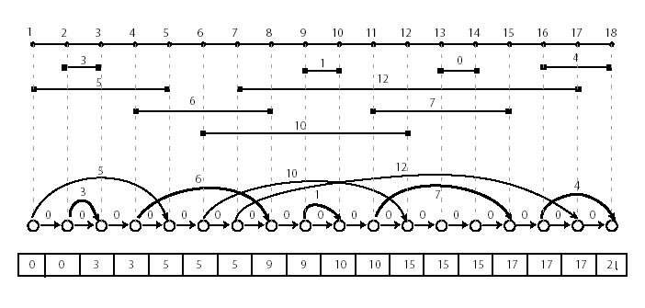
Exon Chaining Problem: Graph Representation
This problem corresponds to the longest path problem in a DAG and can be solved by dynamic programming in O(n) time, given the graph.

Slide 16
Exon Chaining Algorithm
ExonChaining (G, n) //Graph, number of intervals
for i ← to 2n
s_{i} ← 0
for i ← 1 to 2n
if vertex v_{i} in G corresponds to right end of interval I
j ← index of vertex for left end of interval I
w ← weight of the interval I
s_{i} ← max {s_{j} + w, s_{i-1}}
else
s_{i} ← s_{i-1}
return s_{2n}

Slide 17
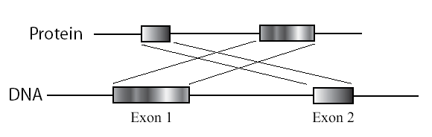
Exon Chaining: Deficiencies
  Poor (weak) definition of the putative exon endpoints
  Optimal chain of intervals may not correspond to any valid alignment
    First interval may correspond to a suffix, whereas second interval may correspond to a prefix
    Combination of such intervals is not a valid alignment

Slide 18
Infeasible Chains
Red local similarities form two non-overlapping intervals but do not form a valid global alignment
Frog Genes (known)
Human Genome

Slide 19
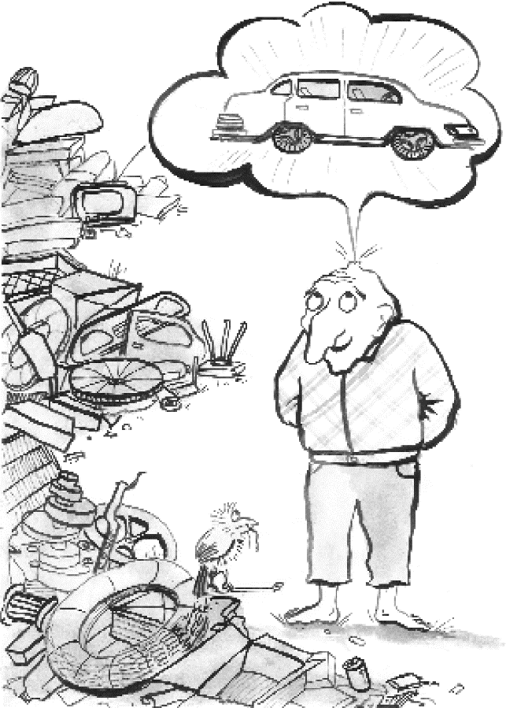
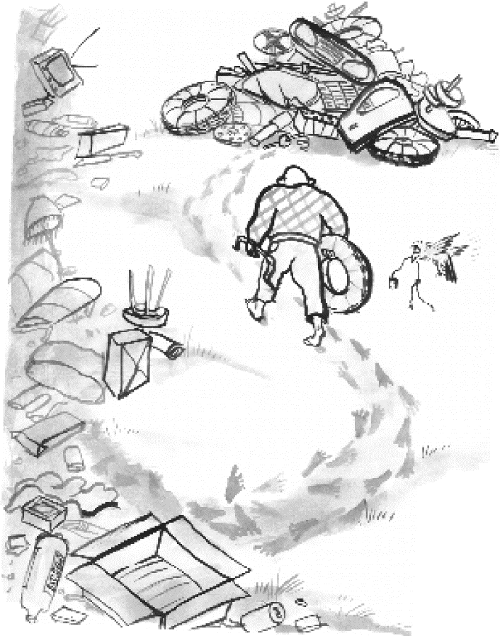
Gene Prediction Analogy: Selecting Putative Exons
The cell carries DNA as a blueprint for producing proteins,
like a manufacturer carries a blueprint for producing a car

Slide 20
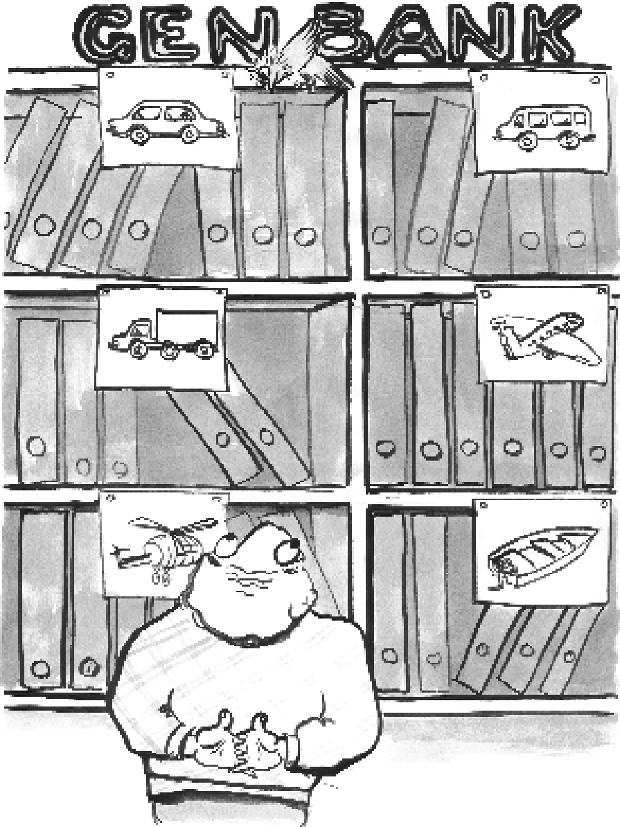
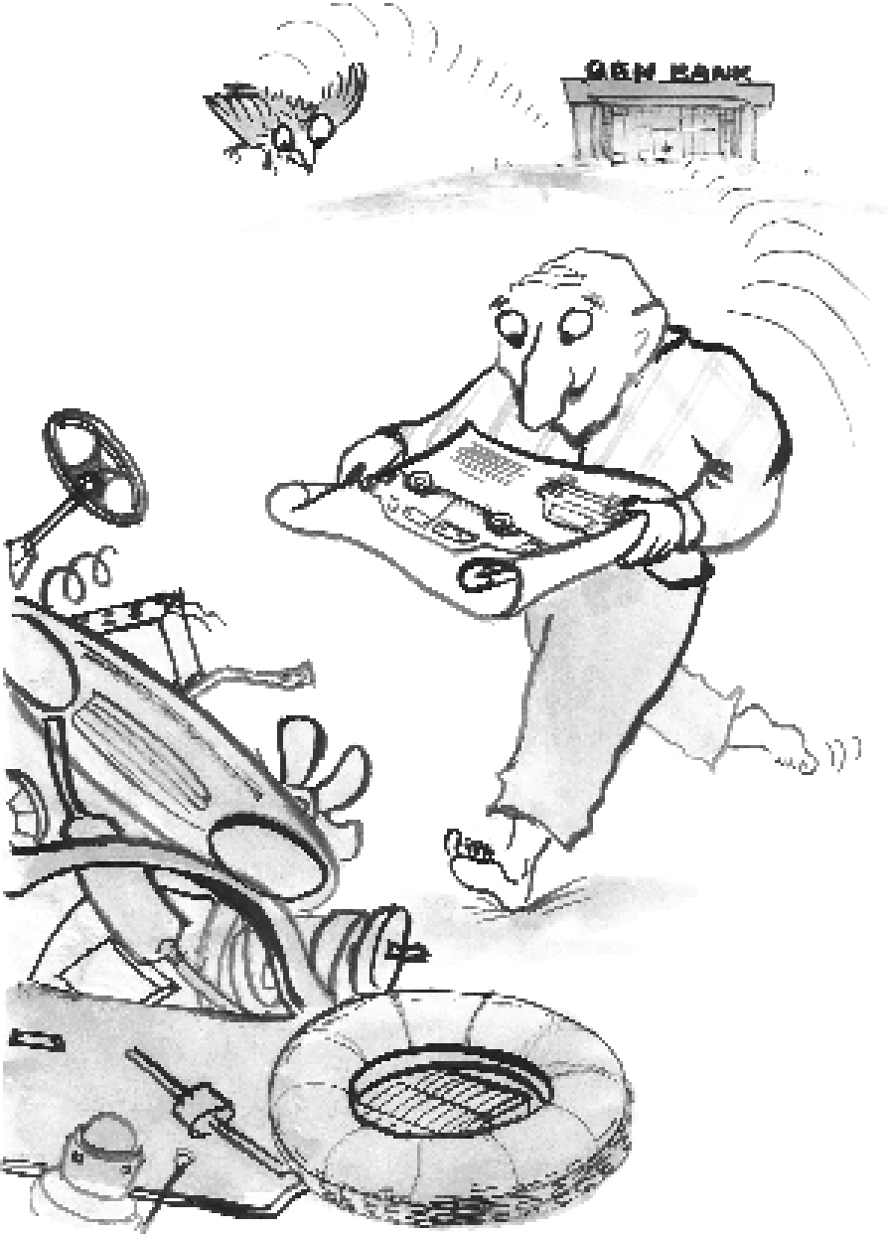
Using Blueprint

Slide 21
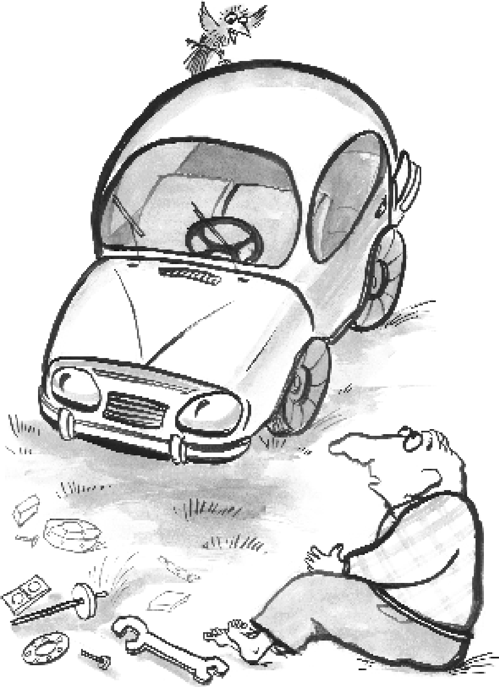
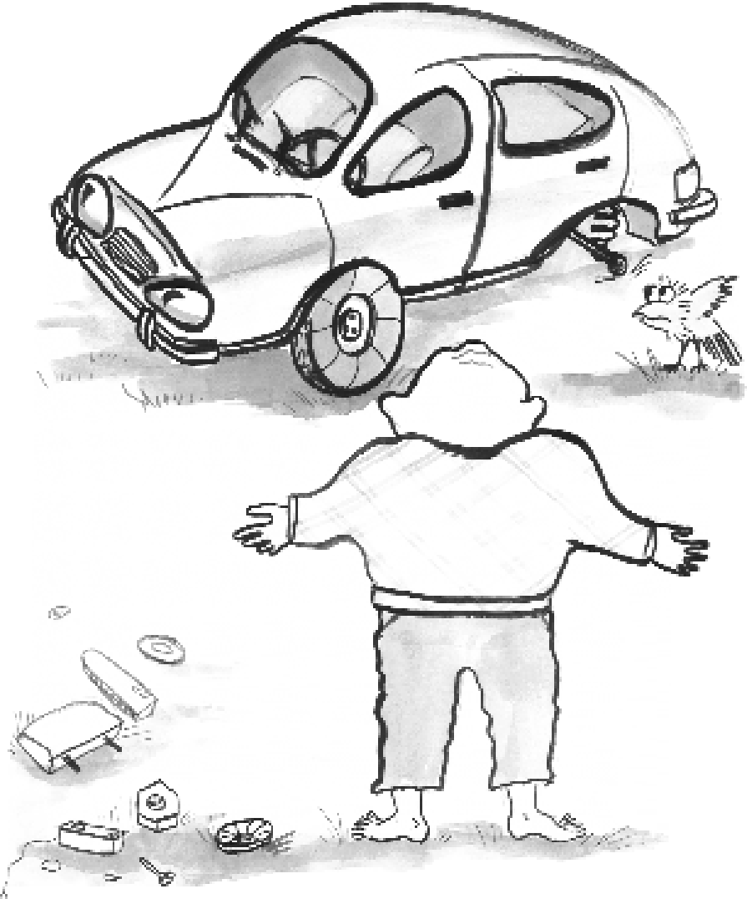
Assembling Putative Exons

Slide 22
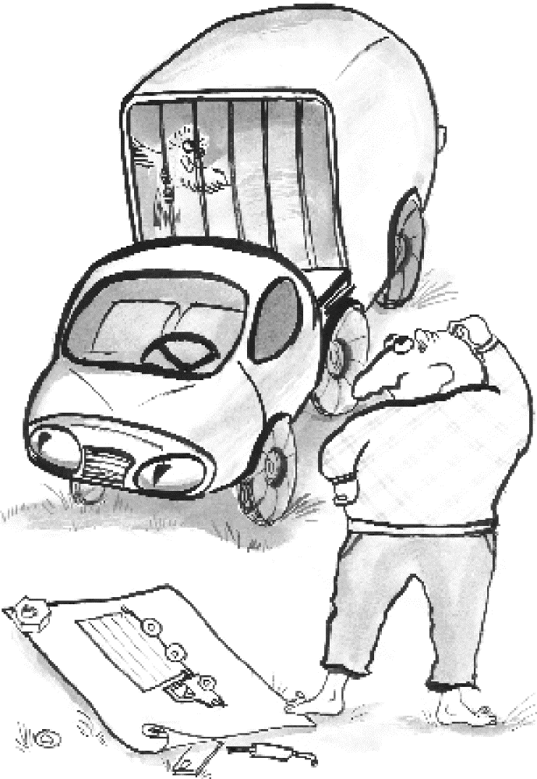
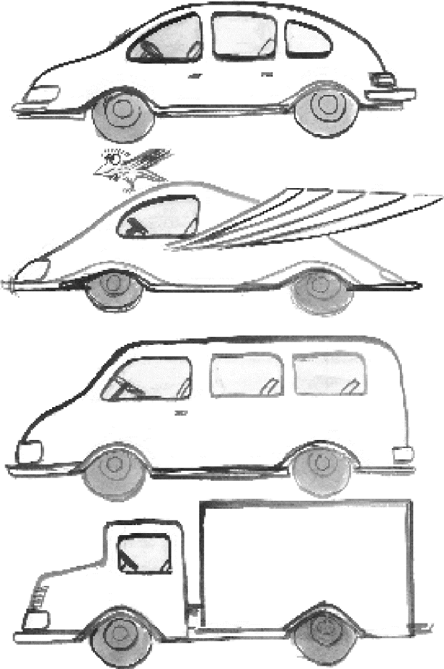
Still Assembling Putative Exons

Slide 23
Spliced Alignment
Mikhail Gelfand and colleagues proposed a spliced alignment approach of using a protein/mRNA from one genome to reconstruct the exon-intron structure of a (related/homologous) gene on another genome.
  Begins by selecting either all putative exons between potential acceptor and donor sites or by finding all substrings similar to the target protein/mRNA (as in the Exon Chaining Problem, but unweighted).
  This set is further filtered in a such a way that attempts to retain all true exons, with some false ones.

Slide 24
Spliced Alignment Problem: Formulation
Goal: Find a chain of blocks in a genomic sequence that best fits a target sequence
Input: Genomic sequence G, target (mRNA or protein) sequence T, and a set B of candidate exons/blocks (in G).
Output: A chain of exons Γ such that the global alignment score between Γ* and T is maximized among all chains of blocks from B.
Γ* - concatenation of all exons from chain Γ

Slide 25
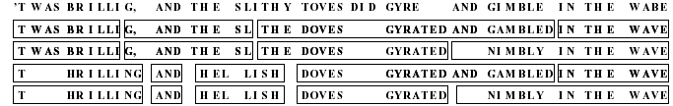
Lewis Carroll Example

Slide 26
Spliced Alignment: Idea
Compute the best alignment between the i-prefix of genomic sequence G and the j-prefix of target T:
S(i,j)
But what is the “i-prefix of G”?
The meaning of the “i-prefix of G” depends on which block we are in because blocks overlap.

Slide 27
Spliced Alignment: Idea
Compute the best alignment between the i-prefix of genomic sequence G and the j-prefix of target T:
S(i,j)
But what is the “i-prefix of G”?
The meaning of the “i-prefix of G” depends on which block we are in. So,
Compute the best alignment between i-prefix of genomic sequence G and j-prefix of target T under the assumption that the alignment uses block B at position i
S(i,j,B)

Slide 28
Spliced Alignment Recurrence
If i is not the start vertex of block B:
S(i, j, B) =
max { S(i – 1, j, B) – indel penalty affine?
S(i, j – 1, B) – indel penalty multiple of 3?
  S(i – 1, j – 1, B) + δ(g_{i}, t_{j}) }
  If i is the start vertex of block B:
S(i, j, B) =
max { S(i, j – 1, B) – indel penalty
        maxall blocks B’ preceding block B S(end(B’), j, B’) – indel penalty
        maxall blocks B’ preceding block B S(end(B’), j – 1, B’) + δ(g_{i}, t_{j})
        }

Slide 29
Spliced Alignment Solution
After computing the three-dimensional table S(i, j, B), the score of the optimal spliced alignment is:
max_{all blocks} _{B}S(end(B), length(T), B)

Slide 30
Spliced Alignment: Complications
Considering multiple i-prefixes leads to slowdown. Running time:
O(mn² |B|) or O(mn|B|^2)
where m is the target length, n is the genomic sequence length, and |B| is the number of blocks.
A mosaic effect: short exons are easily combined to fit any target protein

Slide 31
Spliced Alignment: Speedup

Slide 32
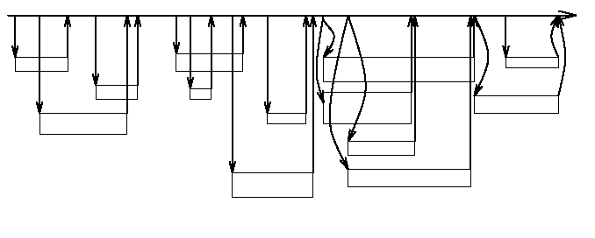
Spliced Alignment: Speedup

Slide 33
Spliced Alignment: Speedup
P(i,j)=maxall blocks B preceding position i S(end(B), j, B)

Slide 34
Exon Chaining vs Spliced Alignment
In Spliced Alignment, every path spells out a string obtained by concatenation of the labels (blocks) of its nodes. The weight of the path is defined as optimal alignment score between concatenated blocks and target sequence
  Nodes are unweighted
Exon Chaining assumes the positions and weights of exons are pre-defined

Slide 35
Gene Prediction: Aligning Genome vs. Genome
Align entire human and mouse genomes
Predict genes in both sequences simultaneously as chains of aligned blocks (exons)
This approach does not assume any annotation of either human or mouse genes.

Slide 36
Gene Prediction Tools
GENSCAN/Genome Scan/AUGUSTUS
TwinScan
Glimmer
GeneMark

Slide 37
The GENSCAN Algorithm
Algorithm is based on a probabilistic model of gene structure similar to Hidden Markov Models (HMMs).
GENSCAN uses a training set in order to estimate the HMM parameters, and returns the exon structure using the maximum likelihood approach standard to many HMM algorithms (Viterbi algorithm).
  Biological input: Codon bias in coding regions, gene structure (start and stop codons, typical exon and intron length, presence of promoters, presence of genes on both strands, etc).
  Covers cases where input sequence contains no gene, partial gene, complete gene, multiple genes.

Slide 38
GENSCAN Limitations
  Does not use similarity search to predict genes. This has been addressed in recent improvements, similar to what has been done in GenomeScan and AUGUSTUS.
  Does not address alternative splicing.
  Could combine two exons from consecutive genes together.

Slide 39
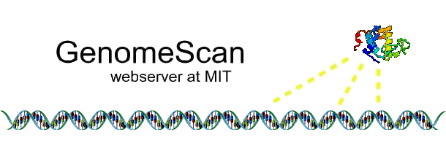
GenomeScan
Incorporates similarity information into GENSCAN: predicts gene structures corresponding to maximum probability conditional on similarity information
Algorithm is a combination of two sources of information
  Probabilistic models of exons-introns
  Sequence similarity information

Slide 40
TwinScan
Aligns two sequences and marks each base as gap ( - ), mismatch (:), or match (|), resulting in a new alphabet of 12 letters: Σ = {A-, A:, A |, C-, C:, C |, G-, G:, G |, T-, T:, T|}
Runs Viterbi algorithm using emissions e_{k}(b) where b ∊ {A-, A:, A|, …, T|}
http://www.standford.edu/class/cs262/Spring2003/Notes/ln10.pdf

Slide 41
TwinScan (cont’d)
The emission probabilities are estimated from from human/mouse gene pairs
  Ex. e_{I}(x|) < e_{E}(x|) since matches are favored in exons, and e_{I}(x-) > e_{E}(x-) since gaps (as well as mismatches) are favored in introns
  Compensates for dominant occurrence of poly-A region in introns

Slide 42

Glimmer
Gene Locator and Interpolated Markov ModelER
Finds genes in bacterial DNA
Uses Interpolated Markov Models

Slide 43
The Glimmer Algorithm
Consists of two programs
  BuildIMM
    Takes sequences as input and outputs the Interpolated Markov Models (IMMs)
  Glimmer
    Takes IMMs and outputs all candidate genes
    Automatically resolves overlapping genes by choosing one, hence limited
    Marks “suspected to truly overlap” genes for closer inspection by user

Slide 44
GeneMark
Based on non-stationary Markov chain models
Results displayed graphically with coding vs. noncoding probability dependent on position in nucleotide sequence

