Slide 1
Greedy (Approximation) Algorithms and Genome Rearrangements

Slide 2
Outline
Transforming Cabbage into Turnip
Genome Rearrangements
Sorting by Reversals
Pancake Flipping Problem
Greedy Algorithm for Sorting by Reversals
Approximation Algorithms
Breakpoints: a Different Face of Greed
Breakpoint Graphs

Slide 3
Outline CHANGE
Genome Rearrangements – give picture of splotch mouse

Slide 4
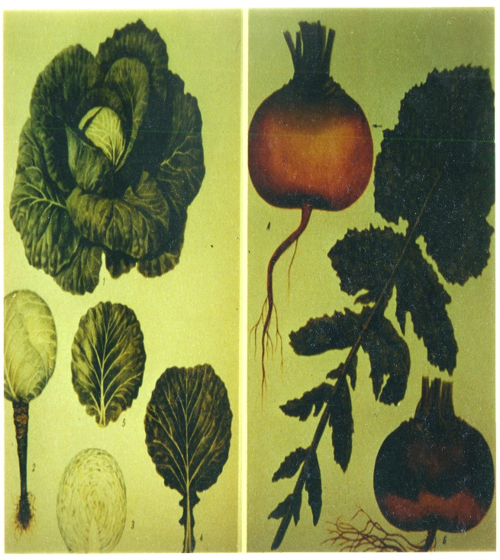


Turnip vs Cabbage: Look and Taste Different
Although cabbages and turnips share a recent common ancestor (9-15 million years ago), they look and taste different

Slide 5
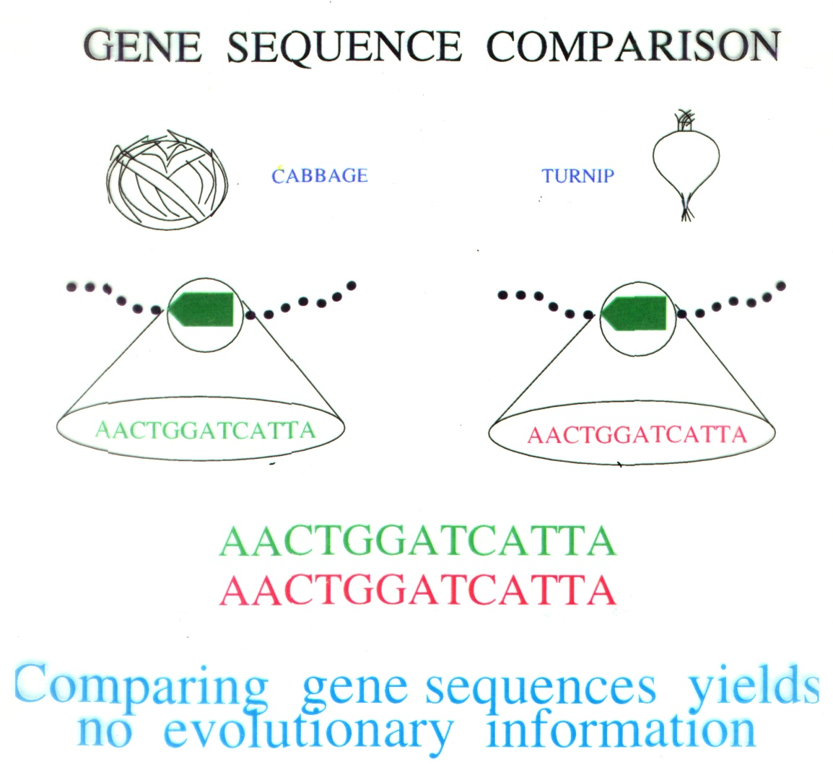
Turnip vs Cabbage: Comparing Gene Sequences Yields No Evolutionary Information

Slide 6
Turnip vs Cabbage: Almost identical mtDNA gene sequences
In 1980s Jeffrey Palmer studied evolution of plant organelles by comparing mitochondrial genomes of the cabbage and turnip
99% similarity between (homologous) genes
These surprisingly similar gene sequences however differ in gene order
This study helped pave the way to analyzing genome rearrangements in molecular evolution

Slide 7
Turnip vs Cabbage: Different mtDNA Gene Orders
Gene order evolution:

Slide 8
Turnip vs Cabbage: Different mtDNA Gene Orders
Gene order evolution:

Slide 9
Turnip vs Cabbage: Different mtDNA Gene Orders
Gene order evolution:

Slide 10
Turnip vs Cabbage: Different mtDNA Gene Orders
Gene order evolution:

Slide 11
Turnip vs Cabbage: Different mtDNA Gene Orders
Gene order evolution:
Before
After
Evolution is manifested in the divergence of gene orders

Slide 12
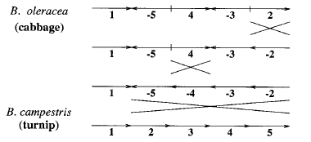
Transforming Cabbage into Turnip

Slide 13
Genome Rearrangements
Mouse (X chrom.)
Unknown ancestor
~ 75 million years ago
Human (X chrom.)
What are the similarity (or syntenic) blocks and how to find them?
What is the architecture of the ancestral genome?
What is the evolutionary scenario for transforming one genome into the other?

Slide 14
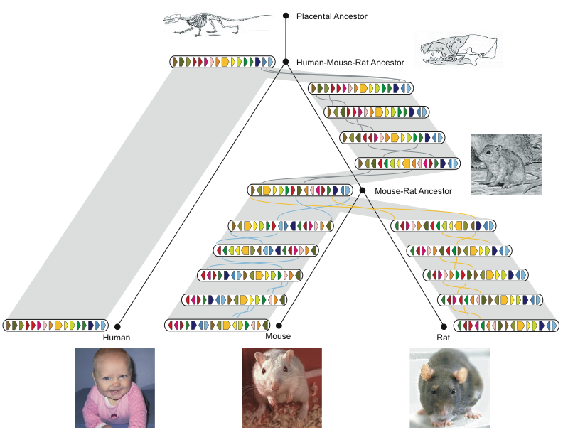
History of Chromosome X
Rat Consortium, Nature, 2004

Slide 15
Reversals
1
2
3
9
10
8
4
7
5
1, 2, 3, 4, 5, 6, 7, 8, 9, 10
6
Blocks represent conserved genes (or syntenic blocks of genes).

Slide 16
Reversals
1
2
3
9
10
8
4
7
5
1, 2, 3, -8, -7, -6, -5, -4, 9, 10
6
Blocks represent conserved genes (or syntenic blocks of genes).
In the course of evolution or in a clinical context, blocks 1,…,10 could be misread as 1, 2, 3, -8, -7, -6, -5, -4, 9, 10.

Slide 17
Reversals and Breakpoints
1
2
3
9
10
8
4
7
5
1, 2, 3, -8, -7, -6, -5, -4, 9, 10
6
The reversal introduced two breakpoints
(disruptions in order).

Slide 18

Reversals: Example
5’ ATGCCTGTACTA 3’
3’ TACGGACATGAT 5’
Break and Invert
5’ ATGTACAGGCTA 3’
3’ TACATGTCCGAT 5’

Slide 19
Types of Rearrangements
Reversal
1 2 3 4 5 6
1 2 -5 -4 -3 6
Translocation
1 2 3 4 5 6
1 6 4 5 2 3
Fusion
1 2 3 4
5 6
1 2 3 4 5 6
Fission

Slide 20
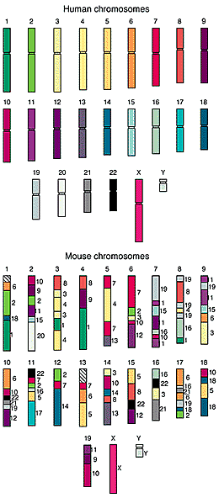
Comparative Genomic Architectures: Mouse vs Human Genomes
Humans and mice have similar genomes, but their genes are ordered differently
~245 rearrangements
  Reversals
  Fusions
  Fissions
  Translocations

Slide 21

Waardenburg’s Syndrome: Mouse Provides Insight into Human Genetic Disorder
Waardenburg’s syndrome is characterized by pigmentary dysphasia
Gene implicated in the disease was linked to human chromosome 2 but it was not clear where exactly it is located on chromosome 2

Slide 22
Waardenburg’s syndrome and splotch mice
A breed of mice (with splotch gene) had similar symptoms caused by the same type of gene as in humans
Scientists succeeded in identifying location of gene responsible for disorder in mice
Finding the gene in mice gives clues to where the same gene is located in humans

Slide 23
Comparative Genomic Architecture of Human and Mouse Genomes
To locate where corresponding gene is in humans, we have to analyze the relative architecture of human and mouse genomes

Slide 24
Reversals: Example (unsigned)
π = 1 2 3 4 5 6 7 8
ρ(3,5)
1 2 5 4 3 6 7 8

Slide 25
Reversals: Example (unsigned)
π = 1 2 3 4 5 6 7 8
ρ(3,5)
1 2 5 4 3 6 7 8
ρ(5,6)
1 2 5 4 6 3 7 8

Slide 26
Reversals and Gene Orders
Gene order is represented by a permutation π:
π = π ₁ ₋₋₋₋₋₋ π _{i-1} π _{i} π _{i+1 ------} π _{j-1} π _{j} π _{j+1 -----} π _{n}
π ₁ ₋₋₋₋₋₋ π _{i-1} π _{j} π _{j-1 ------} π _{i+1} π _{i} π _{j+1 -----} π_{n}
Reversal ρ ( i, j ) reverses (flips) the elements from i to j in π (unsigned version)
ρ(ι,j)

Slide 27
Reversal Distance Problem
Goal: Given two permutations, find the shortest series of reversals that transforms one into the other
Input: Permutations π and σ
Output: A series of reversals ρ₁,…ρ_{t} transforming π into σ, such that t is minimum
d(π, σ) - reversal distance between π and σ
d(π, σ) - smallest possible value of t, given π and σ

Slide 28
Sorting by Reversals Problem
Goal: Given a permutation, find a shortest series of reversals that transforms it into the identity permutation (1 2 … n )
Input: Permutation π
Output: A series of reversals ρ₁, … ρ_{t} transforming π into the identity permutation such that t is minimum

Slide 29
Sorting by Reversals: Example
d(π ) - reversal distance of π
Example :
π = 3 4 2 1 5 6 7 10 9 8
4 3 2 1 5 6 7 10 9 8
4 3 2 1 5 6 7 8 9 10
1 2 3 4 5 6 7 8 9 10
So, d(π ) = 3

Slide 30
Sorting by reversals: 5 steps
signed version
Notes:
hour

Slide 31
Sorting by reversals: 4 steps

Slide 32
Sorting by reversals: 4 steps
What is the reversal distance for this permutation? Can it be sorted in 3 steps?

Slide 33

Pancake Flipping Problem
The chef is sloppy: he prepares an unordered stack of pancakes of different sizes
The waiter wants to rearrange them (so that the smallest winds up on top, and so on, down to the largest at the bottom)
He does it by flipping over several from the top, repeating this as many times as necessary
Christos Papadimitrou and Bill Gates flip pancakes

Slide 34
Pancake Flipping Problem: Formulation
Goal: Given a stack of n pancakes, what is the minimum number of flips to rearrange them into the perfect stack?
Input: Permutation π
Output: A series of prefix reversals ρ₁, … ρ_{t} transforming π into the identity permutation such that t is the minimum

Slide 35
Pancake Flipping Problem: Greedy Algorithm
Question: How many flips are necessary for any permutation of size n?
Greedy approach: 2 prefix reversals at most to place a pancake at correct position. Thus, 2n–2 steps suffice.
Bill Gates and Christos Papadimitriou showed in the mid1970s that this problem can be solved by at most 5/3 (n+1) prefix reversals.
W.H. Gates and C.H. Papadimitriou. Bounds for sorting by prefix reversal. Discrete Math. 27 (1979), 47--57. (received Jan. 1978)

Slide 36
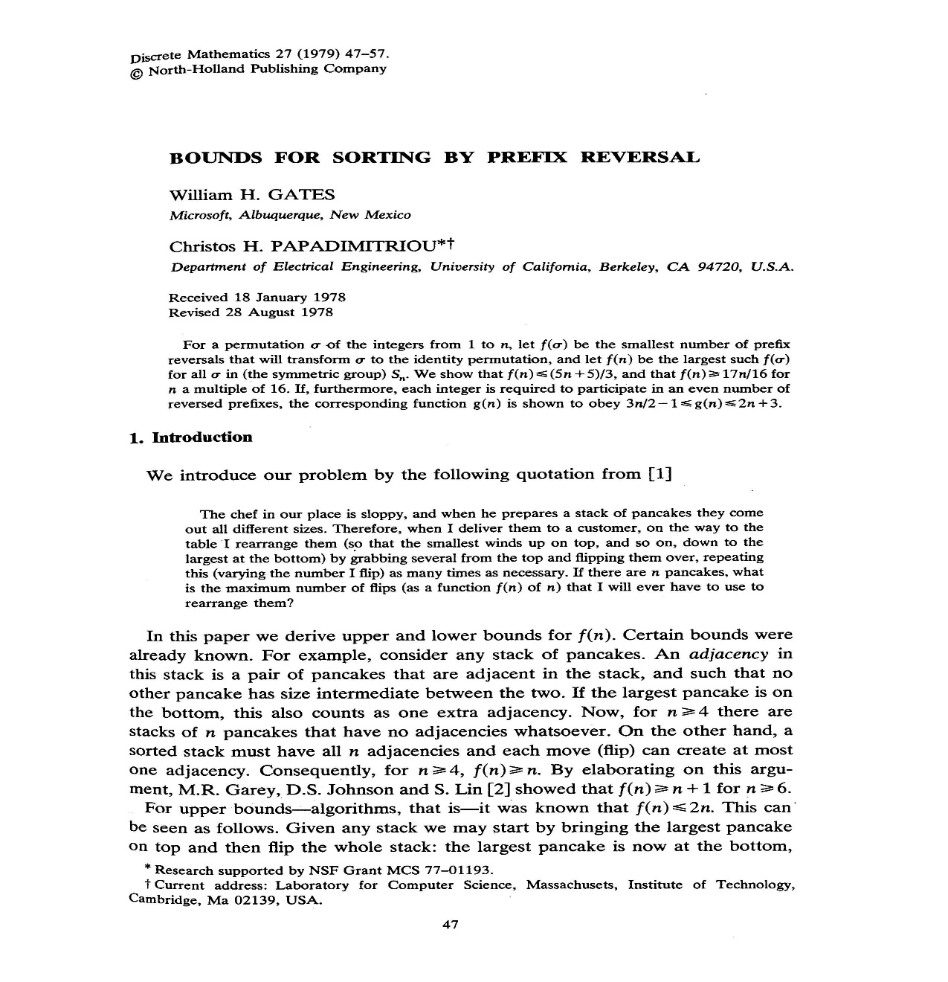
Bounds for Sorting By Prefix Reversal

Slide 37
Sorting By Reversals: A Greedy Algorithm
In sorting permutation π = 1 2 3 6 4 5, the first three elements are already in order so it does not make any sense to break them
The length of the already sorted prefix of π is denoted prefix(π)
  prefix(π) = 3
This results in an idea for a greedy algorithm: increase prefix(π) at every step

Slide 38
Greedy Algorithm: An Example
Doing so, π can be sorted
1 2 3 6 4 5
1 2 3 4 6 5
1 2 3 4 5 6
Number of steps to sort permutation of length n is at most (n – 1)

Slide 39
Greedy Algorithm: Pseudocode
SimpleReversalSort(π)
1 for i ← 1 to n – 1
2 j ← position of element i in π (i.e., π_{j} = i )
3 if j ≠i
4 π ← π * ρ(i, j)
5 output π
6 if π is the identity permutation
7 return

Slide 40
Analyzing SimpleReversalSort
SimpleReversalSort does not guarantee the smallest number of reversals and takes five steps on π = 6 1 2 3 4 5 :
    Step 1: 1 6 2 3 4 5
    Step 2: 1 2 6 3 4 5
    Step 3: 1 2 3 6 4 5
    Step 4: 1 2 3 4 6 5
    Step 5: 1 2 3 4 5 6

Slide 41
Analyzing SimpleReversalSort (cont’d)
But it can be sorted in two steps:
  π = 6 1 2 3 4 5
  Step 1: 5 4 3 2 1 6
  Step 2: 1 2 3 4 5 6
So, SimpleReversalSort(π) is not optimal
The problem is NP-hard; approximation algorithms are desirable

Slide 42
Approximation Algorithms
These (heuristic) algorithms find approximate solutions rather than optimal solutions
The approximation ratio of an algorithm A on input π is:
  A(π) / OPT(π)
  where
  A(π) - solution produced by algorithm A OPT(π) - optimal solution of the problem

Slide 43
Approximation Ratio/Performance Guarantee
Approximation ratio (performance guarantee) of algorithm A: max approximation ratio of all inputs of size n
  For algorithm A that minimizes objective function (minimization algorithm):
    max_{|π| = n} A(π) / OPT(π)

Slide 44
Approximation Ratio/Performance Guarantee
Approximation ratio (performance guarantee) of algorithm A: worst approximation ratio on all input of size n
  For algorithm A that minimizes an objective function (minimization algorithm):
    max_{|π| = n} A(π) / OPT(π)
  For maximization algorithm:
    min_{|π| = n} A(π) / OPT(π)
    So, the approximation ratio of algorithm SimpleReversalSort is n/2

Slide 45
Adjacencies and Breakpoints
Given π = π₁π₂π₃…π_{n-1}π_{n}, a pair of elements π _{i} and π _{i + 1} are adjacent if
π_{i+1} = π_{i} + 1
For example:
π = 1 9 3 4 7 8 2 6 5
(3, 4) or (7, 8) and (6,5) are adjacent pairs

Slide 46
Breakpoints: An Example
There is a breakpoint between any neighboring elements that are not adjacent:
π = 1 9 3 4 7 8 2 6 5
Pairs (1,9), (9,3), (4,7), (8,2) and (2,6) form breakpoints of permutation π
b(π) - # breakpoints in permutation π

Slide 47
Adjacency & Breakpoints
An adjacency - a pair of neighboring elements that are consecutive
A breakpoint - a pair of neighboring elements that are not adjacent
π = 5 6 2 1 3 4
Extend π with π₀ = 0 and π₇ = 7
adjacencies
0 5 6 2 1 3 4 7
breakpoints

Slide 48
Extending Permutations
We put two elements π ₀ =0 and π _{n + 1}=n+1 at the ends of π
  Example:
π = 1 9 3 4 7 8 2 6 5
Extending with 0 and 10
      π = 0 1 9 3 4 7 8 2 6 5 10
Note: A new breakpoint was created after extension

Slide 49
Reversal Distance and Breakpoints
Each reversal eliminates at most 2 breakpoints.
  π = 2 3 1 4 6 5
  0 2 3 1 4 6 5 7 b(π) = 5
  0 1 3 2 4 6 5 7 b(π) = 4
  0 1 2 3 4 6 5 7 b(π) = 2
  0 1 2 3 4 5 6 7 b(π) = 0

Slide 50
Reversal Distance and Breakpoints
Each reversal eliminates at most 2 breakpoints.
This implies:
reversal distance ≥ #breakpoints / 2
  π = 2 3 1 4 6 5
  0 2 3 1 4 6 5 7 b(π) = 5
  0 1 3 2 4 6 5 7 b(π) = 4
  0 1 2 3 4 6 5 7 b(π) = 2
  0 1 2 3 4 5 6 7 b(π) = 0

Slide 51
Sorting By Reversals: A Better Greedy Algorithm
  BreakPointReversalSort(π)
  1 while b(π) > 0
  2 Among all possible reversals, choose reversal ρ minimizing b(π • ρ)
  3 π ← π • ρ(i, j)
  4 output π
  5 return

Slide 52
Sorting By Reversals: A Better Greedy Algorithm
  BreakPointReversalSort(π)
  1 while b(π) > 0
  2 Among all possible reversals, choose reversal ρ minimizing b(π • ρ)
  3 π ← π • ρ(i, j)
  4 output π
  5 return
Problem: This algorithm may run forever!

Slide 53
Strips
Strip: an interval between two consecutive breakpoints in a permutation
  Decreasing strip: strip of elements in decreasing order (e.g., 4 3 ).
  Increasing strip: strip of elements in increasing order (e.g., 7 8 and 5 6)
  0 1 9 4 3 7 8 2 5 6 10
  A single-element strip can be declared either increasing or decreasing. We will choose to declare them as decreasing with the exception of the strips consisting of only 0 or n+1

Slide 54
Reducing the Number of Breakpoints
Theorem 1:
  If permutation π contains at least one decreasing strip, then there exists a reversal ρ that decreases the number of breakpoints (i.e., b(π • ρ) < b(π) )

Slide 55
Things to Consider
For π = 1 4 6 5 7 8 3 2
0 1 4 6 5 7 8 3 2 9 b(π) = 5
  Choose decreasing strip with the smallest element k in π (k = 2 in this case)

Slide 56
Things to Consider (cont’d)
For π = 1 4 6 5 7 8 3 2
0 1 4 6 5 7 8 3 2 9 b(π) = 5
  Choose decreasing strip with the smallest element k in π (k = 2 in this case)

Slide 57
Things to Consider (cont’d)
For π = 1 4 6 5 7 8 3 2
0 1 4 6 5 7 8 3 2 9 b(π) = 5
  Choose decreasing strip with the smallest element k in π (k = 2 in this case)
  Find k – 1 in the permutation

Slide 58
Things to Consider (cont’d)
For π = 1 4 6 5 7 8 3 2
0 1 4 6 5 7 8 3 2 9 b(π) = 5
  Choose decreasing strip with the smallest element k in π (k = 2 in this case)
  Find k–1 in the permutation
  Reverse the segment between k and k-1:
  0 1 4 6 5 7 8 3 2 9 b(π) = 5
  0 1 2 3 8 7 5 6 4 9 b(π) = 4
What if k-1 occurs to the right of k?

Slide 59
Reducing the Number of Breakpoints again
  If there is no decreasing strip, there may be no reversal ρ that reduces the number of breakpoints (i.e., b(π • ρ) ≥ b(π) for any reversal ρ). E.g. 04561237
  By reversing an increasing strip ( # of breakpoints stay unchanged ), we will create a decreasing strip at the next step. Then the number of breakpoints will be reduced in the next step (Theorem 1).

Slide 60
Things to Consider (cont’d)
There are no decreasing strips in π below:
π = 0 1 2 5 6 7 3 4 8 b(π) = 3
π • ρ(6,7) = 0 1 2 5 6 7 4 3 8 b(π) = 3
ρ(6,7) does not change the # of breakpoints
ρ(6,7) creates a decreasing strip thus guaranteeing that the next step will decrease the # of breakpoints.

Slide 61
ImprovedBreakpointReversalSort
ImprovedBreakpointReversalSort(π)
1 while b(π) > 0
2 if π has a decreasing strip
Among all possible reversals, choose reversal ρ
that minimizes b(π • ρ)
4 else
5 Choose a reversal ρ that flips an increasing strip in π
6 π ← π • ρ
7 output π
8 return

Slide 62
ImprovedBreakpointReversalSort: Performance Guarantee
ImprovedBreakPointReversalSort is an approximation algorithm with a performance guarantee of at most 4
  It eliminates at least one breakpoint in every two steps; at most 2b(π) steps
  Approximation ratio: 2b(π) / d(π)
  Optimal algorithm eliminates at most 2 breakpoints in every step: d(π) ≥ b(π) / 2
  Approximation ratio:
    ( 2b(π) / d(π) ) < [ 2b(π) / (b(π) / 2) ] = 4
    This ratio can be improved to 2 by using reversals that will either result in decreasing strips or eliminate 2 breakpoints each time. Exercise?
Notes:
Consider the element to the right of k-1, which must also belong to a decreasing strip.

Slide 63
Signed Permutations
Up to this point, all permutations to sort were unsigned
But genes have directions… so we should consider signed permutations
5’
3’
π = 1 -2 - 3 4 -5
This can be converted to: 1 2 4 3 6 5 7 8 10 9.
So, the previous approximation algorithm works.

Slide 64
GRIMM Web Server
Real genome architectures are represented as signed permutations
Translocations, fusions and fissions can be represented as reversals without altering optimality
The reversal distance between two genomes represents their evolutionary distance
Efficient (exact) algorithms to sort signed permutations have been developed
GRIMM web server computes the reversal distance between signed permutations and an optimal sorting process (which likely reflects the true evolutionary scenario)

Slide 65
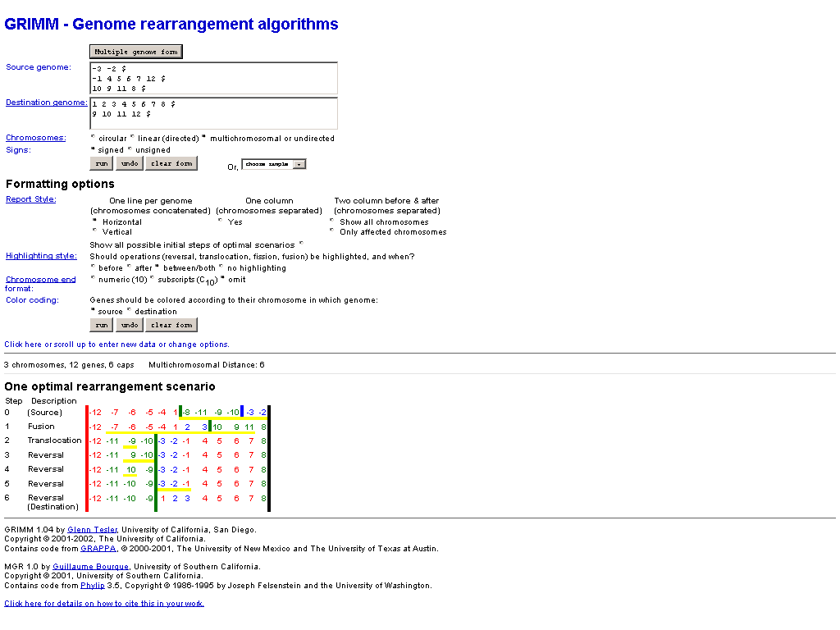
GRIMM Web Server
http://www-cse.ucsd.edu/groups/bioinformatics/GRIMM (down)

Slide 66
Breakpoint Graph
Represent the elements of the permutation π = 2 3 1 4 6 5 as vertices in a graph (ordered along a line)
Connect vertices in order given by π with black edges (black path)
Connect vertices in order given by 1 2 3 4 5 6 with grey edges (grey path)
The graph can be decomposed into edge-disjoint alternating cycles with the maximum number of cycles:
e.g., 232, 656, 46754, 0214310
4) Superimpose black and grey paths
0 2 3 1 4 6 5 7

Slide 67
Breakpoint Graph
Represent the elements of the permutation π = 2 3 1 4 6 5 as vertices in a graph (ordered along a line)
Connect vertices in order given by π with black edges (black path)
Connect vertices in order given by 1 2 3 4 5 6 with grey edges (grey path)
The graph can be decomposed into edge-disjoint alternating cycles with the maximum number of cycles:
e.g., 232, 656, 46754, 0214310
4) Superimpose black and grey paths
0 2 3 1 4 6 5 7

Slide 68
Two Equivalent Representations of the Breakpoint Graph
Consider the following Breakpoint Graph
If we line up the grey path (instead of black path) on a horizontal line, then we would get the following graph
Although they may look different, these two graphs are the same
0 2 3 1 4 6 5 7
0 1 2 3 4 5 6 7

Slide 69
What is the Effect of a Reversal ?
How does a reversal change the breakpoint graph?
The grey paths stayed the same for both graphs
There is a change in the graph at this point
There is another change at this point
The black edges are unaffected by the reversal so they remain the same for both graphs
Before: 0 2 3 1 4 6 5 7
0 1 2 3 4 5 6 7
After: 0 2 3 5 6 4 1 7
0 1 2 3 4 5 6 7

Slide 70
A reversal affects 4 edges in the breakpoint graph
A reversal removes 2 edges (red) and replaces them with 2 new edges (blue)
0 1 2 3 4 5 6 7

Slide 71
Effects of Reversals
Case 1:
Both (red) edges belong to the same cycle (in a max cycle decomposition of edges)
Remove the center black edges and replace them with new black edges (there are two ways to replace them)
(a) After this replacement, there now exist 2 cycles instead of 1 cycle
(b) Or after this replacement, there still exists 1 cycle
Therefore, after the reversal c(πρ) – c(π) = 0 or 1
c(πρ) – c(π) = 1
c(πρ) – c(π) = 0
This is called a proper reversal since there’s a cycle increase after the reversal.

Slide 72
Effects of Reversals (Continued)
Case 2:
Both (red) edges belong to different cycles
Remove the center black edges and replace them with new black edges
After the replacement, there now exists 1 cycle instead of 2 cycles
c(πρ) – c(π) = -1
Therefore, for every permutation π and reversal ρ, c(πρ) – c(π) ≤ 1

Slide 73
Reversal Distance and Maximum Cycle Decomposition
Since the identity permutation of size n allows for the maximum cycle decomposition of n+1 cycles, c(identity) = n+1
c(identity) – c(π) equals the number of cycles that need to be “added” to c(π) while transforming π into the identity
Based on the previous claim, at best after each reversal, the cycle decomposition could be increased by one, then: d(π) = c(identity) – c(π) = n+1 – c(π)
Yet, not every reversal can increase the cycle decomposition
Therefore, d(π) ≥ n+1 – c(π)

Slide 74
Signed Permutations
Genes are directed fragments of DNA and we represent a genome by a signed permutation
If genes are in the same position but their orientations are different, they do not yield the same gene order
For example, these two permutations have the same order, but most genes’ orientations are reversed; therefore, they are not equivalent gene orders
1 2 3 4 5
-1 2 -3 -4 -5

Slide 75
From Signed to Unsigned Permutations
Similar to a normal (unsigned) breakpoint graph
Redefine each vertex x with the following rules:
  If vertex x is positive, replace vertex x with vertex 2x-1 and vertex 2x in that order
  If vertex x is negative, replace vertex x with vertex 2x and vertex 2x-1 in that order
  The extension vertices x = 0 and x = n+1 are replaced by 0 and 2n+1
0 5 6 10 9 15 16 12 11 7 8 14 13 17 18 3 4 1 2 19 20 22 21 23
0 3a 3b 5a 5b 8a 8b 6a 6b 4a 4b 7a 7b 9a 9b 2a 2b 1a 1b 10a 10b 11a 11b 23
+3 -5 +8 -6 +4 -7 +9 +2 +1 +10 -11
0 +3 -5 +8 -6 +4 -7 +9 +2 +1 +10 -11 12

Slide 76
From Signed to Unsigned Permutations (Continued)
Construct the breakpoint graph as usual
Notice the alternating cycles in the graph between every other vertex pair
Since these cycles came from the same signed vertex, we will not be performing any reversal within each cycle. Therefore, these cycles can be removed from the graph (so the pairs will not be broken)
The graph is simply a collection of disjoint cycles!
0 5 6 10 9 15 16 12 11 7 8 14 13 17 18 3 4 1 2 19 20 22 21 23

Slide 77
Interleaving Edges
Interleaving edges are grey edges that cross each other
Example: Edges (0,1) and (18, 19) are interleaving
Cycles are interleaving if they have an interleaving edge
These 2 grey edges interleave
0 5 6 10 9 15 16 12 11 7 8 14 13 17 18 3 4 1 2 19 20 22 21 23

Slide 78
Interleaving Graphs
An Interleaving Graph is defined on the set of cycles in the breakpoint graph and are connected by edges where cycles are interleaved
A
A
B
B
D
C
C
E
E
F
F
0 5 6 10 9 15 16 12 11 7 8 14 13 17 18 3 4 1 2 19 20 22 21 23
0 5 6 10 9 15 16 12 11 7 8 14 13 17 18 3 4 1 2 19 20 22 21 23
B
D
A
E
F
C

Slide 79
Interleaving Graphs (Continued)
Oriented cycles are cycles that have the following form
Mark them on the interleaving graph. Each can be broken by a reversal.
Unoriented cycles are cycles that have the following form
In our example, A, B, D, E are unoriented cycles while C, F are oriented cycles (which are good)
E
C
F
B
D
A
E
F
C

Slide 80
Hurdles
Remove the oriented components from the interleaving graph
The following is the breakpoint graph with the oriented components removed
Hurdles are connected components that do not contain any other connected components within it
B
D
A
E
F
A
C
B
D
E
Hurdle

Slide 81
Reversal Distance with Hurdles
Hurdles are obstacles in the genome rearrangement problem
They cause a higher number of required reversals for a permutation to transform into the identity permutation
Let h(π) be the number of hurdles in permutation π
Taking into account of hurdles, the following formula gives a tighter bound on reversal distance
Roughly speaking, the cycles in a hurdle can be oriented with a single reversal
d(π) ≥ n+1 – c(π) + h(π)

Slide 82
A Brief Summary
 | signed | unsigned
Kececioglu and Sankoff (1995) |  | 2-approximation
Bafna and Pevzner (1996) | 1.5-approximation | 1.75-approximation
Hannenhalli and Pevzner (1995) | Polynomial | Special cases – polynomial
Caprara (1997) |  | NP-hard
Berman and Karpinski (1999) |  | Cannot be approximated within ratio 1.008
Christie (1998) |  | 1.5-approximation
Bader, et al (2001) | Linear – distance only
Berman, et al (2002) |  | 1.375-approximation
The work has also been extended to genomes with multiple chromosomes
(Hannenhalli and Pevaner, 1995; Tesler, 2002; Ozery-Flato and Shamir, 2003)
For the pancake flipping problem, 15n/14 < opt < 18n/11 (as of 2009).
Notes:
d = 3 – 1 + 1 + 0.

