Slide 1
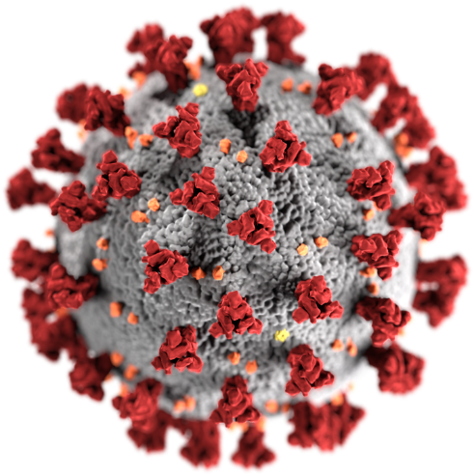
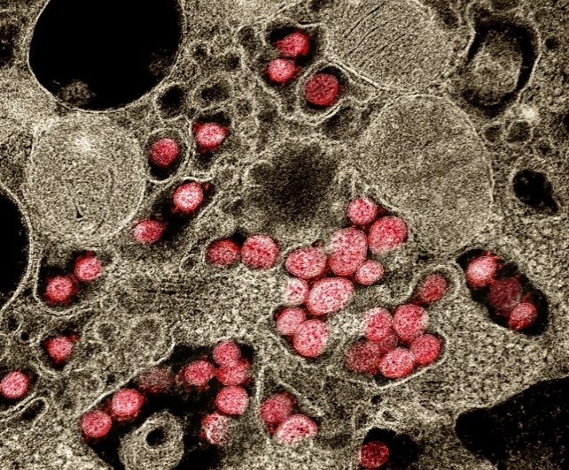
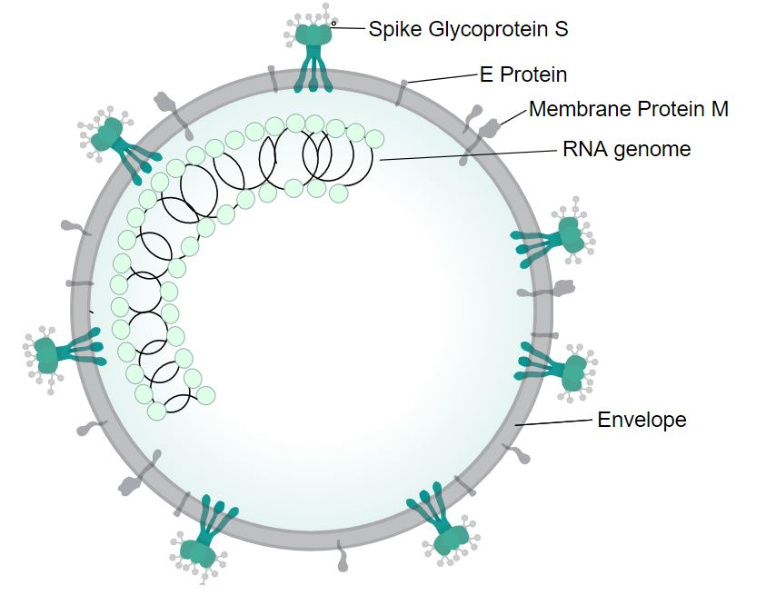
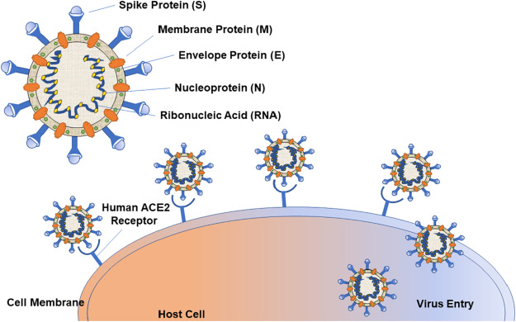
In these slides, we highlight some of the bioinformatics problems that were studied in (early) novel coronavirus research and are of interest to this class
Source: Wikipedia

Slide 2
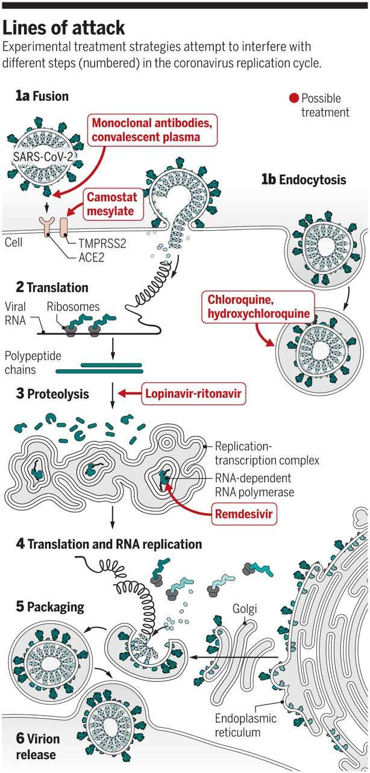
How to Attack SARS-CoV-2

Slide 3
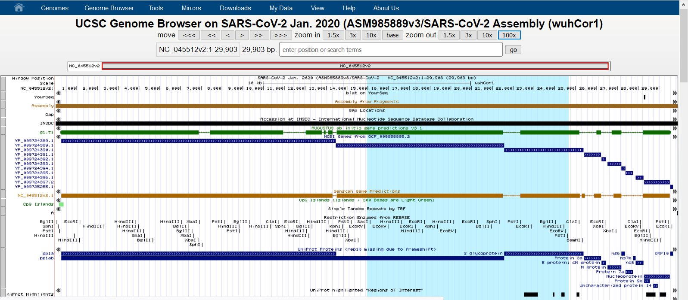
The Map of SARS-CoV-2 Genome:
Genome assembly, gene prediction, restriction sites
Source: UCSC/NCBI Genbank

Slide 4
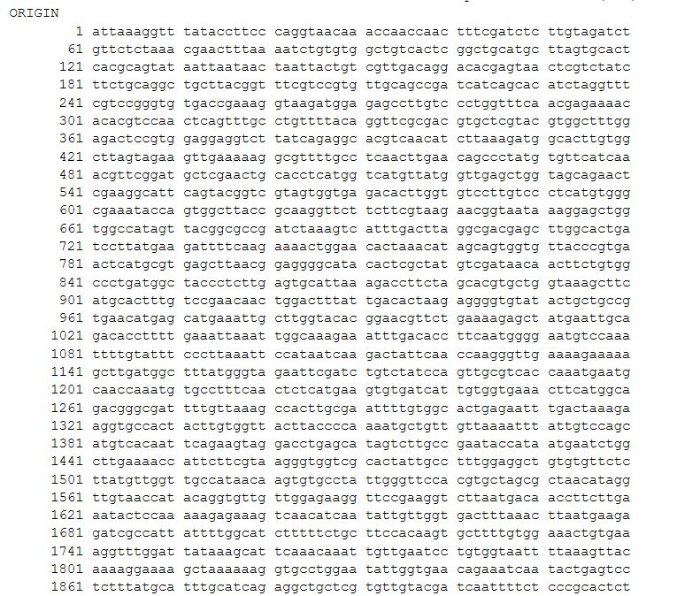
The Sequence of SARS-CoV-2 Genome
Source: UCSC/NCBI

Slide 5
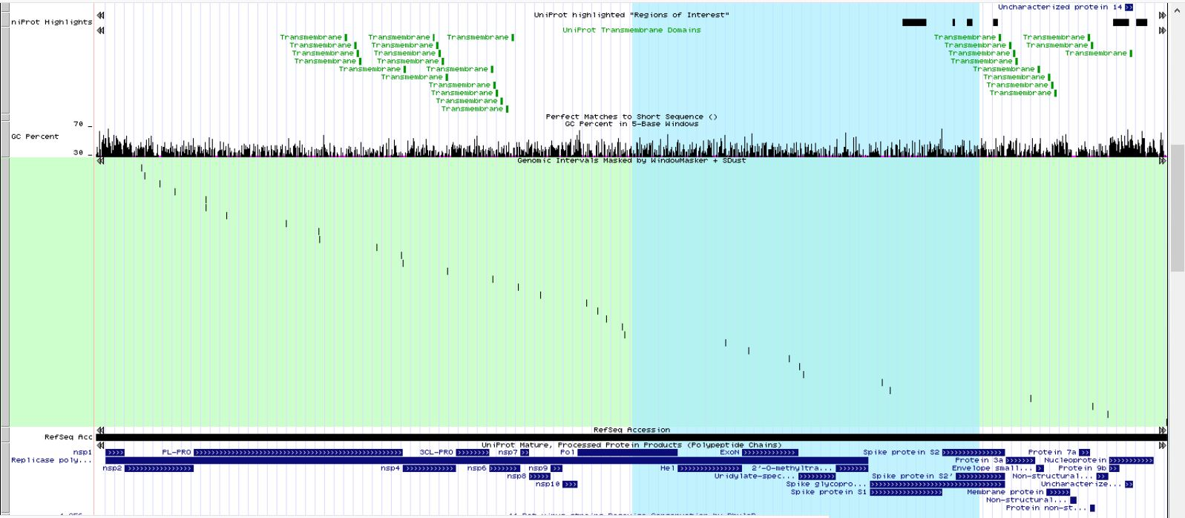
The Map of SARS-CoV-2 Genome: Conserved domains, motifs, GC content, transcripts, etc.
Source: UCSC/NCBI

Slide 6
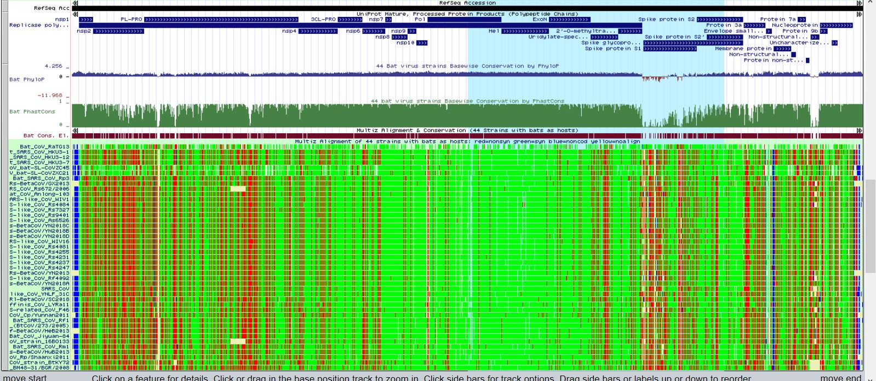
The Map of SARS-CoV-2 Genome: Multiple sequence alignment
Source: UCSC/NCBI

Slide 7
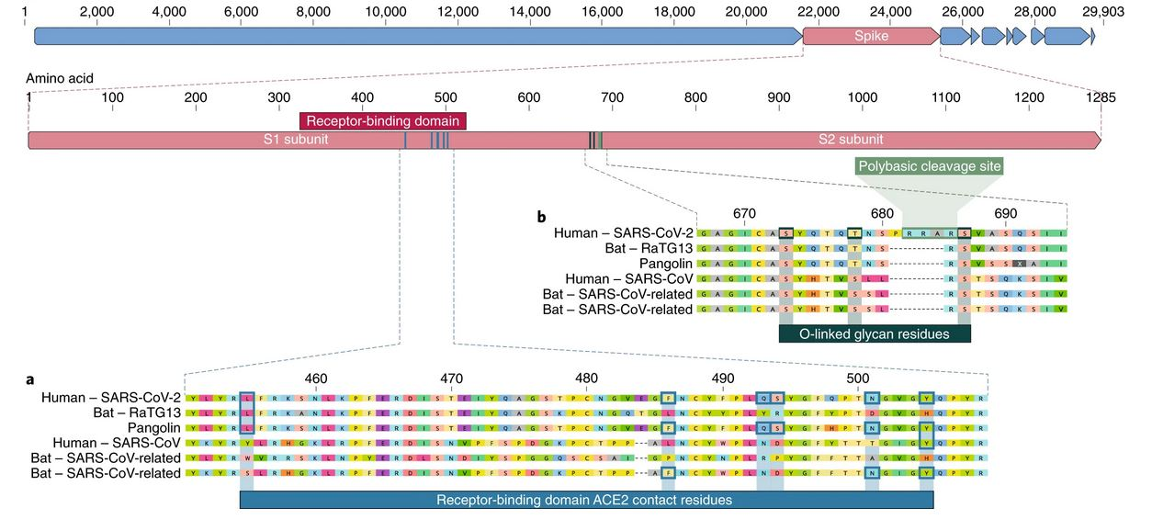
Multiple Alignment of the Spike Protein Sequences
in SARS-CoV-2 and Other Related Virus Genomes

Slide 8
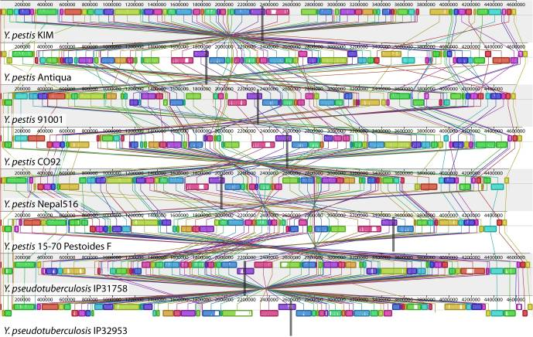
Alignment of 8 Yersinia Genomes in Terms of Genome Rearrangement

Slide 9
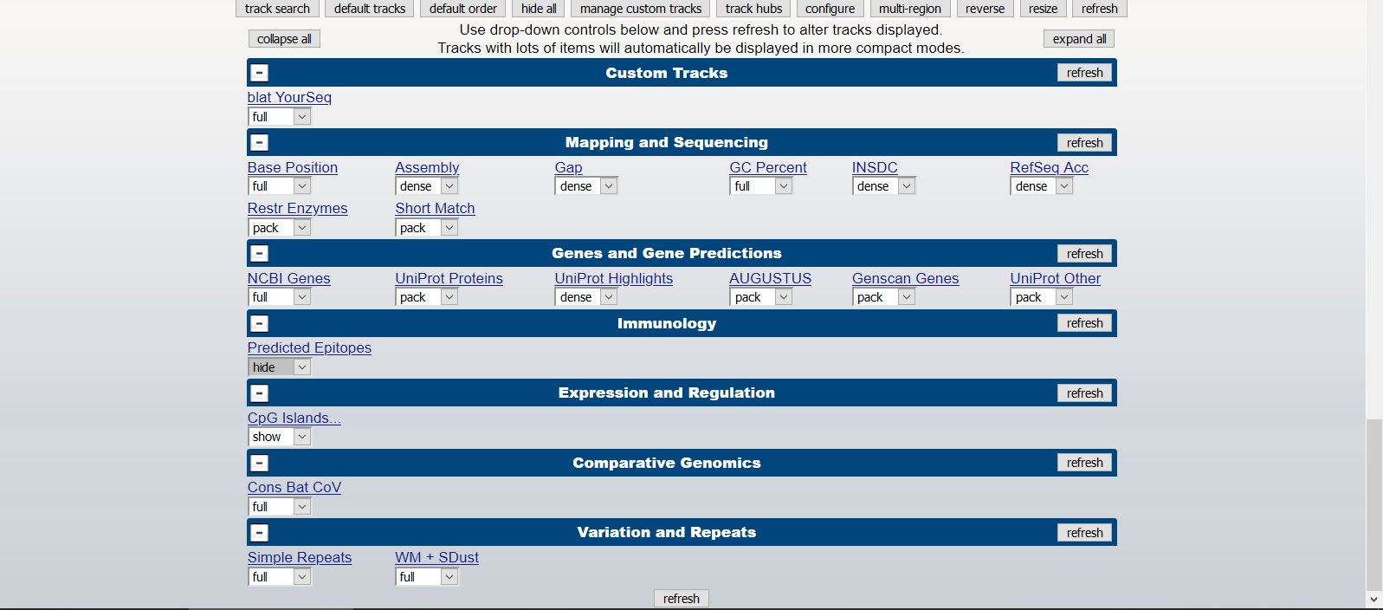
Bioinformatics Tools on UCSC Genome Browser
Source: UCSC/NCBI

Slide 10
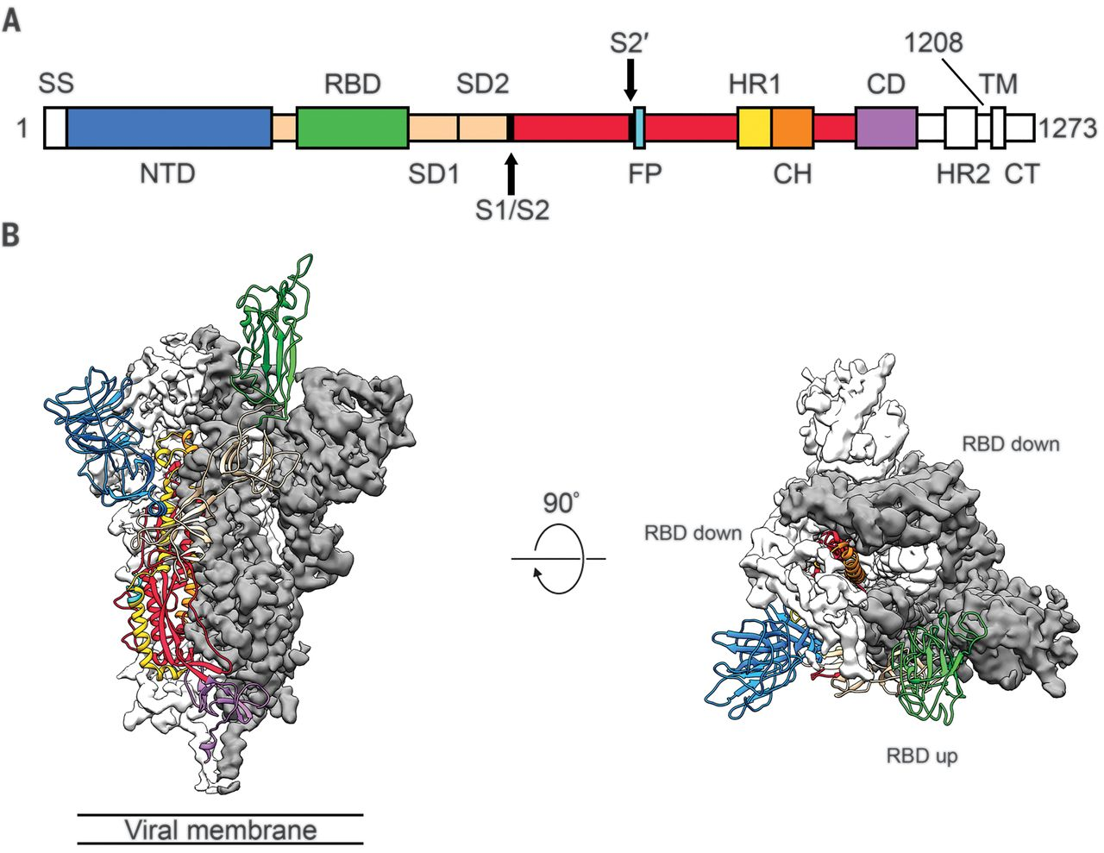
The SARS-CoV-2 Spike Protein 3D Structure
Source: NIH

Slide 11
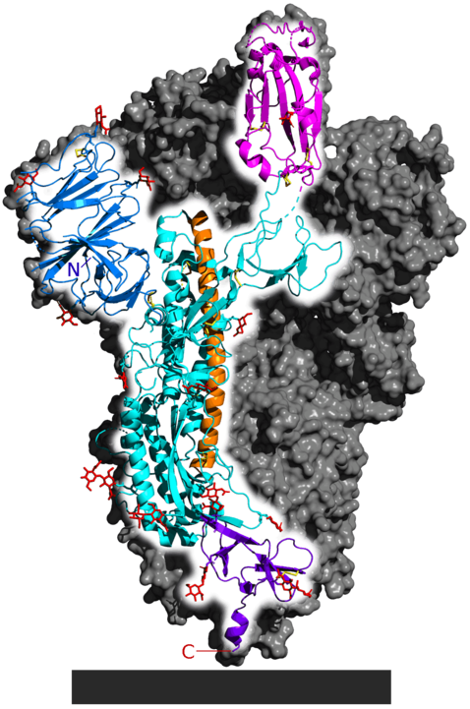
Interaction (Binding) between SARS-CoV-2 Spike Protein and Human Receptor (ACE2)
Source: Wikipedia

Slide 12
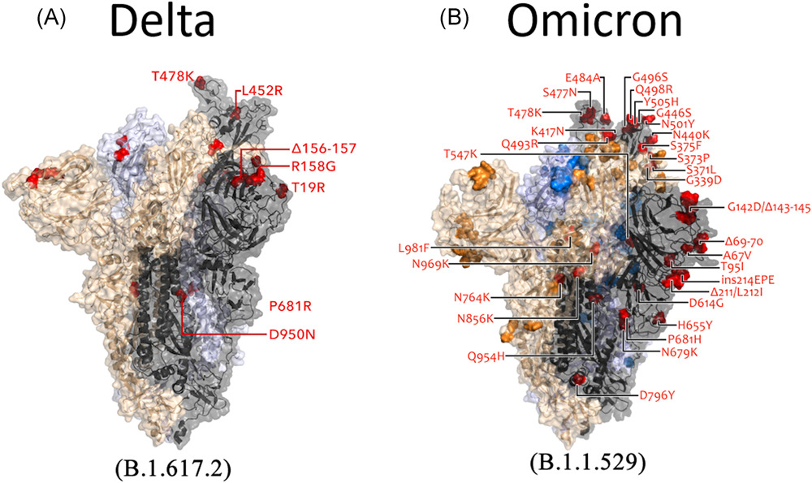
Spike Proteins of the Delta and Omicron Variants of SARS‐CoV‐2
Journal of Medical Virology, First published: 15 December 2021, DOI: (10.1002/jmv.27526)
Notes:
A comparison of (A) Delta and (B) Omicron variant spike mutation (Image source: Modified from COVID‐19 Genomics UK Consortium). COVID‐19, coronavirus disease 2019
IF THIS IMAGE HAS BEEN PROVIDED BY OR IS OWNED BY A THIRD PARTY, AS INDICATED IN THE CAPTION LINE, THEN FURTHER PERMISSION MAY BE NEEDED BEFORE ANY FURTHER USE. PLEASE CONTACT WILEY'S PERMISSIONS DEPARTMENT ON PERMISSIONS@WILEY.COM OR USE THE RIGHTSLINK SERVICE BY CLICKING ON THE 'REQUEST PERMISSIONS' LINK ACCOMPANYING THIS ARTICLE. WILEY OR AUTHOR OWNED IMAGES MAY BE USED FOR NON-COMMERCIAL PURPOSES, SUBJECT TO PROPER CITATION OF THE ARTICLE, AUTHOR, AND PUBLISHER.

Slide 13
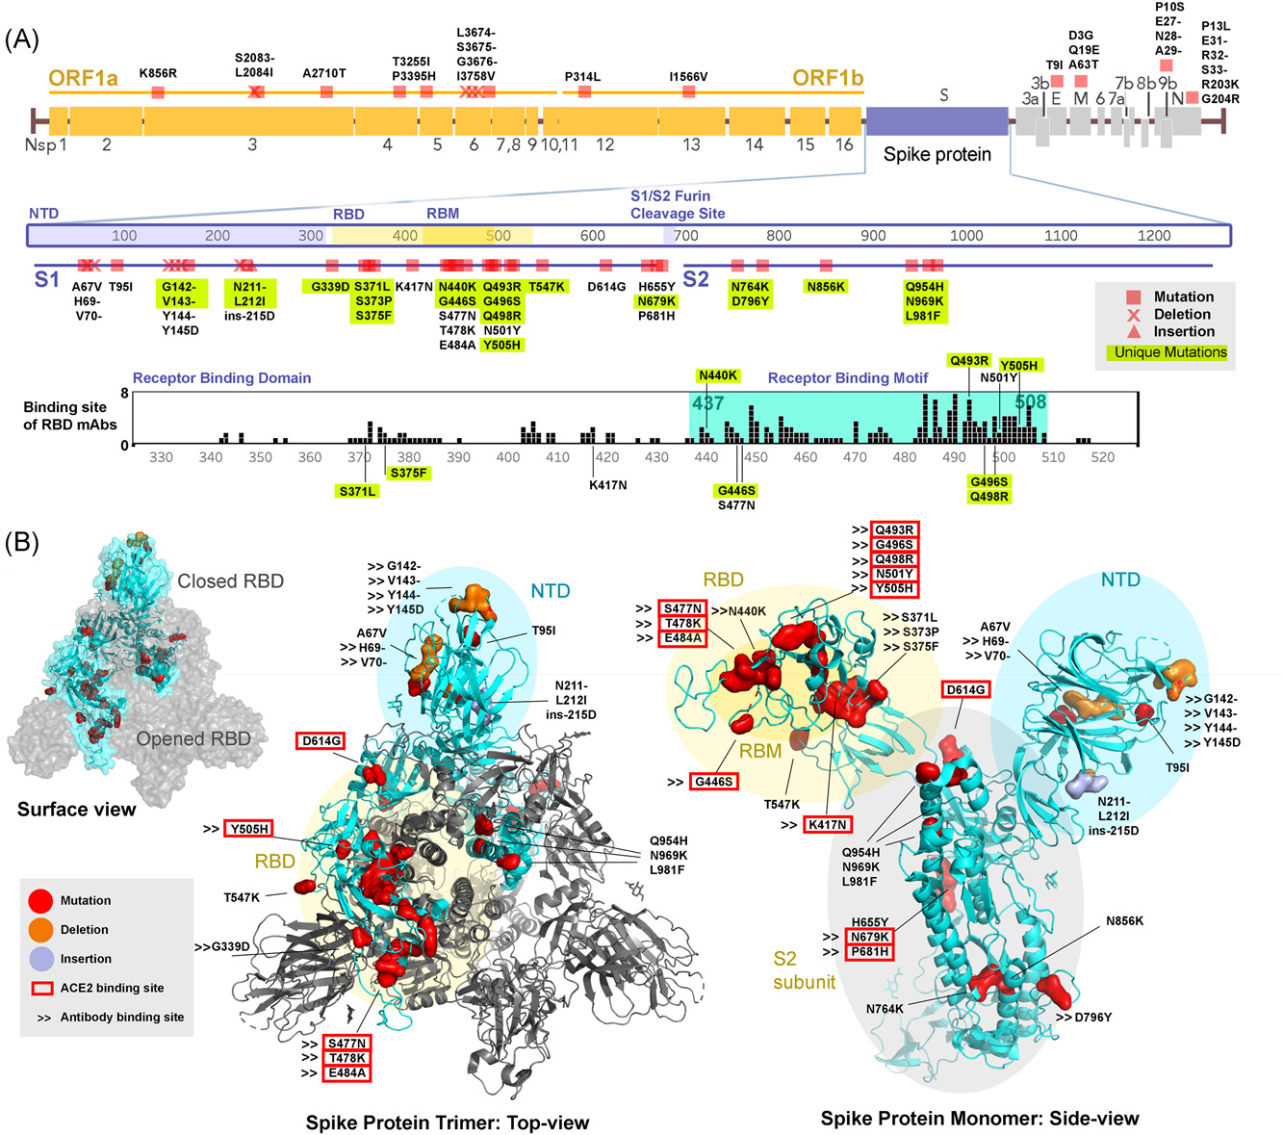
Sequence Analysis of the Emerging Omicron Variant in South Africa
Journal of Medical Virology, First published: 12 December 2021, DOI: (10.1002/jmv.27516)
Notes:
Mutational changes in the Omicron variant. (A) Illustration of mutational positions of the Omicron variant. Novel mutations in the spike protein were highlighted in yellow. Previously identified binding sites of monoclonal antibodies have been tallied, the mutation that corresponds to these sites was labeled. (B) The amino acid residues in the SARS‐CoV‐2 S1 trimer or monomer structure (PDB:6CRZ) using ribbon and surface diagrams were labeled on a “closed” RBD according to the site of mutations from the Omicron variant (highlighted in cyan). NTD is shown in light blue; RBD is shown in light yellow; S2 subunit is shown in gray. Mutations are highlighted in red; deletions are highlighted in orange; insertions are highlighted in pink. ACE2 binding sites are labeled using a red bracket and antibody binding sites are labeled using arrows (>>)
IF THIS IMAGE HAS BEEN PROVIDED BY OR IS OWNED BY A THIRD PARTY, AS INDICATED IN THE CAPTION LINE, THEN FURTHER PERMISSION MAY BE NEEDED BEFORE ANY FURTHER USE. PLEASE CONTACT WILEY'S PERMISSIONS DEPARTMENT ON PERMISSIONS@WILEY.COM OR USE THE RIGHTSLINK SERVICE BY CLICKING ON THE 'REQUEST PERMISSIONS' LINK ACCOMPANYING THIS ARTICLE. WILEY OR AUTHOR OWNED IMAGES MAY BE USED FOR NON-COMMERCIAL PURPOSES, SUBJECT TO PROPER CITATION OF THE ARTICLE, AUTHOR, AND PUBLISHER.

Slide 14
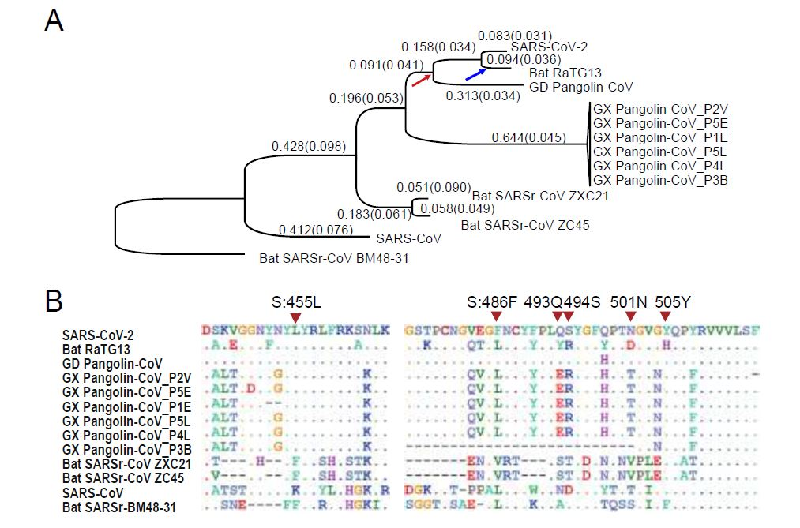
Evolution of the SARS-CoV-2 Genome

Slide 15
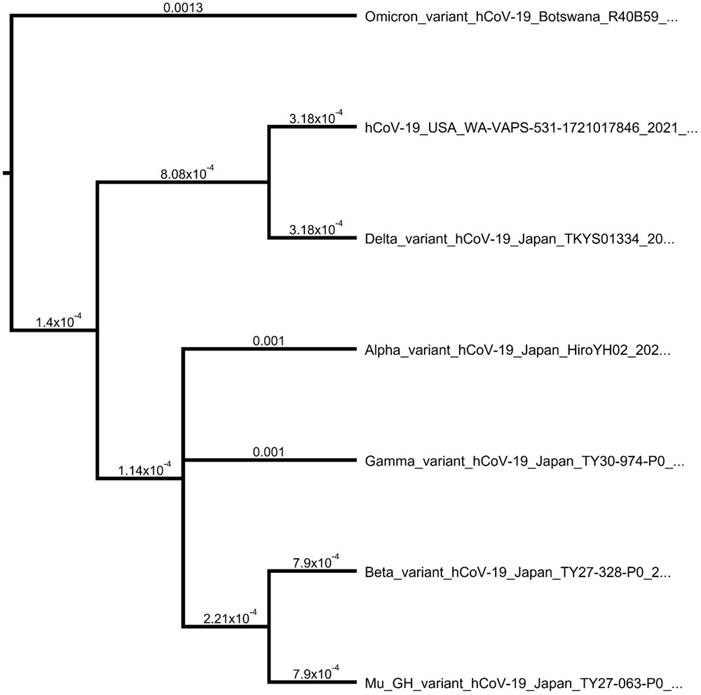
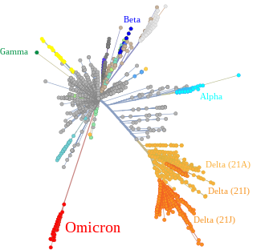
Omicron Variant Genome Evolution and Phylogenetics
Journal of Medical Virology, First published: 10 December 2021, DOI: (10.1002/jmv.27515)
Wikipedia
Notes:
Phylogenetic tree using neighbor‐joining method and Tamura substitution model. The figure was generated by Geneious prime software
IF THIS IMAGE HAS BEEN PROVIDED BY OR IS OWNED BY A THIRD PARTY, AS INDICATED IN THE CAPTION LINE, THEN FURTHER PERMISSION MAY BE NEEDED BEFORE ANY FURTHER USE. PLEASE CONTACT WILEY'S PERMISSIONS DEPARTMENT ON PERMISSIONS@WILEY.COM OR USE THE RIGHTSLINK SERVICE BY CLICKING ON THE 'REQUEST PERMISSIONS' LINK ACCOMPANYING THIS ARTICLE. WILEY OR AUTHOR OWNED IMAGES MAY BE USED FOR NON-COMMERCIAL PURPOSES, SUBJECT TO PROPER CITATION OF THE ARTICLE, AUTHOR, AND PUBLISHER.

Slide 16
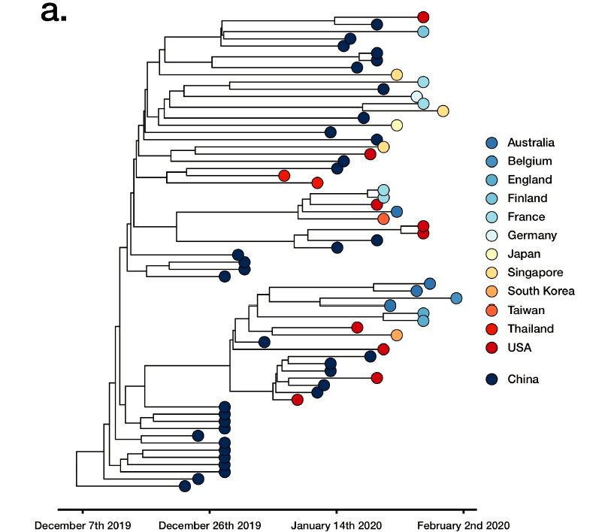
The Evolutionary Relationship of the SARS-Cov-2 Viruses Found in Clinical Cases

Slide 17
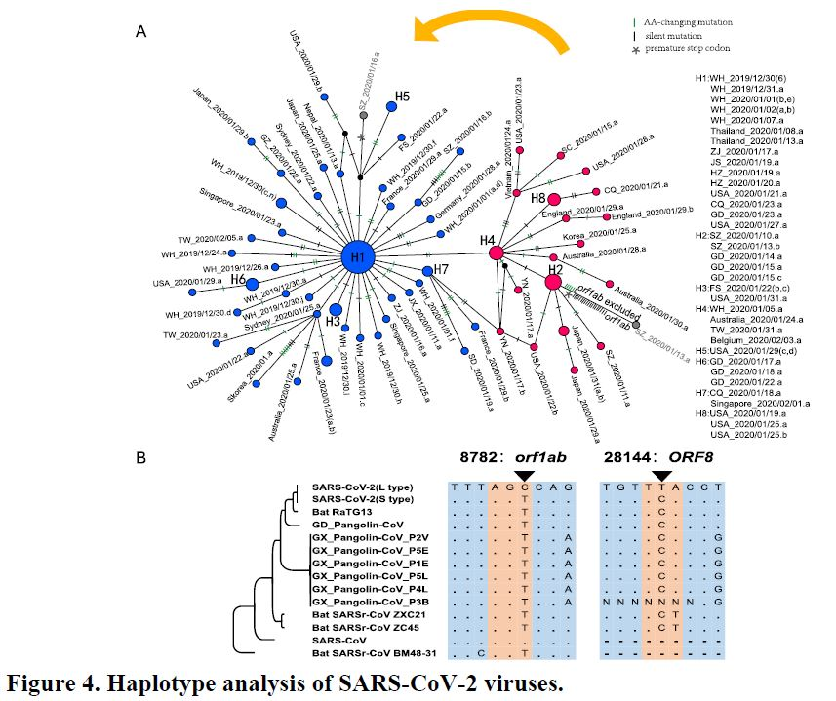
Evolution of SARS-Cov-2 Virus Based on Two Haplotype Types (L and S)

