Slide 1
Search Review

Slide 2
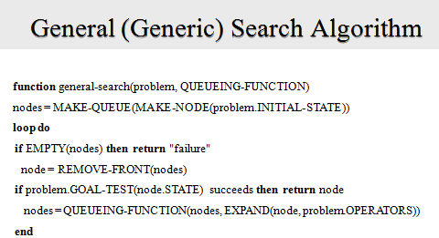
Path Planning Search: Our Role
We have to define the problem space
  State Representation
  Initial State
  Operators
  Goal State (a test to see if a node is the goal)
  (If possible) A heuristic
We have to pick the right algorithm
  We do not need to invent an algorithm
  If you have a heuristic, no choice! Us A*

Slide 3
Which Algorithm to Use
Can you create an admissible heuristic? Then use A* (Rubik's Cube, 15-puzzle, GPS routing finding, maze searching…)
Otherwise
Do you know the exact depth of the solution? Then use depth limited search (frogs and toads)
Is the search tree finite, and you just want a solution (does not have to be optimal)? Then maybe use depth-first search.
Do you want the optimal solution, but don’t know how deep the solution could be? Try Iterative deepening.
Do you want the optimal solution, the goal state is explicit, you have a plan to detect repeated states, and you want the fastest possible results? Try bidirectional search (probably using Iterative deepening from both directions) (GPS route finding)

Slide 4
Three Possible Outcomes of Search
The algorithm finds the goal node, and reports success.
The algorithm keeps searching until there is nothing left in the queue, and then reports failure. (This failure can be seen as successfully proving that there is no solution)
The algorithm keeps searching until you run out of memory, or you run out of time and kill the program.

Slide 5
Diameter of a Search Problem I
The diameter of a search problem is the cost of the cheapest solution to the hardest problem in the search space.
If all operators have the same cost, it the just tree depth at which the cheapest goal state lies, for the worst instantiation of the problem.
Assume both of the below are the worse cases of two problems
Diameter = 9
55
2
Diameter = 2
1
7
2
5
operators have the same cost
operators have the varying costs

Slide 6




Diameter of a Search Problem II
Sometimes we know the diameter of a search problem, because someone worked it out.
For example, for Rubik’s cube it is 20, for the 15-puzzle it is 80, for the N Frogs and Toads problem, it is N² + 2N etc
Let us practice stating some English sentences that capture this:
  No matter how long John spends randomly scrambling a Rubik’s cube, an optimal algorithm can always solve it in 20 moves or less.
  Susan created a new GPU-based algorithm to solve the Rubik’s cube. It was able to solve a scrambled cube in just 0.0000000001 seconds, using 23 moves. The algorithm is fast, but clearly not optimal.

Slide 7
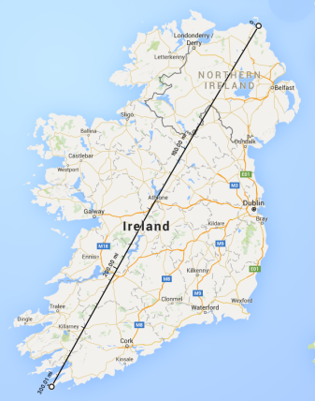
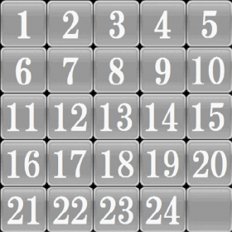
Diameter of a Search Problem III
Sometimes we don’t know the diameter of a search problem, the best we can do is provide a guess, or upper and/or lower bounds.
For example:
  For the 24-puzzle the diameter is unknown. But it is known to be at least 152 and at most 208.
  For the GPS route finding problem in Ireland, the diameter is a little more than 300 miles.

Slide 8
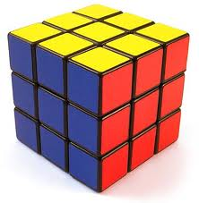

Exercise: The 2Cube Problem
Your friend takes two solved Rubik's cubes.
She scrambles each one for as long as she likes.
You task is to transform one to the other, in as few moves possible.
What can we say about the diameter of 2Cube?
___ ≤ Diameter(2Cube) ≤ ___
Your Task

Slide 9
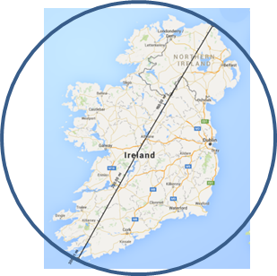
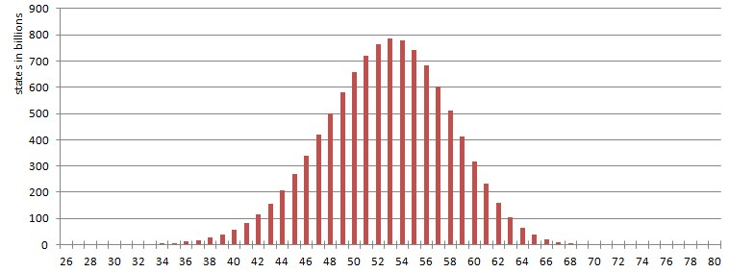
Diameter of a Search Problem IIII
Why do we care about the Diameter? Part 1
Assuming we also know the branching factor (even approximately), then knowing the diameter give us a worst case for the problem space. For example:
  A problem with a BF of 10 and a diameter of 9 means we might have to search a billion nodes (10⁹). If we can check 10,000 nodes a second, that would take about a day.
  A problem with a BF of 5 and a diameter of 20 means we might have to search about 95 trillion nodes (5²⁰). If we can check 10,000 nodes a second, that would take about a 300 years.
This reasoning only applies to the worst case. It may be that most cases are much simpler. For example:
  For the 15 puzzle, of the 10,461,394,944,000 solvable states, only 17 are at depth 80. Most puzzles take under 65 moves (see distribution).
  For GPS directions, most journeys are 20 miles or less.
http://kociemba.org/fifteen/fifteensolver.html

Slide 10
Diameter of a Search Problem V
Why do we care about the Diameter? Part 2
Knowing the diameter immediately suggests two algorithms we might want to use.
  Depth-limited search, with the depth set to the Diameter. (will be complete, but not optimal)
  Iterative Deepening (will be complete, and optimal)

Slide 11
A* I
A* is optimal and complete.
For any given heuristic, A* is optimally fast.
There is no point trying to beat A*, but you may be able to find a better heuristic on a given problem.
Suppose there are two heuristics, h^{A}(n) and h^{B}(n).
It could be that one is always best, then you should only use the best one (how would you know this?)
If sometimes h^{A}(n) is best, and other times h^{B}(n) best, then there is a simple trick you can do. Use h^{C}(n), where:
h^{C}(n) = max[ h^{A}(n) , h^{B}(n) ]

Slide 12
A* II
A heuristic is a function that, when applied to a state, returns a number tells us approximately how far the state is from the goal state*.
  How many miles to drive
  How many twists of the Rubik’s Cube
  How many tiles we have to slide.
  How many …
Note we said “approximately”. Heuristics might underestimate or overestimate the merit of a state. But for reasons which we will see, heuristics that only underestimate are very desirable, and are called admissible.

Slide 13
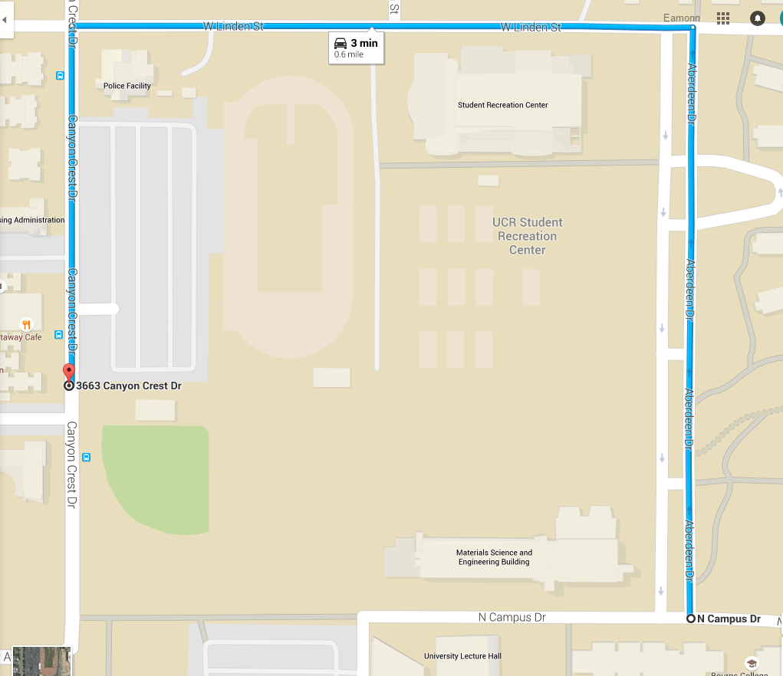
The true driving distance from BCOE to Sub Station is 0.6 miles. The straight line heuristic says it is 0.269.
This is an admissible heuristic

Slide 14
Why Greedy Search Fails
Find Route from Dublin to Arklow
Dublin
Let us say that because the roads are pretty straight, the h(n) costs are basically the same as the true costs.
This just makes my example easier to explain, even if the h(n) estimates are lower than the true costs, my point is true.
100
300
Wicklow
120
60
Arklow
Wexford

Slide 15
Greedy Search
Greedy Search: Dequeue the cheapest node first.
In other words, keep Nodes sorted by h(n), with cheapest node at the head of the queue.

Slide 16
Why Greedy Search Fails
Find Route from Dublin to Arklow
Dublin
Dublin
100
Wicklow
300
Wicklow
Wexford
120
We expand the children of Dublin {Wexford, Wicklow }
Greedy search asks “Which one of you thinks you are closest to Arklow?”
Wexford thinks it is only 60 miles, but Wicklow thinks it is 120 miles, so greedy search say “Lets expand Wexford”
60
Arklow
Wexford

Slide 17
Why Greedy Search Fails
Find Route from Dublin to Arklow
Dublin
Dublin
300
100
100
Wicklow
300
Wicklow
Wexford
60
120
Arklow
60
Arklow
Greedy search found the goal, it was 300 + 60 = 360 miles.
Greedy search only looked at the h(n) costs, it only looked forward.
Wexford

Slide 18
Greedy Search Vs A-Star
Find Route from Dublin to Arklow
Dublin
Dublin
300
100
100
Wicklow
300
Wicklow
Wexford
120
We expand the children of Dublin {Wexford, Wicklow }
A*search asks “Which one of you thinks you are closest to Arklow, after you add in the miles you have already traveled, your g(n) costs?”
Wexford says, I have gone 300, and have 60 miles to go.
Wicklow says, I have gone 100, and have 120 miles to go.
So A* search says “Lets expand Wicklow”
60
Arklow
Wexford

Slide 19
Greedy Search Vs A*
Find Route from Dublin to Arklow
Dublin
Dublin
300
100
100
Wicklow
300
Wicklow
Wexford
120
120
Arklow
60
Arklow
Wexford
Greedy search only looked at the h(n) costs, it only looked forward.
But A-Star looked backwards and forward to make its decision.
f(n) = g(n) + h(n)

Slide 20
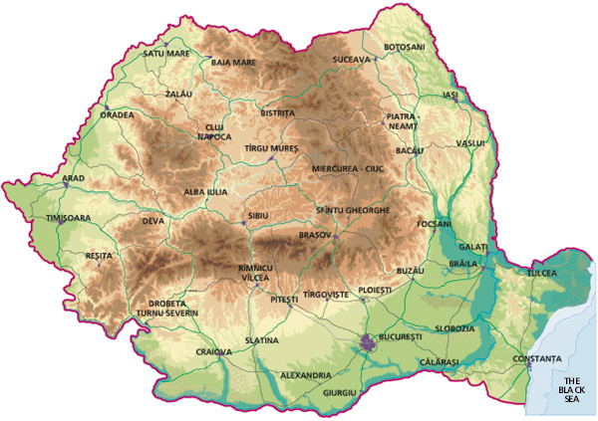
Romania

Slide 21
Romania

Slide 22
Romania

Slide 23
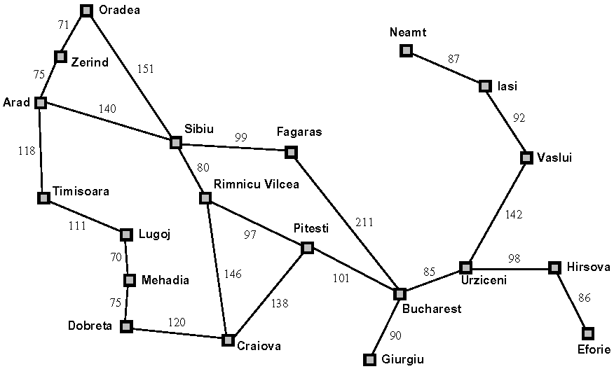

Slide 24
Romania Problem
Initial state: Arad
Goal state: Bucharest
Operators: From any node, you can visit any connected node.
Operator cost, the driving distnace.
What is the BF for this problem?

Slide 25
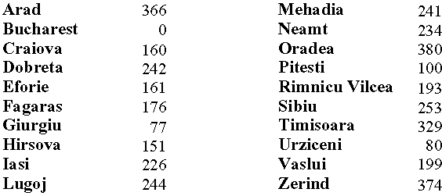
We can use the straight line heuristic
These are the h(n)
values.

Slide 26
These are the g(n)
values.
These are the h(n)
values.

Slide 27

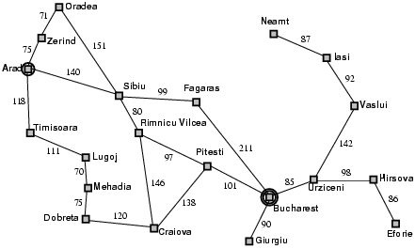
Greedy best-first search example
In other words, we are searching using only the h(n)

Slide 28
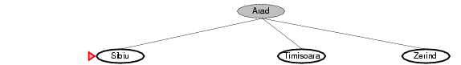
We expand all possible operators (there are three), and then expand the cheapest node on the fringe…
253
329
374

Slide 29
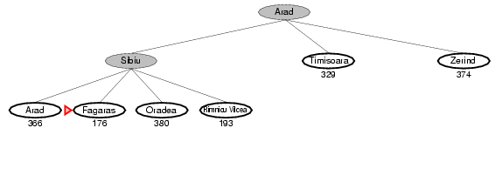
Now the cheapest node on the fringe is Fagaras, so we expand it

Slide 30
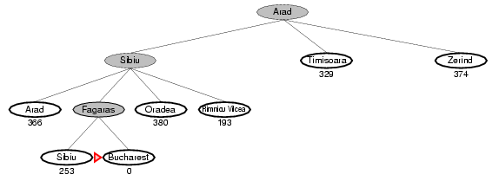
We are done!
So, Arad to Sibiu to Fagaras to Bucharest
140 + 99 + 211 = 450
Is this optimal?

Slide 31
Properties of greedy best-first search
Complete? No – can get stuck in loops, e.g.,
Iasi → Neamt → Iasi → Neamt…
But, complete in finite space with repeated state checking! (may take a lot of memory)
Time? O(b^{m}), but a good heuristic can give dramatic improvement → Similar to depth-first search
Space? O(b^{m}) -- keeps all nodes in memory
Optimal? No!

Slide 32
A* Search
Intuition: Greedy best-first search expands the node that appears to have shortest path to goal (looks only forward). But what about cost of getting to that node? Take it into account (also look backwards)!
Idea: avoid expanding paths that are already relatively expensive
Evaluation function f(n) = g(n) + h(n)
  g(n) = cost so far to reach n
  h(n) = estimated cost from n to goal
  f(n) = estimated total cost of path through n to goal
Aside: do we still have “looping problem”?
Iasi to Fagaras:
Iasi → Neamt → Iasi → Neamt…
No! We’ll eventually get out of it, because g(n) keeps going up.

Slide 33

A* search example
In other words, we are searching using the sum of h(n) and g(n)
f(n) = h(n) and g(n)

Slide 34
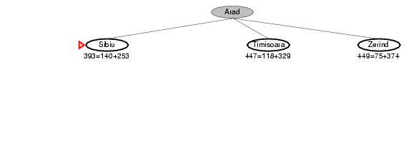

Slide 35
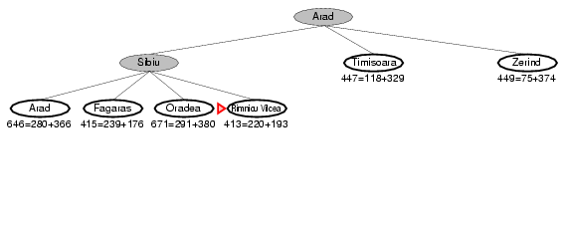

Slide 36
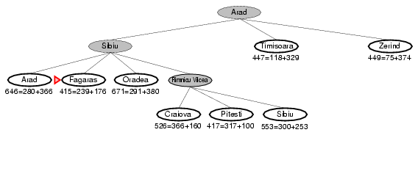

Slide 37
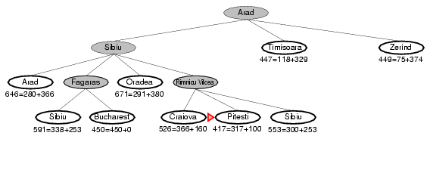
Bucharest appears on the fringe
but not selected for expansion
since its cost (450)
is higher than that of Pitesti (417).

Slide 38
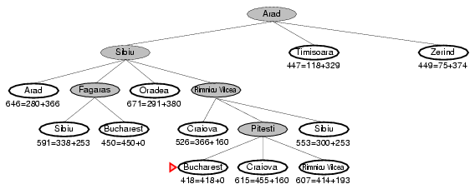
A* found: Arad to Sibiu to Rimnicu to Pitesti to Bucharest = 418 miles
Greedy Search found: Arad to Sibiu to Fagaras to Bucharest = 450 miles
A* found the optimal path!

Slide 39
Blind Search
The search techniques we have seen so far...
  Breadth first search
  Uniform cost search
  Depth first search
  Depth limited search
  Iterative Deepening
  Bi-directional Search
Would also find the optimal solution, but would have expanded more nodes (memory problems)
Will not find optimal solution (in general)
Will not find optimal solution (in general)
Would also find the optimal solution, but would have expanded more nodes (no memory problems, but time problems)
Would also find the optimal solution, assuming both algorithms used would have found the optimal solution

