Slide 1
Natural Language Processing on Time Series
Presenter: Sara Alaee

Slide 2
Definitions
A time series is a series of data points graphed in time order. Most commonly, a time series is a sequence taken at successive equally spaced points in time. [Wikipedia]
A subsequence is a subset of the data in the time series.
subsequence
4
Time series
3
2
1
0
-1
-2
-3
0
10
20
30
40
50
60
70
80
90
100

Slide 3
What do we want?
We want you to describe some time series with the given keywords.
How?
  Look at the red subsequences in the time series,
  Consider the context, i.e. the gray regions to the left and right of the red subsequence,
  Check the keywords that seem relevant to you. (Keywords correspond to the entire time series.)
Let’s see an example. But before that, some definitions…

Slide 4
Definitions
The following figures are extreme examples of Noisy/Smooth, Concave/Convex and Linear/Nonlinear time series.
2.5
100
2
90
Noisy vs. Smooth
1.5
80
1
70
0.5
60
0
50
-0.5
40
-1
30
-1.5
20
-2
10
-2.5
0
0
10
20
30
40
50
60
70
80
90
100
0
10
20
30
40
50
60
70
80
90
100

Slide 5
Definitions (cont.)
1
0
0.9
-0.1
0.8
-0.2
Concave vs. Convex
0.7
-0.3
0.6
-0.4
0.5
Concave
-0.5
Convex
0.4
-0.6
0.3
-0.7
0.2
-0.8
0.1
-0.9
0
0
500
1000
1500
2000
2500
3000
3500
-1
0
500
1000
1500
2000
2500
3000
3500

Slide 6
Definitions (cont.)
5
100
1.5
10
90
80
1
Linear vs. Nonlinear
70
0.5
60
50
0
40
30
-0.5
20
-1
10
0
0
10
20
30
40
50
60
70
80
90
100
-1.5
0
20
40
60
80
100
120

Slide 7
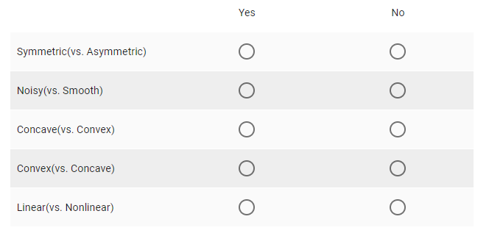
Example
Consider the figure below.
Question: Which keywords describe the red subsequence? (Exactly one choice per row. If you are not sure that either apply, use your best judgement to pick one.)

Slide 8
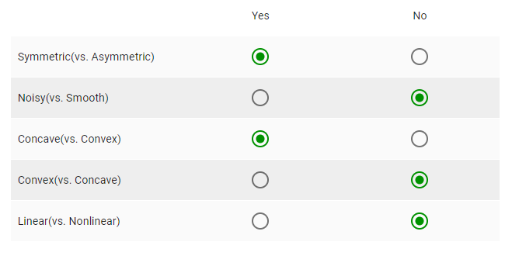
Example (cont.)
A typical user might say it is “Symmetric”, “Smooth”, “Concave” and “Non-linear”. But to be clear, there may be no right answer.
How would you describe it?

Slide 9
Assignment
We will send a survey, consisting of the time series in question, to your email. Please follow the instructions and submit your responses.
Thank you.

