Slide 1
FlowSense: Monitoring Network Utilization with Zero Measurement Cost
Curtis Yu¹, Cristian Lumezanu², Yueping Zhang², Vishal Singh², Guofei Jiang², Harsha V. Madhyastha¹
¹UC Riverside, ²NEC Labs America

Slide 2
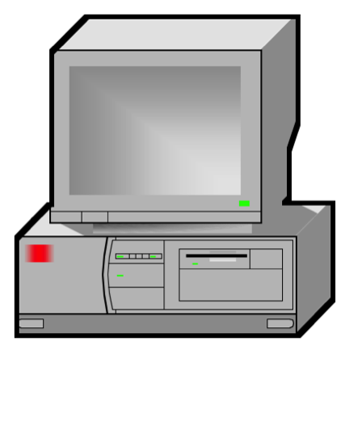
SDN enables centralized control
A centralized controller can set its own routes on an SDN

Slide 3
SDN enables reactive control of network
We can reroute around heavily congested links
Need to know when link is congested
B
A
Path: A ➔ B
Path: A ➔ C ➔ B
C

Slide 4
State-of-the-art measurement
Active measurements
Injection of probes
Passive measurements
Expensive instrumentation and infrastructure setup
SDN measurements
Additional control traffic
Accurate measurements requires high overhead

Slide 5
FlowSense: measuring with zero cost
Leverage existing control traffic to measure network
No additional traffic introduced
Network informs system of changes
As accurate as switch polling

Slide 6
OpenFlow overview
Flow Arrival:
Packet of new flow arrives
PacketIn message sent
FlowMod message sent
New rule installed
Flow Completion:
Rule expires
Remove rule
FlowRemoved message sent
Rule | Match | Output
Rule | Match | Output
1 | Green | sw2
sw1
sw2

Slide 7
Messages have utilization info
PacketIn
Signals new flow on port (t₁)
FlowRemoved
Duration of entry in flow table (10s)
Amount of traffic matched (400 MB)
Can infer utilization contributed by flow on link
t₁
t₁ + 10s
Flow:
40 MB/s
PacketIn
FlowRemoved

Slide 8
Estimating utilization in FlowSense
t₁
t₂
t₃
t₄
t₅
t₆
Time
f₁
40 MB/s
f₂
20 MB/s
f₃
10 MB/s
Checkpoint | Flows Left | Total Utilization
t₄ | 2 | 40 MB/s
Checkpoint | Flows Left | Total Utilization
Checkpoint | Flows Left | Total Utilization
t₄ | 0 | 70 MB/s
t₅ | 0 | 30 MB/s
t₆ | 0 | 20 MB/s
Checkpoint | Flows Left | Total Utilization
t₄ | 1 | 50 MB/s
t₅ | 1 | 10 MB/s

Slide 9
FlowSense system design
Parser
Captures and analyzes control traffic
Utilization Monitor
Runs FlowSense algorithm
Utilization Table
Database of checkpoints

Slide 10
Evaluating FlowSense
Goals
Accuracy
Timeliness
Dataset
Testbed of NEC OpenFlow switches
Real-world traffic trace from a campus network switch

Slide 11
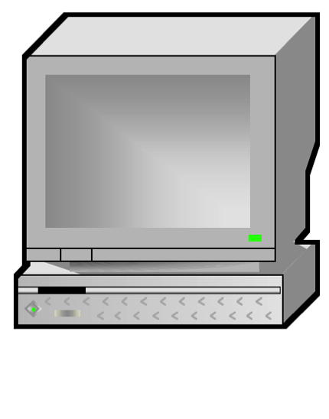
Accuracy testbed
1 continuous flow
3 separate short flows
10 MB/s
20 MB/s
45 MB/s
30 MB/s

Slide 12
FlowSense is as accurate as polling
Utilization values are very similar
FlowSense cannot replicate instantaneous utilization values

Slide 13
Revisiting utilization estimation
t₁
t₂
t₃
t₄
t₅
t₆
Time
f₁
40 MB/s
f₂
20 MB/s
f₃
10 MB/s
Delay from t₄ to t₆ in getting total utilization
Checkpoint | Flows Left | Total Utilization
t₄ | 0 | 70 MB/s
t₅ | 0 | 30 MB/s
t₆ | 0 | 20 MB/s
Checkpoint | Flows Left | Total Utilization
t₄ | 2 | 40 MB/s

Slide 14
Perfect utilization information is typically delayed
In median case, total utilization known after ~100 seconds

Slide 15
Coarse-grained estimation can be obtained soon
Only 30% of checkpoints get 90% utilization
Over 60% of checkpoints get 90% utilization

Slide 16
Data refreshes in the order of seconds
Data refreshes around every 3 seconds

Slide 17
Conclusion
FlowSense
Leverage control traffic to estimate utilization
Incurs no measurement cost
Estimates are accurate
Comparable to switch polling
Data is timely
Do not have to wait too long for new utilization information

Slide 18
Future work
Measuring long flows
Overhead of stopping the rule for measurement
Wildcard and proactive rules
Reasonable way to merge active measurements to keep overhead low
Link Latency
Similar method to enable zero cost measurement of latency

Slide 19
Questions?

