Slide 1
Lecture 5
Branch Prediction (2.3) and Scoreboarding (A.7)

Slide 2
Why do we want to predict branches?
MIPS based pipeline – 1 instruction issued per cycle, branch hazard of 1 cycle.
  Delayed branch
Modern processor and next generation – multiple instructions issued per cycle, more branch hazard cycles will incur.
  Cost of branch misfetch goes up
  Pentium Pro – 3 instructions issued per cycle, 12+ cycle misfetch penalty
    HUGE penalty for a misfetched path following a branch

Slide 3
Branch Prediction
Easiest (static prediction)
  Always taken, always not taken
  Opcode/Profile based
  Displacement based (forward not taken, backward taken)
  Compiler directed (branch likely, branch not likely)
Next easiest
  1 bit predictor – remember last taken/not taken per branch
    Use a branch-prediction buffer or branch-history table with 1 bit entry
    Use part of the PC (low-order bits) to index buffer/table – Why?
      Multiple branches may share the same bit
    Invert the bit if the prediction is wrong
    Backward branches for loops will be mispredicted twice
    EX: If a loop branches 9 times in a row and not taken once, what is the prediction accuracy? Ans: Misprediction at the first loop and last loop => 80% prediction accuracy although branch is taken 90% time.

Slide 4
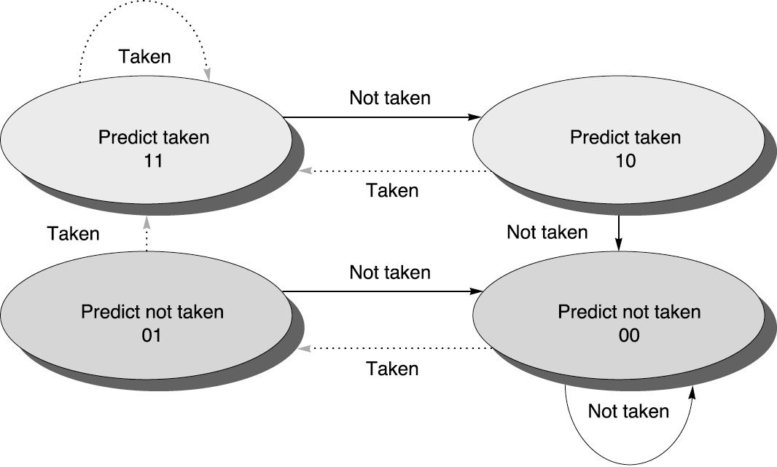
2-bit Branch Prediction
Has 4 states instead of 2, allowing for more information about tendencies
A prediction must miss twice before it is changed
Good for backward branches of loops

Slide 5
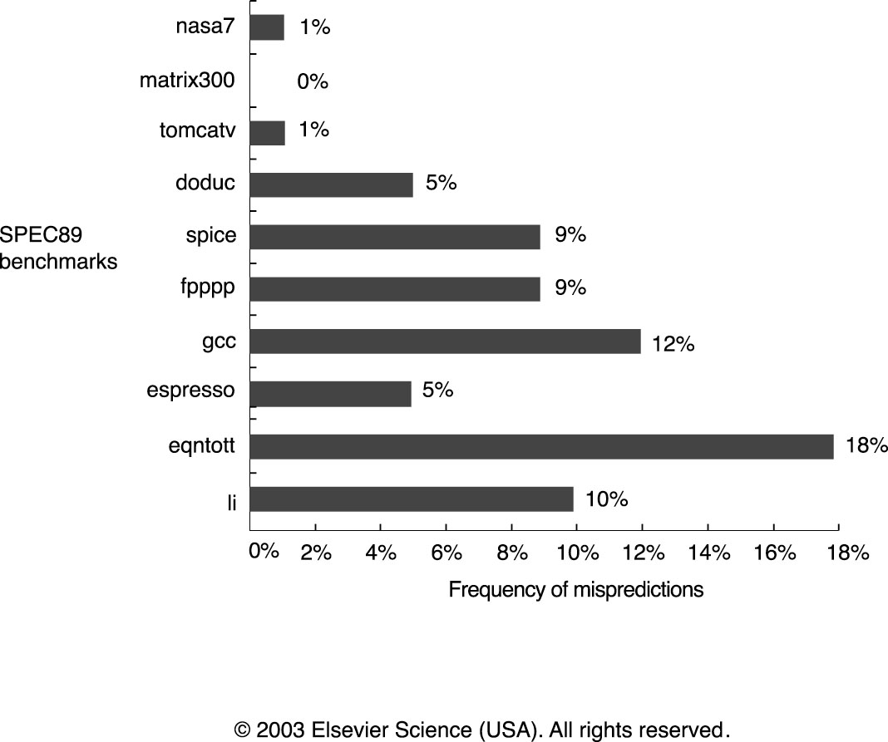
Branch History Table
Has limited size
2 bits by N (e.g. 4K entries)
Uses low-order bits of branch PC to choose entry
Plot misprediction instead of prediction
BHT
branch PC
01

Slide 6
Observations
Prediction Accuracy ranges from 99% to 82% or a misprediction rate of 1% to 18%
Mis-prediction for integer programs (gcc, espresso, eqntott, li) is substantially higher than FP programs (nasa7, matrix300, tomcatv, doduc, spice, fppp)
Branch penalty involves both mis-prediction rate and branch frequency, and is higher for integer benchmarks
Prediction accuracy improves with buffer size, but doesn’t improve beyond 4K entries (Fig. C.20)

Slide 7
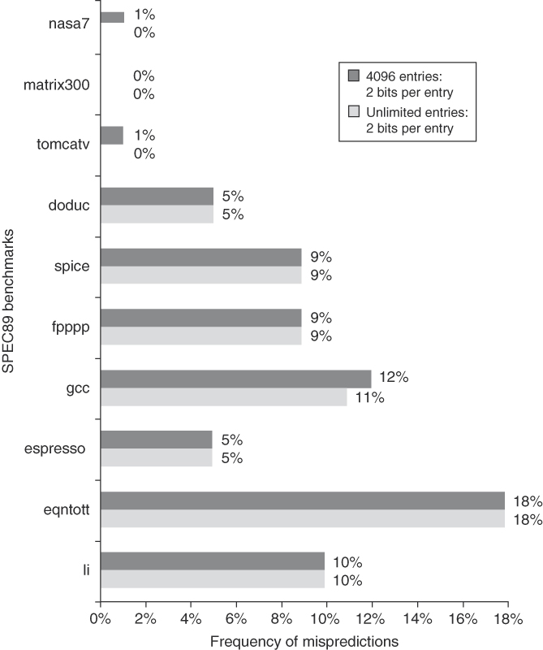
Figure C.20 Prediction accuracy of a 4096-entry 2-bit prediction buffer versus an infinite buffer for the SPEC89 benchmarks. Although these data are for an older version of a subset of the SPEC benchmarks, the results would be comparable for newer versions with perhaps as many as 8K entries needed to match an infinite 2-bit predictor.

Slide 8
Correlating or Two-level Predictors
Correlating branch predictors also look at other branches for clues. Consider the following example.
  if (aa==2) -- branch b1
  aa = 0;
  if (bb==2) --- branch b2
  bb = 0;
  if(aa!=bb) { … --- branch b3 – Clearly depends on the results of b1 and b2
  If b1 is not taken and b2 is not taken, b3 will be taken. If prediction of b3 is based only on its own history (instead of also those of b1 and b2), it is not an accurate prediction.
(1,2) predictor – uses history of 1 branch and uses a 2-bit predictor
(m,n) predictor – uses the behavior of last m branches to choose from 2**m branch predictors, each of which is an n-bit predictor for a single branch.

Slide 9
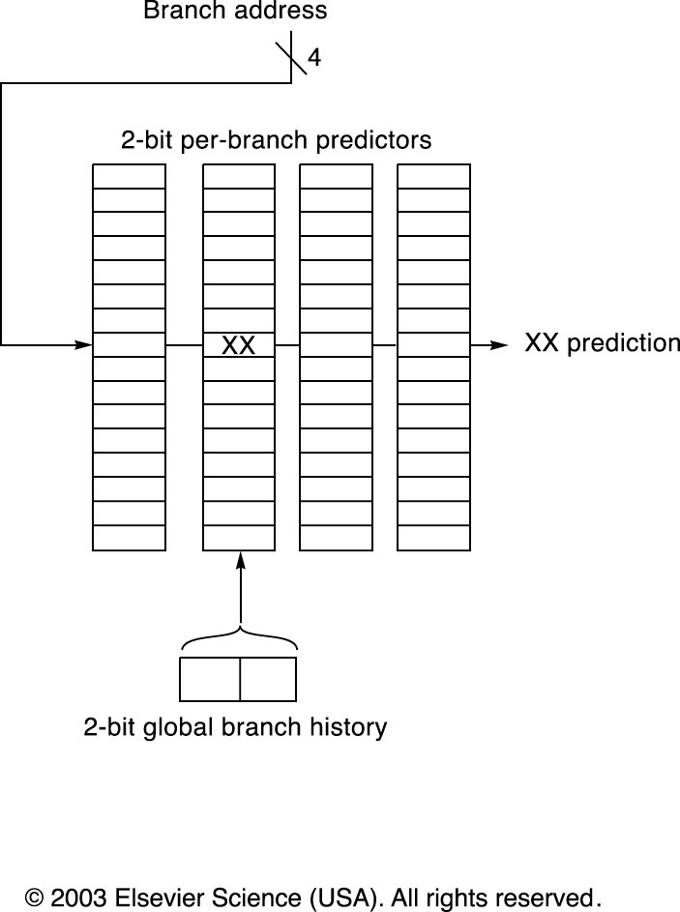
Correlating Branch Predictor
If we use 2 branches as histories, then there are 4 possibilities (T-T, T-NT, NT-NT, NT-T).
For each possibility, we need to use a predictor (1-bit, 2-bit).
And this repeats for every branch.
(2,2) branch prediction

Slide 10
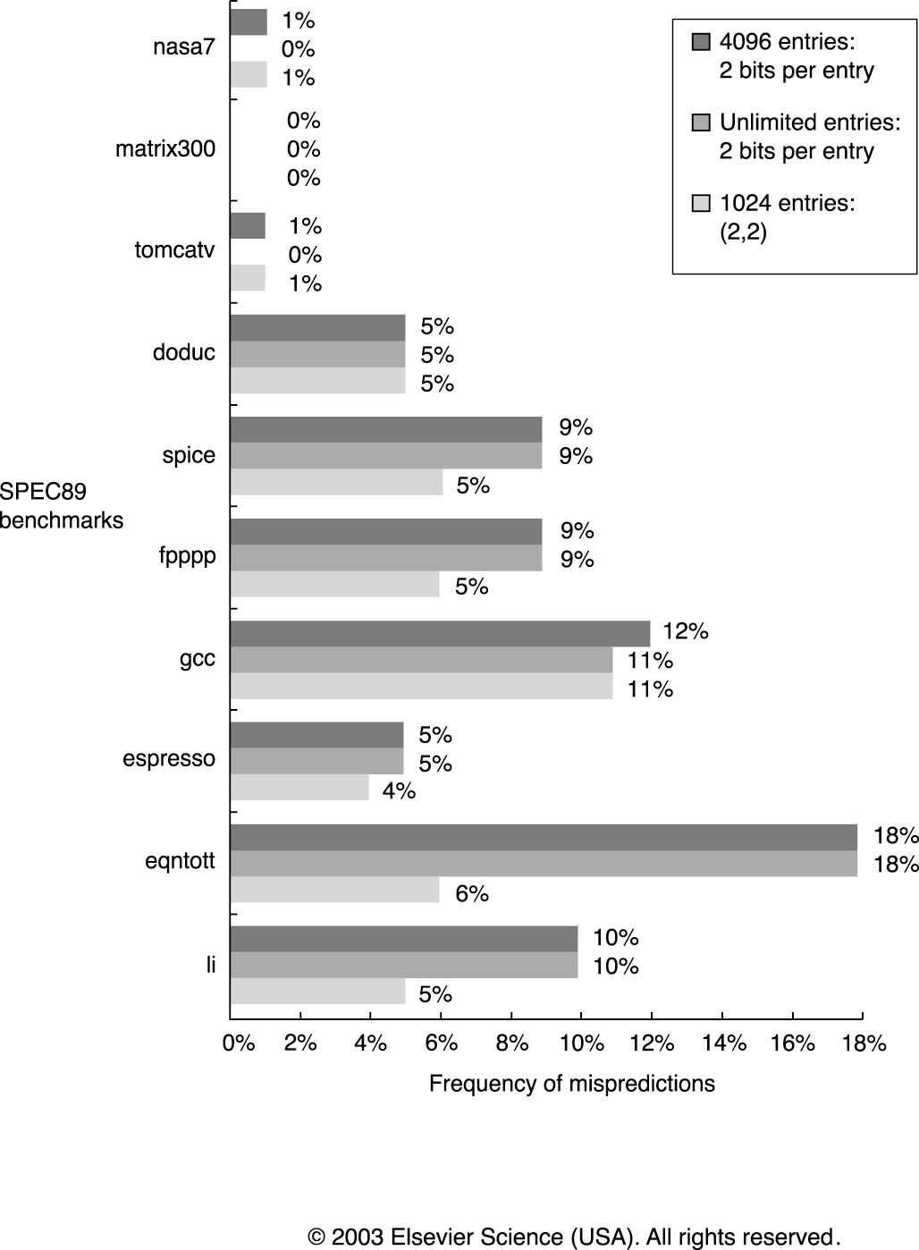
Performance of Correlating Branch Prediction
With 1024 entries, (2,2) performs better than a 4096 entry non-correlating 2-bit predictor.
Outperforms a 2-bit predictor with infinite number of entries

Slide 11
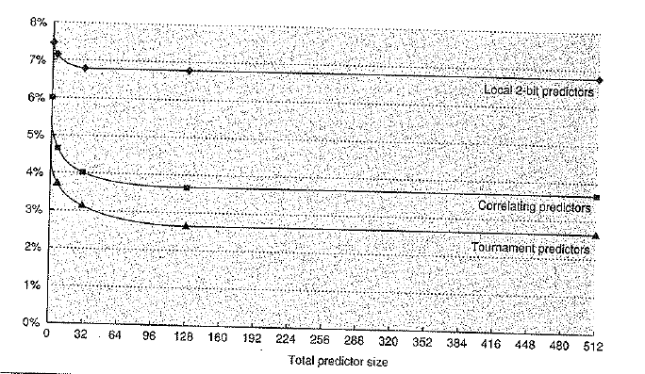
Tournament Predictor
Adaptively combine local and global predictors – Ex. Two mis-predictions before changing from local to global or vice versa
Mis-prediction in Tournament Predictor, Fig. 2.8

Slide 12
Branch Target Buffer (BTB)
BTB is a cache that contains the predicted PC value instead of whether the branch will take place or not (Ex. Loop address)
Is the current instruction a branch ?
• BTB provides the answer before the current instruction is decoded and therefore enables fetching to begin after IF-stage .
What is the branch target ?
• BTB provides the branch target if the prediction is a taken direct branch (for not taken branches the target is simply PC+4 ) .

Slide 13
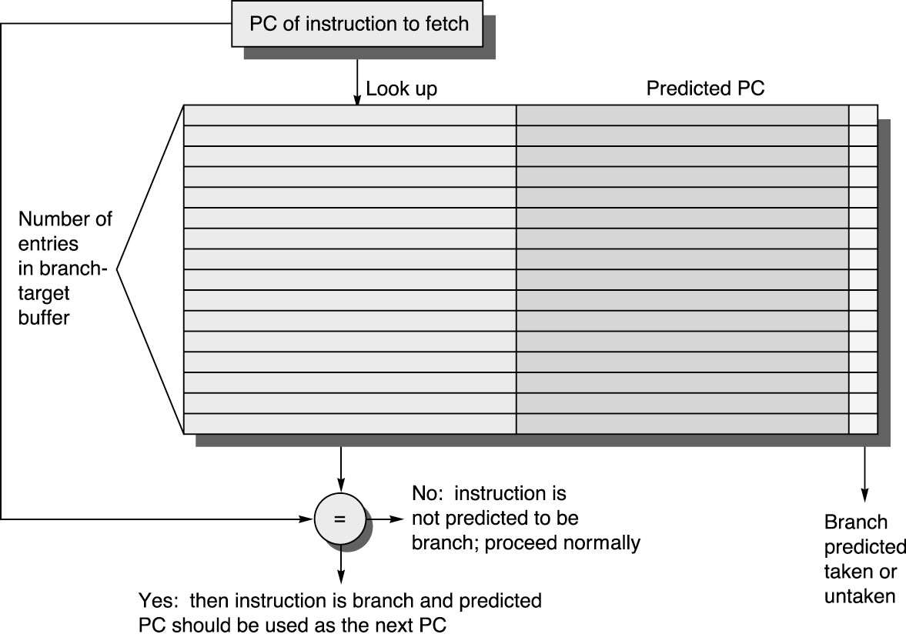
BTB Fig. 2.22

Slide 14
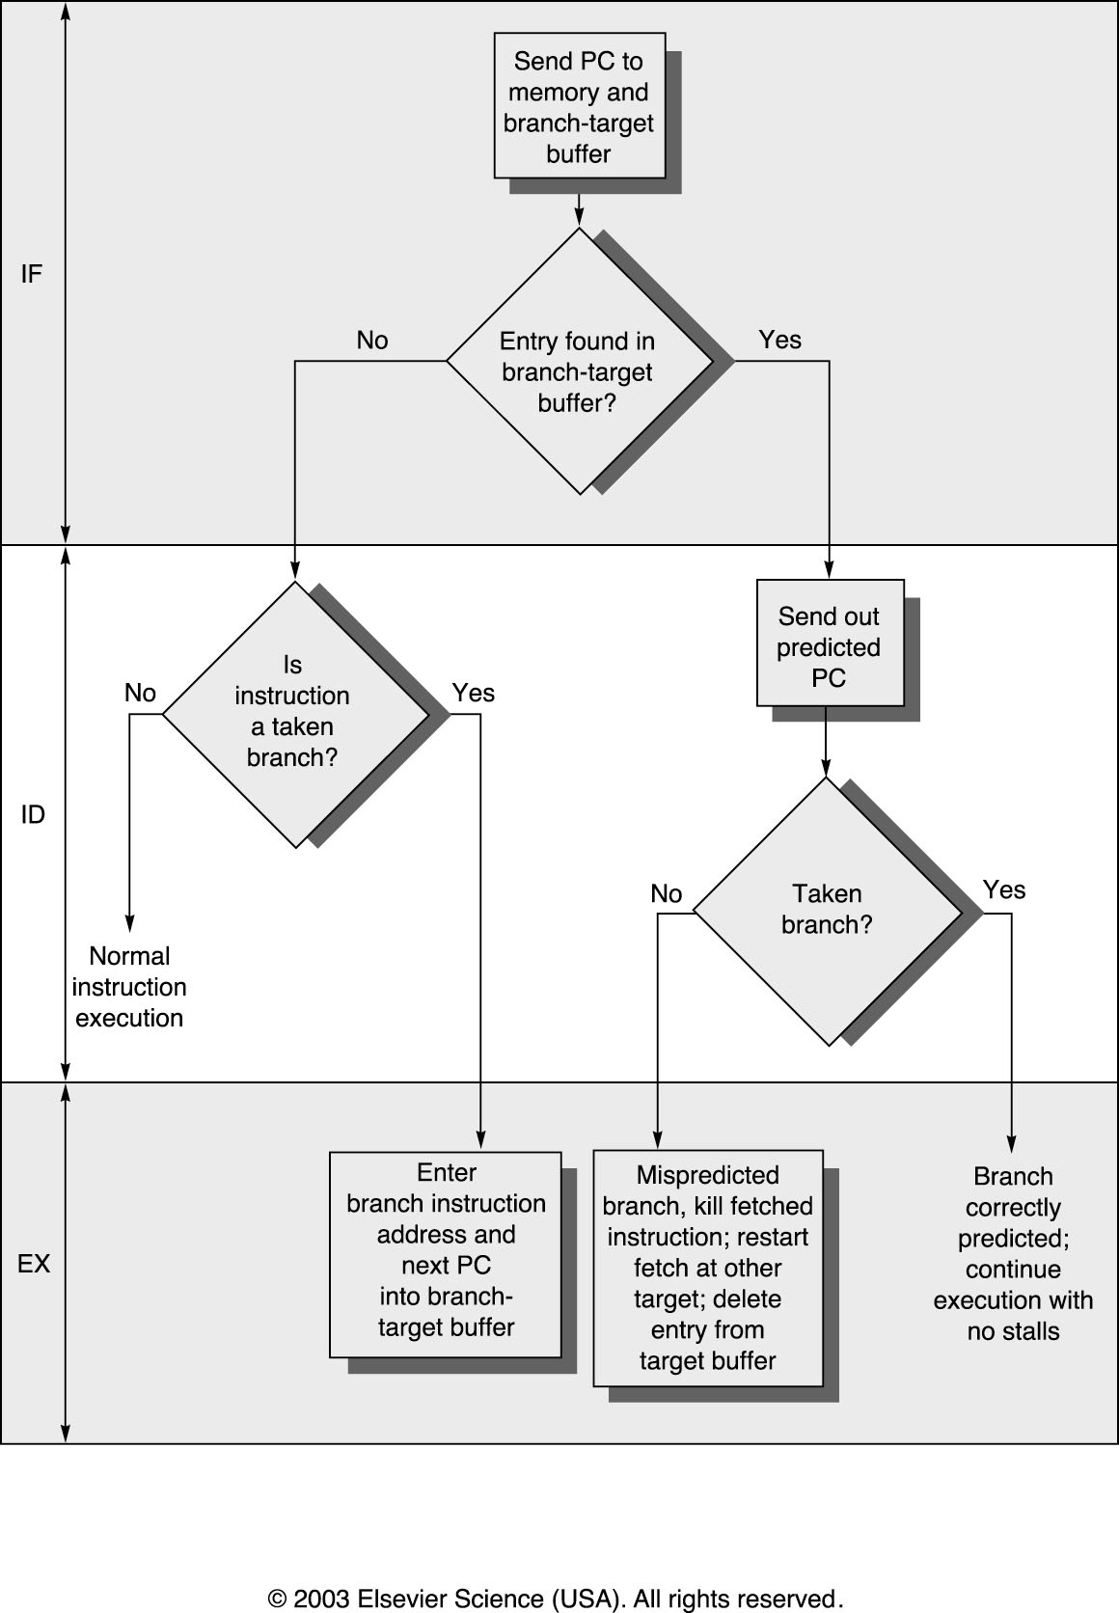
BTB operations Fig. 2.23
BTB hit, prediction taken → 0 cycle delay
BTB hit, misprediction ≥ 2 cycle penalty – Correct BTB
BTB miss, branch ≥ 1 cycle penalty (Detected at the ID stage and entered in BTB)

Slide 15
BTB Performance
Two things can go wrong
  BTB miss (misfetch)
  Mispredicted a branch (mispredict)
Suppose for branches, BTB hit rate of 85% and predict accuracy of 90%, misfetch penalty of 2 cycles and mispredict penalty of 5 cycles. What is the average branch penalty?
  2*(15%) + 5*(85%*10%)
BTB and BPT can be used together to perform better prediction

Slide 16
Integrated Instruction Fetch Unit
Separate out IF from the pipeline and integrate with the following
components. So, the pipeline consists of Issue, Read, EX, and WB
(scoreboarding) ; Or Issue, EX and WB stages (Tomasulo).
Integrated Branch Prediction – Branch predictor is part of the IFU.
Instruction Prefetch – Fetch instn from IM ahead of PC with the help of branch predictor and store in a prefetch buffer.
Instruction Memory Access and Buffering - Keep on filling the Instruction Queue independent of the execution => Decoupled Execution?

Slide 17
Branch Prediction Summary
The better we predict, the higher penalty we might incur
2-bit predictors capture tendencies well
Correlating predictors improve accuracy, particularly when combined with 2-bit predictors
Accurate branch prediction does no good if we don’t know there was a branch to predict
BTB identifies branches in IF stage
BTB combined with branch prediction table identifies branches to predict, and predicts them well

Slide 18
Instruction Level Parallelism

Slide 19
How to obtain CPI>1?
Issue more than one instruction per cycle
Compiler needs to do a good job in scheduling code (rearranging code sequence) – statically scheduled
Fetch up to n instructions as an issue packet if issue width is n
Check hazards during issue stage (including decode)
  Issue checks are too complex to perform in one clock cycle
  Issue stage is split and pipelined
  Needs to check hazards within a packet, between two packets, among current and all the earlier instructions in execution.
In effect an n-fold pipeline with complex issue logic and large set of bypass paths.
Type Pipe Stages
Int. instruction IF ID EX MEM WB
FP instruction IF ID EX MEM WB
Int. instruction IF ID EX MEM WB
FP instruction IF ID EX MEM WB
Int. instruction IF ID EX MEM WB
FP instruction IF ID EX MEM WB

Slide 20
HW Schemes: Instruction Parallelism
Compiler or Static instruction scheduling can avoid some pipeline hazards.
  e.g. filling branch delay slot.
Why in HW at run time?
  Works when can’t know dependence at compile time
    WAW can only be detected at run time
  Compiler simpler
  Code for one machine runs well on another
Key idea: Allow instructions behind stall to proceed
DIVD F0,F2,F4
ADDD F10,F0,F8
SUBD F8,F8,F14
  Enables out-of-order execution => out-of-order completion
  But, both structural and data hazards are checked in MIPS
    ADDD is stalled at ID, SUBD can not even proceed to ID.

Slide 21
HW Schemes: Instruction Parallelism
Out-of-order execution divides ID stage:
  1. Issue—decode instructions, check for structural hazards, Issue in order if the functional unit is free and no WAW.
  Read operands (RO)—wait until no (RAW) data hazards, then read operands
  ADDD would stall at RO, and SUBD could proceed with no stalls.
Scoreboards allow instruction to execute whenever 1 & 2 hold, not waiting for prior instructions.
RO EX₁ … EX_{m}
WB – if no WAR
IF ISSUE
RO EX₁ … ……..EX_{n}
WB?
RO EX₁ … ……….. EX_{p}
WB?
…

Slide 22
Scoreboard Implications
Out-of-order completion => WAR, WAW hazards
Solutions for WAR
  CDC 6600: Stall Write to allow Reads to take place; Read registers only during Read Operands stage.
For WAW, must detect hazard: stall in the Issue stage until other completes
Need to have multiple instructions in execution phase => multiple execution units or pipelined execution units
Scoreboard replaces ID with 2 stages (Issue and RO)
Scoreboard keeps track of dependencies, state or operations
  Monitors every change in the hardware.
  Determines when to read ops, when can execute, when can wb.
  Hazard detection and resolution is centralized.

Slide 23
Four Stages of Scoreboard Control
1. Issue—decode instructions & check for structural hazards (ID1)
  If a functional unit for the instruction is free and no other active instruction has the same destination register (WAW), the scoreboard issues the instruction to the functional unit and updates its internal data structure. If a structural or WAW hazard exists, then the instruction issue stalls, and no further instructions will issue until these hazards are cleared.
2. Read operands—wait until no data hazards, then read operands (ID2)
  A source operand is available if no earlier issued active instruction is going to write it, or if the register containing the operand is being written by a currently active functional unit. When the source operands are available, the scoreboard tells the functional unit to proceed to read the operands from the registers and begin execution. The scoreboard resolves RAW hazards dynamically in this step, and instructions may be sent into execution out of order.

Slide 24
Four Stages of Scoreboard Control
3.Execution—operate on operands (EX)
  The functional unit begins execution upon receiving operands. When the result is ready, it notifies the scoreboard that it has completed execution.
4.Write result—finish execution (WB)
  Once the scoreboard is aware that the functional unit has completed execution, the scoreboard checks for WAR hazards. If none, it writes results. If WAR, then it stalls the instruction.
  Example:
  DIVD F0,F2,F4
  ADDD F10,F0,F8
  SUBD F8,F8,F14
  CDC 6600 scoreboard would stall SUBD until ADDD reads operands
  CDC 6600 has one integer, 2 FP multipliers, 1 FP divide, 1 FP add units.
  See Fig. A.50.

Slide 25
Scoreboard Example Cycle 7
I3 stalled at read because I2 isn’t complete

Slide 26
Three Parts of the Scoreboard
1. Instruction status—which of 4 steps the instruction is in
2. Functional unit status—Indicates the state of the functional unit (FU). 9 fields for each functional unit
Busy—Indicates whether the unit is busy or not
Op—Operation to perform in the unit (e.g., + or –)
Fi—Destination register
Fj, Fk—Source-register numbers
Qj, Qk—Functional units producing source registers Fj, Fk
Rj, Rk—Flags indicating when Fj, Fk are ready and not yet read. Set to
No after operand are read.
3. Register result status—Indicates which functional unit will write each register, if one exists. Blank when no pending instructions will write that register
Notes:
What you might have thought
1. 4 stages of instruction executino
2.Status of FU: Normal things to keep track of (RAW & structura for busyl):
Fi from instruction format of the mahine (Fi is dest)
Add unit can Add or Sub
Rj, Rk - status of registers (Yes means ready)
Qj,Qk - If a no in Rj, Rk, means waiting for a FU to write result; Qj, Qk means wihch FU waiting for it
3.Status of register result (WAW &WAR)s:
which FU is going to write into registers
Scoreboard on 6600 = size of FU
6.7, 6.8, 6.9, 6.12, 6.13, 6.16, 6.17
FU latencies: Add 2, Mult 10, Div 40 clocks

Slide 27
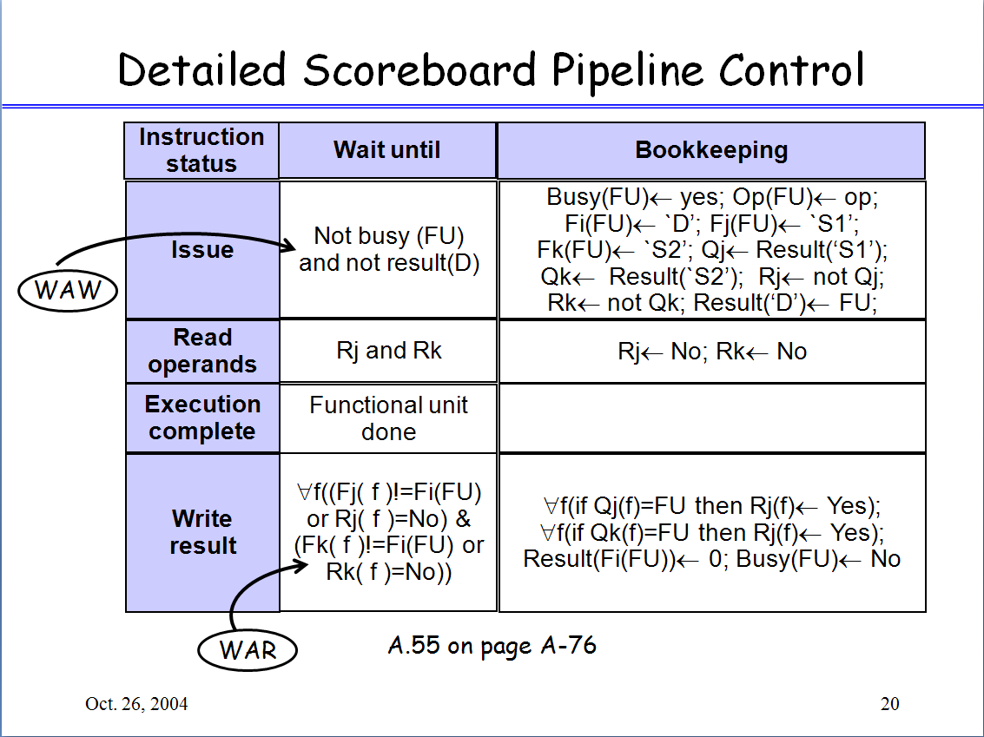
27
Notes:
Rj,Rk==No ➔ 1. Source operands are not ready. OR
2. Source operands are ready and have been read

